Slide 1
Social Networks Analysis using Compressive Sensing (SNACS)
CS591 – Compressive Sensing -12/8/16
Mikhail Andreev, Sahil Deshpande, Stephanie Chiao, Alex Takahashi Chen

Slide 2
Overview
Background
Problem Statement
Related Work
LSR algorithm for weighted graphs
Real-world applications
Visualizing Results
Conclusion

Slide 3
Background
Sparse recovery
easier to monitor, analyze, and interpret a signal’s sparse characteristics
Social networks and their structures
Analyzing individual node is impractical
Role of Compressive Sensing
Group nodes together
Notes:
- Before diving into social networks, define sparse recovery in general and how any signal has sparse characteristics
- Such sparse characteristics are easier to monitor, analyze and interpret as we want, rather
than looking at the whole
signal (an example might be helpful here)
- Going to social network analysis - large set of V and E. Difficult to interpret a graph as a signal, even more
difficult to analyze the entire graph (too many users, too many nodes)
- instead, detect some defining characteristics to group the nodes together, and analyzing gro
ups is much more practical
- various ways to group nodes, compressive sensing has challenging yet promising solutions lik
e the one we'll see later

Slide 4
Problem Statement
Treating graphs as signals
Representing graphs using sparse characteristics
Analyzing collection of nodes is easier than looking at individual nodes
Sparse characteristics are hidden in the form of few sparse edges
Notes:
defining current problem statement-
- given any graph G, find most relevant groups of nodes
- such groups are connected by a few edges belonging to set E
- in a vector x of dimension 1x|E|, only these few entries will be nonzero, rest all are zero
- meaning x is k-sparse = reducing a problem to known compressive sensing skeleton
~
~

Slide 5
Related Work

Slide 6
Related Work
Compressive sensing in networks is in relatively early stages
Very few papers investigate Compressive Sensing in networks
Theoretical restrictions on measurement matrix
Network topology constraint on measurements
Notes:
- as we just saw, we've been trying to somehow bring compressive sensing and social networks together
- compressive sensing in early stages, focused on traditional sensory signals
- network to signal – not intuitive, has one missing hop
- decided to go with detecting community structures in graphs, and later we'll see real-world applications

Slide 7
Related Work
Compressive sensing in networks is in relatively early stages
Very few papers investigate Compressive Sensing in networks
Theoretical restrictions on measurement matrix
Network topology constraint on measurements
RW: “Compressive Sensing over Graphs” from Cornell University
Area of network tomography
States mandatory constraints
Efficient network monitoring using random walks – O(k.log(|V|))
Notes:
- very few algorithms existed before this paper to effectively build measurement matrix – UCS-WN [18], RW[16]
- but not in weighted networks
- Compressive sensing over graphs – Cornell Univ, detecting packet loss, monitor network links using indirect end-to-end measurements. Important in routing networks and compressive sensing provides tools for efficient solutions O(k.log(n)) measurements for k-sparse

Slide 8
Related Work (contd.)
UCS-WN: Unbiased Compressive Sensing for Weighted Networks
Random Walks causes significant bias towards high degree nodes
Need to consider weights for correct measurements
Takeaways
Proves unbiased framework
Proves efficiency – O(k.log(n))
Proves null-space property of measurement matrix which guarantees correctness
Notes:
due to the broad node degree distribution and topological weighted characterization of networks, the constructed measurement matrix has to provide the maximum information coverage using the minimum number of measurements while considering the needs for unbiasedness and lower total cost

Slide 9
Related Work (contd.)
CS-ComDet: Compressive sensing for inter-community detection in social networks
Construct correct measurement matrix A
Optimize number of samples by identifying sub-graphs
Direct comparison with RW
Another l1-minimization technique called Lasso
Notes:
-After papers on CS-networks, CS-weighted networks, we look at this CS-social network
-We saw how sparse characteristics can be helpful

Slide 10
Algorithm

Slide 11
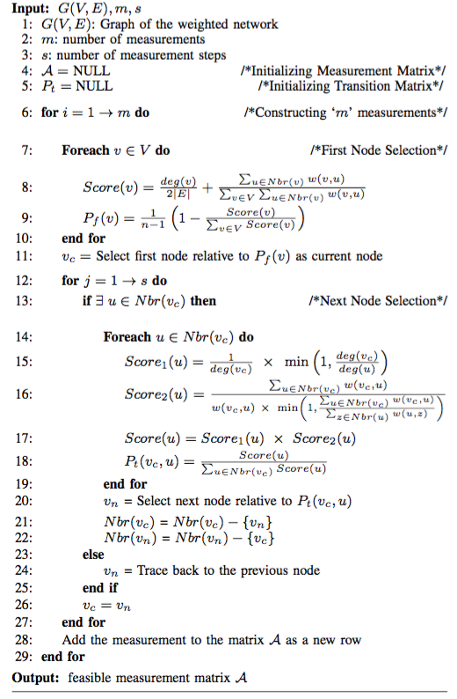
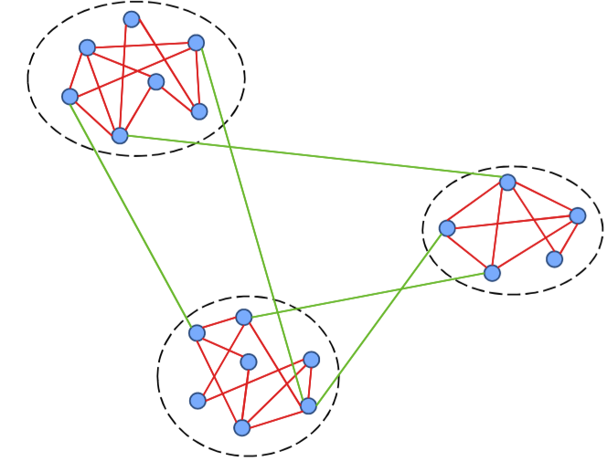
LSR Algorithm

Slide 12
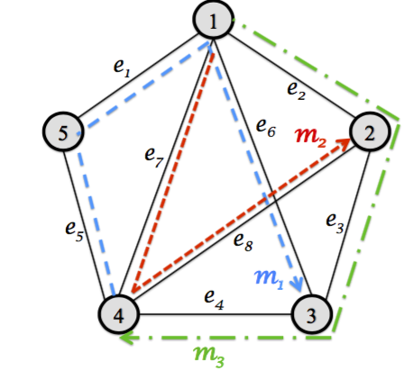

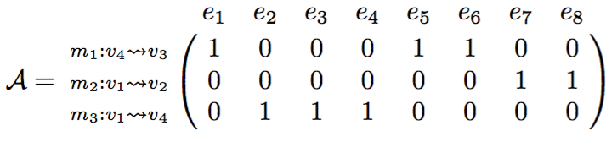
LSR Algorithm
Basic Model:
A matrix structure

Slide 13
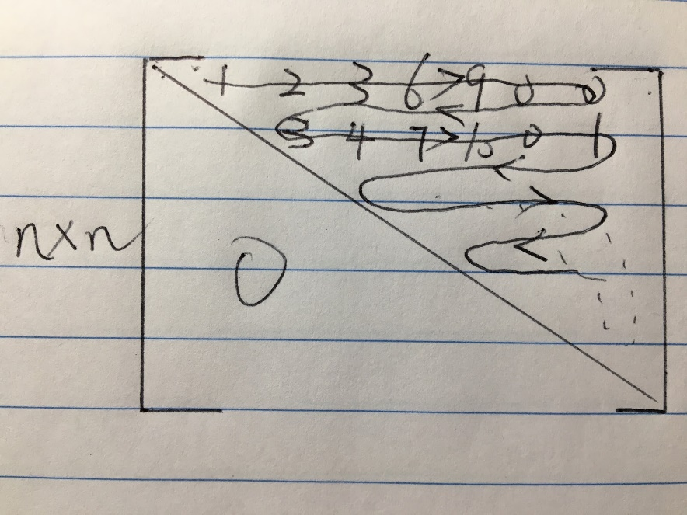
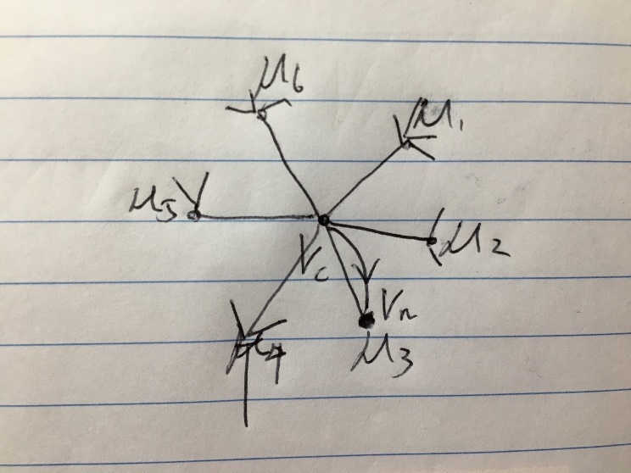
LSR Algorithm
Optimization stuff: (1)upper adjacency matrix in our case
(2)index of edge
Special cases:

Slide 14
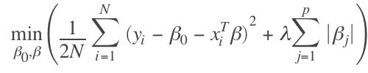

LSR Algorithm
LASSO Model(least absolute shrinkage and selection operator)
General form:
Basis Pursuit Denoising:
Property: trade-off between sparsity and reconstruction fidelity
Special thanks to Sahil for spotting errors and debugging efforts!

Slide 15
Applications
Notes:
haven’t yet defined what the edges mean. edges => some relation in two nodes (users)
by using different relations, we get graphs with different meanings. e.g. friendship 1/0, mutual friends weighted, content accessed - ads, cookies, articles, news, photos

Slide 16
Real-world Applications
Friend recommendations within communities
Edges - friend relationship (weighted or unweighted)
Advertising content within and across communities
Edges - similarity of ads accessed
Notes:
here are few real-world applications that use different types of edges to define various relationships between users
these networks give us different type of communities. this information can then be used in different ways

Slide 17
Real-world Applications (contd.)
Detecting and popping ‘filter bubbles’
Edges - similarity of accessed content
Detecting false information from interactive users
Edges - aggregate reports of false information across ‘social communities’

Slide 18
Visualization
Notes:
haven’t yet defined what the edges mean. edges => some relation in two nodes (users)
by using different relations, we get graphs with different meanings. e.g. friendship 1/0, mutual friends weighted, content accessed - ads, cookies, articles, news, photos

Slide 19

Real-world Social Network
Gathered data about users of Reddit
easy to obtain information
Users and their topics of interest
Created graphs by matching users based on similar topics of interest

Slide 20
Visualizing Results
Visualization is done by mapping nodes into 3D space
Shows sparse representation
Nodes are grouped together using K-Means clustering
Graph is displayed through Plotly

Slide 21
DEMO

Slide 22
Future Work
Run algorithm on larger datasets (>1000 nodes) and determine sparsity
Compare algorithm reconstruction with other algorithms
Attempt to fine tune for additional focus on inter-group connections

Slide 23
Conclusion
Given the complexity of a full network, using this algorithm can make analysis much easier to perform
Useful in social network analysis (Facebook > 1.5 billion users)
Compressive Sensing in networks is a new and developing field
Limitations
Coherence in very sparse graphs

Slide 24
Thank You!

