Slide 1
Mermaid Diagrams in PowerPoint
Using Mermaid to create dynamic diagrams in presentations
2/28/2025

Slide 2
What is Mermaid?
Mermaid is a JavaScript-based diagramming and charting tool
It renders Markdown-inspired text definitions to create diagrams
Supports flowcharts, sequence diagrams, class diagrams, and more
Perfect for technical documentation and presentations
Now integrated into our PowerPoint generator!

Slide 3
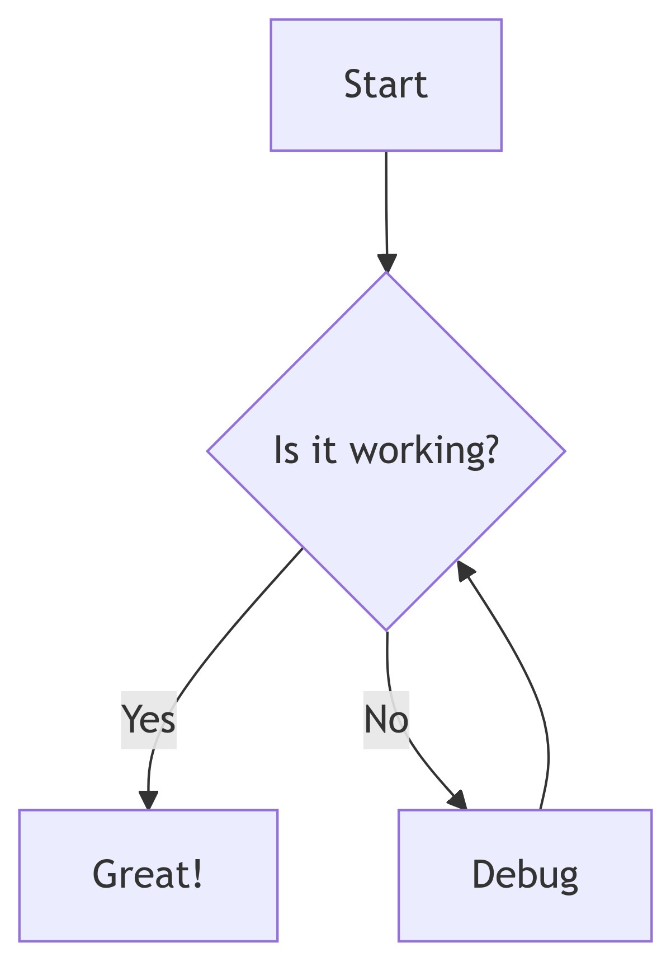
Flowchart Example

Slide 4
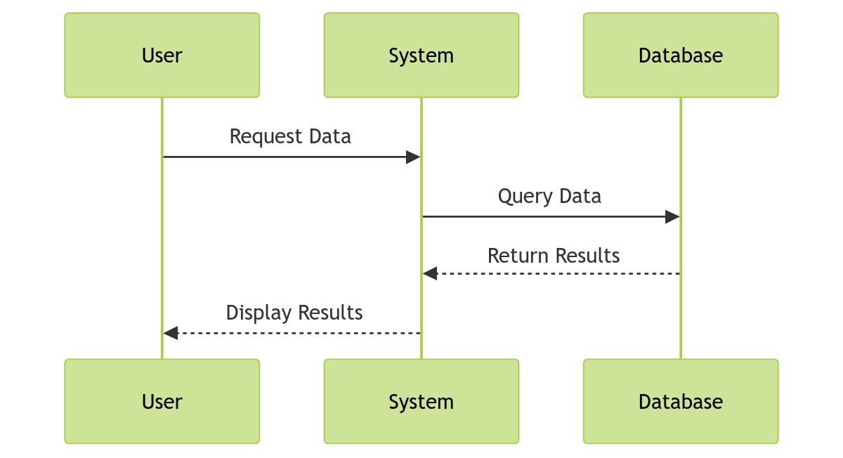
Sequence Diagram Example

Slide 5
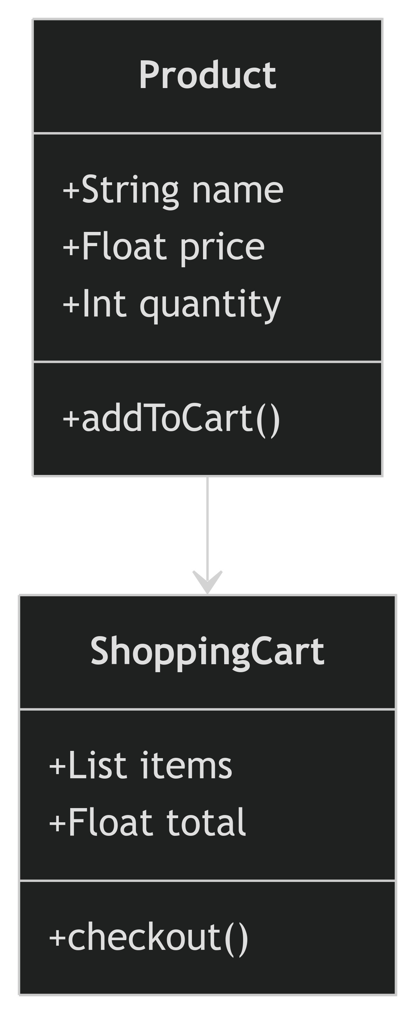
Class Diagram Example

Slide 6
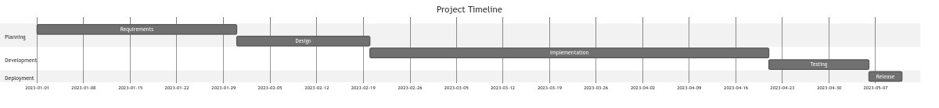
Gantt Chart Example

Slide 7
Multiple Diagrams in Grid Layout

Slide 8
Benefits of Mermaid Diagrams
Create diagrams programmatically without external tools
Maintain diagrams as code for version control
Easily update and regenerate diagrams
Consistent styling across all presentations
Support for multiple diagram types and themes

