Slide 1

Driving Towards a Safer Future: Investigating Traffic Data to Understand and Predict Collisions Literature Review and Exploratory Data Analysis
Mikhail Hershfeld – Spring 2020

Slide 2
Recap
Data being used is 3 million accident records in the US from 2016-2019.
Goal is to predict accident severity in terms of traffic delays based only on immediately known variables.
Want to get a sense of most important explanatory factors as well.
If any geographic anomalies/outliers are found, explore these.

Slide 3
Literature Review
Jianfeng, et al. (2019) used driver, vehicle, driving environment, road and accident attributes to predict severity.
Severity was a discrete label based on vehicle damage and injury.
SVM was used for prediction, with 86% accuracy.
When attributes were carefully chosen based on rough set theory, accuracy was 94%.
Focused more on methodological appropriateness rather than qualitative insights.

Slide 4




Literature Review
Rui Garrido, et al. (2014) used very similar data to predict the same thing.
Deeper dive into explanatory variables.
Notable factors that were associated with more severe accidents:
Rural areas Single Vehicle Collisions
Rollover Collisions Poor lighting

Slide 5
Literature Review
Though not in my data, want to touch on autonomous collisions as well.
Limited research here, Wang, Li (2019) did a study on 114 AV collisions in CA from 2014-2019
Autonomous mode had more severe collisions, usually the fault of the AV
Minor collisions were extremely likely to be the driver’s fault
Very limited data, so hard to make conclusions

Slide 6
Takeaways
My goal is fundamentally different than these despite extremely similar data.
Severity is defined differently in my data, delay may not mean injury.
Can still adapt some methodological approaches that worked well.
Ordinal Logistic regression and tree models were favorably effective.
Jianfeng, et al. in particular gave insight into conducting factor analysis.
Understanding AV crash patterns is the next step in this line of study.

Slide 7
EDA

Slide 8

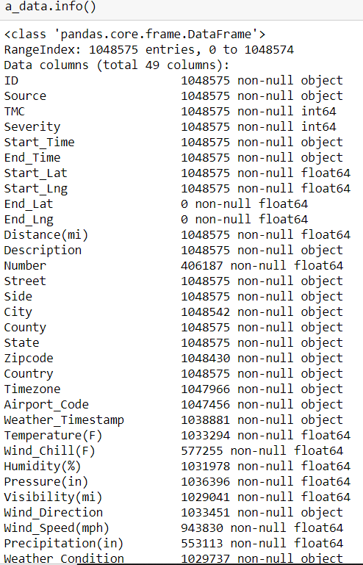
First glance
Chose not to incorporate bad driver data.
Sampled about half the dataset due to computing resources
Lots of missing values for important features, namely weather.
Filled in missing values where possible, interpolated weather data

Slide 9
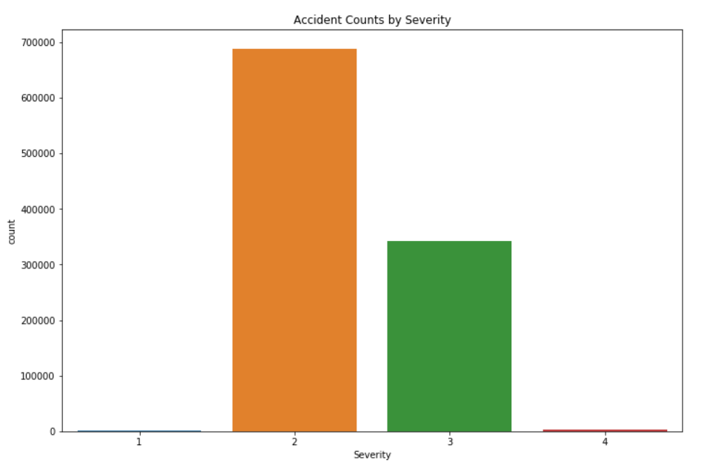
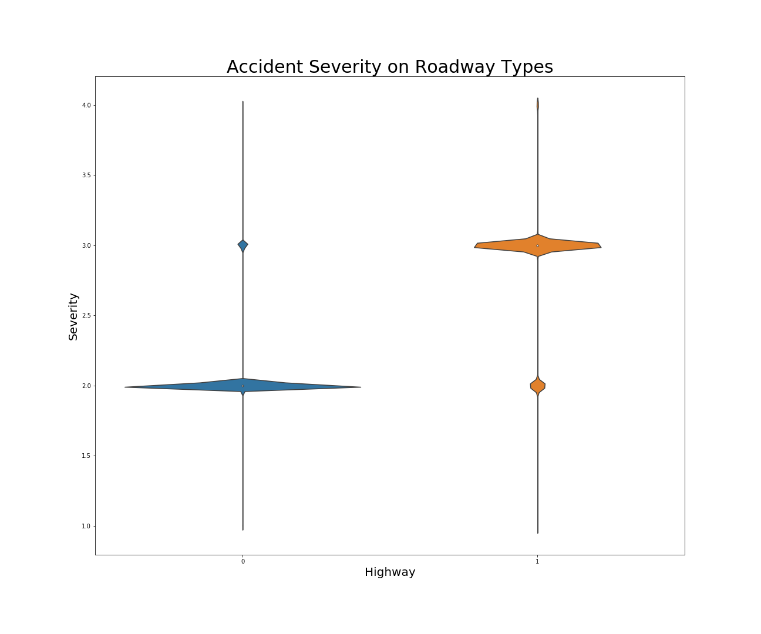
Trends
Distribution of accident severities is bimodal
Whether it occurred on a highway or not was the most influential factor

Slide 10
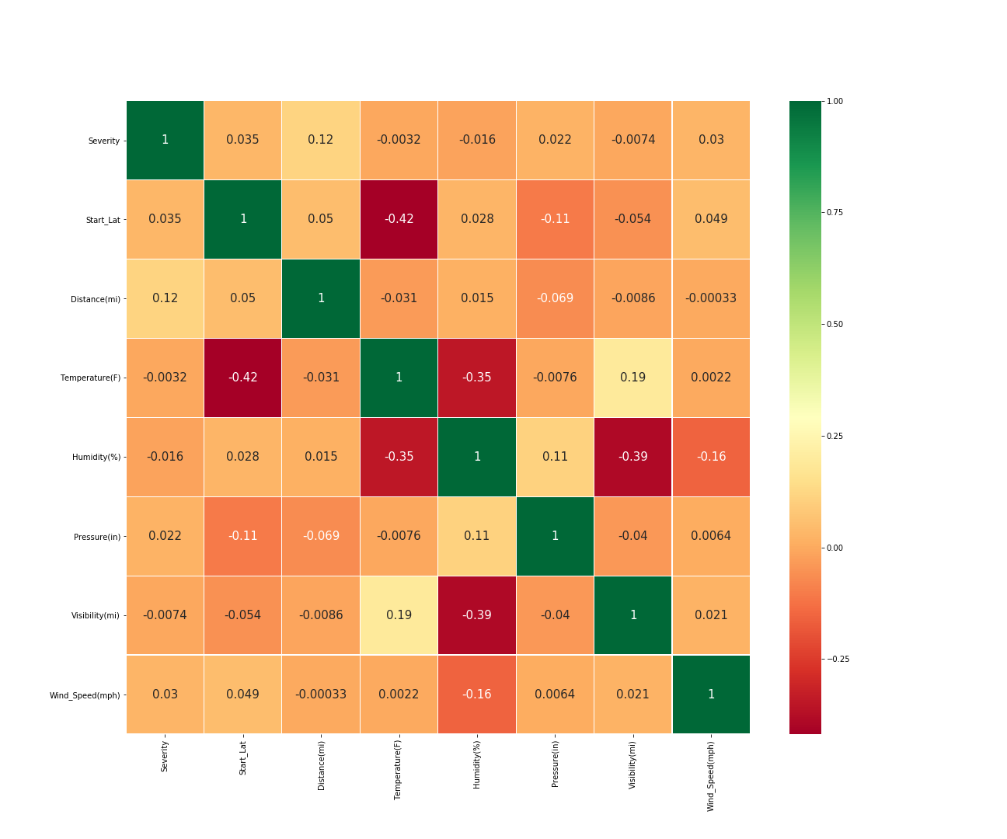
Correlogram

Slide 11
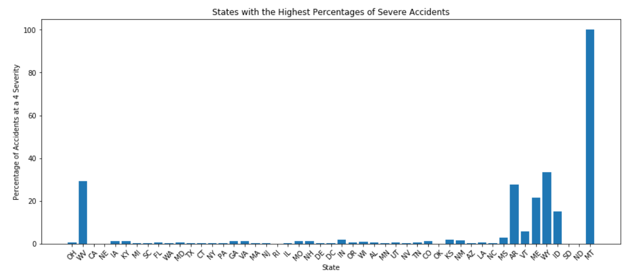
Interesting Find

Slide 12
References
Jianfeng, X., Hongyu, G., Jian, T., Liu, L., & Haizhu, L. (2019). “A classification and recognition model for the severity of road traffic accidents”. Advances in Mechanical Engineering, 11(5), 1687814019851893
Garrido, R., Bastos, A., Almeida, A. D., & Elvas, J. P. (2014). “Prediction of Road Accident Severity Using the Ordered Probit Model”. Transportation Research Procedia, 3, 214–223. doi: 10.1016/j.trpro.2014.10.107
Wang, S., & Li, Z. (2019). “Exploring the mechanism of crashes with automated vehicles using statistical modeling approaches”. Plos One, 14(3). doi: 10.1371/journal.pone.0214550

