Slide 1
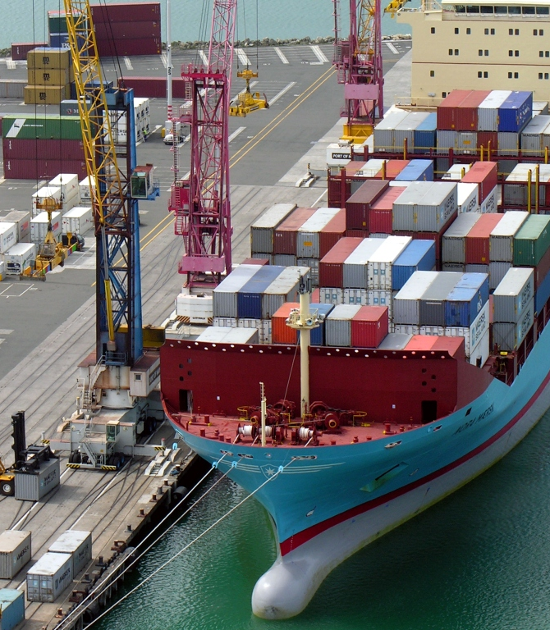
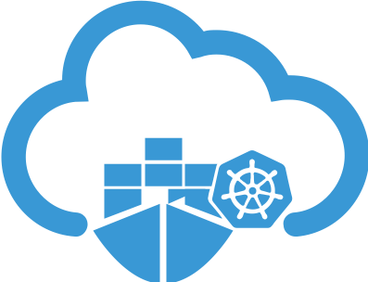
An Introduction to Kubernetes
Mykhailo Sapunov

Slide 2

Who am I?
Mykhailo Sapunov
Senior Software Developer at EPAM
Email: Mykhailo_Sapunov@epam.com
GitHub: https://github.com/mikhails85

Slide 3
What we will talk about in this presentation?
What is Kubernetes ?
Key Concepts
Building Blocks
My experience of setting up a home server based on Kubernetes
Demo
What's next ?
Questions

Slide 4
What is Kubernetes ?

Slide 5
Kubernetes is ...
The name Kubernetes originates from Greek, meaning helmsman or pilot.
Kubernetes is a portable, extensible, open-source platform for managing containerized workloads and services, that facilitates both declarative configuration and automation.
Kubernetes is the fastest growing project in the history of open source.
Kubernetes builds upon a decade and a half of experience that Google has with running production workloads at scale, combined with best-of-breed ideas and practices from the community.

Slide 6
History of Kubernetes
2003-2004: Birth of Borg System
2013: From Borg to Omega
2014: Google Introduces Kubernetes
2015: The year of Kube v1.0 & CNCF
2016: The year Kubernetes goes mainstream!

Slide 7




Kubernetes Contributers
35k
contributors
148k
code commits
83k
pull requests
1.1M
contributions
2k+
companies

Slide 8
Kubernetes Features
Service discovery and load balancing
Storage orchestration
Automated rollouts and rollbacks
Automatic bin packing
Self-healing
Secret and configuration management

Slide 9
Key CONCEPTS

Slide 10
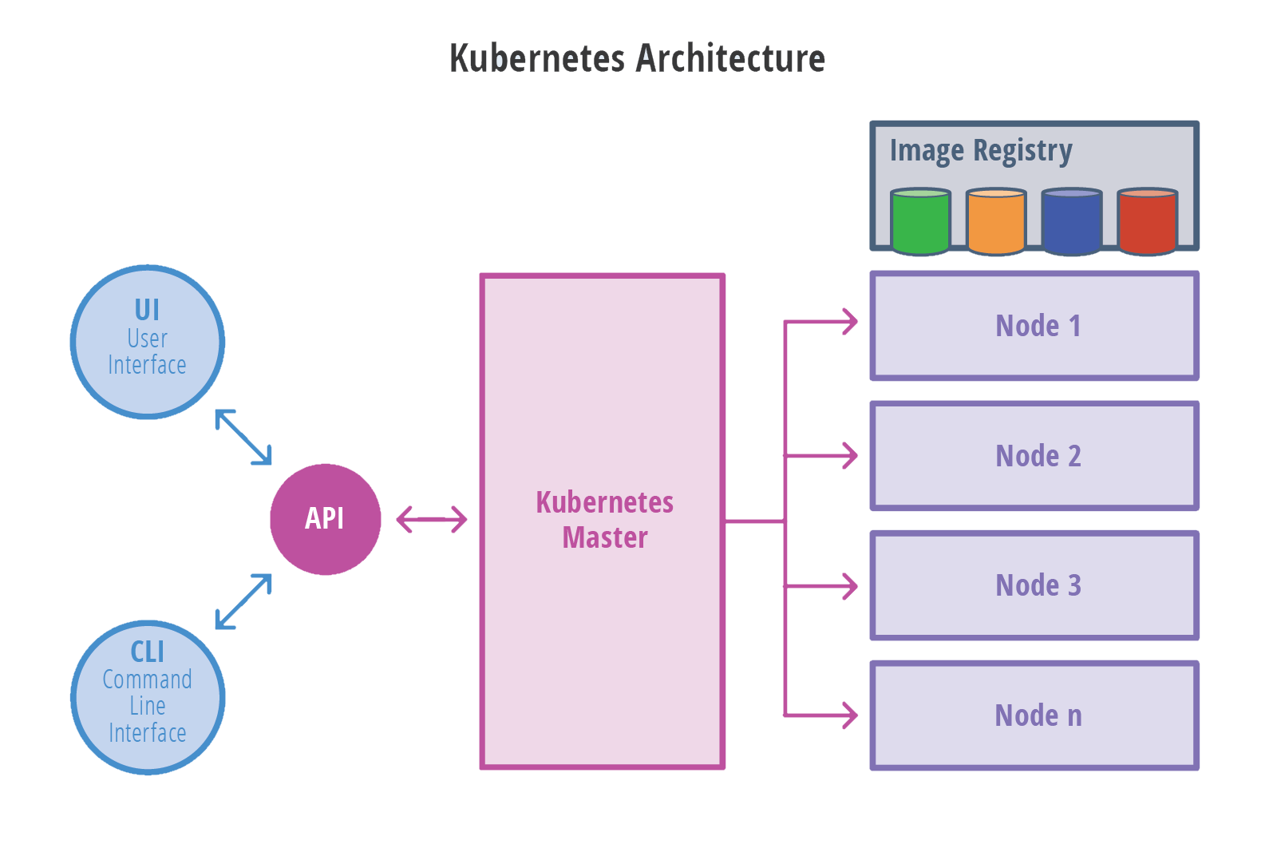
General View
Master - responsible for maintaining the desired state for your cluster
Node - run your applications and cloud workflows

Slide 11
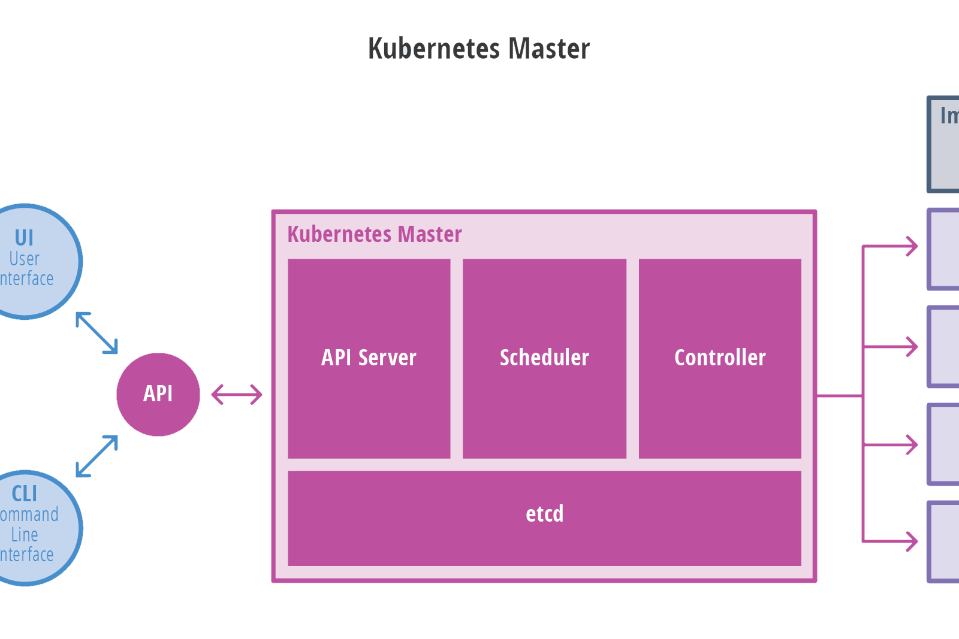
Master Node
API Server: The application that serves Kubernetes functionality through a RESTful interface and stores the state of the cluster.
Scheduler: Scheduler watches API server for new Pod requests. It communicates with Nodes to create new pods and to assign work to nodes while allocating resources or imposing constraints.
Controller Manager: Component on the master that runs controllers.It includes Node controller, Endpoint Controller, Namespace Controller, etc.
etcd: Consistent and highly-available key value store used as Kubernetes’ backing store for all cluster data.

Slide 12
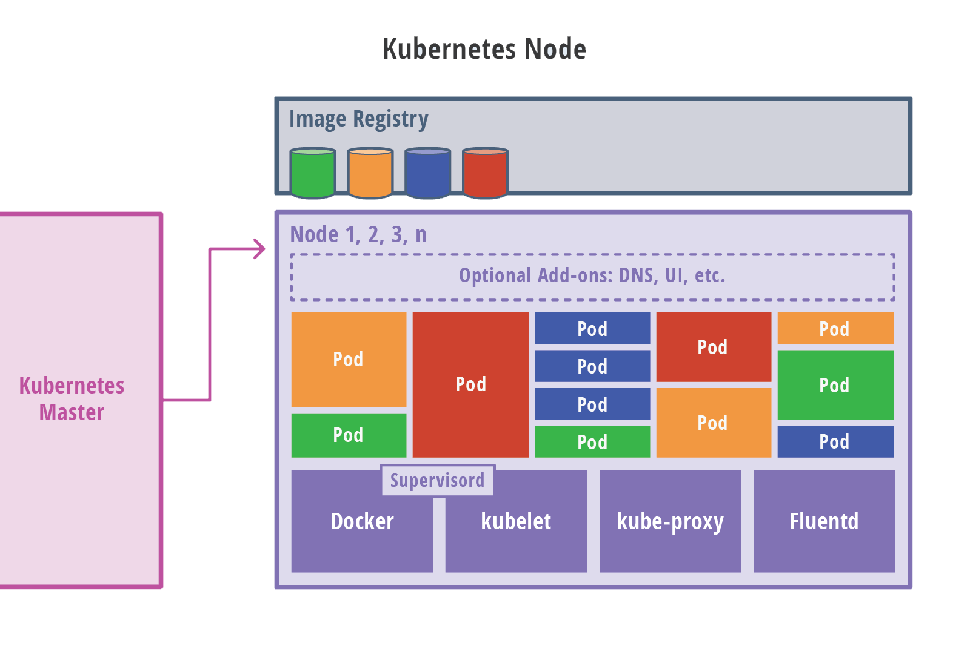
Worker Nodes
Pod: All containers will run in a pod.
Kubelet: Kubectl registers the nodes with the cluster, watches for work assignments from the scheduler, instantiates new Pods, reports back to the master.
Container Engine: Is responsible for managing containers, image pulling, stopping the container, starting the container, destroying the container, etc.
Kube Proxy: Is responsible for forwarding app user requests to the right pod.
Fluentd: Is a data collector for unified logging layer. Example of add-on

Slide 13
Key Design Principles
Scalability: Kubernetes supports horizontal pod auto-scaling or on-demand
Availability: Kubernetes is designed to tackle the availability of both infrastructure and applications
Security: Security in Kubernetes is configured at multiple levels.
Portability: Kubernetes is designed to offer freedom of choice when choosing operating systems, container runtimes, processor architectures, cloud platforms and PaaS.

Slide 14
Building blocks

Slide 15
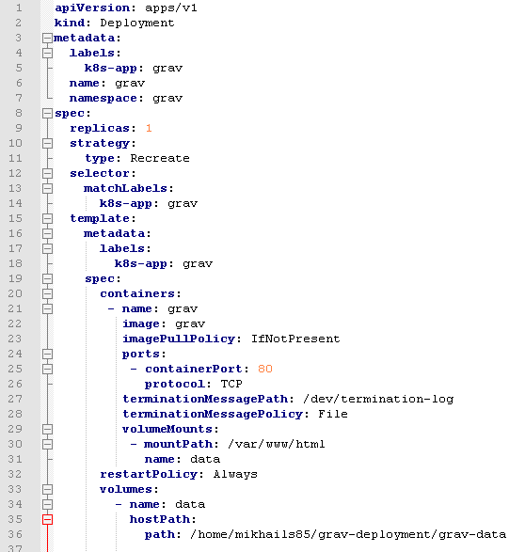
.yaml File Structure
Required Fields
apiVersion - Which version of the Kubernetes API you’re using to create this object
kind - What kind of an object you want to create
metadata - Data that help uniquely identify the object, including a name string, UID, and optional namespace
spec - What state you desire for the object
Command to apply .yaml file
kubectl apply -f /application/deployment.yaml

Slide 16
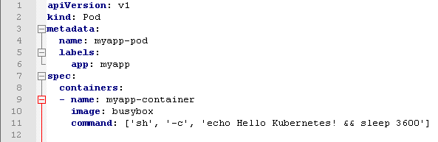
Pod
The basic execution unit of a Kubernetes application. The smallest and simplest unit that you create or deploy.

Slide 17
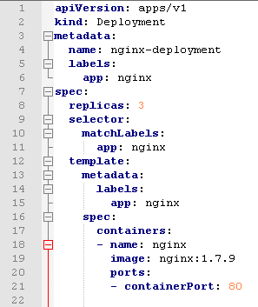
Deployment
A Deployment provides declarative updates for Pods and ReplicaSets.
A deployment is a Kubernetes construct that controls the creation and destruction of pods.

Slide 18
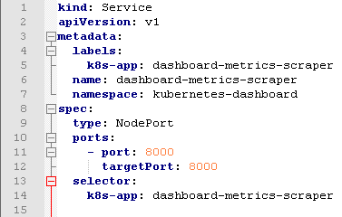
Service
A service is responsible for enabling network access to a set of pods.
Types:
ClusterIP – The default value. The service is only accessible from within the Kubernetes cluster – you can’t make requests to your Pods from outside the cluster!
NodePort – This makes the service accessible on a static port on each Node in the cluster. This means that the service can handle requests that originate from outside the cluster.
LoadBalancer – The service becomes accessible externally through a cloud provider's load balancer functionality.

Slide 19
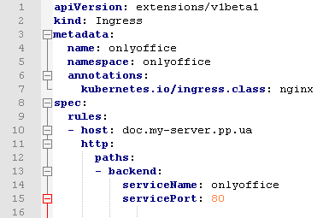
Ingress
Ingress exposes HTTP and HTTPS routes from outside the cluster to services within the cluster. Traffic routing is controlled by rules defined on the Ingress resource.

Slide 20

Namespace
A namespace is a logical unit within Kubernetes used to isolate applications and resources.

Slide 21

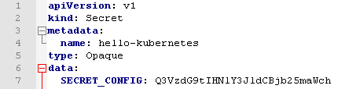
ConfigMaps / Secret
ConfigMaps and Secrets are essentially key-value stores that you can use to inject application configurations either as environment variables or a configuration file on your pods.

Slide 22
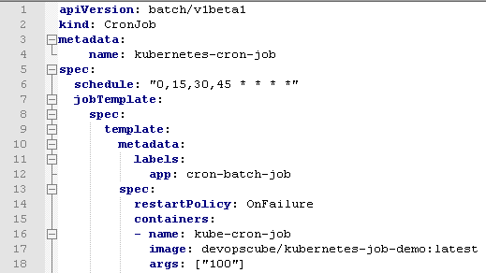
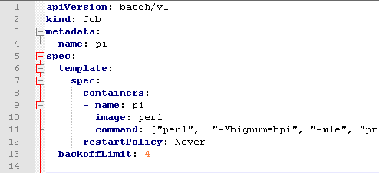
Job / Cron Job
A Job creates one or more Pods and ensures that a specified number of them successfully terminate. As pods successfully complete, the Job tracks the successful completions.
One CronJob object is like one line of a crontab (cron table) file. It runs a job periodically on a given schedule, written in Cron format.

Slide 23
My experience of setting up A home server based on Kubernetes

Slide 24

Lessons learned
Understand Key Concepts before starting doing something
Instal comparable Docker version before starting installing Kubernetes
Remove swap and make sure that it does not get back after the server reboot
Use official nginx ingress controller
Use Calico CNI(container network interface) instead of Flannel
Use the latest version of Dashboard

Slide 25

Let's review what we have got!

Slide 26
Useful kubernetes cli commands
Apply YAML file
kubectl apply -f ./kube-flannel.yml
Get state of objects in namespace
kubectl get all --namespace=kube-system watch kubectl get pods --all-namespaces
Get the list of available nodes in the cluster
kubectl get nodes
Create certificate
mkdir certs
cd certs/
openssl genrsa -des3 -passout pass:x -out dashboard.pass.key 2048
openssl rsa -passin pass:x -in dashboard.pass.key -out dashboard.key
openssl req -new -key dashboard.key -out dashboard.csr
openssl x509 -req -sha256 -days 365 -in dashboard.csr -signkey dashboard.key -out dashboard.crt
kubectl create secret generic kubernetes-dashboard-certs --from-file=$HOME/certs -n kube-system

Slide 27
Dashboard

Slide 28
Installed web sites

Slide 29
DEMO

Slide 30
Demo notes

Slide 31
What's next?

Slide 32
Materials
Introduction to Kubernetes architecture
Concepts
KUBERNETES: AN OVERVIEW
The History of Kubernetes on a Timeline
5 Constructs you must know to get started with Kubernetes
5. Install and Use Kubernetes UI
Create a single node Kubernetes cluster on Ubuntu 18.04.1 (Bionic Beaver) with kubeadm
Quickstart for Calico on Kubernetes
Install Kubernetes on Ubuntu

Slide 33
QUESTIONS

Slide 34
Thank you СПАСИБО!

