Slide 1
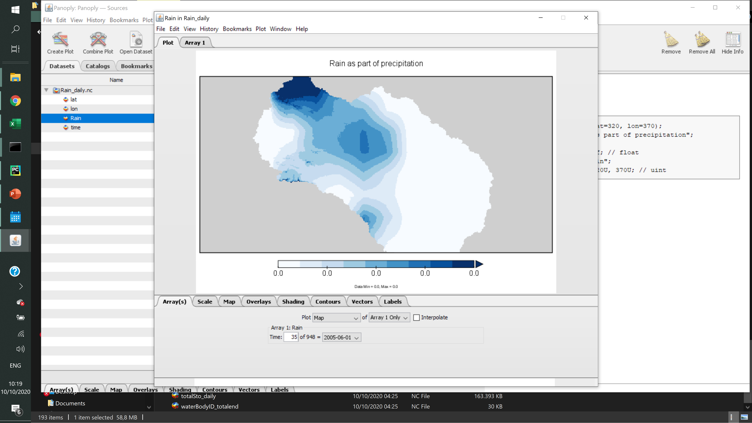

Slide 2
General land
Fallow
Wheat
Fallow
Sugarcane
Wheat
Sorghum
Fallow
Sugarcane

Slide 3
Beginning
Plant Wheat and Sugarcane
Harvest Wheat and plant Sorghum
Harvest Sugarcane and Sorghum
Plant Onion, Spices, and Groundnut
Harvest Onion, Spices, and Groundnut
Automatic fallowing
activate_fallow = True
automaticFallowingIrr = True
use_GeneralCrop(non)Irr = False
General land
General land
General land
General land
Onion
General land
General land
Wheat
Sorghum
Fallow
Fallow
Spices
Fallow
Sugarcane
Sugarcane
Groundnut
Fallowing as standard
activate_fallow = True
automaticFallowingIrr = False
use_GeneralCrop(non)Irr = False
This option is available only to Irrigated fields, and Grasslands is set as Automatic fallowing
Fallow
Fallow
Fallow
Fallow
Onion
Fallow
Fallow
Wheat
Sorghum
Spices
Sugarcane
Sugarcane
Groundnut
General land as standard
activate_fallow = False
use_GeneralCrop(non)Irr = False
This option is set both on Irrigated fields and Grasslands
General land
General land
General land
General land
Onion
General land
General land
Wheat
Sorghum
Spices
Sugarcane
Sugarcane
Groundnut
General land as fixed input
use_GeneralCrop(non)Irr = True
GeneralCrop_(non)Irr is the input variable.
General land
Fallow
General land
Fallow
General land
General land
Onion
General land
General land
Fallow
Wheat
Sorghum
Fallow
Spices
Fallow
Sugarcane
Sugarcane
Groundnut

Slide 4
