Slide 1
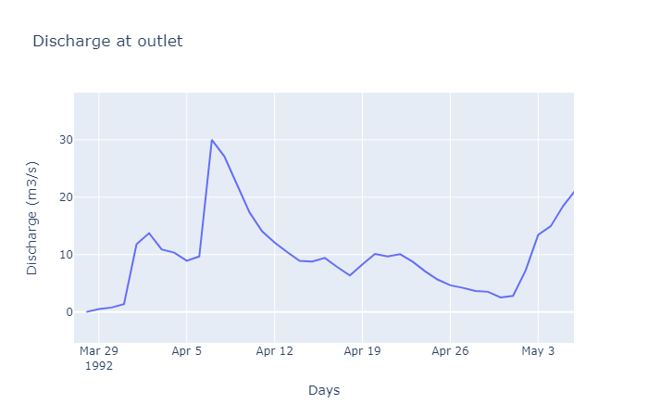
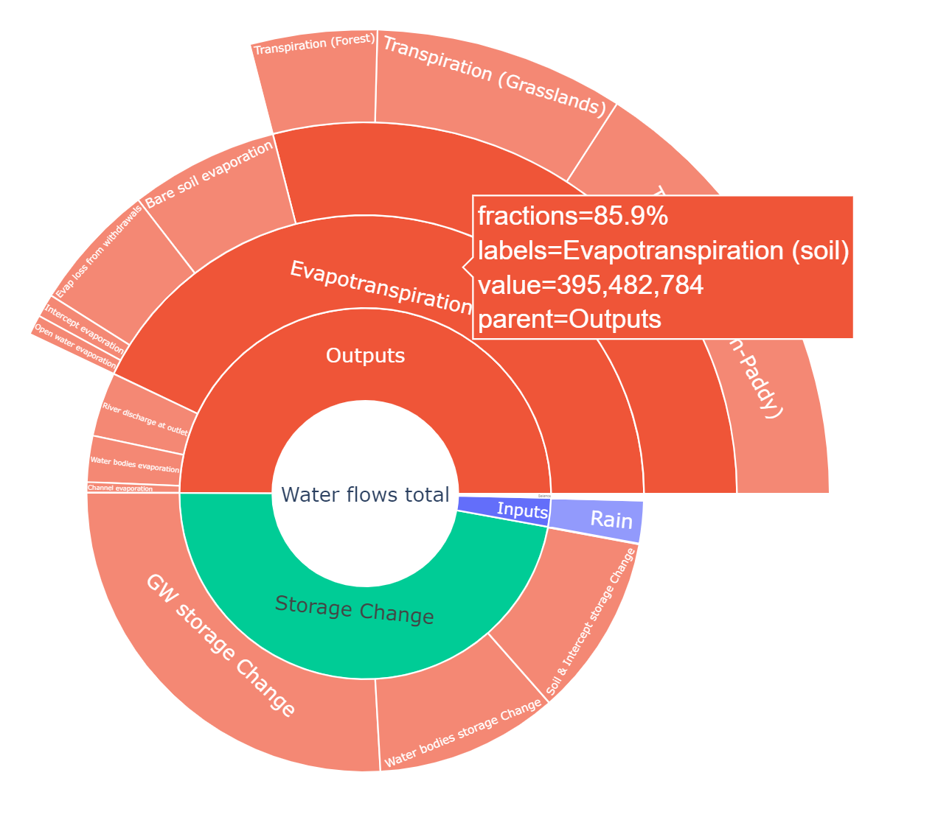
crop_correct = 0.5

Slide 2
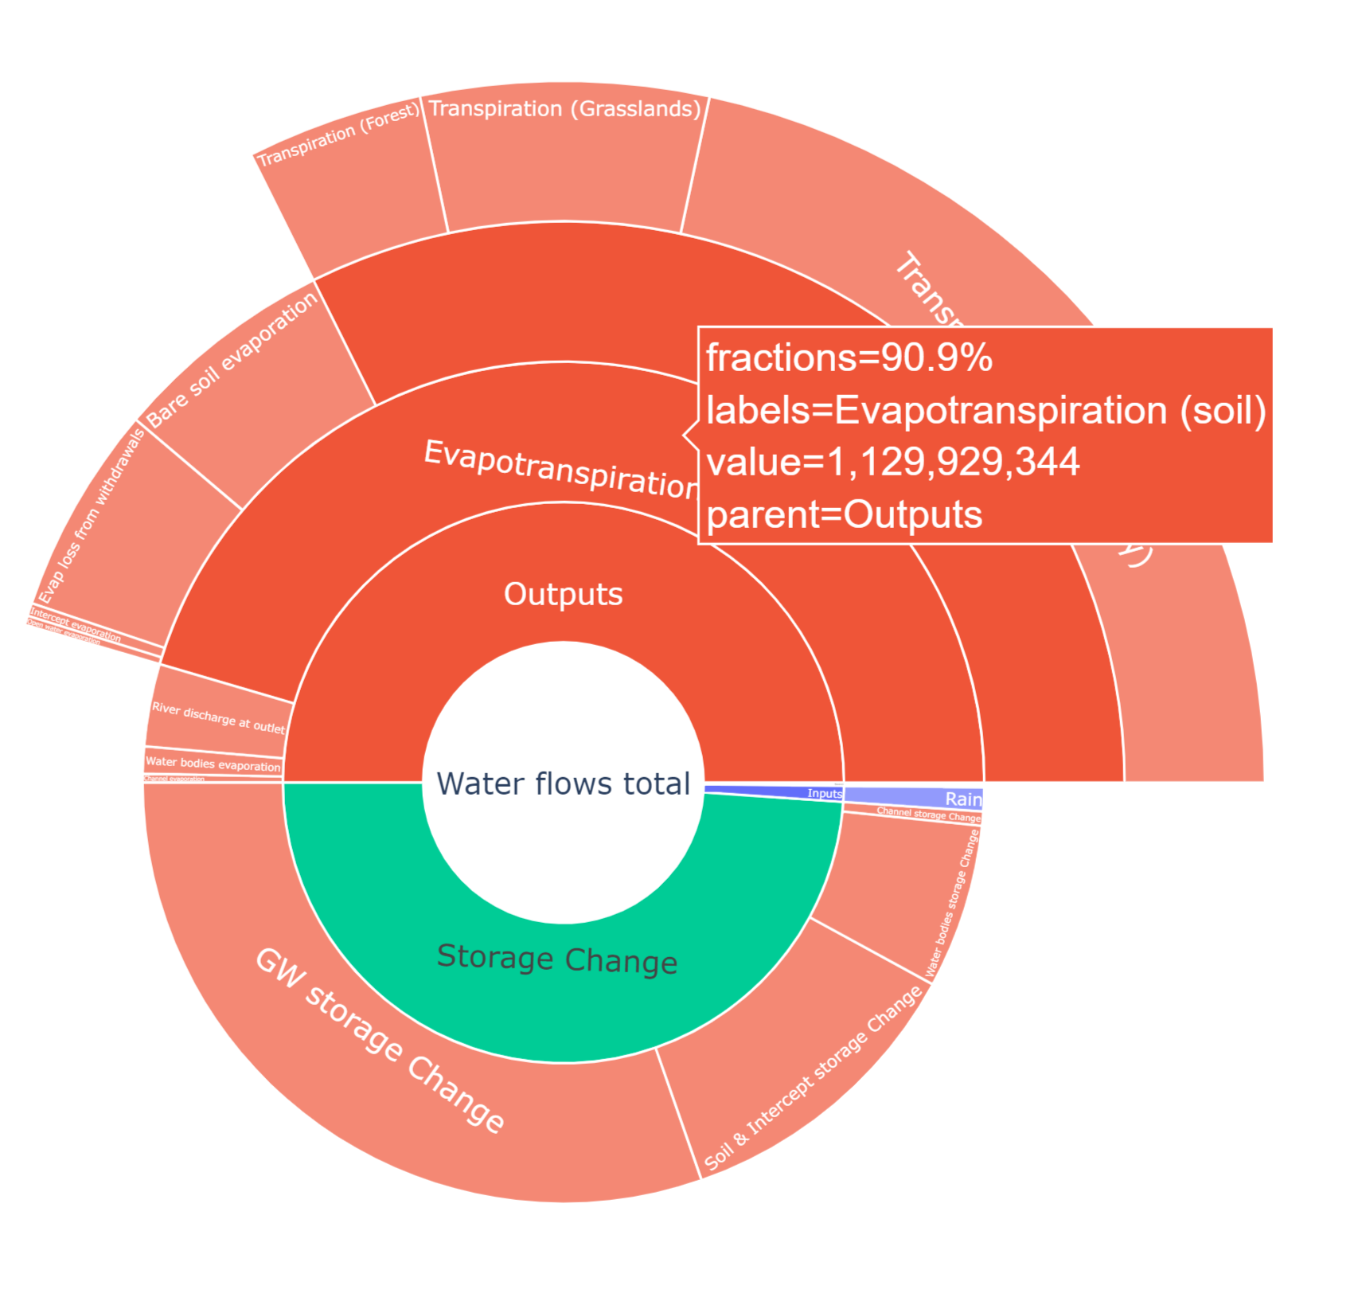
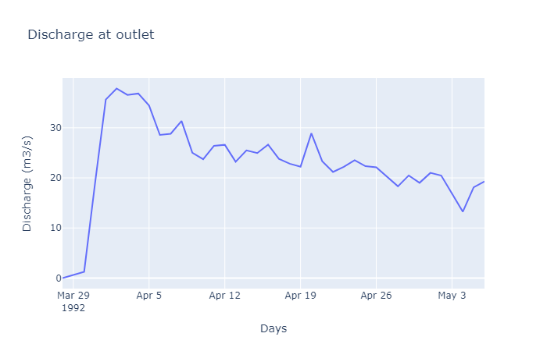
crop_correct = 3

Slide 3
crop_correct = 0.5
crop_correct = 3

Slide 4
crop_correct = 0.5
crop_correct = 3
Generally larger outputs with crop_correct = 3.0 as compared with 0.5. Evapotranspiration increased near 4 times, and discharge twice, although the relative contribution of discharge and evapotranspiration was similar and dominated by evapotranspiration.

Slide 5



Total water request
Total water request
swAbstractionFraction_Local
swAbstractionFraction_Lift
swAbstractionFraction_nonLocal
Irrigation request
act_irrWithdrawal
act_nonIrrWithdrawal
act_nonIrrWithdrawalSW
act_nonIrrWithdrawalGW
act_irrWithdrawalSW
act_irrWithdrawalGW
act_nonIrrConsumption
act_totalIrrConsumption
swAbstractionFraction_Irr
gwAbstractionFraction_Irr
swAbstractionFraction_Irr
swAbstractionFraction_nonIrr
swAbstractionFraction_Local
swAbstractionFraction_nonLocal
gwAbstractionFraction_Irr
non-Irrigation request
swAbstractionFraction_nonIrr
(swAbstractionFraction_Local + swAbstractionFraction_Lift + swAbstractionFraction_nonLocal)*(nonIrrDemand + totalIrrDemand)
<= swAbstractionFraction_nonIrr * nonIrrDemand + swAbstractionFraction_Irr * totalIrrDemand

Slide 6









Total water request
Total water request
$$f_{local}^{sw}$$
swAbstractionFraction_Local
$$f_{lift}^{sw}$$
$$f_{cmd}^{sw}$$
Irrigation request
act_irrWithdrawal
act_nonIrrWithdrawal
act_nonIrrWithdrawalSW
act_nonIrrWithdrawalGW
act_irrWithdrawalSW
act_irrWithdrawalGW
act_nonIrrConsumption
act_totalIrrConsumption
$$f_{Irr}^{sw}$$
$$f_{Irr}^{gw}$$
swAbstractionFraction_Irr
swAbstractionFraction_nonIrr
swAbstractionFraction_Local
swAbstractionFraction_nonLocal
gwAbstractionFraction_Irr
non-Irrigation request
$$f_{nonIrr}^{sw}$$
(swAbstractionFraction_Local + swAbstractionFraction_Lift + swAbstractionFraction_nonLocal)*(nonIrrDemand + totalIrrDemand)
= swAbstractionFraction_nonIrr * nonIrrDemand + swAbstractionFraction_Irr * totalIrrDemand

Slide 7






$$f_{local}^{sw}$$
$$f_{Irr}^{sw}$$
$$f_{Irr}^{gw}$$
$$f_{nonIrr}^{sw}$$
$$f_{lift}^{sw}$$
$$f_{cmd}^{sw}$$
Total water request
Irrigation request
non-Irrigation request

Slide 8

swAbstractionFraction_nonIrr
swAbstractionFraction_Irr
swAbstractionFraction_Irr
swAbstractionFraction_nonIrr
swAbstractionFraction_Local
swAbstractionFraction_nonLocal
gwAbstractionFraction_Irr
gwAbstractionFraction_Irr
swAbstractionFraction_Local
act_irrWithdrawal
act_nonIrrWithdrawal
act_nonIrrWithdrawalSW
act_nonIrrWithdrawalGW
act_irrWithdrawalSW
act_irrWithdrawalGW
act_nonIrrConsumption
act_totalIrrConsumption
swAbstractionFraction_nonLocal
act_SurfaceWaterAbstract
act_channelAbstract
delivered_water
act_bigLakeResAbst
act_LocalLakeAbstract

Slide 9




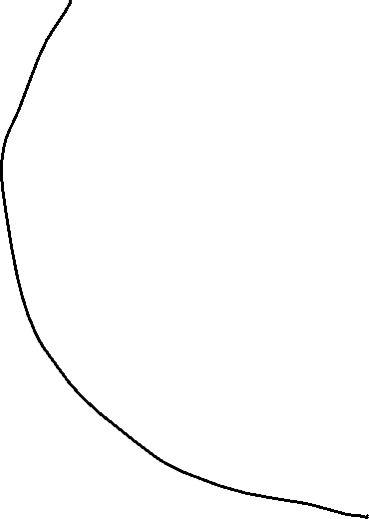








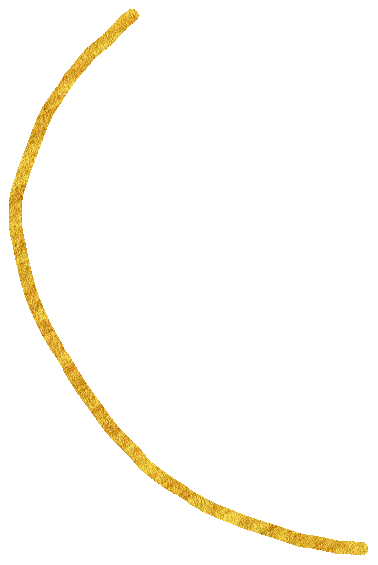


swAbstractionFraction_nonIrr
swAbstractionFraction_Irr
swAbstractionFraction_Irr
swAbstractionFraction_nonIrr
swAbstractionFraction_Local
swAbstractionFraction_nonLocal
gwAbstractionFraction_Irr
gwAbstractionFraction_Irr
swAbstractionFraction_Local
act_irrWithdrawal
act_nonIrrWithdrawal
act_nonIrrWithdrawalSW
act_nonIrrWithdrawalGW
act_irrWithdrawalSW
act_irrWithdrawalGW
act_nonIrrConsumption
act_totalIrrConsumption
swAbstractionFraction_nonLocal

Slide 10
act_SurfaceWaterAbstract
act_channelAbstract
delivered_water
act_bigLakeResAbst
act_LocalLakeAbstract
act_irrWithdrawal
act_nonIrrWithdrawal
act_nonIrrWithdrawalSW
act_nonIrrWithdrawalGW
act_irrWithdrawalSW
act_irrWithdrawalGW
act_nonIrrConsumption
act_totalIrrConsumption
swAbstractionFraction_Irr
swAbstractionFraction_nonIrr
swAbstractionFraction_Local
swAbstractionFraction_nonLocal
gwAbstractionFraction_Irr

Slide 11

act_SurfaceWaterAbstract
act_channelAbstract
delivered_water
act_bigLakeResAbst
act_irrWithdrawal
act_nonIrrWithdrawal
act_nonIrrWithdrawalSW
act_nonIrrWithdrawalGW
act_irrWithdrawalSW
act_irrWithdrawalGW
act_nonIrrConsumption
act_totalIrrConsumption
act_LocalLakeAbstract
act_LocalLakeAbstract
swAbstractionFraction_Irr
swAbstractionFraction_nonIrr
swAbstractionFraction_Local
swAbstractionFraction_nonLocal
gwAbstractionFraction_Irr
(swAbstractionFraction_Local + swAbstractionFraction_nonlocal)*(nonIrrDemand + totalIrrDemand) =
swAbstractionFraction_nonIrr * nonIrrDemand + swAbstractionFraction_Irr * totalIrrDemand

Slide 12
swAbstractionFraction_nonIrr
swAbstractionFraction_Irr
act_irrWithdrawal
act_nonIrrWithdrawal
act_nonIrrWithdrawalSW
act_nonIrrWithdrawalGW
act_irrWithdrawalSW
act_irrWithdrawalGW
act_nonIrrConsumption
act_totalIrrConsumption
Abstraction fractions determine the maximum fraction of demand to be satisfied with the associated source
nonIrrDemand
totalIrrDemand
gwAbstractionFraction_Irr
swAbstractionFraction_Local
swAbstractionFraction_Irr
swAbstractionFraction_nonIrr
swAbstractionFraction_Local
swAbstractionFraction_nonLocal
gwAbstractionFraction_Irr
swAbstractionFraction_nonLocal
(swAbstractionFraction_Local [0.25] + swAbstractionFraction_nonlocal [0.75])*(nonIrrDemand + totalIrrDemand) =
swAbstractionFraction_nonIrr [1]* nonIrrDemand + swAbstractionFraction_Irr [1] * totalIrrDemand

