Slide 1
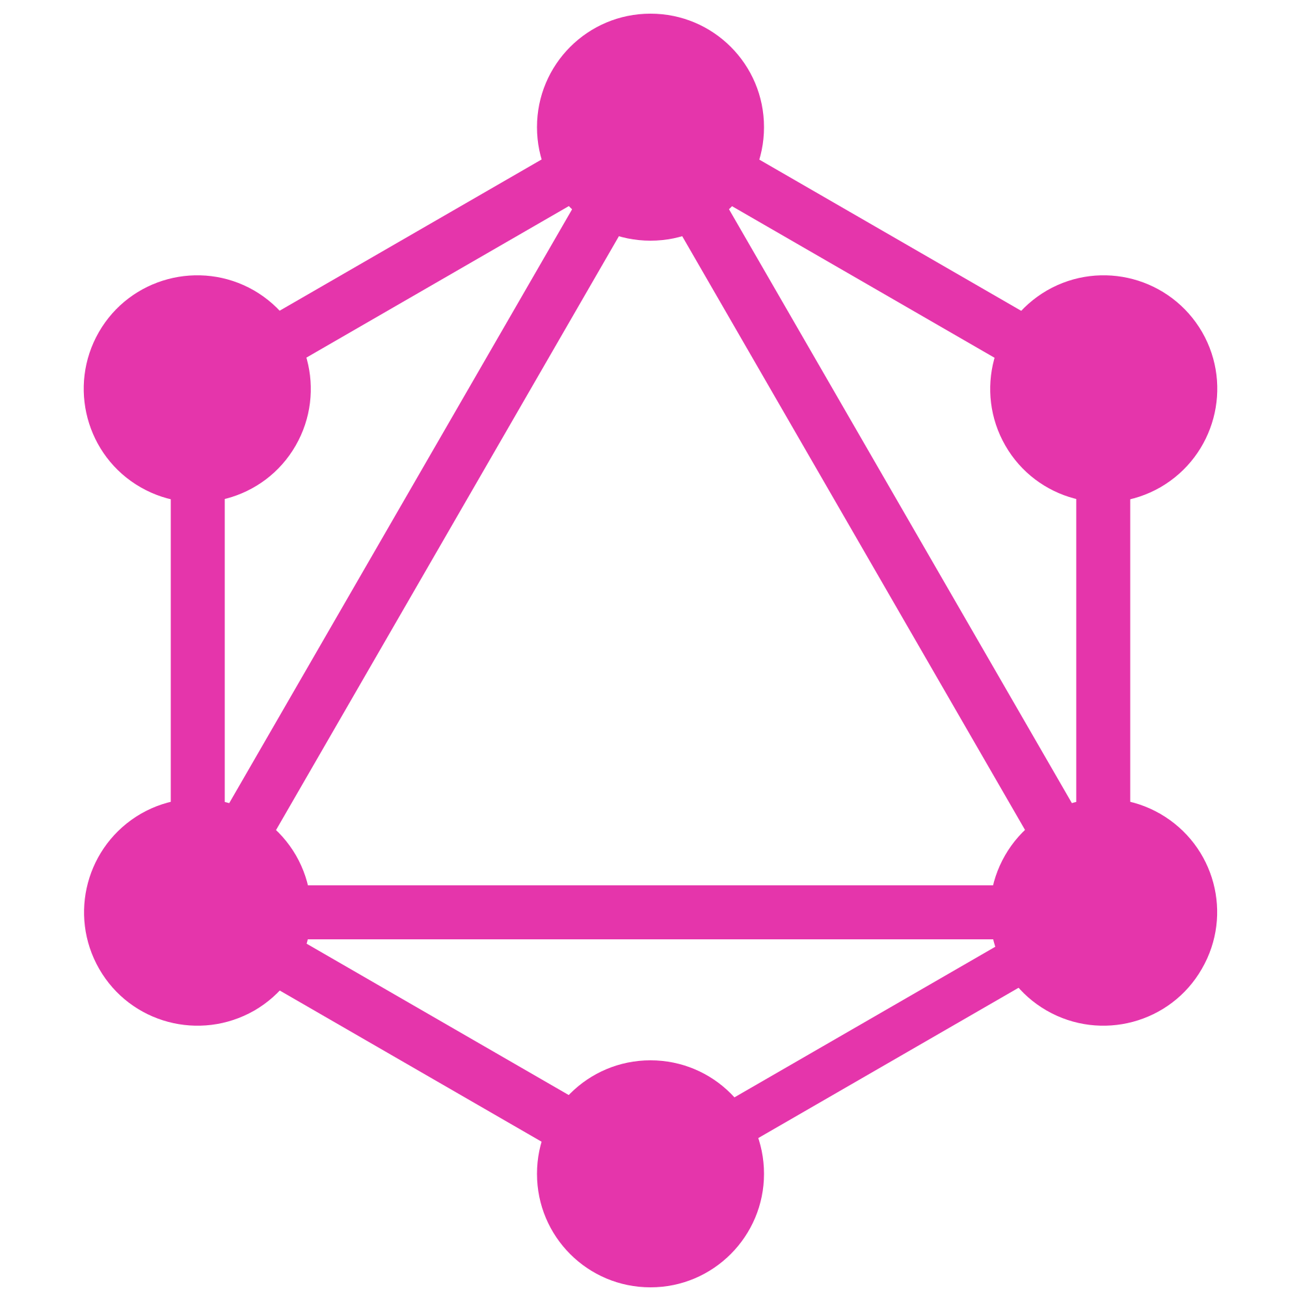
GraphQL
Intro

Slide 2
What is GraphQL?
Data query language supports declarative data fetching
Open-sourceded by Facebook in 2015
More efficient, powerful and flexible alternative to REST
Available in all popular languages

Slide 3










Who is using it?

Slide 4
Why GraphQL?
More efficient data delivery
Fewer resources calls
Strongly-typed schemas - Scheme Definition Language (SDL)
Enables more rapid product development
Rich open-source ecosystem and community

Slide 5
GraphQL vs REST
GraphQL eliminates over/under fetching
Elemintates client dependency on server response formats
Decreases network loading
No need for versioning
Improved monitoring

Slide 6
Cons
Caching
HATEOAS
HTTP status / verbs
Documentation

Slide 7
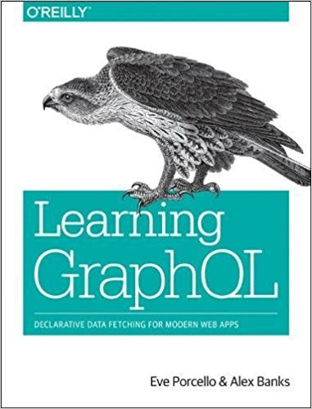
Resources
Release date: July 25th
http://graphql.org
http://howtographql.com
http://github.com/topics/graphql
https://github.com/chentsulin/awesome-graphql

