Slide 1
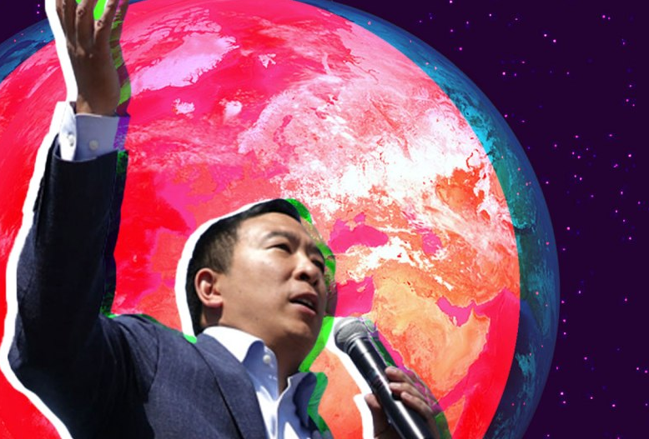

“FUTURIST. I'd say I'm a PRESENT-IST. It's just that the other politicians are stuck in the past.” – Andrew Yang

