Slide 1

SMART INDIA HACKATHON 2026
Problem Statement ID – 26141
Problem Statement Title- Quantum-Inspired Cyber Threat Detection for Digital Signature Security
Theme- Blockchain & Cybersecurity
PS Category- Software
Team ID-
Team Name- TEAM ATHENA

Slide 2

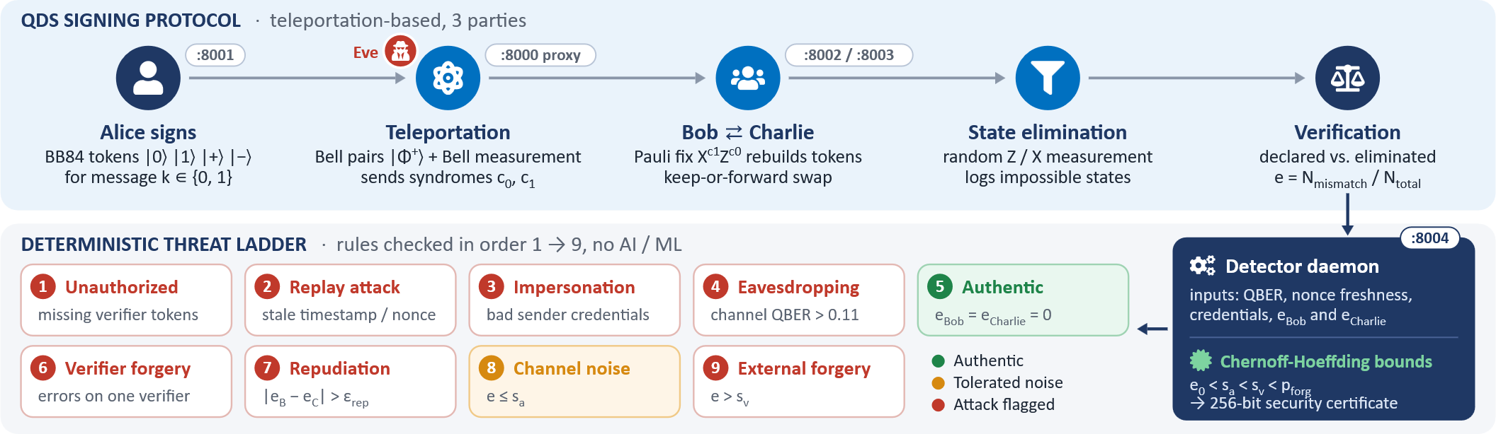
HEDWIG
PROBLEM
Broken Classical PKI: Shor's algorithm breaks RSA and ECC in polynomial time, enabling retroactive decryption of classical keys.
Insider Fraud & Repudiation: Dishonest signers can selectively deny signatures, while rogue verifiers can exploit partial data to frame honest senders.
Session & Transport Exploits: Digital workflows remain vulnerable to signature replay, stale nonces, and unauthorized sender impersonation.
PROPOSED SOLUTION
Teleportation-Based QDS: Transmits signature tokens via Bell pairs (|Φ^+⟩) and Pauli feed-forward gates (𝑋,𝑍) without moving fragile qubits across open channels.
Orthogonal State Elimination: Verifiers record impossible quantum states using projective measurements rather than storing raw secret keys.
Keep-or-Forward Symmetrisation: Verifiers randomly swap tokens, preventing the signer from repudiating messages or cheating individual parties.
ADDRESSING THE PROBLEM
Physic-Based Security: Uses Quantum No-Cloning Theorem and Uncertainty Principle to overcome the vulnerability of Shor's algorithm on RSA/ECC algorithms.
Direct eavesdropper detection: Mid-channel eavesdropping disrupts superpositions to create warnings
WHAT’S DIFFERENT
100% Deterministic (Strict Non-AI): Avoids heuristic ML vulnerabilities, false positives, and adversarial evasion through exact physical observables.
Asymmetric Verification: Verifiers never hold the complete signature, making insider forgery mathematically impossible.

Slide 3
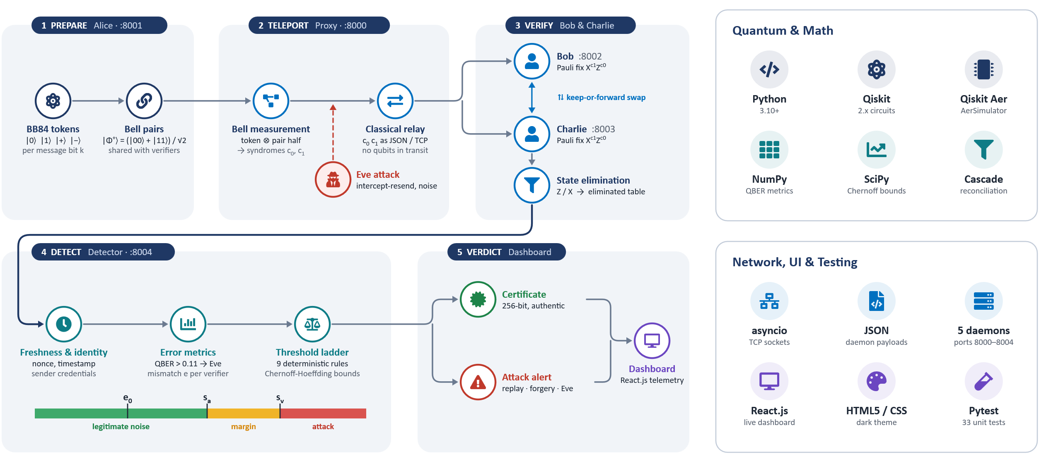
TECHNICAL APPROACH

Slide 4




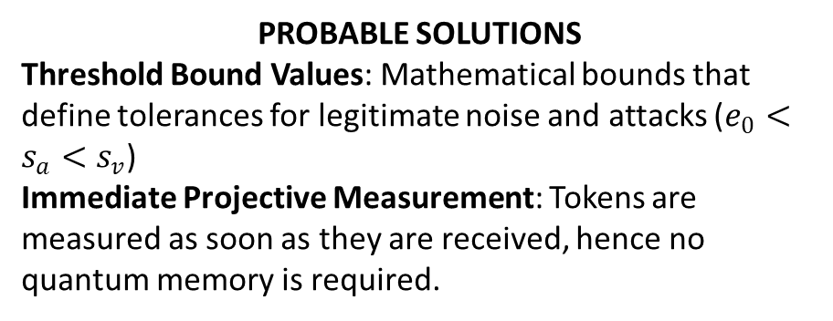
FEASIBILITY AND VIABILITY
FEASIBILITY
Hardware Independent Deployment: Capable of executing completely within conventional computer systems through the Qiskit Aer simulator, not requiring any superconducting hardware.
Extremely Efficient Computational Performance: Instant validation possible with O(1) table lookups and deterministic rules.
LIKELY CHALLENGES
Decoherence on Channels: Noise from the environment (bit/phase flips) can simulate the effects of an eavesdropper.
Memory Lifetime: Long-term quantum memory storage is unfeasible on classical technology and machinery.
PROBABLE SOLUTIONS
Threshold Bound Values: Mathematical bounds that define tolerances for legitimate noise and attacks ($e_{0}<s_{a}<s_{v}$)
Immediate Projective Measurement: Tokens are measured as soon as they are received, hence no quantum memory is required.
RUNS ON STANDARD HARDWARE
React.js dashboard live attack telemetry
Deterministic threat engine O(1) table lookups, rule-based
NOISE vs. ATTACK THRESHOLDS
Qiskit Aer simulator quantum circuits and noise models
e₀
s_{a}
s_{v}
Conventional computer no superconducting hardware needed
Legitimate noise
Safety margin
Attack flagged
mismatch rate (QBER) increases →

Slide 5





IMPACT AND BENEFITS
IMPACTS
Defense & Strategic Sectors: Neutralizes "Harvest Now, Decrypt Later" threats against classified military communications.
FinTech & Banking: Secures high-value transactions with non-repudiable, quantum-proof validation.
Government Infrastructure: Provides tamper-proof authentication for national identity and critical document verification.
BENEFITS
Information-Theoretic Security: Protection backed by physical laws (No-Cloning Theorem), not computational complexity.
Explainable & Auditable: Eliminates black-box AI bias and hallucinations, meeting rigorous regulatory compliance standards.
Zero GPU Overhead: Minimal energy and compute footprint compared to large-scale machine learning threat models.
Conventional
Our approach
Security basis
Math hardness that Shor’s algorithm can break
Physical laws (No-Cloning Theorem)
Defense
FinTech & Banking
Government
Decisions
Black-box ML, false positives
Deterministic and auditable
Blocks “harvest now, decrypt later”
Non-repudiable, quantum-proof transactions
Tamper-proof identity and documents
Compute cost
GPU-heavy threat models
Zero GPU overhead

Slide 6




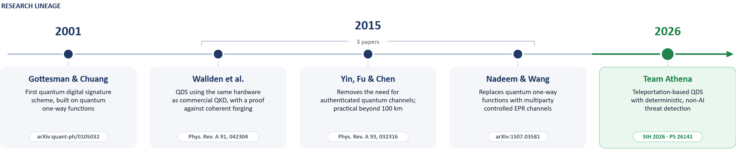
RESEARCH AND REFERENCES
FOUNDATIONAL RESEARCH
Wallden et al. (2015): Quantum digital signatures with quantum key distribution components, Phys. Rev. A / arXiv:1403.5551.
Gottesman & Chuang (2001): Quantum Digital Signatures (arXiv:quant-ph/0105032).
Wang et al. (2015): Quantum Digital Signature Scheme based on Multiparty Controlled EPR Channels (arXiv:1507.03581).
Amiri et al. (2015): Practical Quantum Digital Signature without authenticated quantum channels (arXiv:1507.03333)
CORE PRINCIPLES WE BUILD ON
No-Cloning Theorem
unknown states cannot be copied
Uncertainty Principle
eavesdropping leaves a trace
Quantum Teleportation
Bell pairs + Pauli feed-forward
Chernoff-Hoeffding
finite-sample error bounds

Slide 7
IMPORTANT INSTRUCTIONS
Please ensure below pointers are met while submitting the Idea PPT:
Kindly keep the maximum slides limit up to six (6). ( Including the title slide)
Try to avoid paragraphs and post your idea in points /diagrams / Infographics /pictures
Keep your explanation precise and easy to understand
Idea should be unique and novel.
You can only use provided template for making the PPT without changing the idea details pointers (mentioned in previous slides).
You need to save the file in PDF and upload the same on portal. No PPT, Word Doc or any other format will be supported.
Note - You can delete this slide (Important Pointers) when you upload the details of your idea on SIH portal.

