Slide 1


Learning Autonomous Vehicle Policy using Linear Temporal Logic
Mikihisa Yuasa
4/25/2023

Slide 2

Overview
Motivation
Preliminaries
Method
Results
Discussion & Conclusion
AEROSPACE ENGINEERING
GRAINGER ENGINEERING

Slide 3
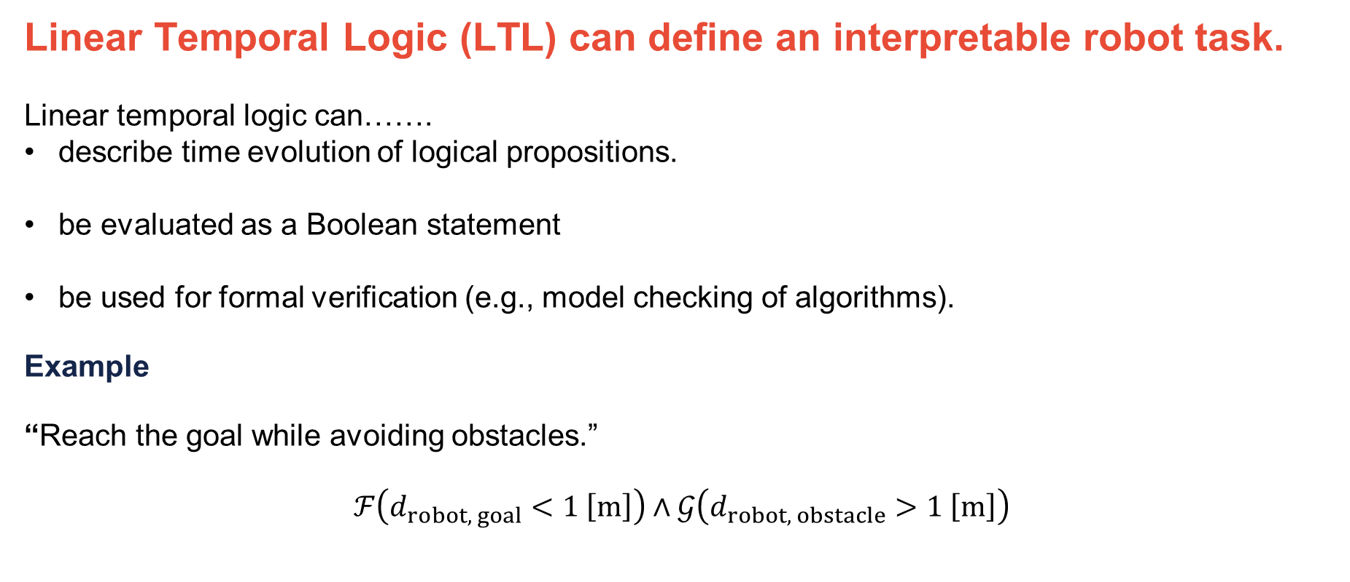
1. Motivation
Linear Temporal Logic (LTL) can define an interpretable robot task.
Linear temporal logic can…….
describe time evolution of logical propositions.
be evaluated as a Boolean statement
be used for formal verification (e.g., model checking of algorithms).
Example
“Reach the goal while avoiding obstacles.”
$$ℱ\left(d_{robot, goal}<1 \left[m\right]\right)∧𝒢\left(d_{robot, obstacle}>1 \left[m\right]\right)$$
AEROSPACE ENGINEERING
GRAINGER ENGINEERING

Slide 4
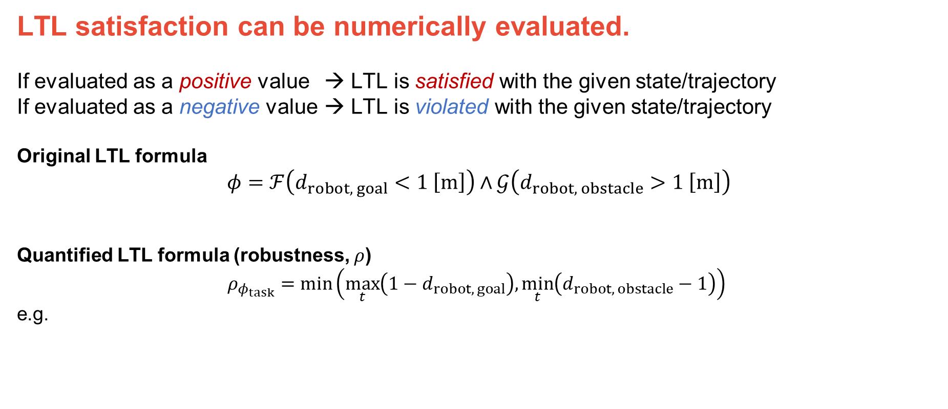

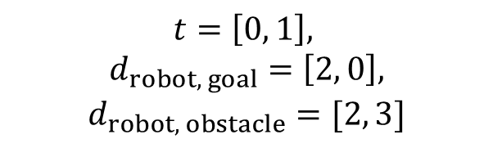
2. Preliminaries
LTL satisfaction can be numerically evaluated.
If evaluated as a positive value → LTL is satisfied with the given state/trajectory
If evaluated as a negative value → LTL is violated with the given state/trajectory
Original LTL formula
$$φ=ℱ\left(d_{robot, goal}<1 \left[m\right]\right)∧𝒢\left(d_{robot, obstacle}>1 \left[m\right]\right)$$
Quantified LTL formula (robustness, $ρ$)
$$ρ_{φ_{task}}=\min\left(\max_{t}\left({1−d}_{robot, goal}\right),\min_{t}\left(d_{robot, obstacle}−1\right)\right)$$
e.g.
$$t=\left[0, 1\right],$$
$$d_{robot, goal}=\left[2, 0\right],$$
$$d_{robot, obstacle}=[2, 3]$$
$$⇒ ρ_{φ}=[−1,1]$$
AEROSPACE ENGINEERING
GRAINGER ENGINEERING

Slide 5
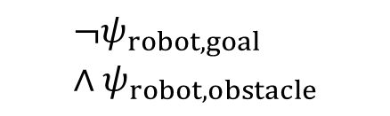



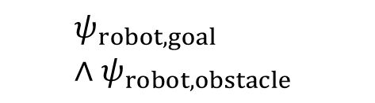





2. Preliminaries
LTL can be translated to an automaton.
An automaton has two kinds of states: goal states and trap states.
$$φ=ℱ\left(ψ_{robot,goal}\right)∧𝒢\left(ψ_{robot,obstacle}\right)$$
$$q_{1}$$
$$ψ_{robot,obstacle}$$
$$¬ψ_{robot,goal}∧ψ_{robot,obstacle}$$
$$ψ_{robot,goal}∧ψ_{robot,obstacle}$$
$$q_{0}$$
$$¬ψ_{robot,obstacle}$$
$$¬ψ_{robot,obstacle}$$
$$q_{2}$$
$$ψ_{robot,goal}$$
AEROSPACE ENGINEERING
GRAINGER ENGINEERING

Slide 6
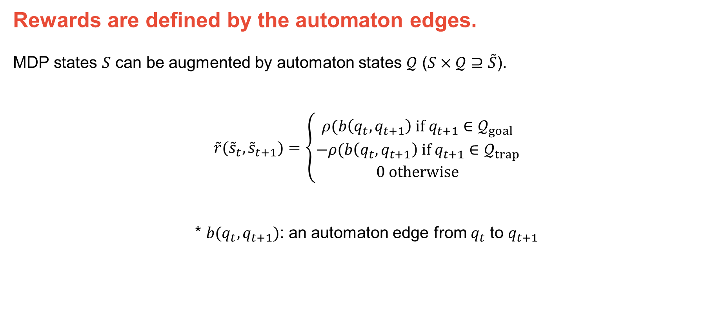
3. Method
Rewards are defined by the automaton edges.
MDP states $S$ can be augmented by automaton states $𝒬$ ($S×𝒬⊇\tilde{S}$).
$$\tilde{r}({\tilde{s}}_{t},{\tilde{s}}_{t+1})=\left\{\begin{aligned}ρ(b\left(q_{t},q_{t+1}\right) if q_{t+1}∈𝒬_{goal} \\ −ρ(b\left(q_{t},q_{t+1}\right) if q_{t+1}∈𝒬_{trap} \\ 0 otherwise\end{aligned}\right.$$
* $b(q_{t},q_{t+1})$: an automaton edge from $q_{t}$ to $q_{t+1}$
AEROSPACE ENGINEERING
GRAINGER ENGINEERING

Slide 7
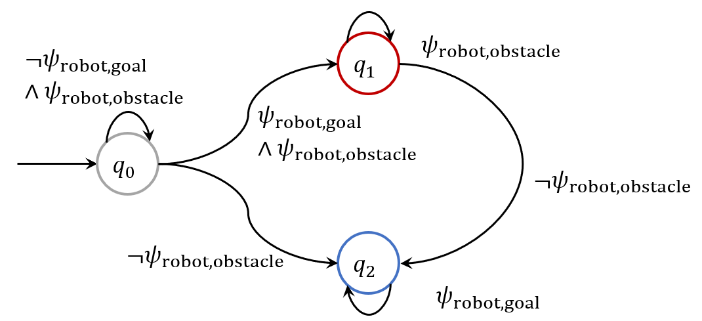
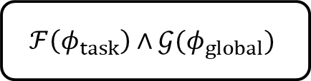


3. Method
Rewards are defined by the automaton edges.
Task specification
$$φ_{task}$$
Automaton
Synthesize
$$ℱ\left(φ_{task}\right)∧𝒢(φ_{global})$$
Global constraints
$$φ_{global}$$
Reward
Feedback
Environment
Feedback
RL Algorithm
Action
AEROSPACE ENGINEERING
GRAINGER ENGINEERING

Slide 8
4. Results
Environment setup
Scenario: roundabout entrance (SUMO)
Task: Turn left without colliding other vehicles
“Ego” vehicle: 1, red
Other vehicles: 2, yellow
Speed of each vehicle: independent from other vehicles
Actions: 0-10 [m/s], discretized by 10
Observation: Fully observable
AEROSPACE ENGINEERING
GRAINGER ENGINEERING

Slide 9
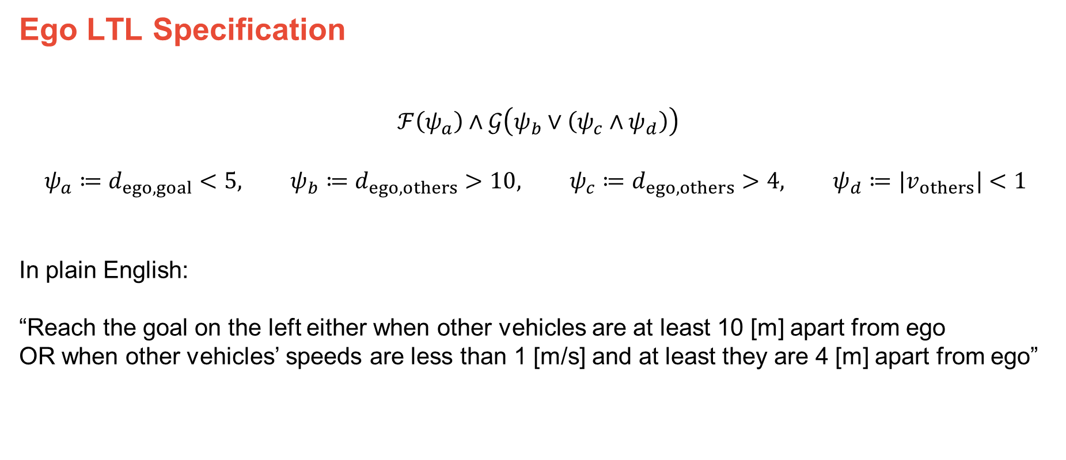
4. Results
Ego LTL Specification
$$ℱ\left(ψ_{a}\right)∧𝒢\left(ψ_{b}∨\left(ψ_{c}∧ψ_{d}\right)\right)$$
$$ψ_{a}≔d_{ego,goal}<5, ψ_{b}≔d_{ego,others}>10, ψ_{c}≔d_{ego,others}>4, ψ_{d}≔|v_{others}|<1$$
In plain English:
“Reach the goal on the left either when other vehicles are at least 10 [m] apart from ego
OR when other vehicles’ speeds are less than 1 [m/s] and at least they are 4 [m] apart from ego”
AEROSPACE ENGINEERING
GRAINGER ENGINEERING

Slide 10
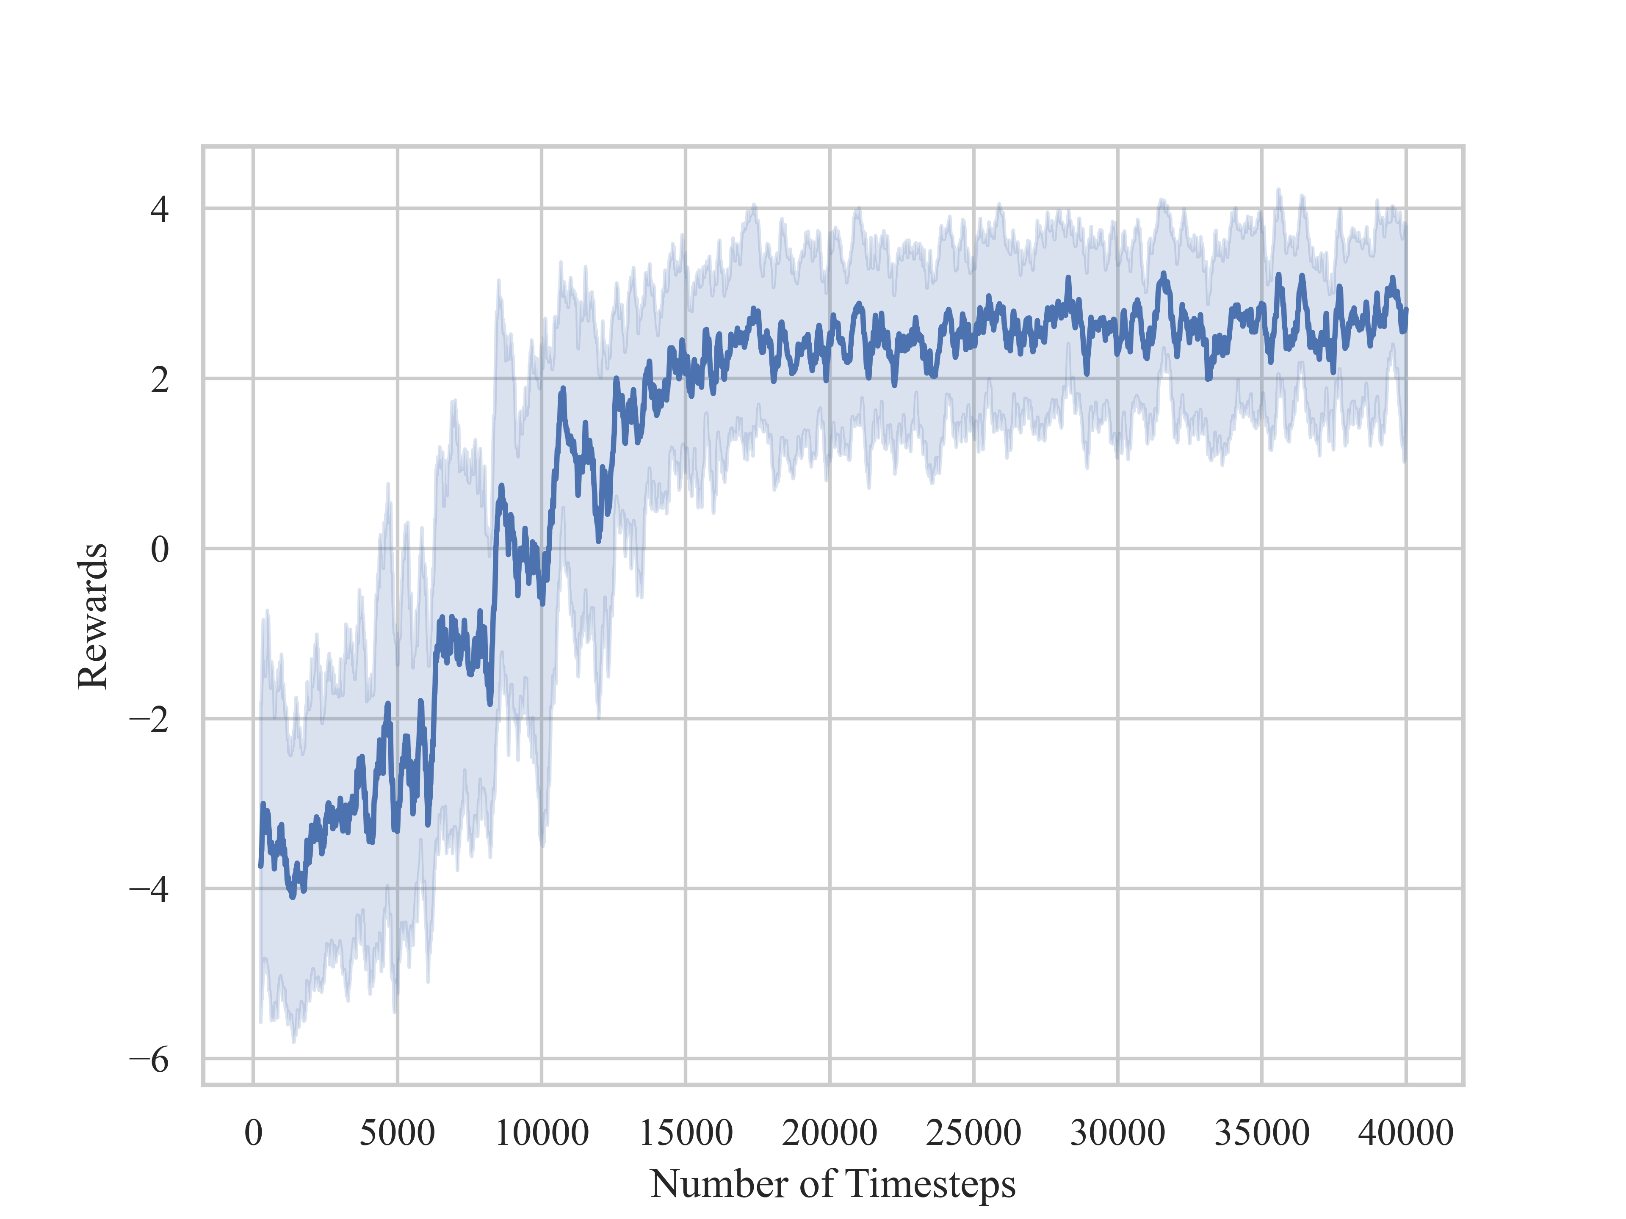
4. Results
The agent learned the LTL task successfully
RL Algorithm: PPO
Number of replicates: 3
Training timesteps: 40,000
Optimal reward: 5
Success rate (no collision)
Run 200 episodes for each replicate
Mean: 1.0
STD: 0.0
AEROSPACE ENGINEERING
GRAINGER ENGINEERING

Slide 11
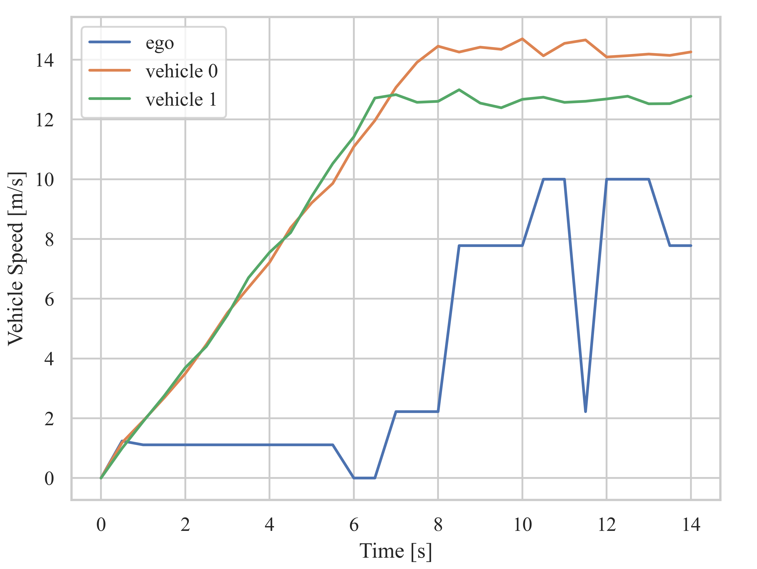
4. Results
The agent learned the LTL task successfully
Sample trajectory
The agent learned conservative policy
AEROSPACE ENGINEERING
GRAINGER ENGINEERING

Slide 12
4. Discussion
A policy for AV scenario can be optimized based on the LTL task specification
Limitation
Required to design effective atomic predicates to use
Difficult to reach the optimal policy
Challenging to encourage more assertive driving
AEROSPACE ENGINEERING
GRAINGER ENGINEERING

Slide 13
4. Conclusion
Linear temporal logic can describe high-level human-readable task specification
LTL task specification can be effectively used as the reward structure
Demonstrates safe driving behaviors for a simple autonomous vehicle scenario
AEROSPACE ENGINEERING
GRAINGER ENGINEERING

