Slide 1

Princeze
Milana Tasovac
Aleksandar savić
Jovan Milićev
Filip marković

Slide 2
Princeze
Milana Tasovac
Aleksandar savić
Jovan Milićev
Filip marković

Slide 3
Models and training
LightGBM Regression
XG Boost
Improvements:
Deductible + price
Weighted LightGBM (based on feature importance)
Second layer

Slide 4
Princeze
Milana Tasovac
Aleksandar savić
Jovan Milićev
Filip marković

Slide 5
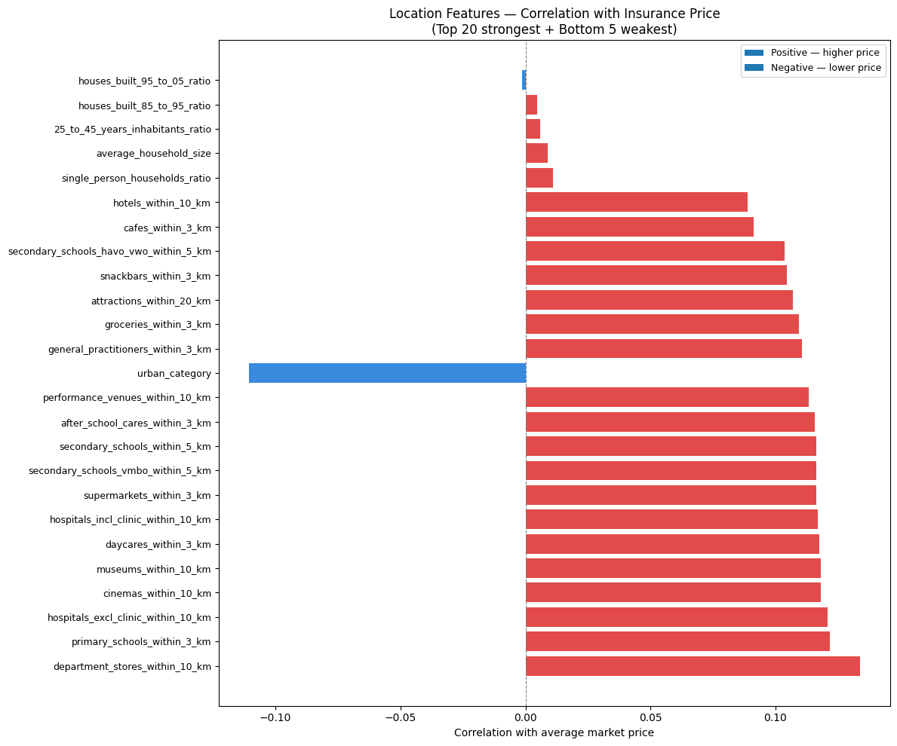
Deeper analysis
The obvious features - age, vehicle value, engine power
Location - urban density

Slide 6
Princeze
Milana Tasovac
Aleksandar savić
Jovan Milićev
Filip marković

Slide 7
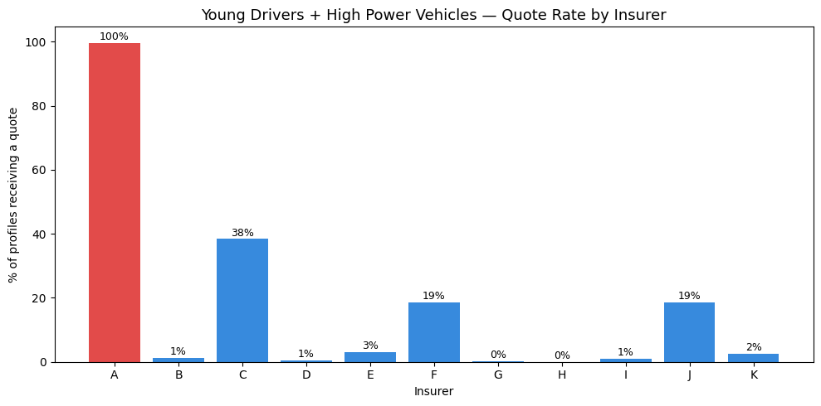
Deeper Analysis
Feature combinations:
young driver + high power vehicle
experienced driver + low value vehicle
age + claim-free years
Insurer A – mass market player
Insurer K – cherry-picker
Insurers H & E – expensive brands

Slide 8
Princeze
Milana Tasovac
Aleksandar savić
Jovan Milićev
Filip marković

Slide 9
Princess Insurence
Drive safely like a princess

Slide 10
Princeze
Milana Tasovac
Aleksandar savić
Jovan Milićev
Filip marković

Slide 11
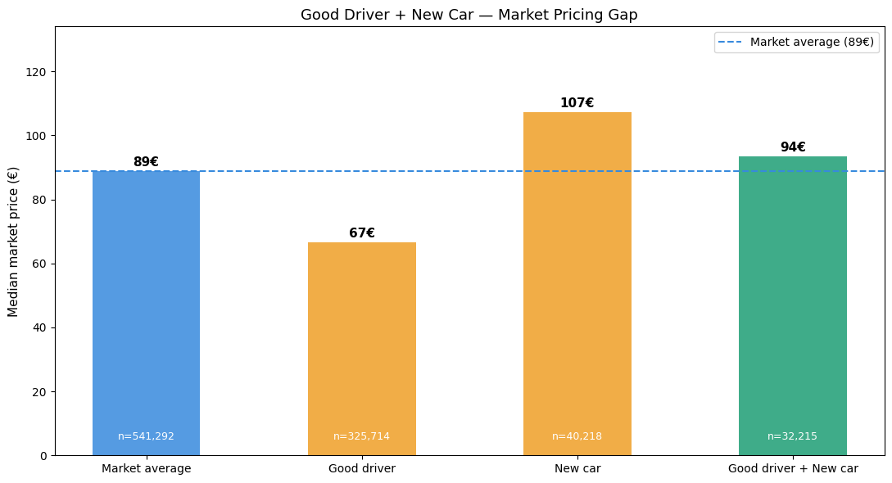
Princess Insurence
Gaps:
young driver + high power vehicle
Good driver + new car
Deductible
Annual payment

Slide 12
Princeze
Milana Tasovac
Aleksandar savić
Jovan Milićev
Filip marković

Slide 13
Princess Insurence
Future improvements:
Traffic penalty points
Data from other insurers
Vehicle reliability surveys

Slide 14
Princeze
Milana Tasovac
Aleksandar savić
Jovan Milićev
Filip marković

Slide 15
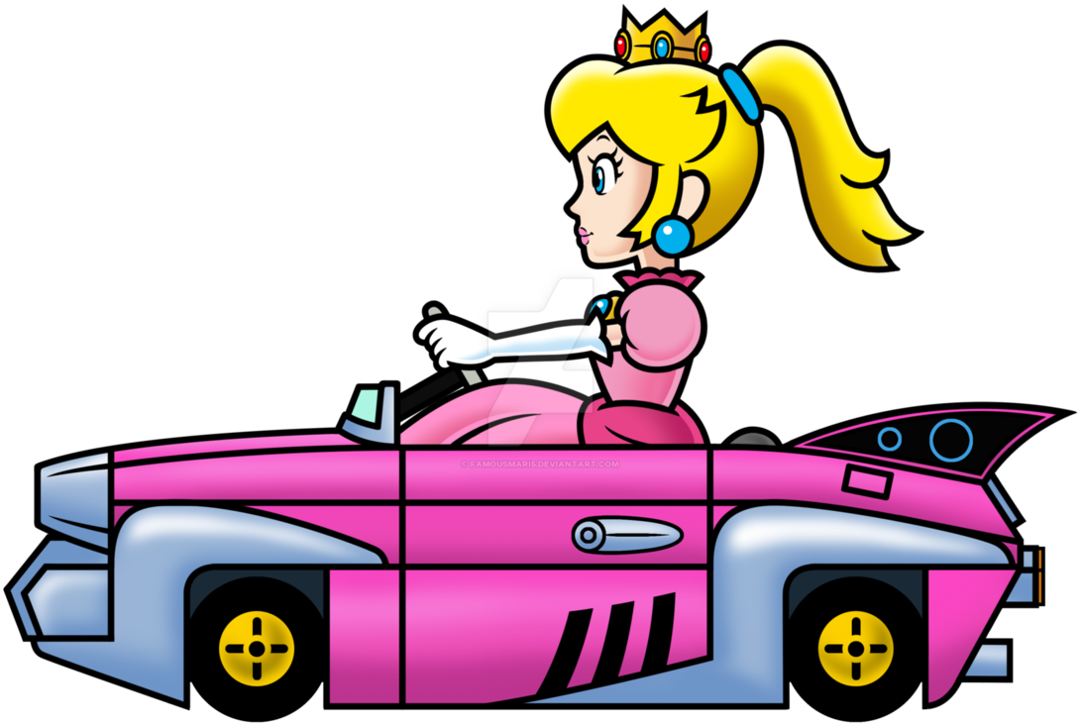
Thank you for your attention!

