Slide 1
Introduction to Data Science
Solomon Teferra Abate @
SIS, AAU

Slide 2
Topics of Data Analytics
Overview of Data Analytics
Types of Data Analytics
Data Analytics lifecycle
Building Data Analytics Models
Introduction to Machine/Deep Learning
Data Visualization and Story telling

Slide 3
Overview of Data Analytics
Overview of Data Analytics
Types of Data Analytics
Data Analytics lifecycle
Building Data Analytics Models
Introduction to Machine/Deep Learning
Data Visualization and Story telling

Slide 4
Overview of Data Analytics
Data analytics is the method for looking at big data to reveal hidden patterns, incomprehensible relationships, and other important information that can be utilized to resolve on enhanced business decisions.
Data analytics is the systematic approach of collecting, processing, and analyzing data sets using statistical and other business analysis methodologies regardless of size and volume to provide better insights in strategic, tactical, and operational decision making.
Hence, data analytics can also be exemplified as the systematic approach of the collection of massive data sets, processing, and analyzing for data-driven decision making

Slide 5

Overview of Data Analytics
Data analysis and Data analytics – are often used interchangeably and could be confusing
Data analysis is a detailed examination of the elements or structure of something
Data analytics is the systematic computational analysis of data or statistics
Data Analytics
Broader
Defines the science behind Looks to the future (predict)
Identifies inexplicable or novel relationships/trends Seeks to visualize the data
to allow the observation of relationships/trends
Data Analysis Specific to a problem Applies analytics methods Looks backwards
Used based on theoretical foundation
Seeks to identify a significant level to address hypotheses or Research Questions

Slide 6
Types of Data Analytics
Overview of Data Analytics
Types of Data Analytics/Analysis
Data Analytics lifecycle
Building Data Analytics Models
Introduction to Machine/Deep Learning
Data Visualization and Story telling

Slide 7
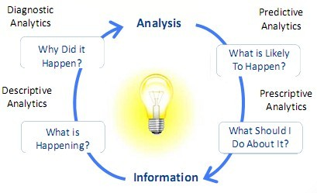
Types of Data Analytics
Analytics/
Data/

Slide 8

Types of Data Analytics
•
Descriptive Analytics: This is a method for quantitatively
describing the main features of a collection of data
Variables: Categorical, Ratio, Independent, Dependent
Frequency Distribution: Histogram, Normal distribution
Measures of Centrality: Mean, Median, Mode
Dispersion of a Distribution: Range, Interquartile range, Variance, Standard deviation
•
Diagnostic Analytics/Causal analysis: Are used for
discovery, or to determine why something happened
Correlation: Pearson’s r correlation

Slide 9
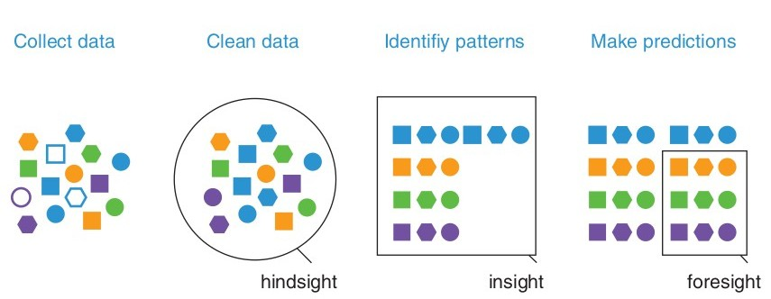
Types of Data Analytics
•
Predictive Analytics: These analytics are about understanding the future using the data and the trends we have seen in the past, as well as emerging new contexts and processes. They are done in stages:
•
Prescriptive Analytics: Analyzes potential decisions, the interactions between decisions, the influences that bear upon these decisions, and the bearing all of this has on an outcome to ultimately prescribe an optimal course of action in real time

Slide 10
Types of Data Analytics
•
Exploratory analysis: Is an approach to analyzing datasets
to find
previously unknown involves using
relationships. Often such
analysis
various data visualization
approaches:
•
Mechanistic analysis: Involves understanding the exact changes in variables that lead to changes in other
variables for individual objects
Regression analysis is a process for estimating the relationships among variables. It shows how one variable can be predicted from another (Correlation shows only their relation)

Slide 11
Data Analytics Lifecycle
Overview of Data Analytics
Types of Data Analytics
Data Analytics lifecycle
Building Data Analytics Models
Introduction to Machine/Deep Learning
Data Visualization and Story telling

Slide 12
Data Analytics Life Cycle
•
Phase 1: Data Discovery and Formation: In the initial step, data will be evaluated for its potential uses and demands – such as where it comes from, what message you wish for it to send and how this incoming information benefits your business.
The data science team investigates and learns about the challenge.
Create context and understanding
Learn about the data sources that will be required and available for the project
The team develops preliminary hypotheses that can later be tested with data
•

Slide 13
Data Analytics Life Cycle
•
Phase 2: Data Preparation and Processing: Data preparation and processing involves gathering, sorting, processing and purifying collected data to make sure it can be utilized by subsequent steps of analysis
Following are methods of data acquisition
Data Collection: Draw information from external sources.
Data Entry: Within an organization, data entry refers to creating new points of information using either digital technologies or manual input procedures.
Signal Reception: Accumulating data from digital devices like the Internet of Things devices and control systems.
•

Slide 14
Data Analytics Life Cycle
•
Phase 3: Design a Model: The phase of creating a model that uses the data to achieve the defined goal. Model planning is the name given to this stage of the data analytics process.
There are numerous methods for loading data into the system and starting to analyze it:
ETL (Extract, Transform, and Load) converts the data
before loading it into a system using a set of business rules.
ELT (Extract, Load, and Transform) loads raw data into the sandbox before transforming it.
ETLT (Extract, Transform, Load, Transform) is a combination of two layers of transformation.
•

Slide 15
Data Analytics Life Cycle
•
Phase 3: Model Building: The use of tools and methods,
such as decision trees, regression techniques logistic
regression), and neural networks to create and run the model.
Tasks that are done in this stage include:
•
Creation of datasets for use in testing, training, and production.
Examining if the present tools will serve for running the models or if a more robust environment is required for model execution.
Python, R, Octave, and WEKA are examples of free or open-source tools.

Slide 16
Data Analytics Life Cycle
Phase 5: Result Communication and Publication: The communication process begins with cooperation with key stakeholders to decide whether the project’s outcomes are successful or not.
The project team is responsible for identifying the major conclusions of the analysis, calculating the business value associated with the outcome, and creating a narrative to summarize and communicate the results to stakeholders.

Slide 17
Data Analytics Life Cycle
Phase 6: Measuring Effectiveness: As your data analytics life cycle comes to an end, the final stage is to offer stakeholders a complete report that includes important
results, coding, briefings, and technical papers or documents. Furthermore, to assess the effectiveness of the study, the data is transported from the sandbox to a live environment and observed to see if the results match the desired business aim.
If the findings meet the objectives, the reports and outcomes are finalized. However, if the conclusion differs from the purpose stated in phase 1, then you can go back in the data analytics life cycle to any of the previous phases to adjust your input and get a different result.
•
•

Slide 18
Building Data Analytics Models
Overview of Data Analytics
Types of Data Analytics
Data Analytics lifecycle
Building Data Analytics Models
Introduction to Machine/Deep Learning
Data Visualization and Story telling

Slide 19
Building Data Analytics Models
The models are built to extract insights and knowledge from the data to make business decisions and strategies
In this phase of the project data science team needs to develop data sets for training, testing, and production purposes
Model building in data analytics is aimed at achieving not only
•
high accuracy on the training data but also the ability to generalize and perform well on new, unseen data.
Dividing The Dataset For Model Building
Scaling The Dataset: Makes our model more robust to the outliers
Modeling The Data:
✓
Is the problem a regression or a classification problem? Should the model be more explainable or of higher accuracy?
✓
Plotting The Decision Graph

Slide 20
ML/DL for Data Analytics
Overview of Data Analytics
Types of Data Analytics
Data Analytics lifecycle
Building Data Analytics Models
Introduction to Machine/Deep Learning
Data Visualization and Story telling

Slide 21
What is machine learning?
A branch of artificial intelligence,
●
concerned development
with the design of algorithms that
and
allow
computers to evolve behaviors based on empirical data.
As intelligence requires knowledge, it is necessary for the computers to acquire knowledge.
●

Slide 22
ML/DL for Data Analytics
Machine Learning: explores the use of algorithms that can learn from the data and use that knowledge to make predictions on data they have not seen before
Such static
algorithms are designed to overcome strictly program instructions by making data-driven
predictions or decisions through building a model from sample inputs.
Machine Learns from past experiences Improve
the performances of intelligent programs
A computer program is said to learn from experience E with respect to some class of tasks T and performance measure P

Slide 23
Traditional Programming
Traditional Programming vs Machine Learning
Data Program
Computer
Output
Machine Learning
Data
Computer
Program/ Rules
Output

Slide 24

ML Related Fields
Assignment1: Discuss their relation to ML
data mining
control theory
statistics
decision theory
machine learning
information theory
cognitive science
databases
psychological models neuroscience
evolutionary models
●
Machine learning is primarily concerned with the accuracy and effectiveness of the computer system in performing complex tasks.

Slide 25
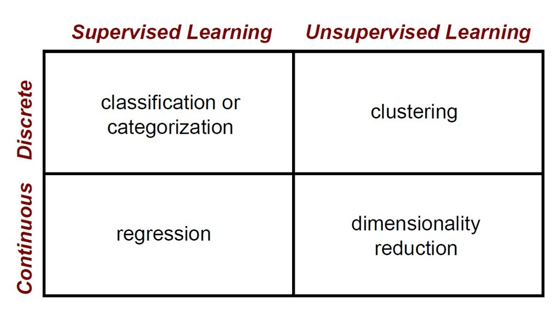
Machine Learning Domain

Slide 26
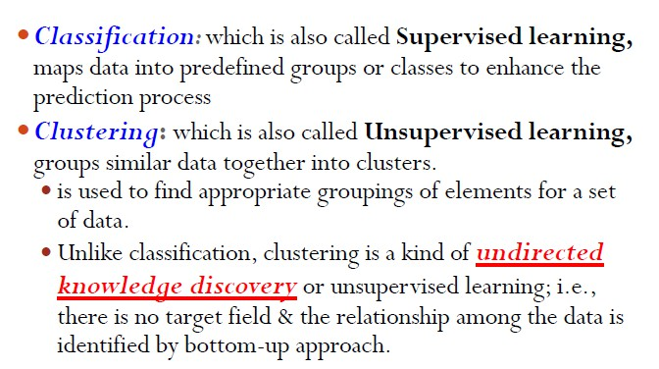
Basic Algorithms

Slide 27
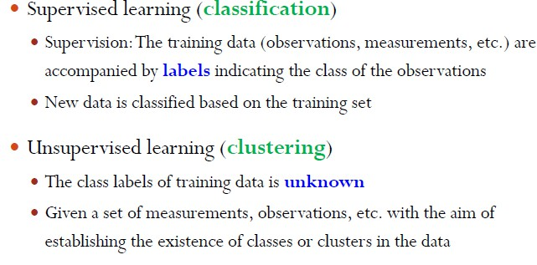
Supervised Vs Unsupervised Learning

Slide 28
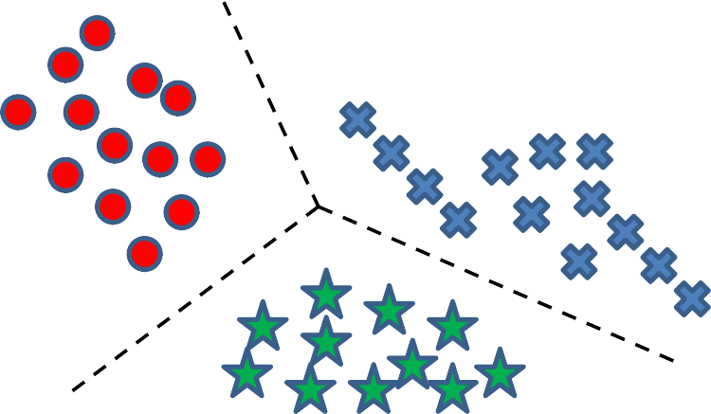
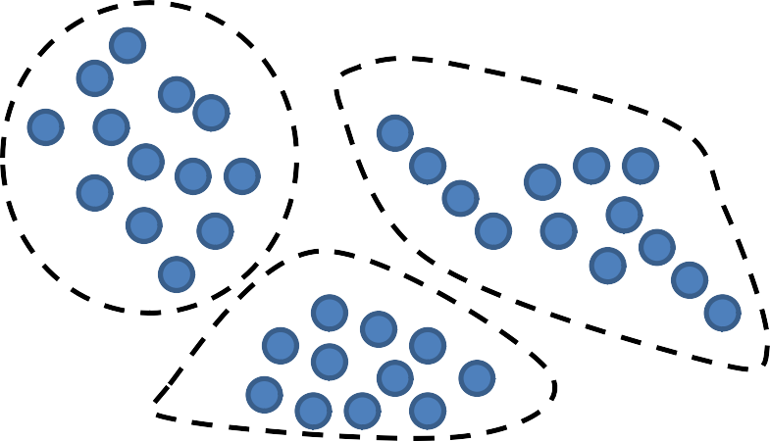
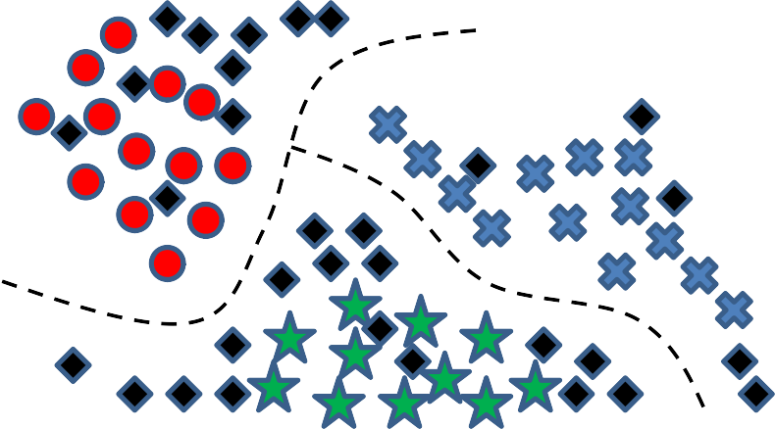
Algorithms
Supervised learning Training data with labels
Unsupervised learning Training data not labeled
Semi-Supervised learning

Slide 29
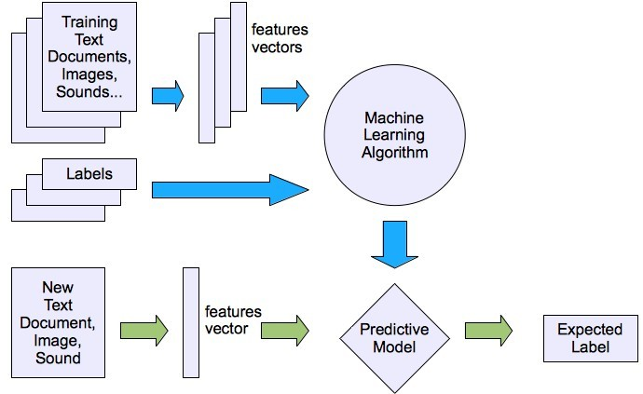
Machine learning structure
Supervised learning
●

Slide 30
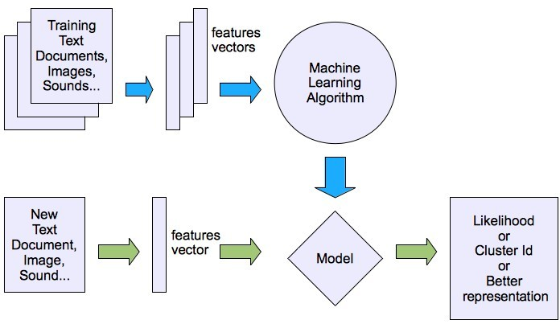
Machine learning structure
●
Unsupervised learning

Slide 31
Learning Techniques
Supervised learning categories and techniques
− Linear classifier (numerical functions)
− Parametric (Probabilistic functions)
●
Naïve Bayes, Gaussian discriminant analysis (GDA), Hidden Markov models (HMM), Probabilistic graphical models
− Non-parametric (Instance-based functions)
●
K-nearest neighbors, Kernel regression, Kernel density estimation, Local regression
− Non-metric (Symbolic functions)
●
Classification and regression tree (CART), decision tree
− Aggregation (Ensembling)
Bagging (bootstrap + aggregation), Adaboost, Random forest

Slide 32
Learning Techniques
Unsupervised learning categories and techniques
− Clustering
●
K-means clustering Spectral clustering
●
− Density Estimation
Gaussian mixture model (GMM) Graphical models
●
− Dimensionality reduction
Principal component analysis (PCA) Factor analysis
●

Slide 33
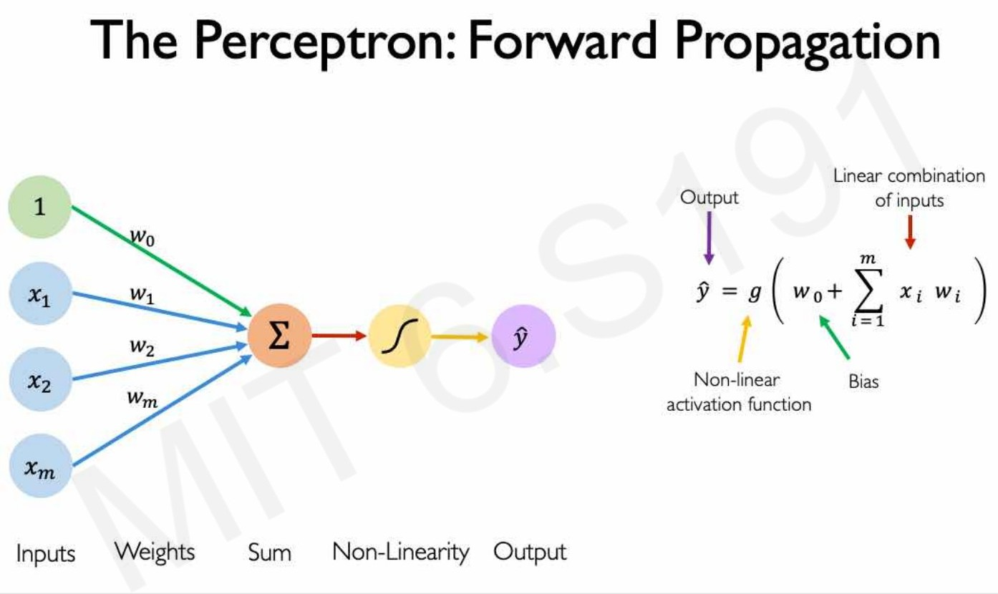
Deep Learning

Slide 34
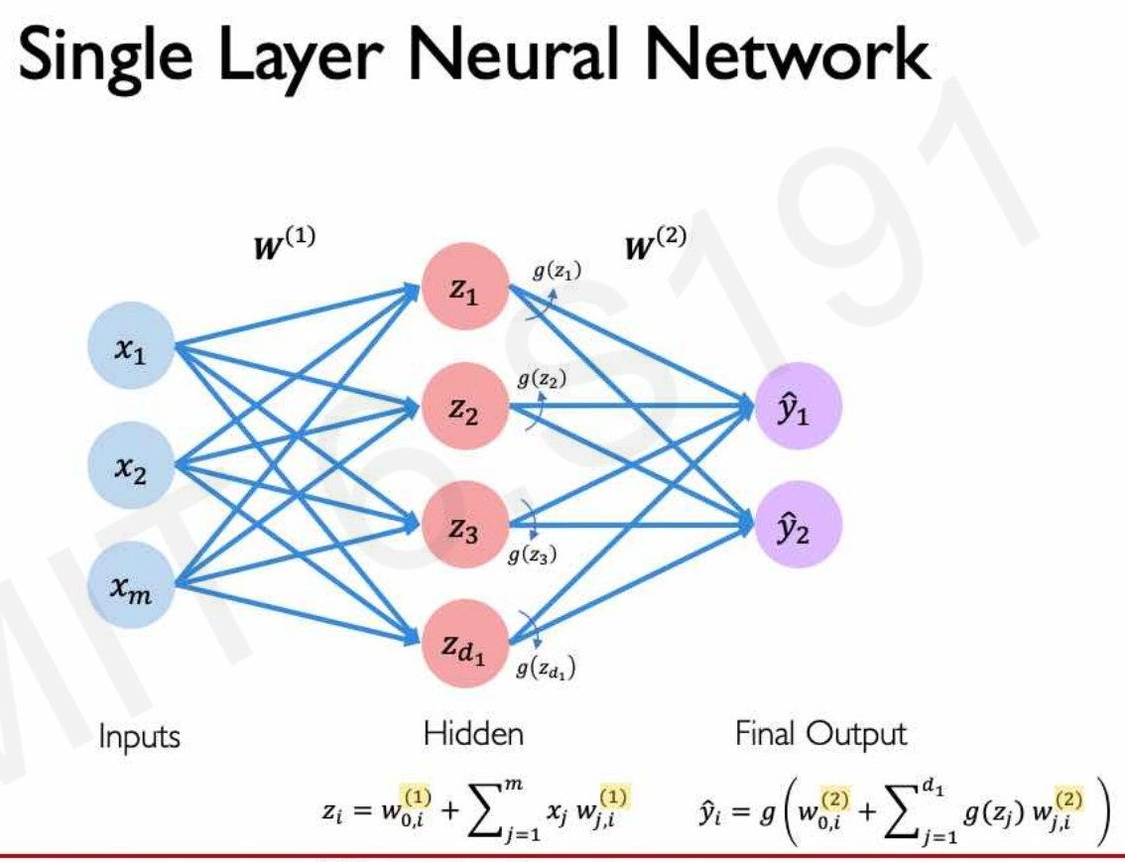
Deep Learning

Slide 35
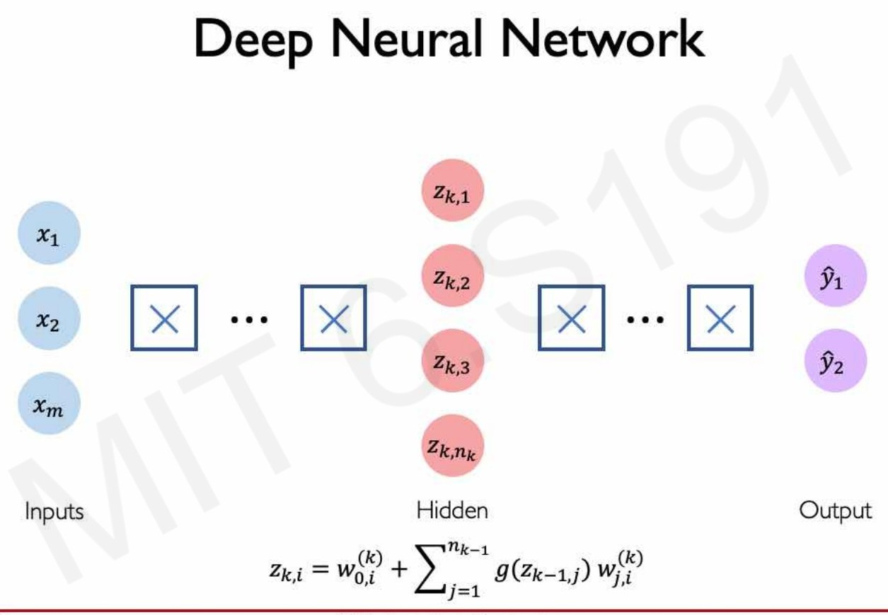
Deep Learning

Slide 36
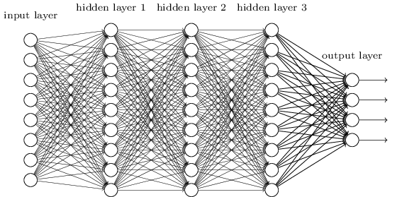
Deep Learning
•
•
Lots of hidden layers Depth = power (usually)
Weights to learn!
Weights to learn!
Weights to learn!
Weights to learn!

Slide 37
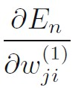

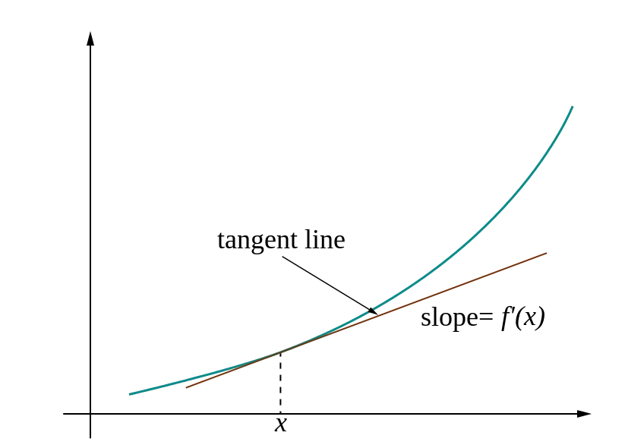
Deep Learning- Loos gradients
•
Denoted as (diff notations):
•
i.e. how does the loss change as a function of the weights
We want to change the weights in such a way that makes the loss decrease as fast as possible
•

Slide 38
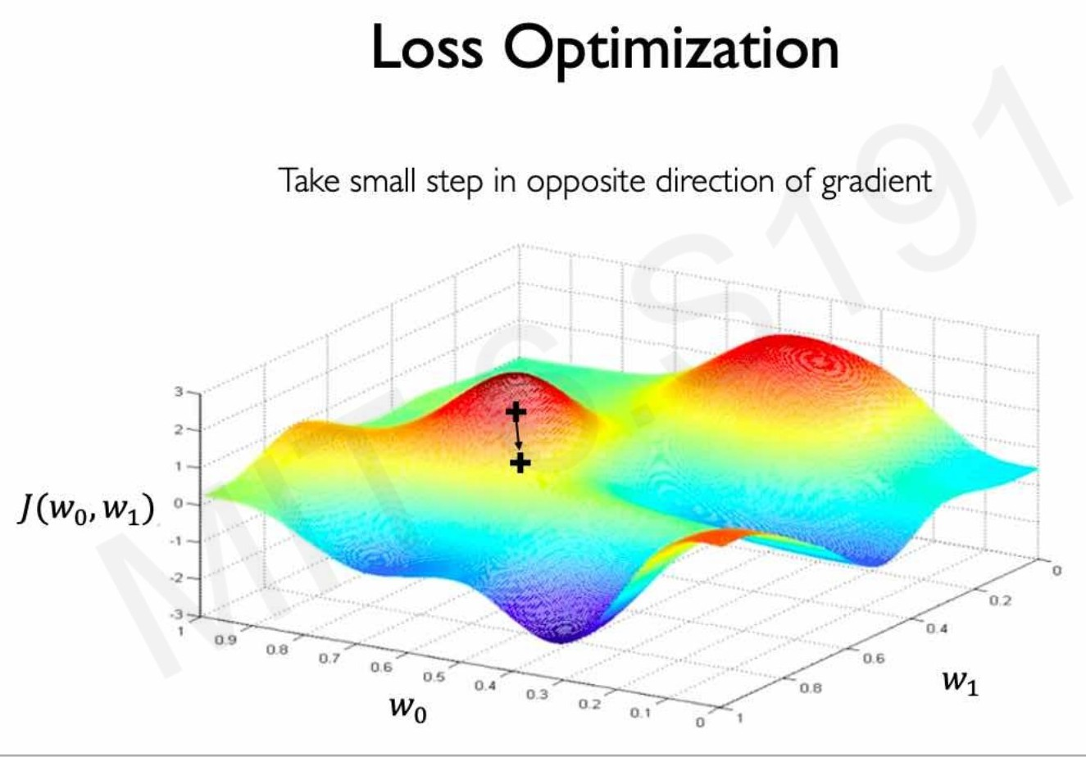
Deep Learning- Loos gradients

Slide 39
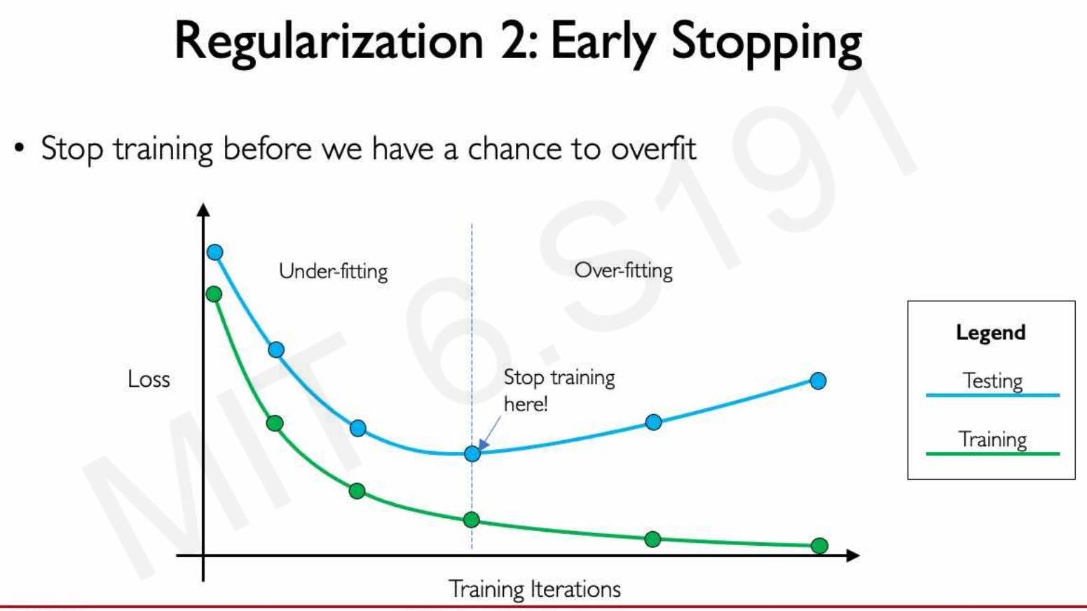
Deep Learning- Loos gradients

Slide 40
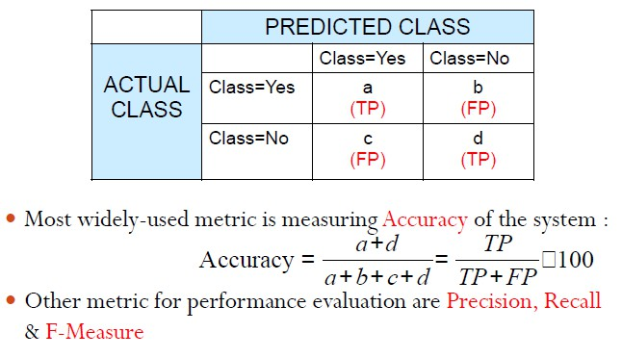
Evaluation Metrics

Slide 41
Few Applications
Predication (weather, agricultural yield, etc) Face Detection; Character recognition; Surveillance and security system
Object detection and recognition Natural language processing Speech/Image Recognition Multimedia event detection Economical and commercial usage
……… many many many more
●
●
●
●
●
●
●
●
●

Slide 42
Data Analytics for DV and ST
Overview of Data Analytics
Types of Data Analytics
Data Analytics lifecycle
Building Data Analytics Models
Introduction to Machine/Deep Learning
Data Visualization and Story telling

Slide 43
Data Visualization and Story Telling
Data Visualization is the act of placing data into a visual context, such as a graph.
It makes data easier for the human brain to understand and detect patterns, trends and outliers in a group of data.
The goal of data storytelling is to present complex data in a way that is easy to understand and engaging for the audience.
By using data visualization, charts, and other tools, data storytellers can make their data more accessible and understandable to a wider audience.

Slide 44
Data Visualization vs Storytelling
Data visualization and data storytelling are related concepts, but they are not interchangeable.
Data visualization refers to the graphical representation of
data, such as charts, graphs, and maps, whereas data
using data to tell a
storytelling refers to the process of
compelling story.
Data visualization is an important part of data storytelling, as it helps to make data more accessible and understandable for the audience. Data visualization can help highlight trends, patterns, and insights that might have been missed with traditional data analysis methods. Data storytelling, on the other hand, goes beyond data visualization to create a narrative that connects the data to the audience. Data
storytelling involves using data to tell a identifying a problem, presenting evidence
story, such as to
support a
solution, and providing a call to action.

Slide 45
Data Visualization vs Storytelling
Data visualization
focuses on presenting data in a visual format, such as charts, graphs, or maps.
often used to highlight patterns, trends, or relationships in data.
aims to help the audience understand the data quickly and easily.
requires technical skills to create effective visualizations.
It may not always tell a story or provide context for the data being presented.
Data Storytelling
focuses on presenting data in a way that tells a story and connects with the audience.
may use data visualization, but it goes beyond charts and graphs to include narratives and other storytelling techniques.
aims to help the audience understand the data in the context of a larger story.
requires both technical and storytelling skills to be effective.
can inspire action and change by providing insights and solutions based on the data.

Slide 46
Data Visualization - Types
Bar charts: Bar charts (vertical or horizontal) are used to compare categorical data.
Line charts: Line charts are used to show trends over time. Scatter plots: Scatter plots are used to show the relationship between two variables. They consist of points on a graph that represent the values of the two variables being compared.
Pie charts: Pie charts are used to show the proportion of different categories in a data set.
Heat maps: Heat maps are used to show the distribution of values in a data set. They consist of a grid where each cell is colored based on the value it represents.
●
●
●
Bubble charts: Bubble charts are used to show the
relationship between three variables. They consist of circles that vary in size and color to represent the values of three different variables.
Maps: Maps are used to show geographic data.
●

Slide 47
Data Storytelling- Elements
●
Audience: Understanding your audience is key to creating an effective data story.
You should consider their background knowledge, interests, and motivations when selecting the data and crafting the narrative.
Narrative: A narrative structure can help to make data more compelling and understandable.
●
●
The story should have a clear beginning, middle, and end, and should be focused on a central problem or question.
Data: The data should be accurate, relevant, and reliable.
●
●
It should support the story and help to provide evidence for the main argument.
Visuals: Visuals such as charts, graphs, and maps can help to make the data more accessible and understandable.
●
●
The visuals should be chosen based on the story's needs, and should be clear and easy to interpret.

Slide 48
Data Storytelling- Elements
●
Emotion: Emotion can help to engage the audience and make the story more memorable.
Including personal anecdotes, case studies, or testimonials can help to bring the data to life and connect with the audience on an emotional level.
Call to Action: A call to action can help to inspire the audience to take action based on the insights provided by the data.
●
●
The call to action should be specific, realistic, and achievable, and should be aligned with the story's main message.

Slide 49
Data Visualization and Storytelling tools
●
The Best Data Visualization tools of 2024
Microsoft Power BI: Best for business intelligence (BI) Tableau: Best for interactive charts
Qlik Sense: Best for artificial intelligence (AI) Klipfolio: Best for custom dashboards Looker: Best for visualization options
Zoho Analytics: Best for Zoho users Domo: Best for custom apps
●
●
●
●
●
●
●
Other data visualization and storytelling tools:
Infogram: Allows us to create a variety of charts, graphs, and infographics.
Canva: A design tool that allows us to create a range of visual content, including data visualizations, charts, and infographics. Google Data Studio: Allows us to create interactive dashboards and
reports. It offers a range of visualization options and allows us to connect to a variety of data sources.
Piktochart: Allows us to create a variety of visual content, including
infographics and presentations.
●
●
●

