Slide 1
Chapter One
Introduction to Data Science

Slide 2
Outline
Overview of the data Revolution
The demand for data Professionals
Defining the Data Science Discipline
Data Science and other Data Related Disciplines
Knowledge areas of the Data Science Discipline

Slide 3
Overview of the data Revolution
Data revolution refers to the “transformative actions needed to respond to the demands of a complex development agenda, improvements in how data is produced and used.
It also touches upon issues of data management, data governance, and data lifecycle, and describes key current and future trends for a broad range of data-related activities.

Slide 4
Continued……..
It concern to closing data gaps to prevent discrimination; building capacity and data literacy in “small data” and “Big Data”.
Big Data is described as “data sets that are impossible to store and process using common software tools, regardless of the computing power or the physical storage at hand”

Slide 5
The demand for data Professionals
Why Data Science Professionals Are So Much in Demand Globally?
Abundance of data: Organizations around the world are finding it a big challenge to handle the enormous amounts of data at their disposal.
Talent deficit: Finding an equipped talent in the data science domain is tough.

Slide 6
Continued…..
No entry for professionals with zero knowledge of related subjects: Entry is almost banned for professionals or students with no connection with computer science, engineering, mathematics/statistics, and general science.

Slide 7
Continued ….
Handsome salary: There’s no doubt about that! The pay is simply great! But so is the work that goes into being a data science professional in your organization.
Diverse and long skillset required: Being a data science professional requires so much than having an ordinary knowledge of programming, or coding.

Slide 8
Data Science Discipline
Data science is an interdisciplinary field that uses scientific methods, processes, algorithms and systems to extract knowledge and insights from data in various forms, both structured and unstructured, similar to data mining

Slide 9
Data insights
Data insights refers to the deep understanding an individual or organization gains from analyzing information on a particular issue. This deep understanding helps organizations make better decisions than by relying on gut instinct
Data: Customers complain that sales reps often take over 72 hours to respond to their messages.
Data insight: You decide your reps should receive training on how to automate and improve response times.

Slide 10
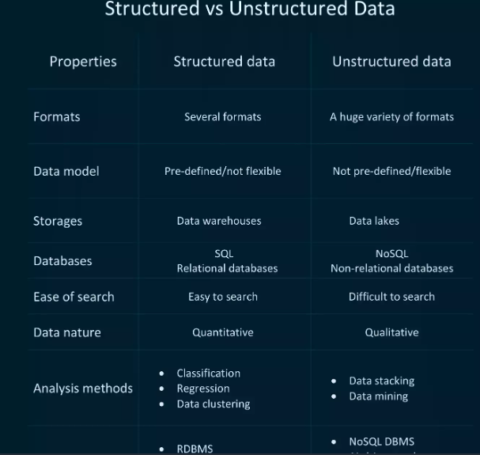

Slide 11
Continued ….
Data science is the field of study that combines domain expertise, programming skills, and knowledge of math and statistics to extract meaningful insights from data.
Data science practitioners apply machine learning algorithms to numbers, text, images, video, audio, and more to produce artificial intelligence (AI) systems that perform tasks which ordinarily require human intelligence.

Slide 12
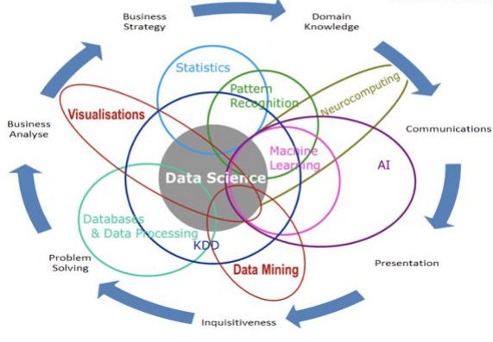
Data Science is Multidisciplinary

Slide 13
What Data Science do?
A typical data science process looks like this, which can be modified for specific use case:
Understand the business
Collect & explore the data
Prepare & process the data
Build & validate the models
Deploy & monitor the performance

Slide 14
Why is Data Science Important?
By leveraging the right data, companies can create and implement business strategies to stay ahead of the competition
Leaders can make data-driven decisions to solve business problems using trends and data insights
Recommendations for business growth and expansion can be made by combining experiments with analytics

Slide 15
Cont…
It is a good opportunity for companies to achieve a sustainable competitive advantage by evaluating the current data strategy approach
Leaders can also drive business improvement and re-evaluate the company’s needs by analyzing data sets and future trends

Slide 16
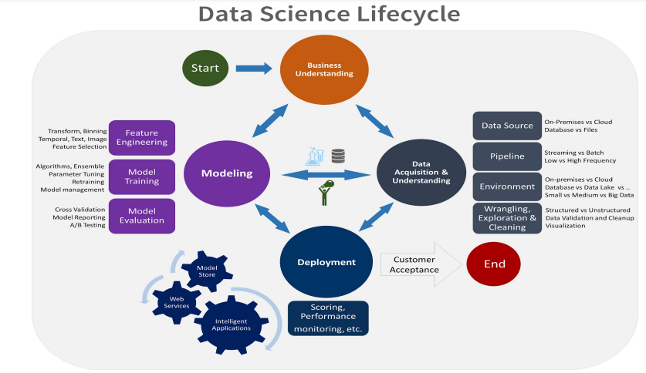

Slide 17
1. Business Understanding
identifying the central objectives of your project by identifying the variables that need to be predicted.
If it’s a regression, it could be something like a sales forecast. If it’s a clustering, it could be a customer profile. Understanding the power of data and how you can utilize it to derive results for your business by asking the right questions is more of an art than a science, and doing this well comes with a lot of experience

Slide 18
Data mining
Data mining is the process of gathering your data from different sources
At this stage, some of the questions worth considering are - what data do I need for my project? Where does it live? How can I obtain it? What is the most efficient way to store and access all of it?

Slide 19
Data Cleaning
It is the process of filtering, and cleaning data before it is put in a data warehouse or any other storage solution on which data analysis can be carried out
there are so many possible scenarios that could necessitate cleaning.
For instance, the data could also have inconsistencies within the same column, meaning that some rows could be labelled 0 or 1, and others could be labelled no or yes..

Slide 20
Data Exploration
Involves analysis and transforming, data with the goal of highlighting relevant data, synthesizing and extracting useful hidden information with high potential from a business point of view
This is where you understand the patterns and bias in your data
Using all of this information, you start to form hypotheses about your data and the problem you are tackling

Slide 21
Feature Engineering
In machine learning, a feature is a measurable property or attribute of a phenomenon being observed.
Feature selection is the process of cutting down the features that add more noise than information
Feature construction involves creating new features from the ones that you already have (and possibly ditching the old ones)

Slide 22
Predictive Modeling
this is where you decide which model to pick for your problem
that you end up training will be dependent on the size, type and quality of your data, how much time and computational resources you are willing to invest, and the type of output you intend to derive.

Slide 23
Data Visualization
Once you’ve derived the intended insights from your model, you have to represent them in way that the different key stakeholders in the project can understand.
This is where you evaluate how the success of your model relates to your original business understanding. Does it tackle the problems identified? Does the analysis yield any tangible solutions?

Slide 24
Data Science and other Data Related Disciplines
Data Science vs Data Analysis
Data analysis emphasizes on correlative analysis to predict relationships between data sets or known variables to discover how a particular event can occur in the future.
Data science emphasizes on providing strategic actionable insights into the world where people don’t know what they don’t know.
Data Analysts focus more on descriptive nature of data analysis, but the role of a Data Scientist is to deep dive into the data and find actionable insights based on the data set.

Slide 25
Data Science vs Data Mining
Data mining is a subset of data science that refers to the process of collecting data and searching it for patterns in data.
The main goal is to design algorithms that extract insights from large unstructured data sets and validate the findings by applying identified patterns to novel subsets of data.
The ultimate and direct business application of data mining is prediction.
Data Science is dependent on data mining. Rather data mining can be considered the first step of data science.

Slide 26
Data Science vs Machine Learning
Machine learning along with data science and big data is gaining traction because of its widespread use in various big data companies across the world.
The major refining tools for doing data science is machine learning which is a cocktail of statistics, computer science and mathematics.
Data science is a broader discipline that materializes around machine learning concepts which include interaction with existing systems like production databases, data acquisition and data cleaning.

Slide 27
Data Science vs. Deep Learning
Deep learning is a branch of the broader field of machine learning. Deep learning involves the use of neural networks in problem-solving. A neural network is a framework where several machine learning techniques are combined to solve specific tasks.
Deep learning is a part of machine learning, and machine learning is a part of data science.
Hence data science comprises the tools and techniques used in deep learning too.

Slide 28
Data Science vs. Data Engineering
Data engineering primarily involves the design And implementation of reliable and secure database management systems. | Data Science involves taking raw data available, and applying analytic tools and modeling techniques to analyze the data to get insights on the data.
Data engineering transforms the big data into A structure that can be further processed and analyzed | Data science performs the actual analysis of Big Data

Slide 29
Data Science vs Statistics
Data Science is an umbrella term for scientific techniques which involve processing, algorithms, and statistical analysis of data to extract actionable insights from the data. | Statistics is a branch of mathematics that involves providing a collection of methods to plan for data collection, evaluation, and representation for any further data analysis.
Data Science is used to solve data-related problems with large data sets by identifying trends, patterns, or behaviors in the data | Statistics is used to perform data analysis using tables, charts, and graphs on relatively smaller data sets.
Data may be in any format i.e., text, files, videos, pictures, logs, etc. | The data involved is usually numeric.
Data may be structured, unstructured, semi-structured, or a mix of all. | Data is usually in a structured format.

Slide 30
Data Science vs Artificial Intelligence
Artificial Intelligence spans various knowledge domains like robotics, cognitive science, natural language processing, human-computer interaction, pattern recognition, etc.
Artificial Intelligence is a core part of data science and very well intersects with pattern recognition and the design of intelligent systems that perform various tasks.

Slide 31
Knowledge areas of the Data Science Discipline
A data scientist should have skills and knowledge in the following areas:
Data, statistics, or other quantitative methods.
Programming, computer science, or engineering.
Domain under investigation.

Slide 32
Data, Statistics, or other Quantitative Methods
At the heart of data science is the transformation of data into knowledge.
To create knowledge, data scientists should understand both descriptive and inferential statistics.
Descriptive statistics characterize a sample of reality and includes such measures as centre (e.g. mean, median),
Inferential statistics makes conclusions about the population based on the description of the sample data.
Data scientists may also have knowledge of other quantitative methods including forecasting.

Slide 33
Programming, computer science, or engineering.
Programming typically is the centre of fields such as computer science and computer systems engineering.
Data scientists need advanced programming skills for the manipulation of data, the calculation of complex metrics, and for advanced machine learning.
Data scientists need to have some understanding of data storage techniques including databases, data warehouses, and data lakes.

Slide 34
Domain under investigation.
Data scientists also need a good understanding of the domain area knowledge base to contribute additional valuable knowledge to the domain.
Domain area knowledge also helps to better define the problem, determine what is already known, and accurately interpret the results.

Slide 35
The End

