Slide 1
Boosting Methods
Benk Erika
Kelemen Zsolt

Slide 2
Summary
Overview
Boosting – approach, definition, characteristics
Early Boosting Algorithms
AdaBoost – introduction, definition, main idea, the algorithm
AdaBoost – analysis, training error
Discrete AdaBoost
AdaBoost – pros and contras
Boosting Example

Slide 3
Overview
Introduced in 1990s
originally designed for classification problems
extended to regression
motivation - a procedure that combines the outputs of many “weak” classifiers to produce a powerful “committee”

Slide 4
To add:
What is a classification problem, (slide)
What is a weak learner, (slide)
What is a committee, (slide)
…… Later ……
How it is extended to classification…

Slide 5
Boosting Approach
select small subset of examples
derive rough rule of thumb
examine 2nd set of examples
derive 2nd rule of thumb
repeat T times
questions:
  how to choose subsets of examples to examine on each round?
  how to combine all the rules of thumb into single prediction rule?
boosting = general method of converting rough rules of thumb into highly accurate prediction rule

Slide 6
Ide egy kesobbi slide-ot… …… peldanak

Slide 7
Boosting - definition
A machine learning algorithm
Perform supervised learning
Increments improvement of learned function
Forces the weak learner to generate new hypotheses that make less mistakes on “harder” parts.

Slide 8
Boosting - characteristics
iterative
successive classifiers depends upon its predecessors
look at errors from previous classifier step to decide how to focus on next iteration over data

Slide 9
Early Boosting Algorithms
Schapire (1989):
  first provable boosting algorithm
  call weak learner three times on three modified distributions
  get slight boost in accuracy
  apply recursively

Slide 10
Early Boosting Algorithms
Freund (1990)
  “optimal” algorithm that “boosts by majority”
Drucker, Schapire & Simard (1992):
  first experiments using boosting
  limited by practical drawbacks
Freund & Schapire (1995) – AdaBoost
  strong practical advantages over previous boosting algorithms

Slide 11
Boosting
Training Sample
h₁
Weighted Sample
h₂
H
…
Weighted Sample
h_{T}

Slide 12
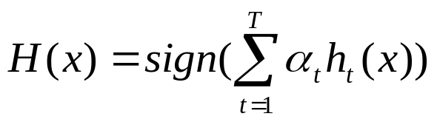
Boosting
Train a set of weak hypotheses: h₁, …., h_{T}.
The combined hypothesis H is a weighted majority vote of the T weak hypotheses.
  Each hypothesis h_{t} has a weight α_{t}.
During the training, focus on the examples that are misclassified.
  ➔ At round t, example x_{i} has the weight D_{t}(i).

Slide 13
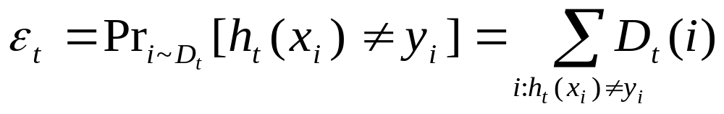
Boosting
Binary classification problem
Training data:
D_{t}(i): the weight of x_{i} at round t. D₁(i)=1/m.
A learner L that finds a weak hypothesis h_{t}: X ➔ Y given the training set and D_{t}
The error of a weak hypothesis h_{t}:

Slide 14
AdaBoost - Introduction
Linear classifier with all its desirable properties
Has good generalization properties
Is a feature selector with a principled strategy (minimisation of upper bound on empirical error)
Close to sequential decision making

Slide 15
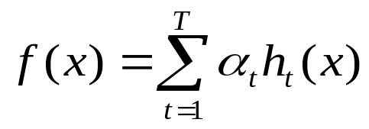
AdaBoost - Definition
Is an algorithm for constructing a “strong” classifier as linear combination
of simple “weak” classifiers h_{t}(x).
h_{t}(x) - “weak” or basis classifier, hypothesis, ”feature”
H(x) = sign(f(x)) – “strong” or final classifier/hypothesis

Slide 16
The AdaBoost Algorithm
Input – a training set: S = {(x₁, y₁); … ;(x_{m,} y_{m})}
  x_{i} ε X, X instance space
  y_{i} ε Y, Y finite label space
    in binary case Y = {-1,+1}
Each round, t=1,…,T, AdaBoost calls a given weak or base learning algorithm – accepts as input a sequence of training examples (S) and a set of weights over the training example (Dt(i) )

Slide 17
The AdaBoost Algorithm
The weak learner computes a weak classifier (ht), : ht : X → R
Once the weak classifier has been received, AdaBoost chooses a parameter (αtεR ) – intuitively measures the importance that it assigns to ht.

Slide 18
The main idea of AdaBoost
to use the weak learner to form a highly accurate prediction rule by calling the weak learner repeatedly on different distributions over the training examples.
initially, all weights are set equally, but each round the weights of incorrectly classified examples are increased so that those observations that the previously classifier poorly predicts receive greater weight on the next iteration.

Slide 19
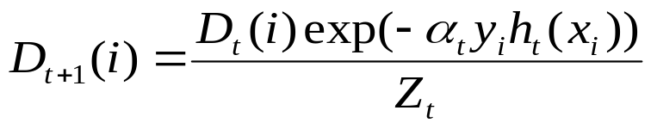
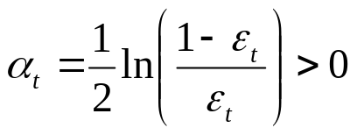
The Algorithm
Given (x₁, y₁),…, (x_{m}, y_{m}) where x_{i}єX, y_{i}є{-1, +1}
Initialise weights D₁(i) = 1/m
Iterate t=1,…,T:
  Train weak learner using distribution Dt
  Get weak classifier: h_{t} : X → R
  Choose α_{t}εR
  Update:
    where Zt is a normalization factor (chosen so that Dt+1 will be a distribution), and α_{t:}
Output – the final classifier

Slide 20


AdaBoost - Analysis
the weights Dt(i) are updated and normalised on each round. The normalisation factor takes the form
and it can be verified that Zt measures exactly the ratio of the new to the old value of the exponential sum
on each round, so that п_{t}Z_{t} is the final value of this sum. We will see below that this product plays a fundamental role in the analysis of AdaBoost.

Slide 21
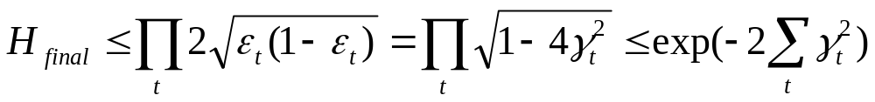
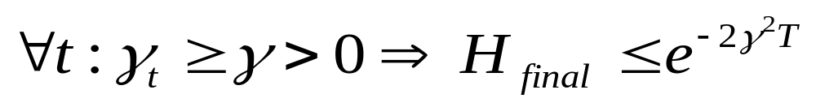
AdaBoost – Training Error
Theorem:
  run Adaboost
  let ε_{t}=1/2-γ_{t}
  then the training error:

Slide 22

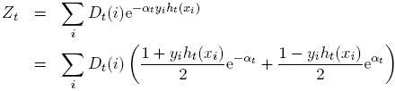
Choosing parameters for Discrete AdaBoost
In Freund and Schapire’s original Discrete AdaBoost the algorithm each round selects the weak classifier, h_{t}, that minimizes the weighted error on the training set
Minimizing Z_{t,} we can rewrite:

Slide 23


Choosing parameters for Discrete AdaBoost
analytically we can choose α_{t} by minimizing the first (ε_{t}=…) expression:
Plugging this into the second equation (Z_{t}), we can obtain:

Slide 24



Discrete AdaBoost - Algorithm
Given (x₁, y₁),…, (x_{m}, y_{m}) where x_{i}єX, y_{i}є{-1, +1}
Initialise weights D₁(i) = 1/m
Iterate t=1,…,T:
  Find where
  Set
  Update:
Output – the final classifier

Slide 25
AdaBoost – Pros and Contras
Pros:
  Very simple to implement
  Fairly good generalization
  The prior error need not be known ahead of time
Contras:
  Suboptimal solution
  Can over fit in presence of noise

Slide 26
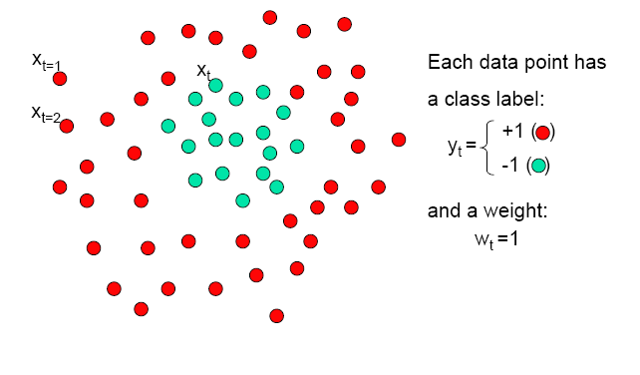
Boosting - Example

Slide 27
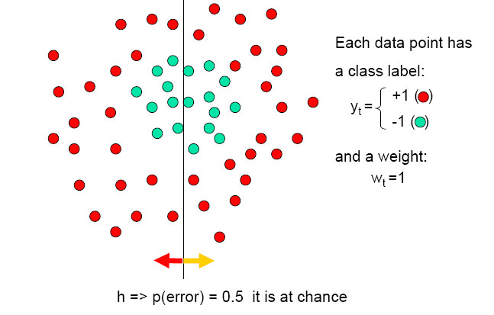
Boosting - Example

Slide 28
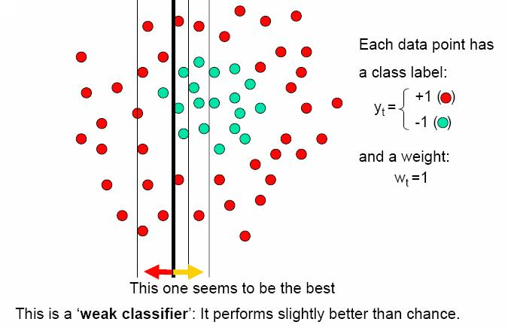
Boosting - Example

Slide 29
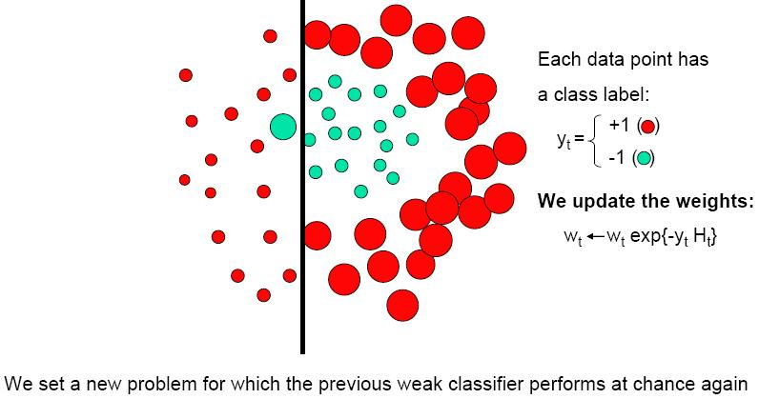
Boosting - Example
Ezt kellene korabban is mutatni …… peldanak

Slide 30
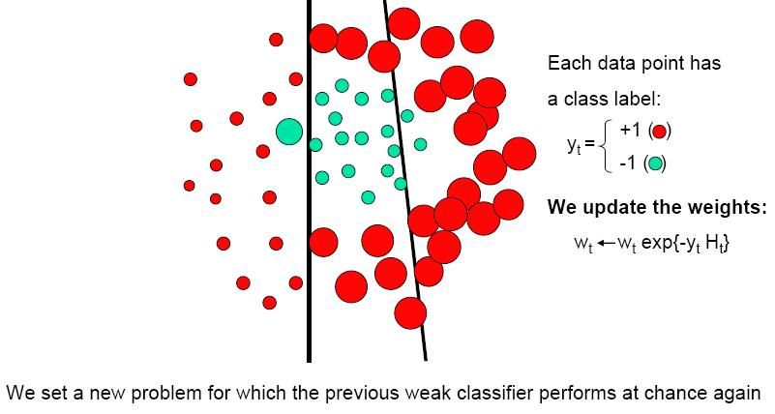
Boosting - Example

Slide 31
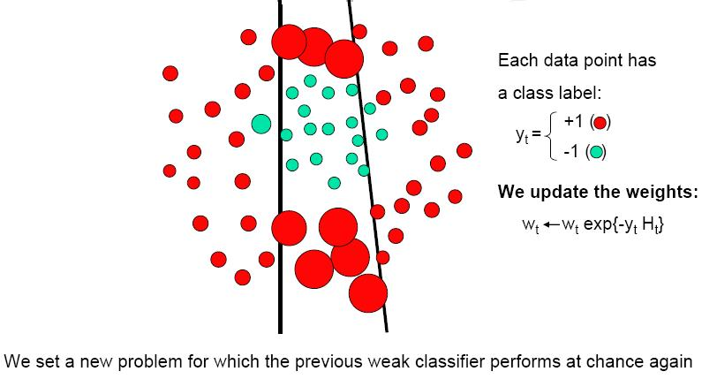
Boosting - Example

Slide 32
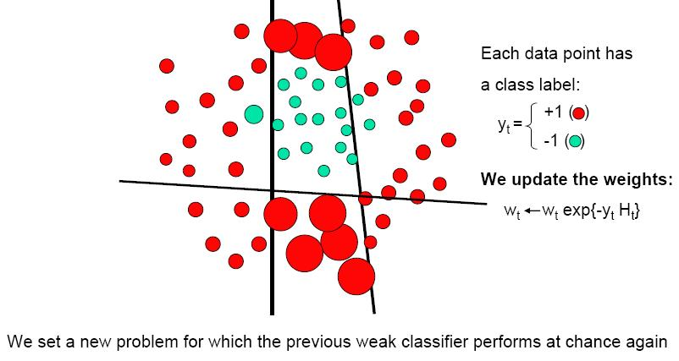
Boosting - Example

Slide 33
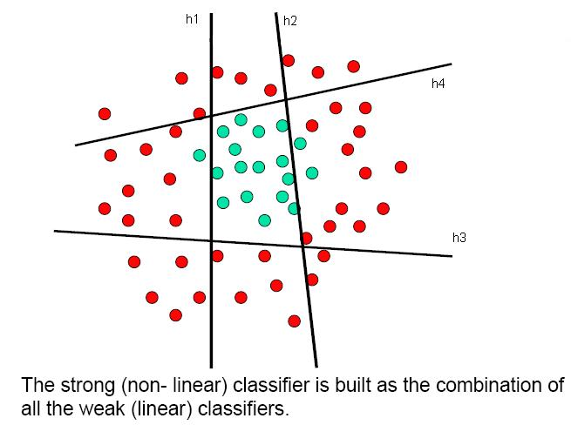
Boosting - Example

Slide 34
Bibliography
Friedman, Hastie & Tibshirani: The Elements of Statistical Learning (Ch. 10), 2001
Y. Freund: Boosting a weak learning algorithm by majority. In Proceedings of the Workshop on Computational Learning Theory, 1990.
Y. Freund and R.E. Schapire: A decision-theoretic generalization of on-line learning and an application to boosting. In Proceedings of the Second European Conference on Computational Learning Theory, 1995.

Slide 35
Bibliography
J. Friedman, T. Hastie, and R. Tibshirani: Additive logistic regression: a statistical view of boosting. Technical Report, Dept. of Statistics, Stanford University, 1998.
Thomas G. Dietterich: An experimental comparison of three methods for constructing ensembles of decision trees: Bagging, boosting, and randomization. Machine Learning, 139–158, 2000.

