Slide 1
Boosting
LING 572
Fei Xia
02/02/06

Slide 2
Outline
Boosting: basic concepts and AdaBoost
Case study:
  POS tagging
  Parsing

Slide 3
Basic concepts and AdaBoost

Slide 4
Overview of boosting
Introduced by Schapire and Freund in 1990s.
“Boosting”: convert a weak learning algorithm into a strong one.
Main idea: Combine many weak classifiers to produce a powerful committee.
Algorithms:
  AdaBoost: adaptive boosting
  Gentle AdaBoost
  BrownBoost
  …

Slide 5
Bagging
ML
Random sample
with replacement
f₁
ML
f₂
f
ML
Random sample
with replacement
f_{T}

Slide 6
Boosting
ML
Training Sample
f₁
ML
Weighted Sample
f₂
f
…
ML
Weighted Sample
f_{T}

Slide 7

Intuition
Train a set of weak hypotheses: h₁, …., h_{T}.
The combined hypothesis H is a weighted majority vote of the T weak hypotheses.
  Each hypothesis h_{t} has a weight α_{t}.
During the training, focus on the examples that are misclassified.
  ➔ At round t, example x_{i} has the weight D_{t}(i).

Slide 8

Basic Setting
Binary classification problem
Training data:
D_{t}(i): the weight of x_{i} at round t. D₁(i)=1/m.
A learner L that finds a weak hypothesis h_{t}: X ➔ Y given the training set and D_{t}
The error of a weak hypothesis h_{t}:

Slide 9
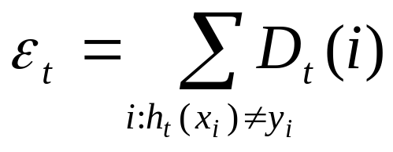
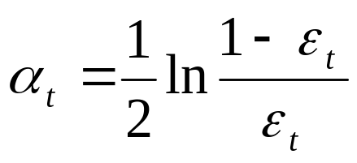
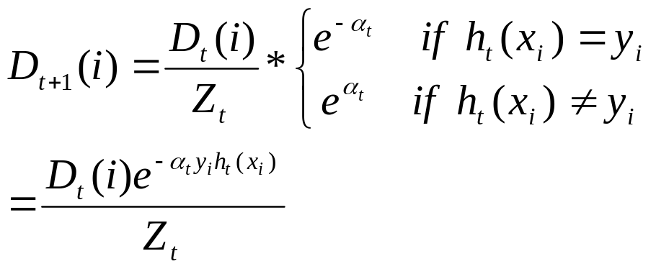
The basic AdaBoost algorithm
For t=1, …, T
Train weak learner using training data and D_{t}
Get ht: X ➔ {-1,1} with error
Choose
Update

Slide 10
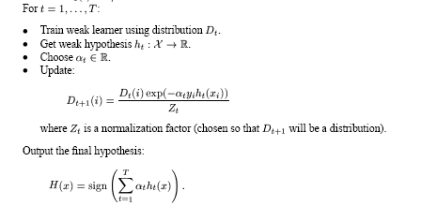
The general AdaBoost algorithm

Slide 11
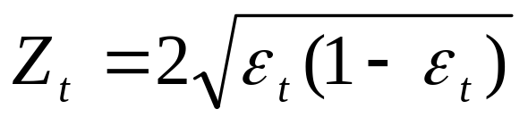
The basic and general algorithms
In the basic algorithm,
➔ Problem #1 of Hw3
The hypothesis weight α_{t} is decided at round t
The weight distribution of training examples is updated at every round t.
Choice of weak learner:
  its error should be less than 0.5:
  Ex: DT (C4.5), decision stump

Slide 12
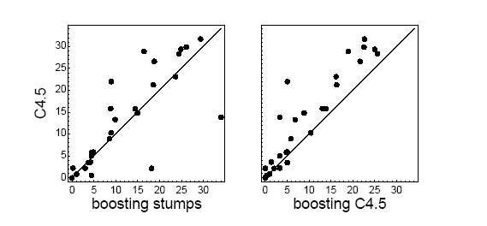
Experiment results
(Freund and Schapire, 1996)
Error rate on a set of 27 benchmark problems

Slide 13
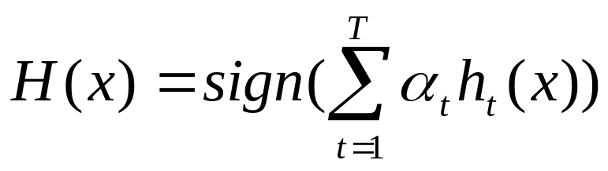
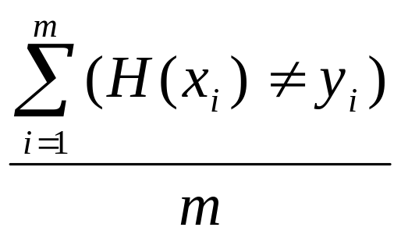
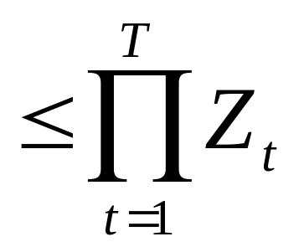
Training error
Final hypothesis:
Training error is defined to be
#4 in Hw3: prove that training error

Slide 14
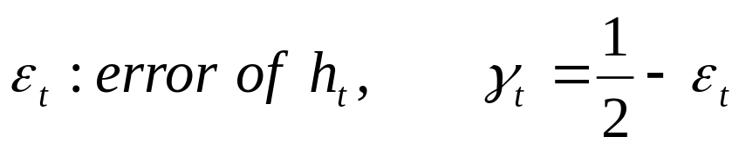
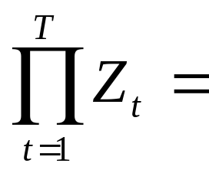

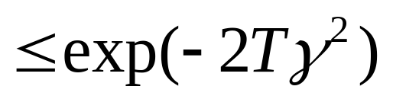
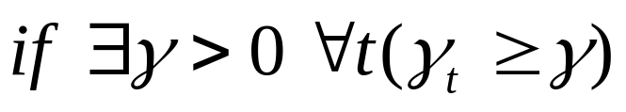
Training error for basic algorithm
Let
Training error
➔ Training error drops exponentially fast.

Slide 15

Generalization error
(expected test error)
Generalization error, with high probability, is at most
T: the number of rounds of boosting
m: the size of the sample
d: VC-dimension of the base classifier space

Slide 16
Issues
Given h_{t}, how to choose α_{t}?
How to select h_{t}?
How to deal with multi-class problems?

Slide 17
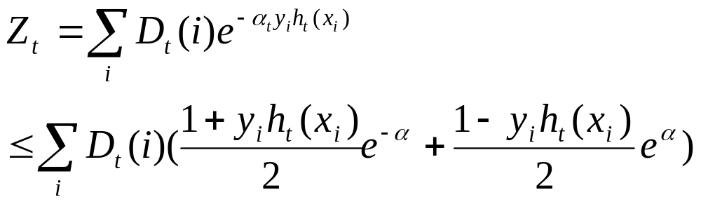
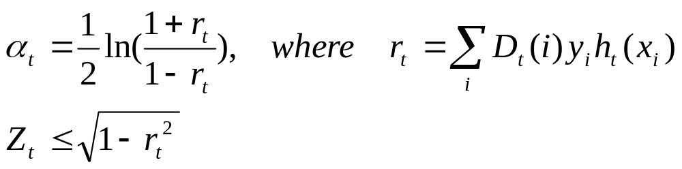
How to choose α_{t} for h_{t} with range [-1,1]?
Training error
Choose α_{t} that minimize Z_{t}.
➔
(Problems #2 and #3 of Hw3)

Slide 18
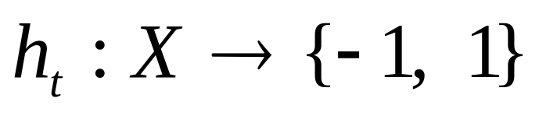
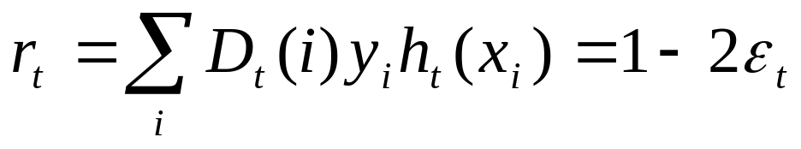
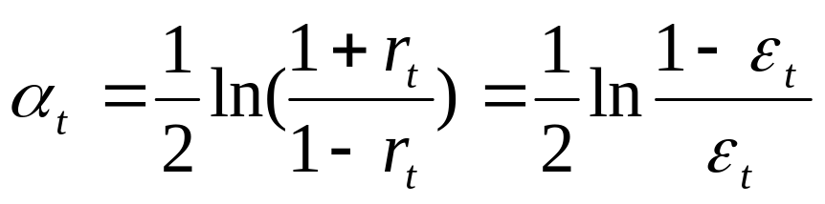
How to choose α_{t} when h_{t} has range {-1,1}?

Slide 19
Selecting weak hypotheses
Training error
Choose h_{t} that minimize Z_{t}.
See “case study” for details.

Slide 20
Multiclass classification
AdaBoost.M1:
AdaBoost.M2:
AdaBoost.MH:
AdaBoost.MR

Slide 21
Strengths of AdaBoost
It has no parameters to tune (except for the number of rounds)
It is fast, simple and easy to program (??)
It comes with a set of theoretical guarantee (e.g., training error, test error)
Instead of trying to design a learning algorithm that is accurate over the entire space, we can focus on finding base learning algorithms that only need to be better than random.
It can identify outliners: i.e. examples that are either mislabeled or that are inherently ambiguous and hard to categorize.

Slide 22
Weakness of AdaBoost
The actual performance of boosting depends on the data and the base learner.
Boosting seems to be especially susceptible to noise.
When the number of outliners is very large, the emphasis placed on the hard examples can hurt the performance.
➔ “Gentle AdaBoost”, “BrownBoost”

Slide 23
Relation to other topics
Game theory
Linear programming
Bregman distances
Support-vector machines
Brownian motion
Logistic regression
Maximum-entropy methods such as iterative scaling.

Slide 24
Bagging vs. Boosting
(Freund and Schapire 1996)
Bagging always uses resampling rather than reweighting.
Bagging does not modify the distribution over examples or mislabels, but instead always uses the uniform distribution
In forming the final hypothesis, bagging gives equal weight to each of the weak hypotheses

Slide 25
Case study

Slide 26
Overview
(Abney, Schapire and Singer, 1999)
Boosting applied to Tagging and PP attachment
Issues:
  How to learn weak hypotheses?
  How to deal with multi-class problems?
  Local decision vs. globally best sequence

Slide 27
Weak hypotheses
In this paper, a weak hypothesis h simply tests a predicate Φ:
  h(x) = p₁ if Φ(x) is true, h(x)=p₀ o.w.
  ➔ h(x)=p_{Φ(x)}
Examples:
  POS tagging: Φ is “PreviousWord=the”
  PP attachment: Φ is “V=accused, N1=president, P=of”
Choosing a list of hypotheses ➔ choosing a list of features.

Slide 28
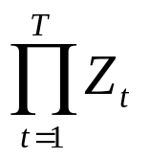
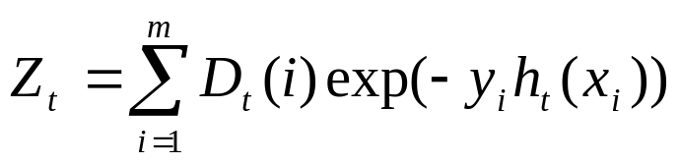
Finding weak hypotheses
The training error of the combined hypothesis is at most
where
➔ choose h_{t} that minimizes Z_{t}.
h_{t} corresponds to a (Φ_{t}, p₀, p₁) tuple.

Slide 29
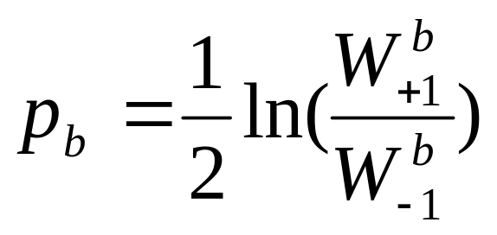
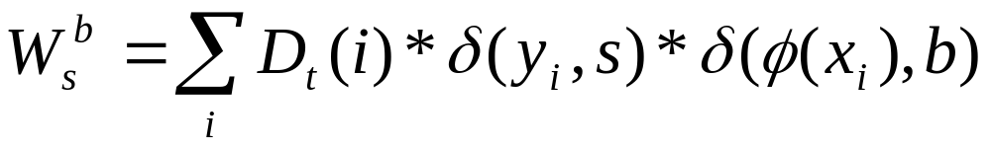
Schapire and Singer (1998) show that given a predicate Φ, Z_{t} is minimized when
where

Slide 30
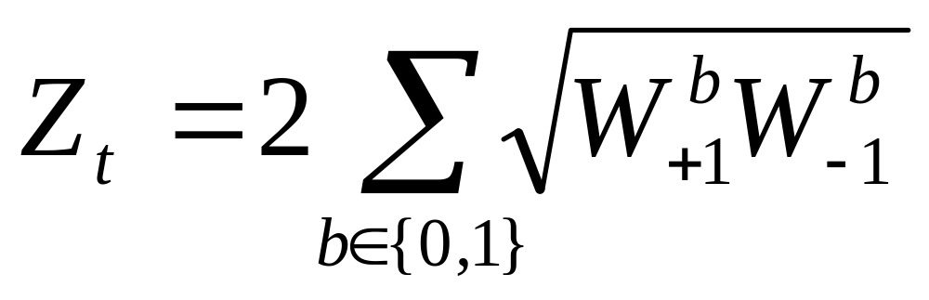
Finding weak hypotheses (cont)
For each Φ, calculate Z_{t}
Choose the one with min Z_{t}.

Slide 31
Multiclass problems
There are k possible classes.
Approaches:
  AdaBoost.MH
  AdaBoost.MI

Slide 32
AdaBoost.MH
Training time:
  Train one classifier: f(x’), where x=(x,c)
  Replace (x,y) with k derived examples
    ((x,1), 0)
    …
    ((x, y), 1)
    …
    ((x, k), 0)
Decoding time: given a new example x
  Run the classifier f(x, c) on k derived examples:
  (x, 1), (x, 2), …, (x, k)
  Choose the class c with the highest confidence score f(x, c).

Slide 33
AdaBoost.MI
Training time:
  Train k independent classifiers: f₁(x), f₂(x), …, f_{k}(x)
  When training the classifier f_{c} for class c, replace (x,y) with
    (x, 1) if y = c
    (x, 0) if y != c
Decoding time: given a new example x
  Run each of the k classifiers on x
  Choose the class with the highest confidence score f_{c}(x).

Slide 34
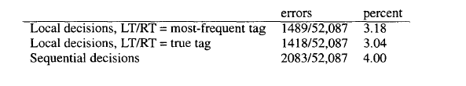
Sequential model
Sequential model: a Viterbi-style optimization to choose a globally best sequence of labels.

Slide 35
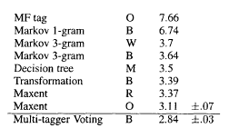
Previous results

Slide 36

Boosting results

Slide 37
Summary
Boosting combines many weak classifiers to produce a powerful committee.
It comes with a set of theoretical guarantee (e.g., training error, test error)
It performs well on many tasks.
It is related to many topics (TBL, MaxEnt, linear programming, etc)

Slide 38
Additional slides

Slide 39
Sources of Bias and Variance
Bias arises when the classifier cannot represent the true function – that is, the classifier underfits the data
Variance arises when the classifier overfits the data
There is often a tradeoff between bias and variance

Slide 40
Effect of Bagging
If the bootstrap replicate approximation were correct, then bagging would reduce variance without changing bias.
In practice, bagging can reduce both bias and variance
  For high-bias classifiers, it can reduce bias
  For high-variance classifiers, it can reduce variance

Slide 41
Effect of Boosting
In the early iterations, boosting is primary a bias-reducing method
In later iterations, it appears to be primarily a variance-reducing method

