Slide 1
Boosting
---one of combining models
Xin Li
Machine Learning Course

Slide 2
Outline
Introduction and background of Boosting and Adaboost
Adaboost Algorithm introduction
Adaboost Algorithm example
Experiment results

Slide 3
Boosting
Definition of Boosting[1]:
Boosting refers to a general method of producing a very accurate prediction rule by combining rough and moderately inaccurate rules-of-thumb.
Intuition:
1) No learner is always the best;
2) Construct a set of base-learners which when combined achieves higher accuracy

Slide 4
Boosting(cont’d)
3) Different learners may:
--- Be trained by different algorithms
--- Use different modalities(features)
--- Focus on different subproblems
--- ……
4) A week learner is “rough and moderately inaccurate” predictor but one that can predict better than chance.

Slide 5
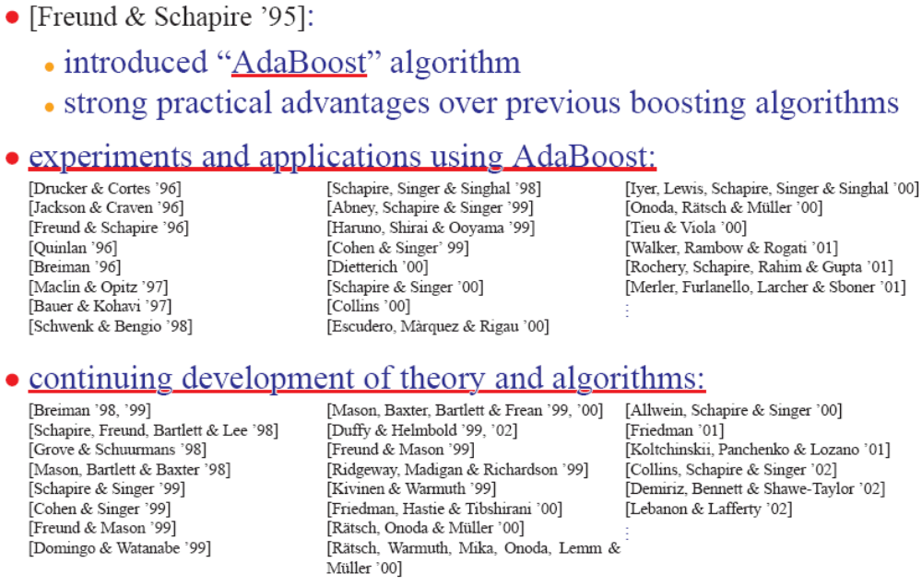
background of Adaboost[2]

Slide 6
Outline
Introduction and background of Boosting and Adaboost
Adaboost Algorithm introduction
Adaboost Algorithm example
Experiment results

Slide 7
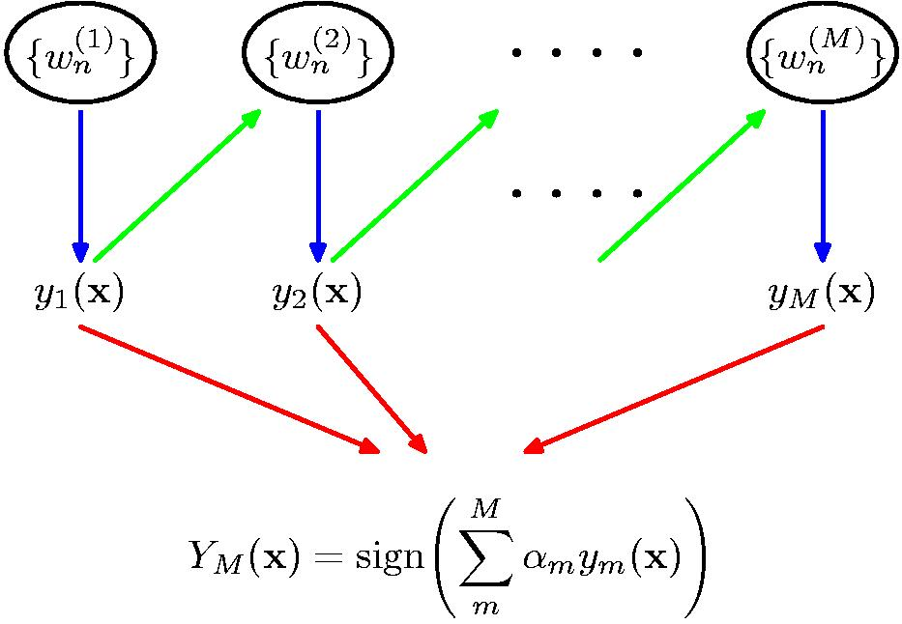
Schematic illustration of the boosting Classifier

Slide 8

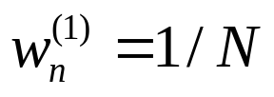



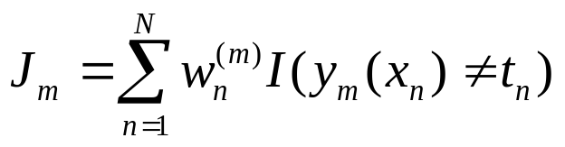
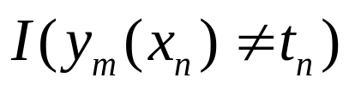
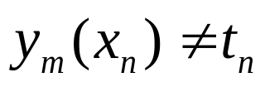
Adaboost
1. Initialize the data weighting coefficients by setting for
2. For :
(a) Fit a classifier to the training data by minimizing the weighted error function
Where is the indicator function and equals 1 when and 0 otherwise.

Slide 9
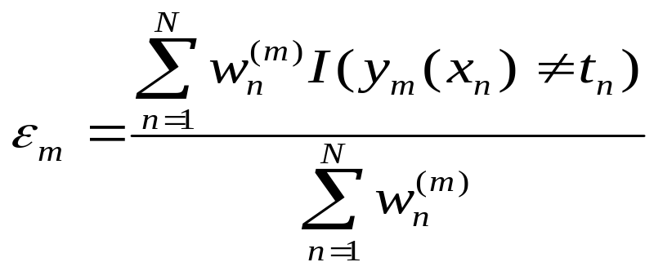
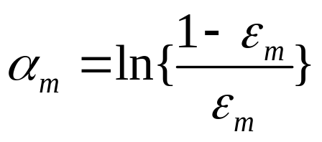
Adaboost(cont’d)
(b) Evaluate the quantities
and then use these to evaluate

Slide 10
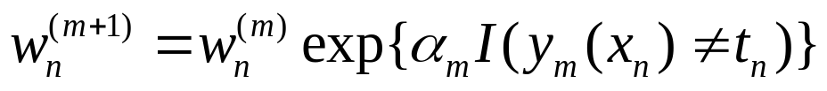
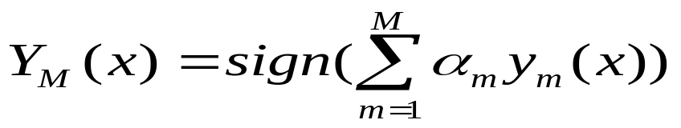
Adaboost(cont’d)
(c) Update the data weighting coefficients
3. Make predictions using the final model, which is given by

Slide 11
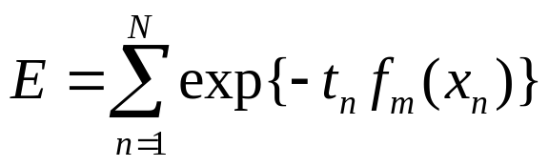
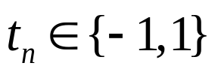
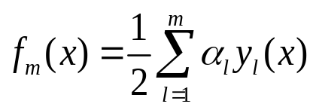

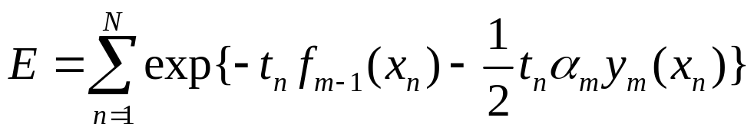
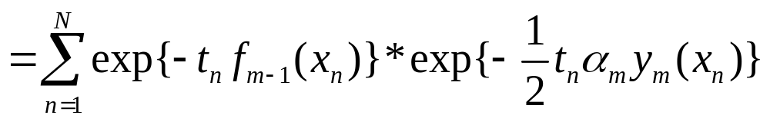
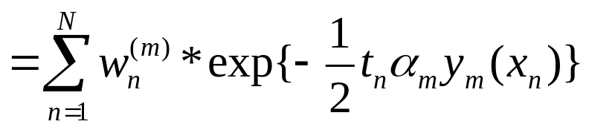
Prove Adaboost
Consider the exponential error function defined by
      ------training set target values
      ------classifier defined in terms of a linear
      combination of base classifiers

Slide 12


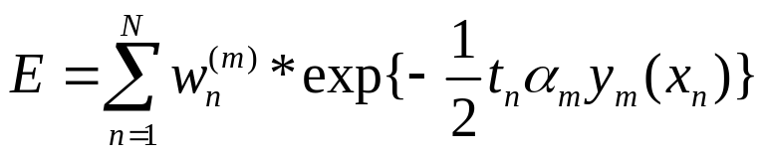
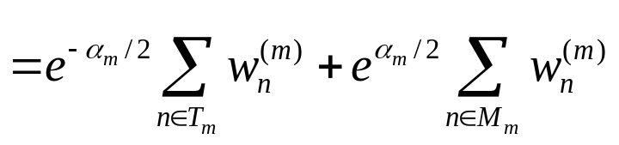
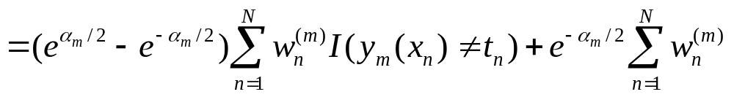
Prove Adaboost(cont’d)
denote the set of data points that are correctly classified by
denote misclassified points by

Slide 13
Outline
Introduction and background of Boosting and Adaboost
Adaboost Algorithm introduction
Adaboost Algorithm example
Experiment results

Slide 14
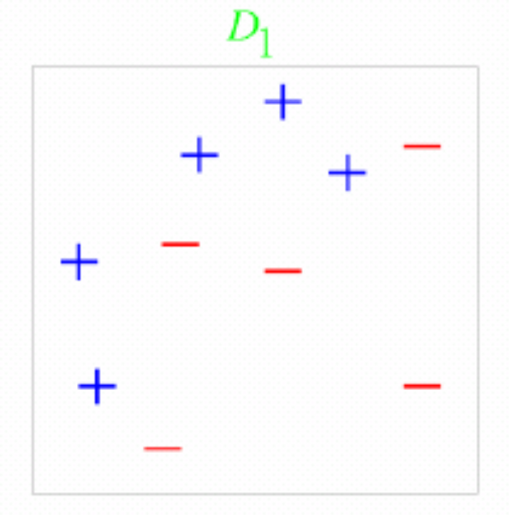
A toy example[2]
Training set: 10 points (represented by plus or minus)
Original Status: Equal Weights for all training samples

Slide 15
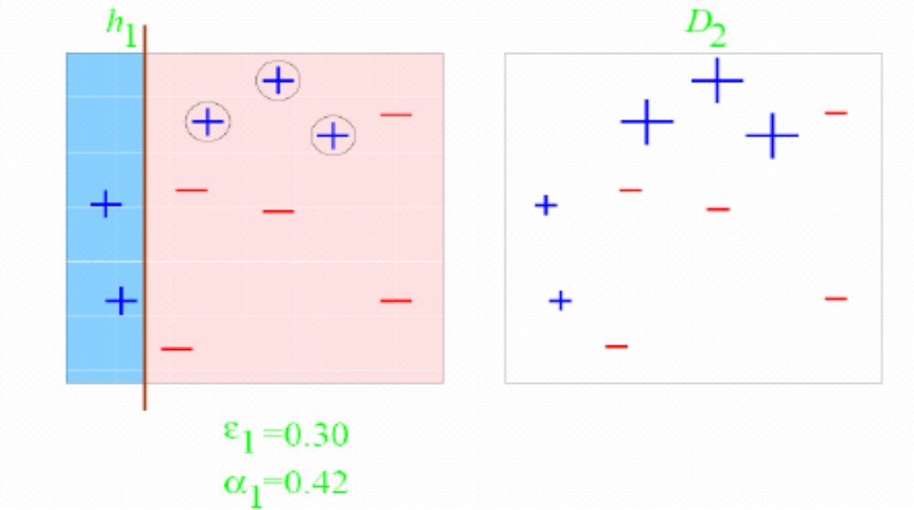
A toy example(cont’d)
Round 1: Three “plus” points are not correctly classified;
They are given higher weights.

Slide 16
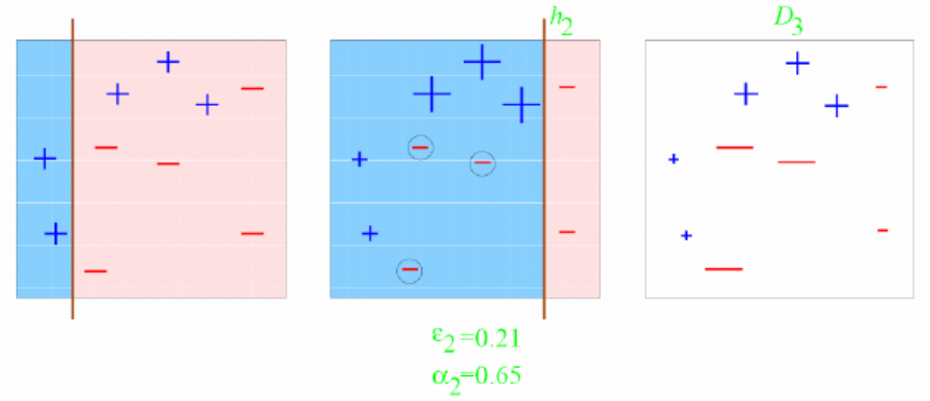
A toy example(cont’d)
Round 2: Three “minuse” points are not correctly classified;
They are given higher weights.

Slide 17
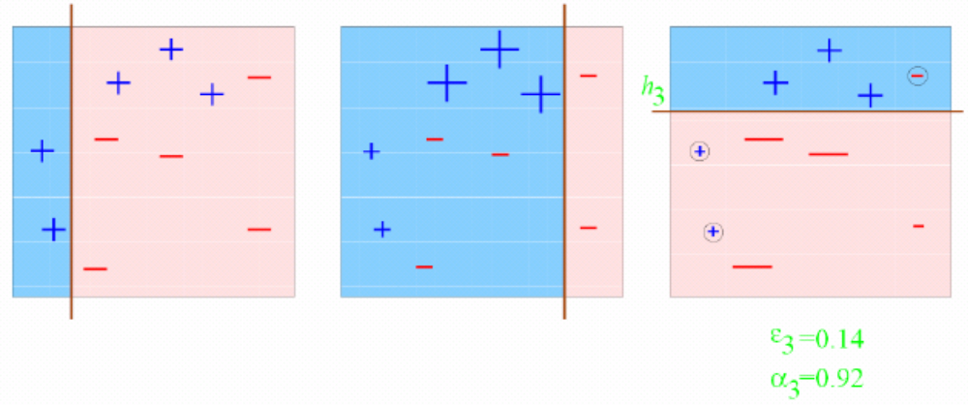
A toy example(cont’d)
Round 3: One “minuse” and two “plus” points are not correctly classified;
They are given higher weights.

Slide 18
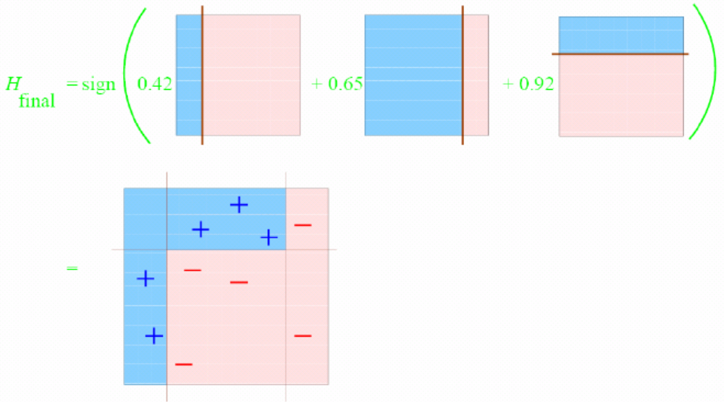
A toy example(cont’d)
Final Classifier: integrate the three “weak” classifiers and obtain a final strong classifier.

Slide 19
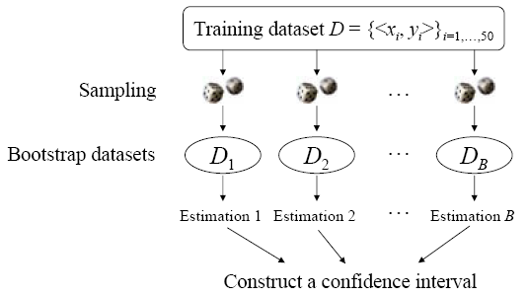
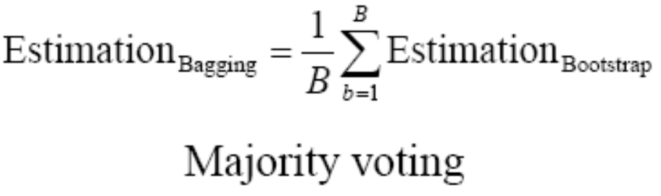
Revisit Bagging

Slide 20
Bagging vs Boosting
Bagging: the construction of complementary base-learners is left to chance and to the unstability of the learning methods.
Boosting: actively seek to generate complementary base-learner--- training the next base-learner based on the mistakes of the previous learners.

Slide 21
Outline
Introduction and background of Boosting and Adaboost
Adaboost Algorithm introduction
Adaboost Algorithm example
Experiment results(Good Parts Selection)

Slide 22
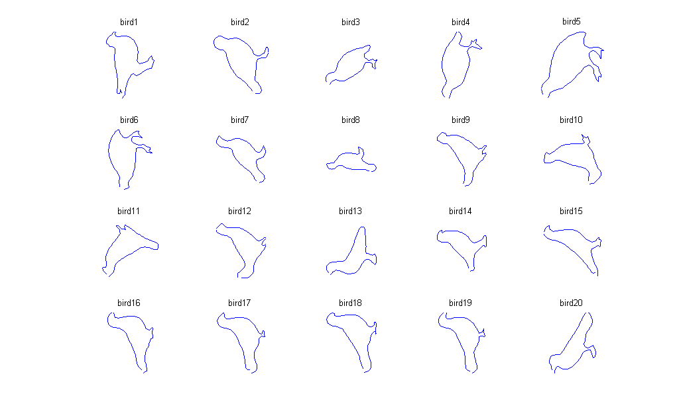
Browse all birds

Slide 23
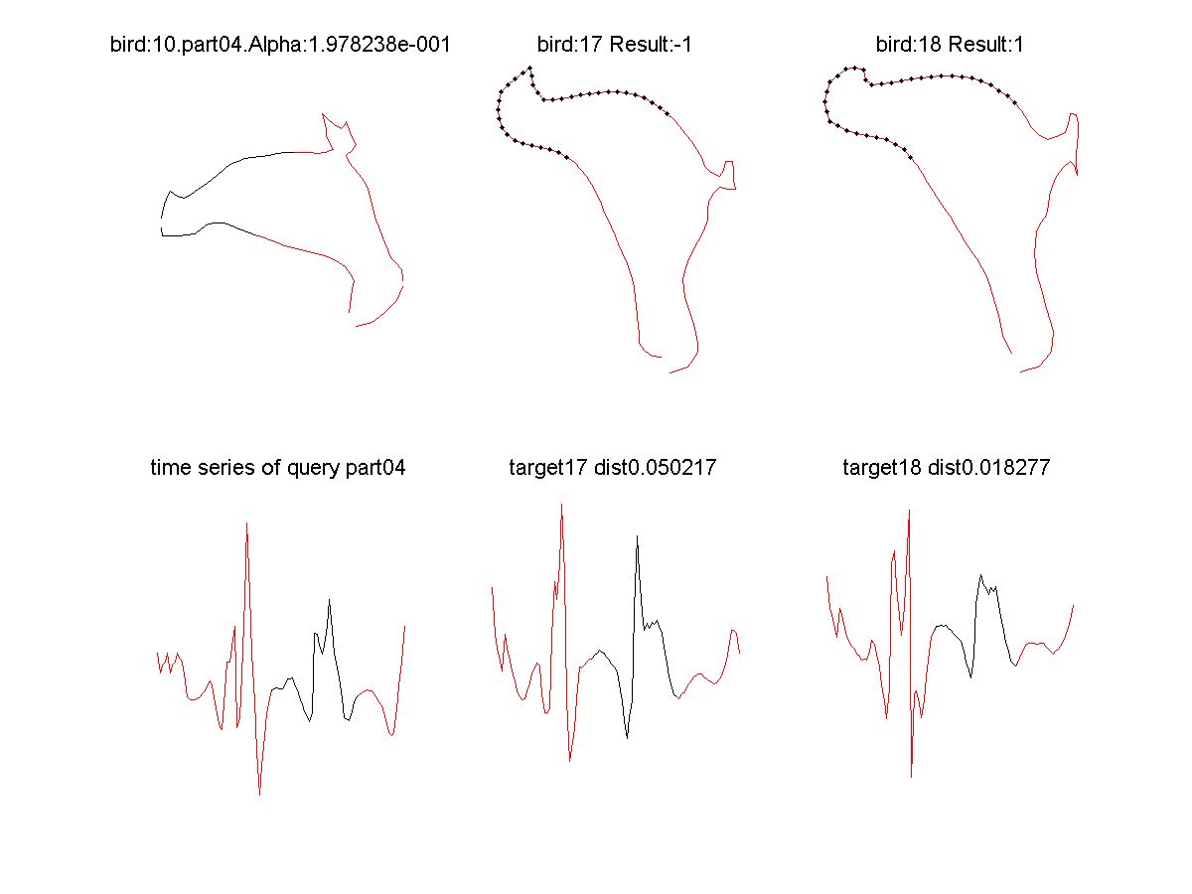
Curvature Descriptor

Slide 24
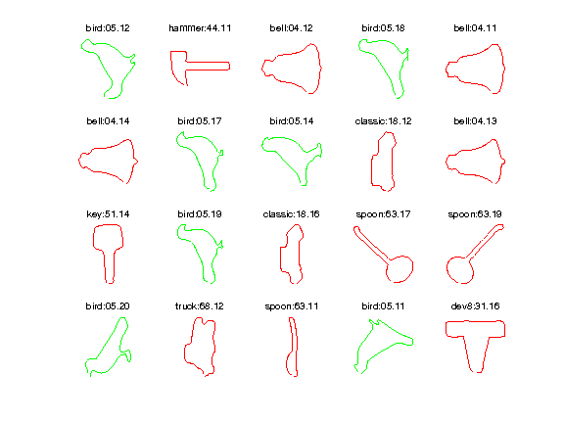
Adaboost with CPM

Slide 25
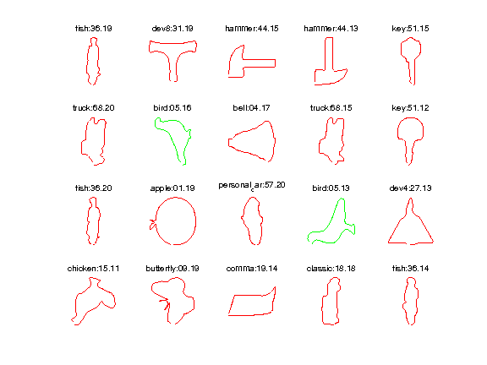
Adaboost with CPM(con’d)

Slide 26
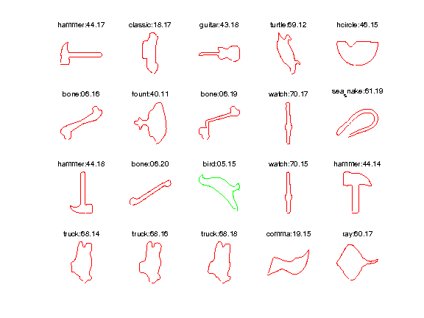
Adaboost with CPM(con’d)

Slide 27
Adaboost without CPM(con’d)
The Alpha Values
Other Statistical Data: zero rate: 0.6167;
covariance: 0.9488; median: 1.6468
2.521895 | 0 | 2.510827 | 0.714297 | 0 | 0
1.646754 | 0 | 0 | 0 | 0 | 0
2.134926 | 0 | 2.167948 | 0 | 2.526712 | 0
0.279277 | 0 | 0 | 0 | 0.0635 | 2.322823
0 | 0 | 2.516785 | 0 | 0 | 0
0 | 0.04174 | 0 | 0.207436 | 0 | 0
0 | 0 | 1.30396 | 0 | 0 | 0.951666
0 | 2.513161 | 2.530245 | 0 | 0 | 0
0 | 0 | 0 | 0.041627 | 2.522551 | 0
0.72565 | 0 | 2.506505 | 1.303823 | 0 | 1.611553

Slide 28
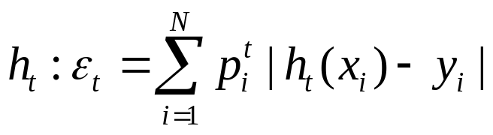
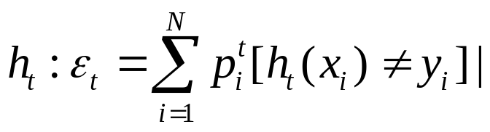
Parameter Discussion
For error bound, this depends on the specific method to calculate the error:
1) two class separation[3]:
2) one vs several classes[3]:

Slide 29
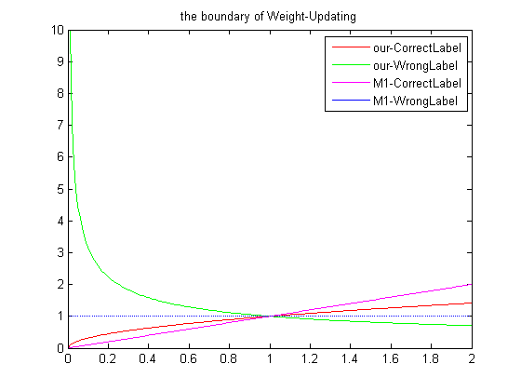
The error bound figure

Slide 30
Thanks a lot!
Enjoy Machine Learning!

Slide 31
Reference
[1] Yoav Freund, Robert Schapire, a short Introduction to Boosting
[2] Robert Schapire, the boosting approach to machine learning; Princeton University
[3] Yoav Freund, Robert Schapire, A decision-theoretic generalization of on-line learning and application to boosting
[4] Pengyu Hong, Statistical Machine Learning lecture notes.

