Slide 1
Generate/Tweak Trading Strategy
Train Optimal Scheduler
Run Scheduler with Trading Strategy
Bad Trading Strategy

Slide 2
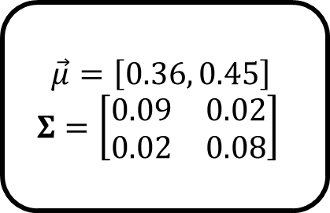
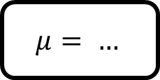
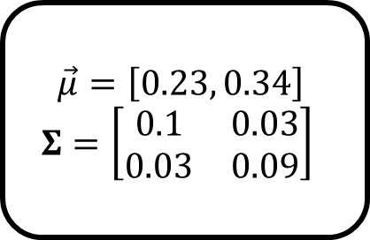

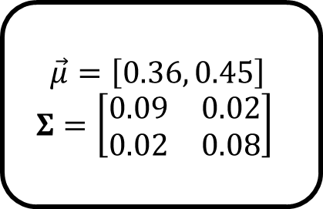
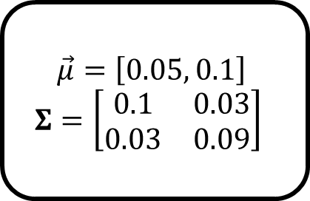
$$μ= …$$
$$\vec{μ}=\left[0.36, 0.45\right]$$
$$Σ=\left[\begin{matrix}0.09 & 0.02 \\ 0.02 & 0.08\end{matrix}\right]$$
$$\vec{μ}=\left[0.36, 0.45\right]$$
$$Σ=\left[\begin{matrix}0.09 & 0.02 \\ 0.02 & 0.08\end{matrix}\right]$$
+
$$\vec{μ}=\left[0.23, 0.34\right]$$
$$Σ=\left[\begin{matrix}0.1 & 0.03 \\ 0.03 & 0.09\end{matrix}\right]$$
-
$$\vec{μ}=\left[0.05, 0.1\right]$$
$$Σ=\left[\begin{matrix}0.1 & 0.03 \\ 0.03 & 0.09\end{matrix}\right]$$
$$μ= …$$

