Slide 1
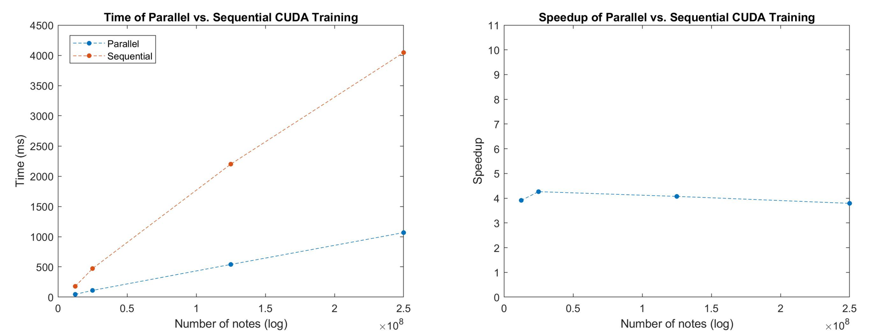

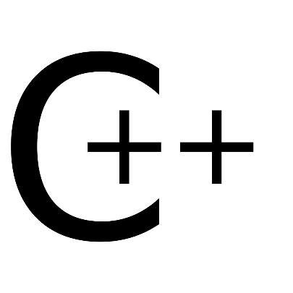

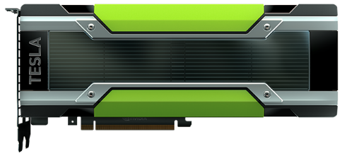
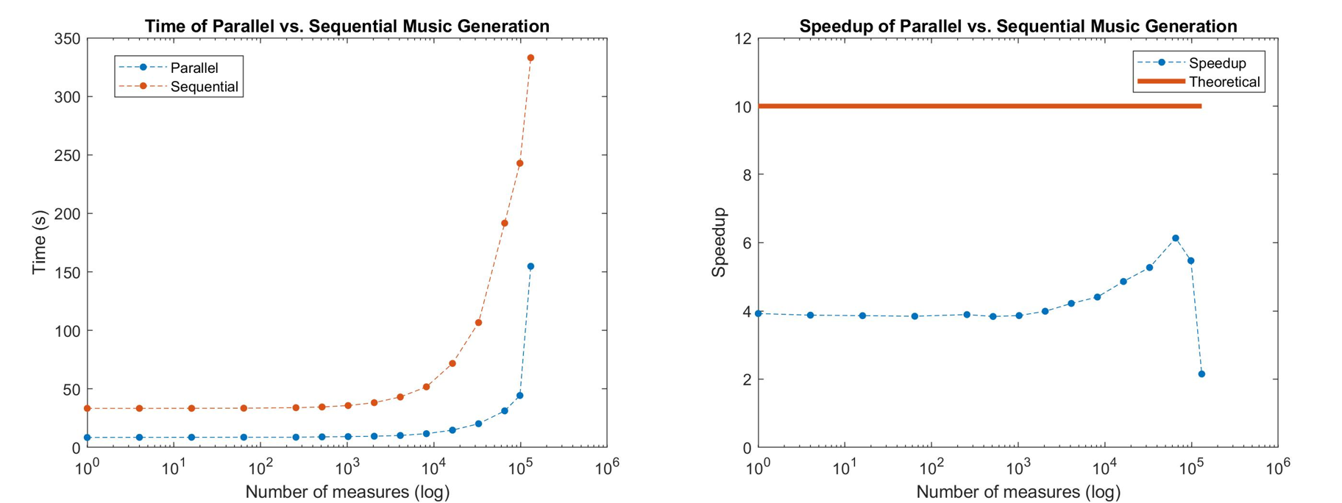




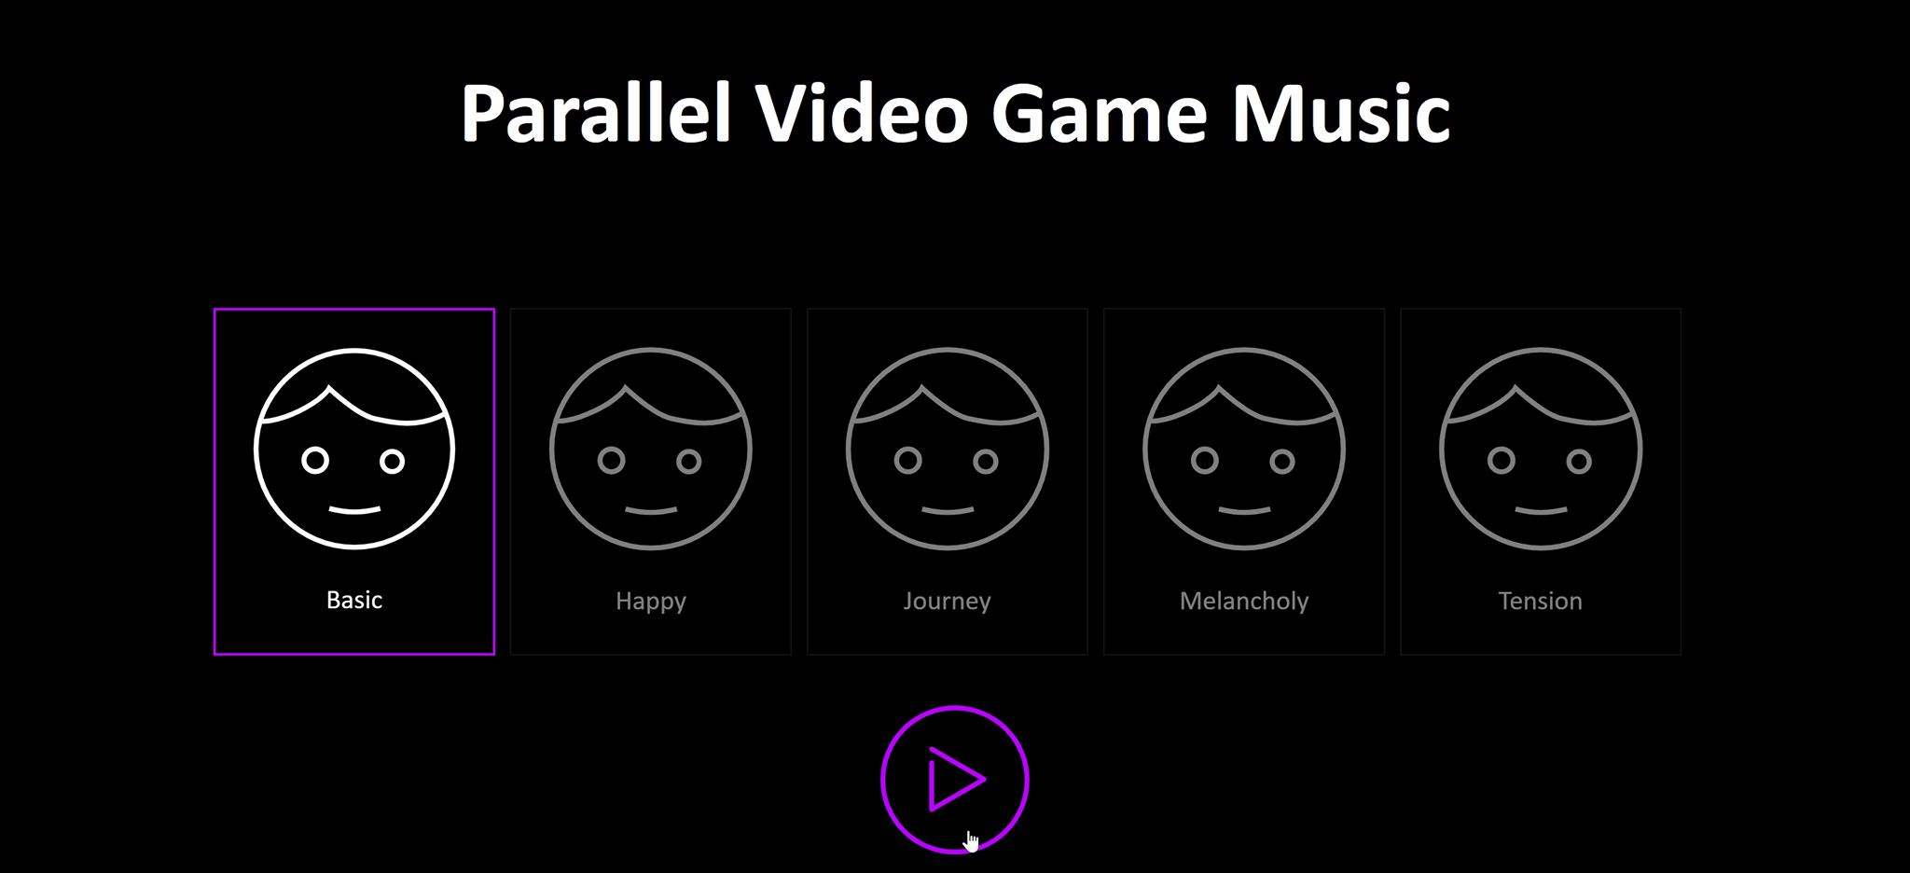

Video Game Music Generation with CUDA-trained Markov Chains and Multithreading Optimizations
Annie Xu (jingjinx@andrew.cmu.edu) Michael You (myou@andrew.cmu.edu)
15-418 Final Project
Abstract
Process
Optimizations and Results
Challenges Faced
Most video games use static soundtracks, which although can be impressive in their own right, can quickly become repetitive to the gamer. In this project, we build a complete system that can process, learn, and generate new video game music. Our system takes in MIDI files, which are processed and trained as a Markov Chain. We then use our Markov Chain to generate a multi-voice music excerpt. We optimize our algorithms by using CUDA techniques in our training algorithm, and multi-threading in the music generation. Speedup analysis shows that our system performs significantly better than sequential algorithms. In fact, because our system is fast, we explore the possibility of integrating our music generation method into video games, so that games can have real-time generated music for a more interactive and unique gaming experience.
MIDI files are hard to parse and missing important information – key signature, rhythm, etc.
Required pre-processing and re-formatting of input MIDI files into a text file
Pre-processing and server algorithms use different languages and parallelism techniques
Balance of size in Markov Model - larger matrices mean more detailed probabilities and likely better sounding music, but take up a lot of storage
Client-Server communication of generation settings and live music generation results
Multithreading vs. GPUs balance in Markov training (much more material to parallelize) and generation (fewer parts and heavier computation)
Gave user the ability to customize the music they wanted to generate, including live-mixing
Preprocessing
Convert MIDI to text
Transpose to C Major
Specific encoding
music21
Markov Model Training
Counts note transitions
Parallelized over multiple GPUs and threads
Split between matrix type (major/minor, soprano/ bass/chord) on GPUs
Split notes into sections for many threads to read
Isolated parallel section of algorithm to produce speedup data counting transitions
Speedup stays steady at around 4 over all data sets
Linear runtime increase in parallel algorithm suggests full thread usage
CPU-GPU transfer times dominate performance in most data set sizes
Optimizations for asynchronous memory copy operations, multiple GPU usage, contiguous row split
Background
Conclusion
Music can be treated as a set of rules - ideal for an algorithmic implementation
Video game music is characterized by the overlapping of multiple melodic lines and a repetitive and structured format
Old 8-bit music constrained composers
Newer video game music is often symphonic
Many melodic lines offer ample avenues for parallelization - parallel synthesis of different parts
Rigid structure makes music easier to predict and generate with a Markov Model
Created a real-time video game music generator!
With parallelism, we see speedup in both model training and music generation
Depending on the structure of the issue, multiple forms of parallelism (GPUs vs. multithreading) are better for different problems
Even with communication costs, especially between voices, parallelism is still able to achieve both speedup and maintain musicality
Music Generation
Creates music based on client request and global settings
Uses trained Markov Chain to make musical choices
Multithreading to generate many voices at once
Synchronization of voices via the conductor
websockets
multi-
processing
Future Work
1st – Order Matrix
Note | A | D | G
A | 0.1 | 0.6 | 0.3
D | 0.25 | 0.05 | 0.7
G | 0.7 | 0.3 | 0
2nd – Order Matrix
Note | A | C | G
AA | 0.18 | 0.6 | 0.22
AD | 0.5 | 0.5 | 0
AG | 0.15 | 0.75 | 0.1
DD | 0 | 0 | 1
DA | 0.25 | 0 | 0.75
DG | 0.9 | 0.1 | 0
GG | 0.4 | 0.4 | 0.2
GA | 0.5 | 0.25 | 0.25
GD | 1 | 0 | 0
$\left[\begin{matrix}0.5 & ⋯ & 0.4 \\ ⋮ & ⋱ & 0.5 \\ 0.1 & ⋯ & 0.1\end{matrix} \right]$
Speedup increases with problem size up to a point, then drastically drops
Shape of speedup graph indicates balance between output communication and computation
Matrix loading dominates runtime for low number of measures
Optimizations for CUDA, multi-threading, and multi-processing, as well as matrix loading
Explore feasibility of using parallel computation for video game music in industry
Generating video game music in real time along with gameplay
Further and more complicated setting manipulation on the client side
Expansion into other genres/types of music
Execution Breakdown
Acknowledgments
Matrices built from training data which fit a similar genre
During generation, probabilities from transition matrix are used to generate next note based on current notes
Generated music uses structure and patterns from training music
Training requires looking at millions of notes and updating a very large matrix
Generation has ~10 music lines generated at once, where each line requires complex computation and synchronization
Client
Requests music
Plays notes from server
 | Parallel Pinned | Parallel Unpinned | Sequential
Allocating Host Memory | 10.31047 | 1.398417 | 0.000051
Allocating Device Memory | 9.545223 | 3.524767 | 0
Parsing File and Counting | 3.361578 | 3.370691 | 8.501543
Copying to Host | 0.013167 | 7.993404 | 0
Free Memory | 4.644862 | 0.049685 | 0.045188
Total | 27.8753 | 16.336964 | 8.546782
Professor Mowry and Professor Railing
15-418 TA Staff
Carnegie Mellon University
References
“Algorithmic Composer.” OpenMusic Markov Chains and Omlea, 23 Apr. 2010, www.algorithmiccomposer.com/2010/04/openmusic-markov-chains-and-omlea.html.
Elowsson, A. and Friberg, A. “Algorithmic Composition of Popular Music,” in Proceedings of the 12th International Conference on Music Perception and Cognition and the 8th Triennial Conference of the European Society for the Cognitive Sciences of Music, July 2012, pp 276-285
Dannenberg, R. (2018). Music Generation and Algorithmic Composition [Powerpoint slides]. Retrieved from http://www.cs.cmu.edu/~./music/cmsip/slides/05-algo-comp.pdf
Collins, Karen. “In the Loop: Creativity and Constraint in 8-Bit Video Game Audio.” Twentieth-Century Music, vol. 4, no. 2, 2007, pp. 209–227., doi:10.1017/S1478572208000510.
Whalen, Zach. "Case Study: Film Music vs. Video game Music: The case of Silent Hill.“ 2007.
Seabrook, Andrea (Host). 13 April, 2008. The Evolution of Video Game Music [All Things Considered]. https://www.npr.org/templates/story/story.php?storyId=89565567

