Slide 1
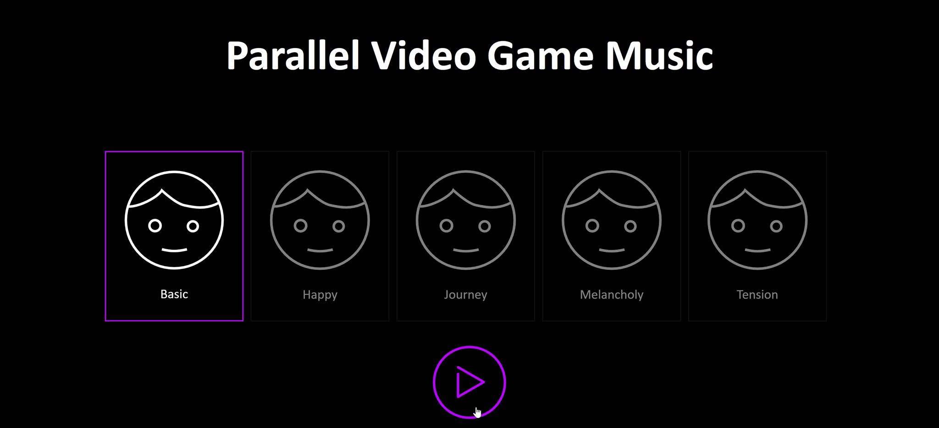
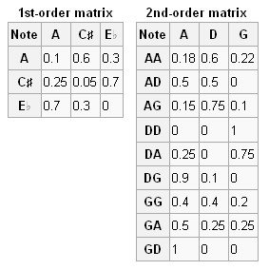
Live Generation of Video Game Music with CUDA
Annie Xu (jingjinx@andrew.cmu.edu) Michael You (myou@andrew.cmu.edu)
15-418 Final Project
Abstract
Process
Results and Optimizations
Challenges Faced
Preprocessing
Convert MIDI to text
Transpose to C Major
Specific encoding
MIDI files are hard to parse and missing important information – key signature, rhythm, etc.
Required pre-processing and re-formatting of input MIDI files into a usable text file
Pre-processing and server algorithms required use of multiple programming languages and techniques
Balance of size in probability matrices - Larger matrices mean more detailed probabilities, better sounding music, but take up a lot of storage
Required user global settings for music generation
Client-Server communication of music and balance of settings – which are necessary for generation and which can be handled by client
Multithreading vs. GPUs balance in Markov training (much more material to parallelize) and generation (fewer parts and heavier computation)
Markov Model Training
Counts note transitions
Parallelized over multiple GPUs, threads
Split between matrix type (major/minor, soprano/bass/chord) on GPUs and file section on threads
Background
Conclusion
Music is rules by many rigid guidelines – leading to straightforward algorithmic implementation
Parallel algorithmic composers need a component to parallelize on
Video game music - characterized by the overlapping of multiple melodic lines and a repetitive and structured format
Many melodic lines offer ample avenues for parallelization - parallel synthesis of different parts
Rigid structure makes such music easier to predict and generate with a Markov Model
Real-time video game music generator!
With parallelism, we see speedup in both model training and music generation
Depending on the structure of the issue, multiple forms of parallelism (GPUs vs. multithreading) are better for different problems
Even with communication costs, especially between voices, parallelism is still able to achieve both speedup and musicality
Future Applications:
Explore feasibility of using parallel computation for video game music in industry
Generating video game music in real time along with gameplay
Further and more complicated setting manipulation on the client side
Expansion into other genres/types of music
Music Generation
Creates music based on client request and global settings
Multithreading to generate many voices at once
Synchronization between voices
Matrices built from training data which fits a specified genre/format
Normalized probabilities based on the number of transitions of a certain form
During generation, probabilities used to generate next note based on the notes appearing around it
Resulting melodies likely follow similar structure and sounds as training music
Conductor keeps melodies from veering too far into randomness
Client
Requests music
Plays notes from server
References
“Algorithmic Composer.” OpenMusic Markov Chains and Omlea, 23 Apr. 2010, www.algorithmiccomposer.com/2010/04/openmusic-markov-chains-and-omlea.html.
Elowsson, A. and Friberg, A. “Algorithmic Composition of Popular Music,” in Proceedings of the 12th International Conference on Music Perception and Cognition and the 8th Triennial Conference of the European Society for the Cognitive Sciences of Music, July 2012, pp 276-285
Dannenberg, R. (2018). Music Generation and Algorithmic Composition [Powerpoint slides]. Retrieved from http://www.cs.cmu.edu/~./music/cmsip/slides/05-algo-comp.pdf

