Slide 1
Chapter-4 Knowledge-based Agent in Artificial intelligence
Outline:
What are Agents?
What is knowledge?
What is knowledge base agents?
Operations of knowledge base agents
Architecture of knowledge base agents
Knowledge representation techniques
Conclusion

Slide 2
Knowledge base agents
An intelligent agent needs knowledge/understanding about the real world for taking decisions and reasoning efficiently.
Uses their defined knowledge to solve a problem.
These agents can represent the world with some formal representation and act intelligently.

Slide 3
Knowledge-based agents are composed of two main parts:
Knowledge-base and,
Inference system.
Knowledge-base
The knowledge base contains all the information the agent has.
In the knowledge-based agent, all the decision are taken in accordance with the data present in its knowledge base.

Slide 4
Knowledge base:
Knowledge-base is a central component of a knowledge-based agent,
it is also known as KB.
It is a collection of sentences (here 'sentence' is a technical term and it is not identical to sentence in English).
A Knowledge base represents the actual facts which exist in the real world.
It is the central component of a knowledge-based agent.
It is a set of sentences which describes the information related to the world.

Slide 5
These sentences are expressed in a language which is called a knowledge representation language / Rules and facts.
The Knowledge-base of KBA stores fact about the world.
The knowledge base contains all the information the agent has.
In the knowledge-based agent, all the decision are taken in accordance with the data present in its knowledge base.

Slide 6
Inference system- It takes an input from the environment and consults with the knowledge component.
The knowledge-based agent (KBA) take input from the environment by perceiving the environment.
The input is taken by the inference engine of the agent and which also communicate with KB to decide as per the knowledge store in KB.
The learning element of KBA regularly updates the KB by learning new knowledge.

Slide 7
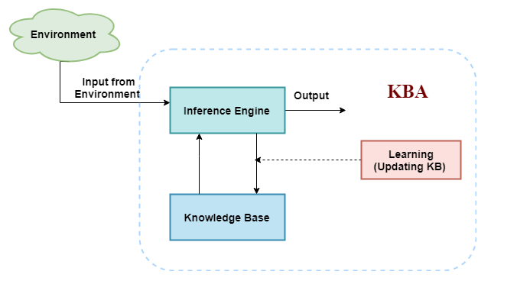
The architecture of knowledge-based agent

Slide 8
Why the AI-Agents use a knowledge base?
Knowledge base is required to make decision
To make decision / for solving problems
Knowledge-base is required to take action as per the knowledge.
For updating knowledge of an agent learning with experiences is mandatory.

Slide 9
Operations Performed by Knowledge based Agents
The following are three operations which are performed by KBA in order to show the intelligent behavior:
TELL: This operation tells the knowledge base what it perceives from the environment.
ASK: This operation asks the knowledge base what action it should perform.
Perform: It performs the selected action.

Slide 10
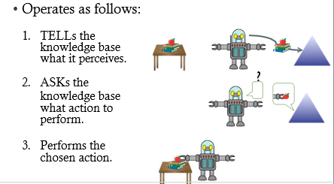
See this pic:-

Slide 11
knowledge Representation
Why we need knowledge Representation?
Problem solving requires large number amount of knowledge and some mechanism for manipulating that knowledge

Slide 12
Note:-Main problems in developing an intelligent system are:-
Knowledge representation-how to represent the knowledge one has about a problem domain / world.
Reasoning out- how to reason using the knowledge in order to answer questions or make decisions- inferencing.
.
Knowledge representation techniques-
Prepositional logic
First order logic.

Slide 13
Knowledge representation using Prepositional logic
A simple language that is useful for representing facts facts
The k/ge is represented using facts, which are either true or false, but it cannot be both. .
Each facts are represented using symbols, like P, Q, R….
Each of the prepositional symbols are atomic sentences.
User defines the semantics of each of these symbols.
For example:-
P means "It is hot"
Q means "It is humid"
R means "It is raining“

Slide 14
Knowledge representation using Prepositional logic
A knowledge representation using PL have :
Syntax: all possible sequences of symbols that form sentences
Semantics: facts in the world to which the sentences refer
What does it mean?

Slide 15
Statements which are questions, commands, or opinions are not propositions.
such as "Where is Rohini",
"How are you",
"What is your name", are not propositions.
The propositions and connectives are the basic elements of the propositional logic.
Prepositions can be-
Atomic Propositions- Atomic propositions are the simple propositions.
It consists of a single proposition symbol.
These are the sentences which must be either true or false.
2+2 is 4, it is an atomic proposition as it is a true fact.
"The Sun is cold" is also a proposition as it is a false fact.

Slide 16
Compound proposition: Compound propositions are constructed by combining simpler or atomic propositions using logical connectives.
Example:-
It is raining today, and street is wet.
Abebe is a doctor, and his clinic is in Hawassa.

Slide 17
Connectors /Logical Connectors:
Uses to connect the prepositions /to connect facts of the world.
Negation: A sentence such as ¬ P is called negation of P
Conjunction: A sentence which has ∧ connective such as, P ∧ Q is called a conjunction.
Example: Abebe is intelligent and hardworking. It can be written as,
P= Abebe is intelligent, Q= Abebe is hardworking.
P∧ Q.
Disjunction: A sentence which has ∨ connective, such as P ∨ Q. is called disjunction, where P and Q are the propositions. Example: “Abebe is a doctor or Engineer", Here P= Abebe is Doctor. Q= Abebe is Engineer,
We can write it as P ∨ Q.

Slide 18
Implication: A sentence such as P → Q, is called an implication. Implications are also known as if-then rules.
It can be represented as If it is raining, then the street is wet. Let P= It is raining, and Q= Street is wet, so it is represented as P → Q
Biconditional: A sentence such as P⇔ Q is a Biconditional sentence, example If I am breathing, then I am alive P= I am breathing, Q= I am alive, it can be represented as P ⇔ Q.

Slide 19
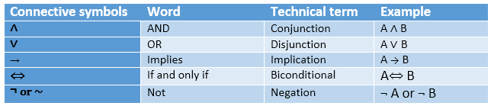
List of connecters-

Slide 20
Truth table of prepositional logics
In propositional logic, we need to know the truth values of propositions in all possible scenarios.
We can combine all the possible combination with logical connectives, and the representation of these combinations in a tabular format is called Truth table.

Slide 21
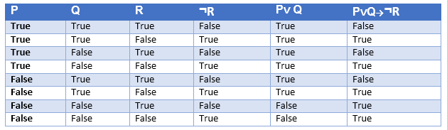
Example-

Slide 22
Properties of logical connectors
Commutativity:
P∧ Q= Q ∧ P, or
P ∨ Q = Q ∨ P.
Associativity:
(P ∧ Q) ∧ R= P ∧ (Q ∧ R),
(P ∨ Q) ∨ R= P ∨ (Q ∨ R)
Identity element:
P ∧ True = P,
P ∨ True= True.
Distributive:
P∧ (Q ∨ R) = (P ∧ Q) ∨ (P ∧ R).
P ∨ (Q ∧ R) = (P ∨ Q) ∧ (P ∨ R).
DE Morgan's Law:
¬ (P ∧ Q) = (¬P) ∨ (¬Q)
¬ (P ∨ Q) = (¬ P) ∧ (¬Q).
Double-negation elimination:
¬ (¬P) = P.

Slide 23
Limitations of Propositional logic:
We cannot represent relations like ALL, some, or none with propositional logic.
Example:
All the girls are intelligent.
Some apples are sweet.
Propositional logic has limited expressive power.
In propositional logic, we cannot describe statements in terms of their properties or logical relationships.
Note- To solve this limitation,
We can use First order logic to represent the knowledge base.

Slide 24
Knowledge representation using first-order logic
First-order logic is a powerful language that develops information about the objects in a more easy way and
can also express the relationship between those objects.

Slide 25
First-order logic (like natural language) does not only assume that the world contains facts like propositional logic but also assumes the following things in the world:
Objects: A, B, people, numbers, colors, wars, theories, squares, etc
Relations: relation such as: red, round, is adjacent, the sister of, brother of, has color, comes between
Function: Father of, best friend, third of, end of, ......
And uses quantifiers,
Universal Quantifier, (for all, everyone, everything)
Existential quantifier, (for some, at least one).

Slide 26
Example:
Abebe and Asmelash are brothers:
Brother(Abebe, Asmelash).
Chinky is a cat: cat (Chinky).
See the next sample knowledge content.

Slide 27
black(naty).
human(aman).
reads(x,y).
reads(x1,y1).
reads(x2,y2).
reads(x3,y3).
reads(x3,y5).
loves(x,y).
loves(y,x).
loves(a,b).
loves(b,a).
friends(X,Y):-loves(X,Y),loves(Y,X).
father(abebe,kasa).
father(abebe,yirdaw).
father(x,y).
father(x,y1).
father(x1,y4).
father(x1,y7).
brothers(Y,B):-father(X,Y),father(X,B).
father(h1,h).
father(h,h3).
grandF(X,G):-father(X,H1),father(H1,G).

Slide 28
Quantifiers in First-order logic:
A quantifier is a language element which generates quantification, and quantification specifies the quantity of specimen in the universe of discourse.
These are the symbols that permit to determine or identify the range and scope of the variable in the logical expression. There are two types of quantifier:
Universal Quantifier, (for all, everyone, everything)
Existential quantifier, (for some, at least one).

Slide 29
All man drink coffee.
∀x man(x) → drink (x, coffee).
It will be read as: There are all x where x is a man who drink coffee.
∃x: boys(x) ∧ intelligent(x)
It will be read as: There are some x where x is a boy who is intelligent.

Slide 30
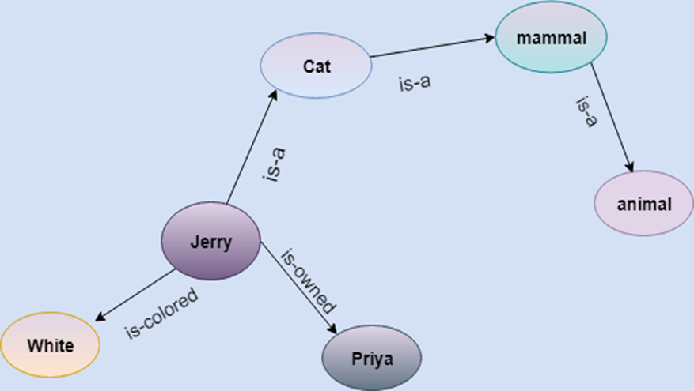
Other techniques of k/ge representation
Semantic Network representation-

Slide 31
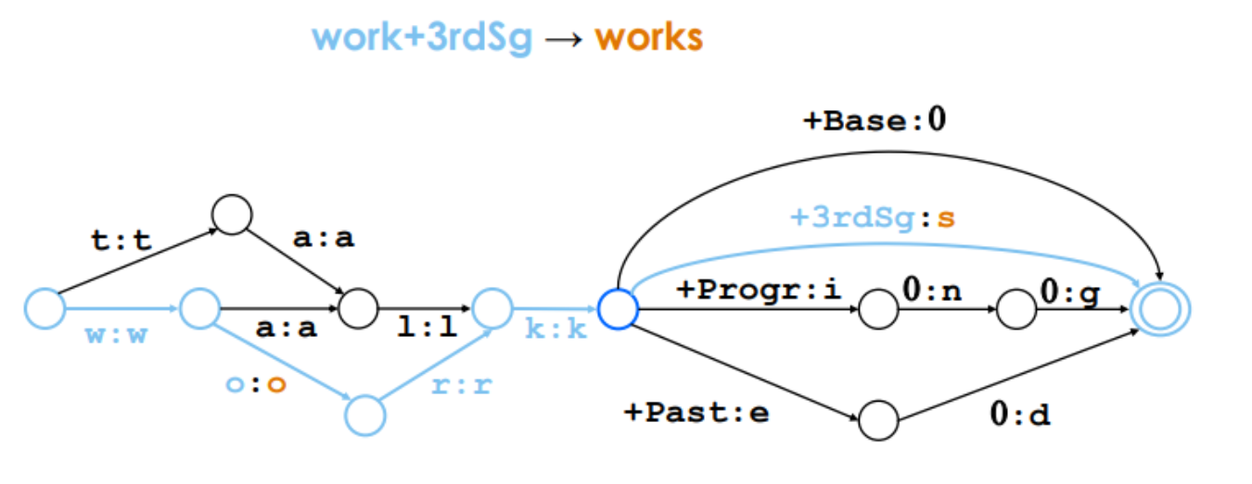
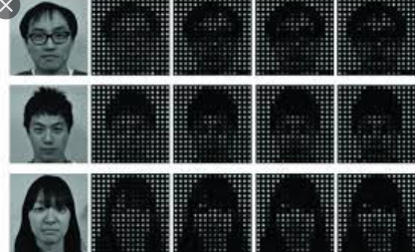
Examples image knowledge vs finite state of words

Slide 32
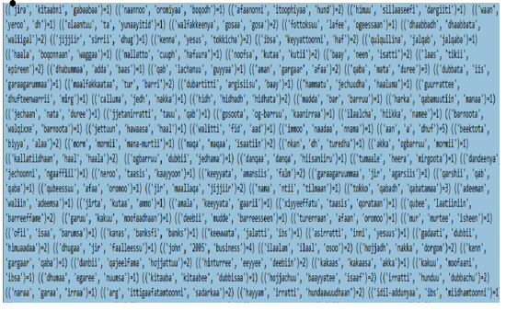
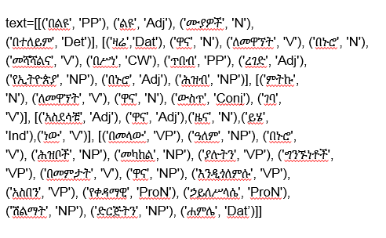
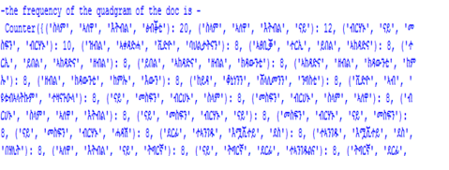
Examples

Slide 33
Questions
Questions:
What are knowledge based agents
What is knowledge base
Define sample knowledge base of problem

Slide 34
End of chapter-4.

