Slide 1

Classification
Miguel Vázquez García
Dep. Ingeniería del Software e Inteligencia Artificial,
Complutense University of Madrid
Madrid, July 2009

Slide 2
What is classification?
With classification we mean prediction of class labels As opposed to quantitative variables, which we discussed last class
Classification could be two class or multi-class. Some methods can handle multi-class easily, others are design only for two classes but can be made useful for multiple classes

Slide 3
Lecture Outline
We will be covering four sections in this lecture
  Introduction to the problem and a brief review into inference based on the join probability
  We will see three different algorithms to solve a classification problem that differ in their philosophy or assumptions
  We will consider the subject of the insight that can be extracted from the model
  Finally we will briefly examine some supervised learning algorithms

Slide 4
Introduction
Male? | Black? | Rich? | Count
Yes | Yes | Yes | 297
Yes | Yes | No | 1272
Yes | No | Yes | 6089
Yes | No | No | 13085
No | Yes | Yes | 90
No | Yes | No | 1465
No | No | Yes | 1028
No | No | No | 7614
Suppose we take the some census data (Adult Census dataset UCI) and look at how the income is distributed by sex and race. For simplicity we consider only Black and White levels in race
Total: 30940

Slide 5
Introduction: Joint probability
How can we make inferences with this data? If where where to ask “What is the chance of been a rich white male?”, which we would write P(Male, White, Rich), wed have to say that we do not really know, but we can estimate it as the frequency of such people in the data 6089 / 30940. This is called the joint probability
We can use it to compute other things:
  Marginal probabilities: Rich Female
  P(Female, Rich) = P(Female, Black, Rich) + P(Female, White, Rich)
  Conditional probabilities: Rich if Black Male
  P(Rich | Male, Black) = P(Male, Black, Rich) / P(Black, Male)

Slide 6
Joint probability
Good news: We have a classifier of the shelf. The question “With these measurement X does this patient have cancer?” would be P(Cancer | X), and we could estimate it from the data using the join probability
The Bad New: Actually, that is not likely to work in general. I our census example the dataset was dense enough to be able to estimate the joint, but if there are more variables or they take more values, especially continuous variables, then there is not enough data to estimate the joints and it will overfit. The Joint probability does not generalize

Slide 7
Classification Algorithms
Many of the learning methods are based in making assumptions about the population to simplify the conditional probabilities we have seem before. These are called generative models, because the make assumptions about the distribution that generated the data. For example: naïve Bayes and linear discriminant analysis
Other methods are only interested in separating the classes, these are called discriminative models. For example: support vector machines and logistic regression
Generative models tend to work better with less data, thanks to the additional assumptions, but asymptotically discriminative models are less biased. Although, dataset size should not be the only consideration in deciding a classifier

Slide 8
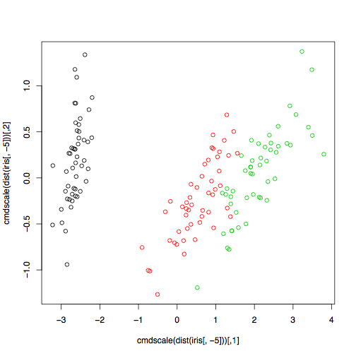
Example 1: Iris dataset (iris e1071)
Measurements in centimeters of the variables sepal length and width and petal length and width, respectively, for 50 flowers from each of 3 species of iris. The species are Iris setosa, versicolor, and virginica.
4 predictors and a response label, the species
Left is a 2-d plot of the 5-d data based on distance.
Verdiscolor and virginica have some overlap

Slide 9
Naïve Bayes
The naïve bayes assumes that all the predictors are independent that P(X_{1,}X₂) = P(X₁) P(X₂)
Our conditional can be simplified as follows
  P(Y|X) = P(X|Y) * P(Y) / P(X) using the Bayes rule
P(Y) are the class prior, that can be estimated by the proportions of each class, and P(X) we do not really need for classifications. So we need only to estimate P(X|Y)
  P(X|Y) = P(X₁|Y) P(X₂|Y) … P(X_{p}|Y) by independence assumption
This means that we need to compute only the class priors and the univariate distributions of the predictors in each class
Since the variables are continuous we further assume them gaussian and find maximum likelihood estimations for the mean and variance

Slide 10
Naïve Bayes: Training
This table is an examples of the maximum likelihood estimates found for specie ‘setosa’
The specie’s prior is 0.33, as there is as many of one type as there is of the others. This is the empirical prior, a botanist may have a more informed idea
Specie: setosa | Mean | Variance
Sepal Length | 5.006 | 0.3524897
Sepal Width | 3.428 | 0.3790644
Petal Length | 1.462 | 0.1736640
Petal Width | 0.246 | 0.1053856

Slide 11
Naïve Bayes: Prediction
Given an iris plant that we wish to classify, we compute for each specie the likelihood of that specie having an individual with each of the 4 measurements. All 4 likelihoods and the species prior are multiplied (or their logs sums, as its done often in practice) to produce the class posterior. The plant is classified to the species with the highest probability

Slide 12
Naïve Bayes: Training errors
The following contingency table shows the predicted classes for the training data. The cross validation error rate is 0.04
 | setosa | versicolor | virginica
setosa | 50 | 0 | 0
Versicolor | 0 | 47 | 3
Virginica | 0 | 3 | 47

Slide 13
Linear Discriminant Analysis
Here the assumption we make is that the class conditional density follows a (multivariate) Gaussian distribution. And, if we assume these Gaussians have the same covariance matrices, then we can easily derive a discriminant function for each class.
Its called Linear Discriminant analysis because the boundaries between classes are linear
Naïve Bayes has its own discriminant function, based on class posteriors. In this case the discriminant functions are not class posteriors but behave in a similar way. The difference comes from the assumptions made in each case, normality of the class posterior or independence of predictors

Slide 14
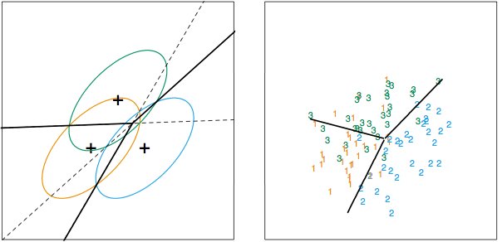
Linear Discriminant Analysis
Example of three classes in two dimensions. The lines in the left plot are the optimal decision boundaries knowing the real distributions, the picture in the right shows a random sampling and the fitted boundaries found by LDA

Slide 15
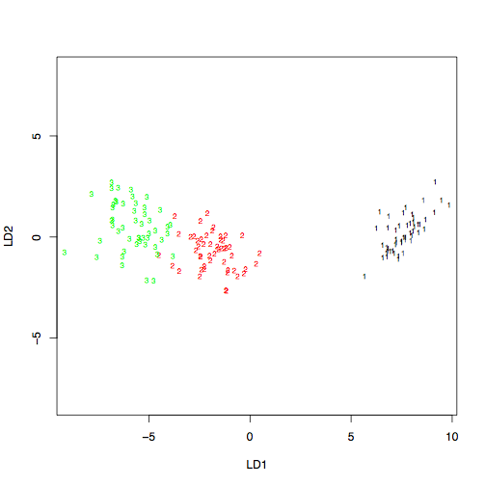
Linear Discriminant Analysis
An additional benefit from LDA is that the centroids of the classes provide a subspace of lower rank into which to project the high-dimensional data
Compare with the first 2d before. That one was unsuppervised, this one does a better job

Slide 16
Linear Discriminant Analysis
Linear Discriminant Analysis fits the data better than naïve Bayes. Cross validation error rate: 0.02 against 0.04 of NB
 | setosa | versicolor | virginica
setosa | 50 | 0 | 0
Versicolor | 0 | 48 | 1
Virginica | 0 | 2 | 49

Slide 17
Support Vector Machines
As we mentioned before, the last to algorithms where generative. Support vector machines look directly for the boundary between classes
SVM are in nature two class classifiers, although they can be extended to deal with multiple classes. For now lets look at how the separate two classes.
There are three stages to understand SVM
  Linear separable case
  Linear non-separable case
  Non-linear case

Slide 18
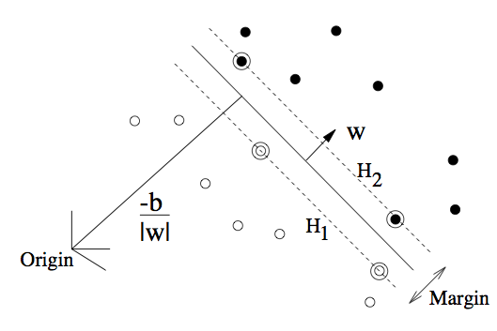
SVM: Linear separable case
The idea in the separable case is to find a line that separates both classes
Of all the possible lines, we find the one that maximizes the margin between both classes. This margin maximization will play a critical role
The points over the line are the support vectors

Slide 19
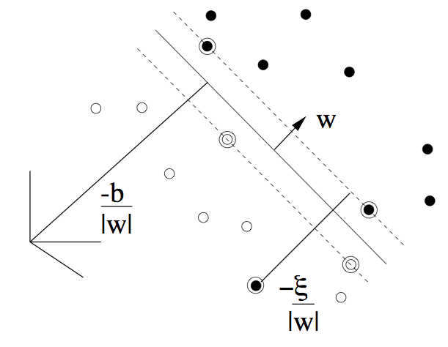
SVM: Non-separable case
The previous reasoning is extended to include possible error
The maximization problem now includes a penalty for the error, commonly called a cost
The cost regulates how much to focus on error and how much on boundary points
Both boundary points and error points are support vectors

Slide 20
SVM: The kernel trick, going non-linear
In linear regression we saw how using polynomial expansion or spline basis we could take a linear algorithm and make it non-linear. SVM do the same, except for two very important factors:
  1. A mathematical property dubbed the kernel trick. Allows to substitute to basis expansion with general functions. In particular the Radial Basis Function is equivalent to projecting the points in to an infinite dimensional space! where anything can be separated with no additional cost in computations
  2. An infinite dimensional basis expansion would undoubtedly overfit the data. Except that the margin maximization coupled with allowing for errors, serves as a regulatory framework for function complexity, much like ridge regression
The results is a method with unlimited discriminative power and a self built regularization framework

Slide 21
SVM: Results
 | setosa | versicolor | virginica
setosa | 50 | 0 | 0
Versicolor | 0 | 48 | 2
Virginica | 0 | 2 | 48
This results used a cost of 1.
They do not completely fit the train data.
Cross-validation error rate is 0.04.
 | setosa | versicolor | virginica
setosa | 50 | 0 | 0
Versicolor | 0 | 50 | 0
Virginica | 0 | 0 | 50
This results used a cost of 300.
They completely fit the train data.
Cross-validation error rate
is 0.06 so it seems to overfit a little

Slide 22
Summary so far
We have examined what classification and prediction would be in an ideal world, using the join probability
We have seen to approximation to the class posterior: naïve Bayes and linear discriminant analysis. And discussed their different assumptions
We have seem a discriminative method called support vector machines that looks for separating hyperplanes in an expanded base of inputs

Slide 23
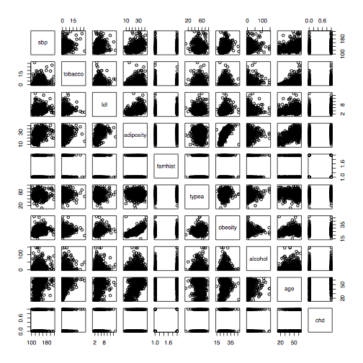
Example 2: South African Heart Disease
(SAheart ElemStatLearn)

Slide 24
Example 2: South African Heart Disease
(SAheart ElemStatLearn)
We want to study the incidence of a hear condition chd, a binary variable
I we are only interested in classification, we can try using any of the methods we known, and use cross validation to select both method parameters of between particular methods
Actually, linear regression with the response codified as 0 and 1, with forward feature selection gives better results than other more advanced alternatives

Slide 25
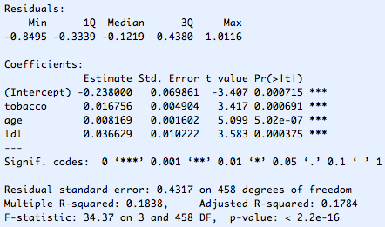
Linear regression model
Model after forward subset selection

Slide 26
Interpreting the results
When we look at the coefficients of the linear regression we might ask ourselves what does a particular value mean, can we see the response as a probability? And if so, how can I interpret the effect of a particular coefficient in the probability of having a heart condition.
Support vector machines offer no practical information to perform this kind of reasoning. While in naïve Bayes we know that it computes the posterior class probability, but we can not easily establish how the parameters directly affect it
We would like to say, “Sir, if you keep smoking your odds of having a heart attack increase by 10%”. Logistic regression is able to do exactly this

Slide 27


Logistic Regression
Logistic regression is a particular generalization of linear regression specially suited for classification where, instead of fitting a linear model to the response, we fit a linear model to the log-odds of the classes
This turns in term results in a logistic fit on the parameters
Odds are similar to probabilities, and logistic regression calculates odds, while linear regression cannot be said to be computing probabilities

Slide 28
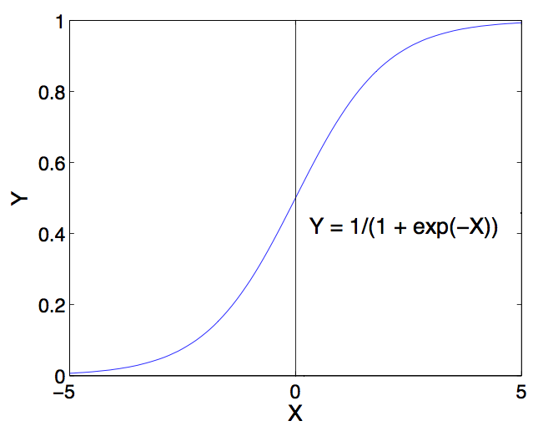
Logistic Regression
The logistic function, it offers a more abrupt response which is often more appropriate for binary variables
Also the form of the response guarantees that the response would be between 0 and 1, a reasonable constrain when dealing with probabilities

Slide 29
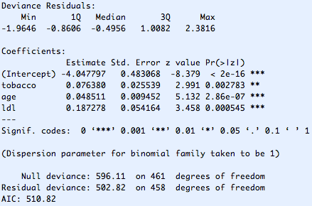
Logistic Regression Results
The forward selection was repeated and found the same terms

Slide 30
Logistic Regression: Interpretation
Each of the coefficients is represents the ratio of change in the odds. So for example: Tobacco has 0.76 coefficient, which means the accumulated consumption of 1 kilo of results in a exp(0.76) = 1.07 (7%) increase in odds of having a heart condition
These changes in odds are for unit change in the variable, so the scale may vary
  Tobacco 7% increase per Kg
  Age 5% increase per year
  Low density lipoprotein cholesterol 20% increase per unit

Slide 31
Trees
Another popular tool are trees. In its basic form they divide the parameter space into rectangular regions and fit the regression function locally to each region. The local function is often constant, like the average of the response for the points in the region, which is a least squares criterion, or the most likely class in a classification problem
The tree defines regions by recursively dividing using linear splits. By large the most common splits are amongst a single variable, and usually dividing by two at each step
When and where to make each split is the main difference between tree-based algorithms
One of the main benefits of trees is their interpretability

Slide 32
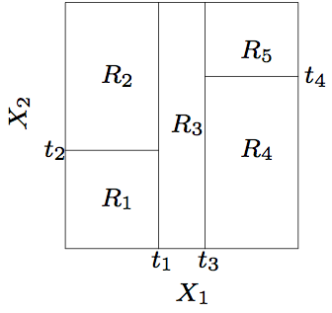
Trees: Rectangular regions
This is the topology of the regions that a tree fits in 2D. Any dataset that severally violates this general structure may make the tree perform badly

Slide 33
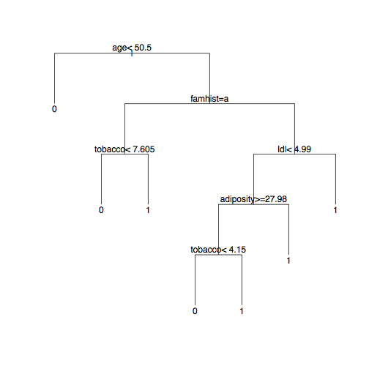
Tree results
Trees have an implicit regularization mechanism, which may between each particular algorithm, that works by avoiding or removing unnecessary splits
On the other hand, their rigid nature may make them fail in certain configurations
Also, the greedy algorithm used to perform splits may drive the tree to saddle points

Slide 34
Random Forest
To avoid local minima a very practical approach is bagging, which uses several classifiers In a vote scheme
Random Forests uses bootstrap sampling to generate multiple training datasets, each datasets is trained using a tree after removing a number of variables. Each tree is different because is train with a different bootstrap sample in a different input subspace.
Random Forests are accurate and robust to large numbers of inputs. But one of the main benefits is that is provides a lot of additional information, like an estimate for generalization error, relative importance of variables and variable interactions, good methods for missing value imputation, etc…

Slide 35
Random Forest
age | 34
tobacco | 33
ldl | 30
adiposity | 29
obesity | 25
sbp | 24
alcohol | 20
famhist | 10
Importance of the terms, based on how use useful in average each term was in each tree in wich it was used
As we can see the pot ranking 3 are the same that where selected in our forward subset selection in both linear regression and logistic regression, the forth was also used in our regular tree we fit before
It is interesting that the famhist was used in the tree before, but was not considered useful now

Slide 36
Summary so far
We have seen how different classification methods may offer different insight into the data
Logistic regression shows the effect of each predictor on the odds ration
Trees show a visual representation that may be easy to understand
Random Forest internally compute a number of statistics that can help gain insight in the data, in particular variable importance

Slide 37
Unsupervised learning
So far we have been considering ways to study the joint density of P(Y,X) in particular we are interested in the conditional P(Y|X), where X is a p-dimensional vector of predictors and Y is the response. This is called supervised learning, the metaphor been that we have observed responses in our training data that helps us fit our model
In unsupervised learning we do not have a response Y we only have the input vector X, what we try is to study the properties of P(X), is the density uniform, or does it form clusters? Are there any interesting many-folds where the data concentrates? Are there any regions that have an significantly higher density?…

Slide 38
Unsupervised Learning
Is the probability distribution uniform, or does it form clusters?
  Clustering
Are there any interesting many-folds?
  Projection Pursuit, Component Analysis, dimensionality reduction, etc
Are there regions of significantly high density?
  Association Rules
And many others. Today we are going to take a brief look at clustering. We have had a glimpse of dimensionality reduction with LDA, and Association Rules will be covered extensively next lecture

Slide 39
K-means
In k-means you try to group the data into a predetermined number k of cluster based on their distance
It works iteratively, start with k locations arbitrarily distributed. These places are called centroids. And iterate until convergence:
  Assign each data point to the closest of these centroids
  Move the centroids to the center of the assigned points
Most likely in the first iterations of this algorithms centroids will move around until they reach a stable position
The main drawbacks of this methods is that you need to specify the number of cluster upfront, and that the algorithm may converge to a saddle point

Slide 40
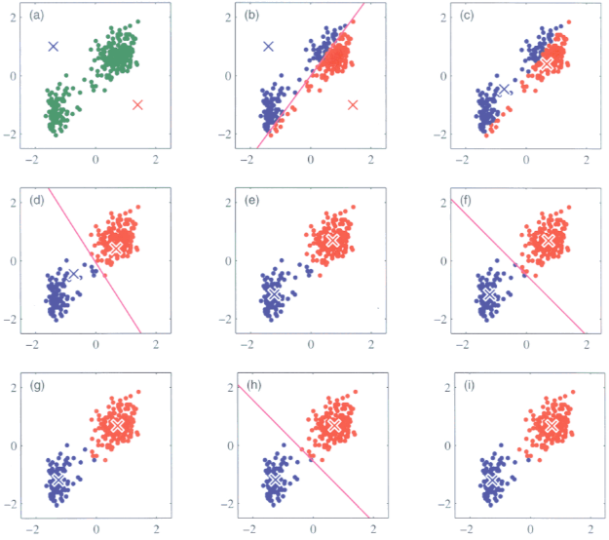
K-means
These plots are not always immediate since points may be in more than 2 dimension. One would need to build a low rank projection, like LDA or multi-dimensional scaling

Slide 41
Hierarchical clustering
Points are also group together based on their distances, but this time in a forward fashion the two closes points are join together, then the next to closes point, considering the new pair as a single point. This is done until they are all joined into one group.
The sequence of merges draw a tree, which servers as a useful visual aid. Also it does not need to know a number of cluster, its up to the user to select the clusters, usually by visual inspection
The previous description is for an agglomerative algorithm, other algorithms start from the total group and divide down to the individual nodes. Also, algorithms differ in how to measure the distance of a point and a group of points: Closes point in the group, furthest, centroid of the group,etc. This can make a big difference

Slide 42
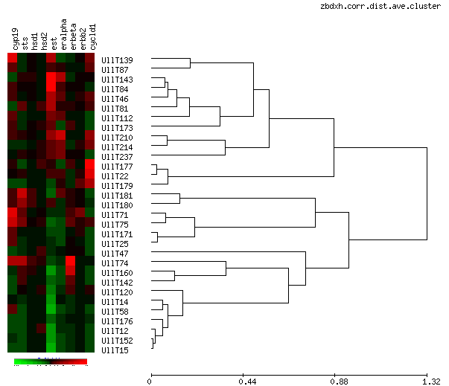
Hierarchical Clustering
Hierarchical clustering analysis of micro-array data, where is extensively used

