Slide 1
Data Mining: A practical perspective
Prediction
Miguel Vázquez García
Structural Biology and Biocomputing Programme
Spanish National Cancer Research Centre (CNIO)
Madrid - July 4th to July 15th, 2011

Slide 2
What do we mean by prediction?
Learning from data
Been able to predict a response in terms of a set of predictors
  Grades of final test from grades of midterm test
  Levels of a prostate cancer related gene from several measurements
  Changes in bone mineral density from age of subject
Classification means predicting class labels, will deal with classification in next lecture. Today is only about quantitative variables.

Slide 3
Lecture Outline
You will learn four things
  Fit Linear Regression Models
  Deal with numerous and correlated predictors
  Go beyond Linear Models by Basis Expansion and Local Kernel Methods
  Asses the performance of models and select the most appropriate
The the ideas will be introduced using example datasets
This course is not meant to be comprehensive, just offer practical examples of analysis that can show some light into the common issues when analyzing quantitative data

Slide 4
Prerequisites and bibliography
Some familiarity with probability and statistics is required: Probability density functions, Normal distribution, Random Variables, Expectation, etc
There will be some formulas, but there will be an emphasis in the intuition behind the methods, not in the formulas themselves
The following two references cover the topics extensively
  The Elements of Statistical Learning. T Hastie, R Tibshirani, J Friedman. Springer
  Practical Regression and Anova using R. JJ Faraway. Free on the internet

Slide 5
Linear Regression Models

Slide 6
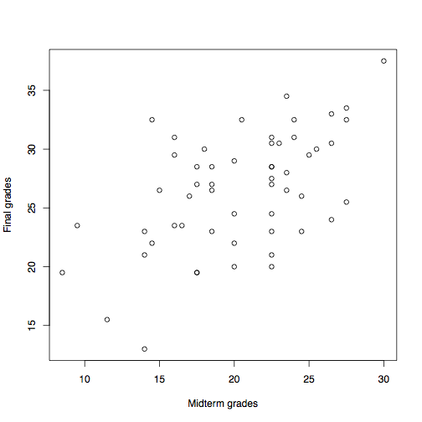
Example 1: Test grades (stat500 faraway)
Can we predict the grades of the final test in terms of the grades from the midterm?
  Both variables have a positive correlation: 0.55
  There is no evidence that there are nonlinear effects
  There is a high variability, but seems random
Try a linear model

Slide 7
Fitting a liner model: Draw a line… but what line?
We need a criterion to select the line: Minimize Residual Sum of Squares (RSS)
Why squared?
  Its analytically convenient
  Its what the mean minimizes, actually
Fortunately, this criterion enables us to solve our problem analytically by setting the derivative to 0

Slide 8
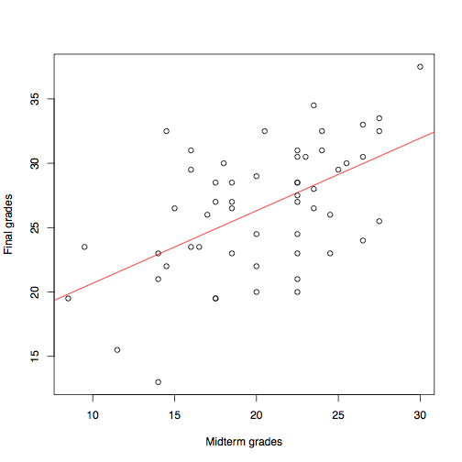

Coefficients of the fit
Intercept: 15, Slope: 0.56
If a student gets x more points in the midterm then another student, he is expected to get 0.56 * x more points in the final
The intercept is the offset of the curve, so it does not have to go through the origin. In practice it means adding an extra dimension with value 1 to al points

Slide 9
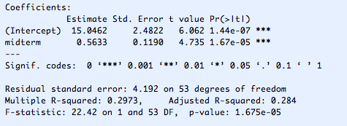
Estimation confidence
How confident are we of the values?
Both the intercept and slope are significantly not 0

Slide 10
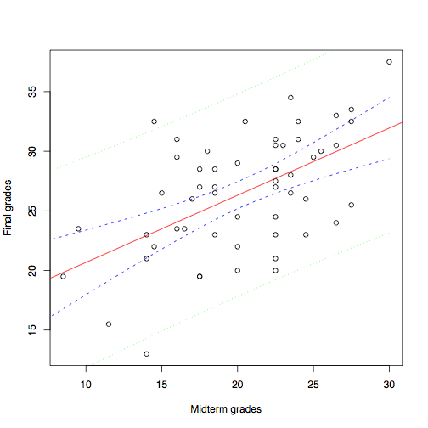
Confidence intervals
The blue dashed lines are the confidence intervals for the estimates. If the true values where anywhere inside the interval it could have given the same estimates, they are indistinguishable to a 95% confidence
The green dotted lines are the prediction interval. We expect the response to be inside 95% of the times.

Slide 11
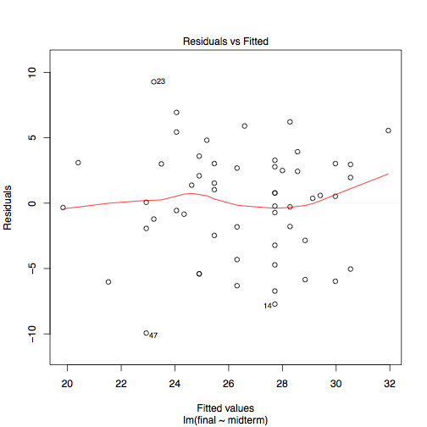
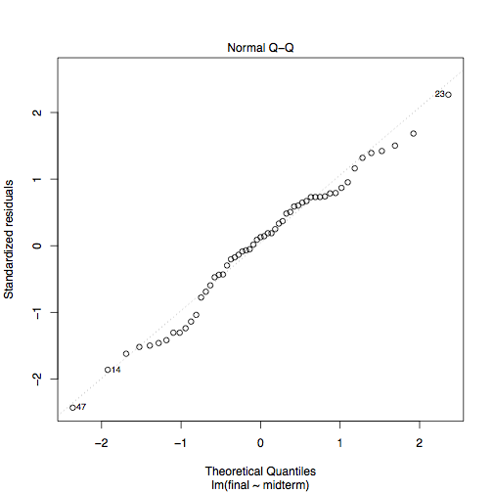
Residual analysis
Linear regression assumes independent Gaussian residuals with equal variance. Residual analysis allows us to determine any abnormalities: outliers, unequal variances, etc

Slide 12

R^{2:} Goodness of fit
Measure how much our model improves over the baseline model of predicting always the response mean. All students are expected the achieve the average points in the final, regardless of the grade in the midterm.
It computed as:
The relative importance of the R² depends on the task

Slide 13
General properties of linear regression
The lest squares solution is also the maximum likelihood estimate for the parameters under the assumption of Gaussian residuals. Of all possible values for the parameters, the likelihood of producing those points is higher for the chosen estimates than for any other.
If we assume the model is in fact linear then the least squares solution is unbiased. The expected value of our estimates are the real parameters.
Amongst all unbiased estimates, the least squares has the lowest variance. The estimates are the most robust and closer to the real parameters.
NOTE: Unbiased estimates are not necessarily better, we will see later that we can trade a slight bias for a smaller variance.

Slide 14
Feature Selection and Regularization

Slide 15
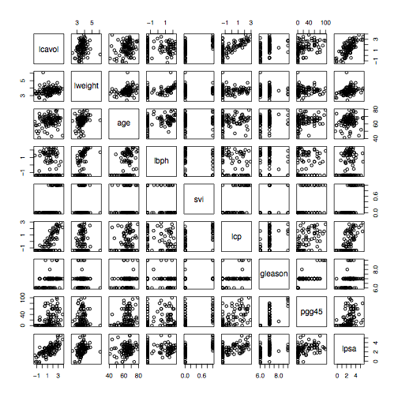
Example 2: Prostate Cancer (prostate ElemStatLearn)

Slide 16
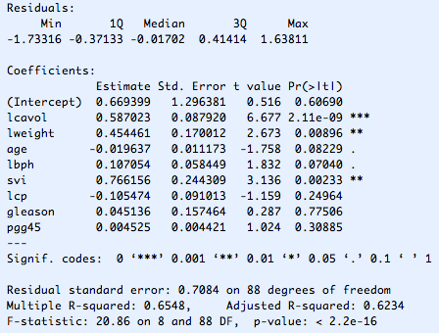
Linear fit with multiple predictors
Many predictors seem not significant
Are only lcavol, lweight and svi related to lpsa?

Slide 17
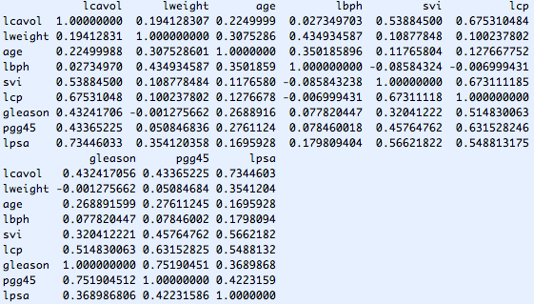
Predictor correlation
Many of the predictor variables are correlated.

Slide 18
Predictor correlation 2
If two correlated variables are in a model, the importance is shared, one taking most of the credit
Loose intuition: Imagine the responses as linear combinations of the predictors, the response vector is a projection into the prediction space. If two predictors are correlated the space spawned by them is only that of their orthogonal components, the overlap is lost
The consequence is that removing one predictor changes the values of the coefficients of the other predictors
Predictor correlation may degenerate the performance of the regression by inducing large variance in the estimates

Slide 19
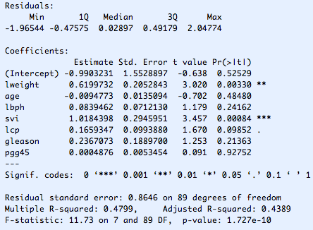
Predictor correlation 3
lcavol had a strong influence, removing it changes the coefficients. In particular lweight and svi

Slide 20
Predictor sub-setting and shrinking
We saw that many of the predictors did not appear to be significant, can we get rid of them?
Removing or shrinking coefficients can do two things:
  Improve accuracy by limiting variance
  Improve interpretability by removing unimportant predictors
We will see two simple strategies:
  Subset selection. By forward stepwise selection in our case
  Ridge regression

Slide 21

Forward stepwise subset selection
The idea is to start with a model consisting of only the intercept and iteratively add the predictor that best improve the model
To measure model improvement we use the F statistic
This value follows a F distribution with parameters (1, N - k - 2)
The stopping criteria could be when no predictor produces an F value larger than the 95th percentile

Slide 22
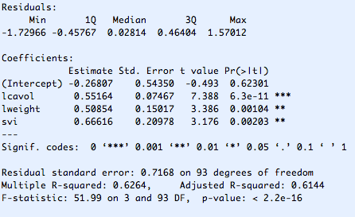
Forward stepwise subset selection
Best subset: lcavol, lweight, svi

Slide 23

Ridge regression: coefficient shrinkage
Ridge regression places a penalty in the size of the coefficients.
There is a connection between the penalty lambda and the effective degrees of freedom
The rationale is that when predictors are correlated least squares may use this correlation to balance out the effects of each predictor, so large values in a coefficient are compensated by large values in another so that the remains fit the data more closely. This makes the estimates very unstable, or equivalently, make them have a large variance
Ridge regression gives a biased estimate for the coefficients, but reduces the variance significantly

Slide 24
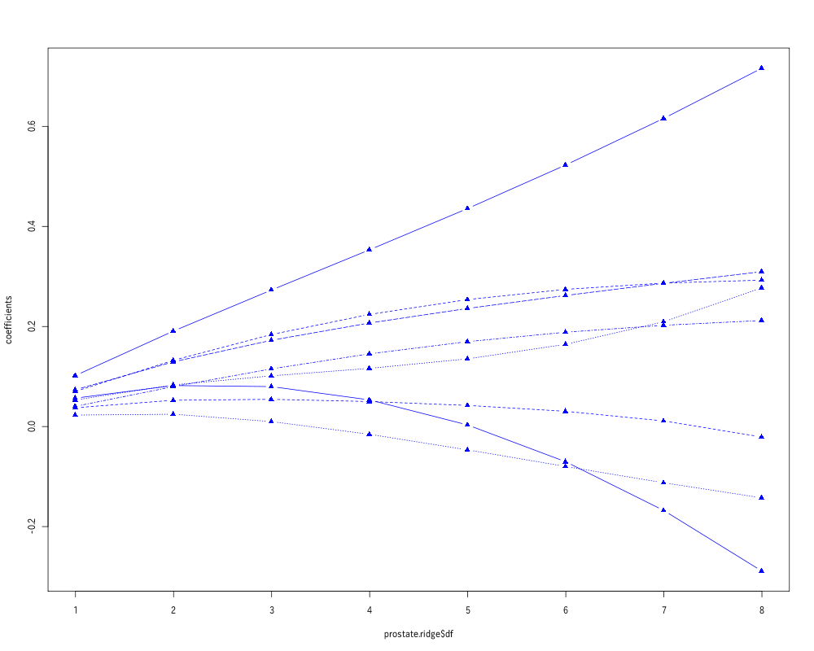
Ridge regression: coefficient shrinkage
Coefficients grow with effective degrees of freedom

Slide 25
Model Evaluation: Using test data
In the previous example we examined a few options. Using all the predictors, selecting a subset, or using all but shrinking the coefficients. We would like to compare them
We know the residual sum of squares for each model, but that is underestimates the real error. The more complex the model the smaller the residuals, but the larger the variance, and this translates into a worse predictive power. We need to find a compromise
We are going to separate a random sample of the input points and use them to test the predictive power. The rest are the train data
We must rebuild models with the train data. This means also running the best subset selection, it would be unfair to use the subset determined before using the complete dataset

Slide 26
Model Evaluation: Results
Baseline Model (Mean of lpsa): 0.741
Complete Model: 0.569
Best Subset (Forward): 0.555
Ridge Regression: 0.546

Slide 27
Beyond Linear

Slide 28
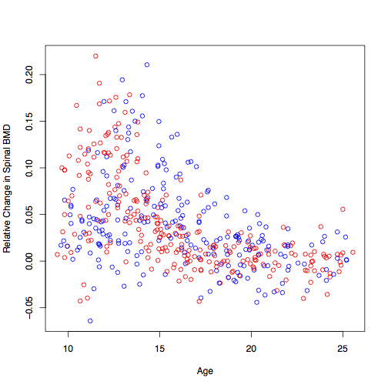
Example 3: Bone Mineral Density
(bone ElemStatLearn)

Slide 29
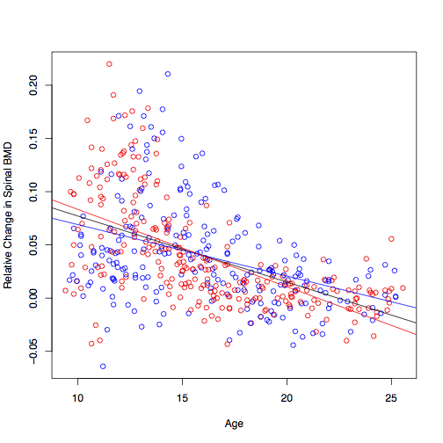
Linear model
The distinction is unclear, not very informative…

Slide 30
Basis Expansion
If we fit a linear regression on the original predictors, our model will be linear on these predictors, however, if we augment the parameters by including, for example, interactions between predictors, then the regression will still be linear on the parameters, but non-linear on the original predictors

Slide 31

Non-linear fit: Polynomial
First idea: Use a polynomial instead of a linear fit by adding the polynomial terms to the input (x,y) => (x,x²,x³,y)
Captures the general trend better
But the values at the extremes are odd
Polynomial fits are to unstable, they are rarely used

Slide 32
Non-linear fit
Let us think about this again:
We are trying to find a function that approximates the data. We know that the more flexible the function the more chance it has to over fit. First we try to limit function to linear functions, then we extended to polynomials, but polynomials have the problem that fitting one part has unexpected consequences in other parts. This is due to its global nature. Lets try a function that is composed of local components

Slide 33
Kernel Regression
We have several options
  Nearest neighbors: For each point x we wish to predict, find the closes k points and average the response value.
  Epanechnikov: The same as before, but instead of just selecting k neighbors, weight them according to the distance
  Use any of the above methods, but instead of averaging the responses, fit a local regression model (local regression can also use weights)

Slide 34

Kernel Regression: Loess
A weighted least squares is fitted to each data point

Slide 35
Kernel Regression: Disadvantages
Very computationally intensive
As a local method is not so robust to outliers
As it is based on neighborhoods it needs a high density of points. This means that it may work well in two dimensions. But as the number of dimensions grow the number of points need to grow by a power in order to maintain the density
There is no closed formula for the model, therefore hindering interpretability. All the data is used to specify the model, not just a set of coefficients like in linear regression

Slide 36
Non-linear fits: Cubic splines
Another popular option that is part way from polynomials and kernel regression is a type of piecewise polynomial fit known as splines.
Cubic splines place a collection of knots along the range of the predictor, and fits a cubic polynomial through between each knot, with the additional constraints that there should be continuous in the knots and have the same first derivative. This is usually regarded to be enough to please the eye
This is done by the same means as polynomial fits, using Basis Expansion. Inputs are transformed into a new basis, called a spline basis, and linear regression is performed with the transformed inputs

Slide 37

Cubic splines
Cubic spline with 12 degrees of freedom

Slide 38
Model Assessment and Selection: In-sample
In sample prediction Error: Error rates in the training data are underestimated, this is called optimism of the training data. The harder we fit the data the larger the optimism. In general the more degrees of freedom of a model the larger the optimism.
Akaike Information Criteria (AIC) is a measure that that combines the performance in the training data with a penalty for model complexity. The model complexity is specified by the degrees of freedom of the model, roughly the number of parameters

Slide 39
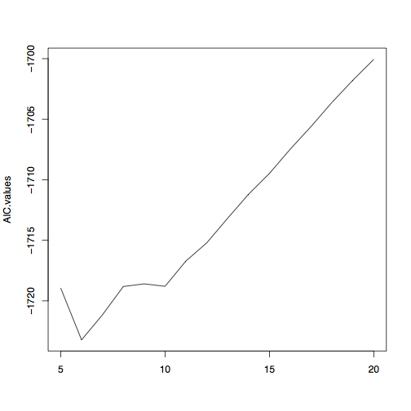
AIC: B-spline basis for bone data
There is a minimum at 6

Slide 40
Model Assessment and Selection: Off-sample
We say in the previous example how to split data into training and test to perform model assessment by giving en estimate of out-of-sample generalization. A variation of this approach is called k-fold cross-validation
Take the data and divided it into k subgroups, use each subgroup to evaluate the performance of a model built with the other groups
Typical values for k are 5 and 10
Cross-validation estimates are themselves random

Slide 41
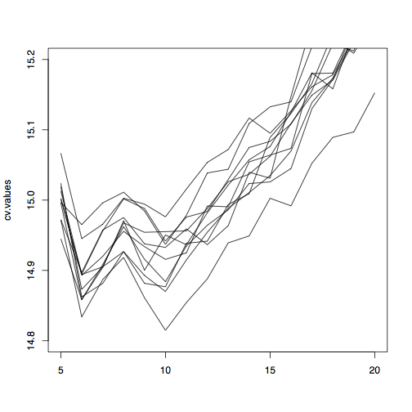
Cross validation: B-spline basis for bone data
10 different 10-fold CV runs
There is variability, but there is consistently a minimum at 6
The drop in error in 10 is more that what predicted by AIC. This might indicate that AIC overestimated the complexity penalty for test error

Slide 42
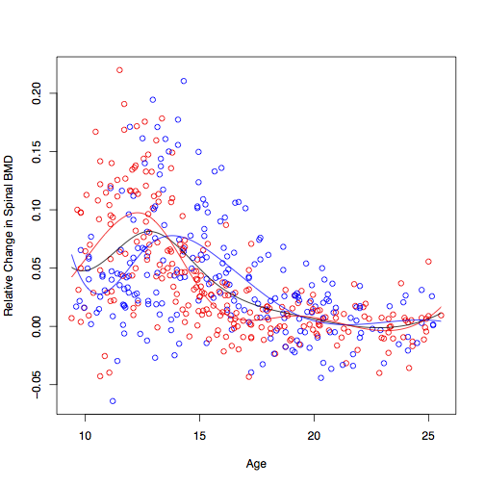

B-splines at predicted degrees of freedom
Left is 6 degrees of freedom, right is 10

Slide 43
You should know
Fitting linear regression models
Selecting predictors
The idea behind kernel regression and splines for non-linear fits
Using F-statistics, AIC and cross-validation for model selection and assessment
You will know learn how to do this things using R in the practice session

