Slide 1



OpenInvest
BETTER THAN NEVER

Slide 2



Comlexity
Problem
Identification
Limited Financial Literacy
Behavioral Barriers
Limited Advisory Support
Lack of knowledge about markets, products, and risks prevents participation.
Fear of loss, mistrust, or overconfidence can prevent engagement.
Professional financial advice is often expensive or inaccessible.

Slide 3

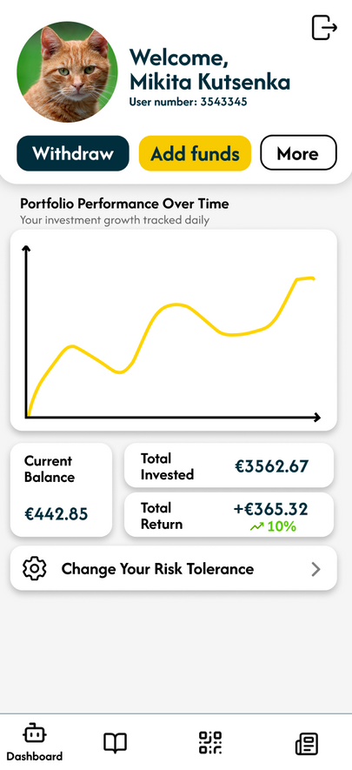
Logic
Educational Materials
The user makes a decision based on AI Summary Review, which are based on news from financial markets.
Since test investing mode is developed for those, who are just starting with investing, only 30 thrusted companies are chosen.
This helps to boost user confidence.
01
App provides users with learning modules, where users can learn the basics of investing and economics.
News Digest
02
Help experienced investors to stay informed about events that may affect their investments, providing macroeconomic interpretation of current news.
Investment Playground
03
The place, where user can buy and sell, go bankrupt and become a millioner and he should not be worried about consequences.
News Feed and AI Teacher

Slide 4

Demonstration
Video uploaded separately

Slide 5
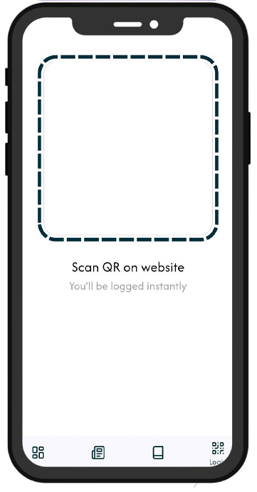
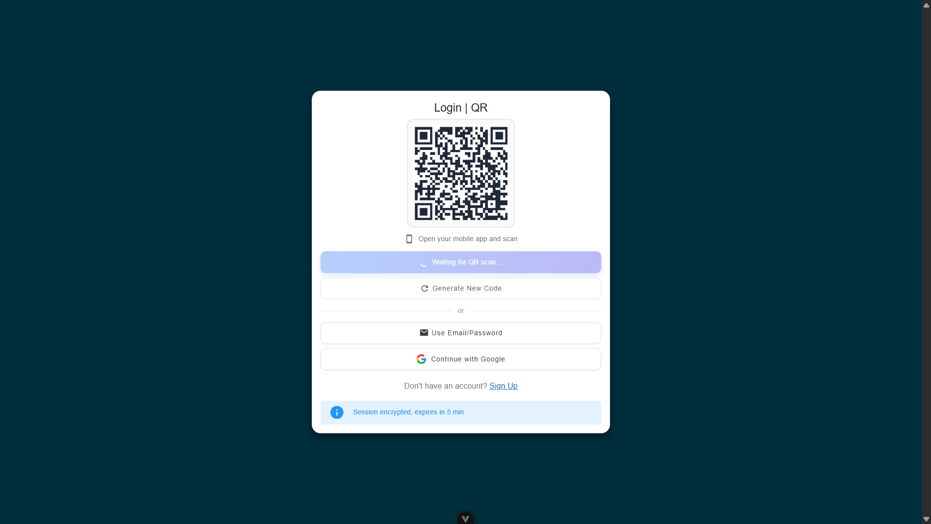


Want to Log In?

Slide 6

Want to Log In?
Simply scan it!
Fast
Simple
Secured

Slide 7
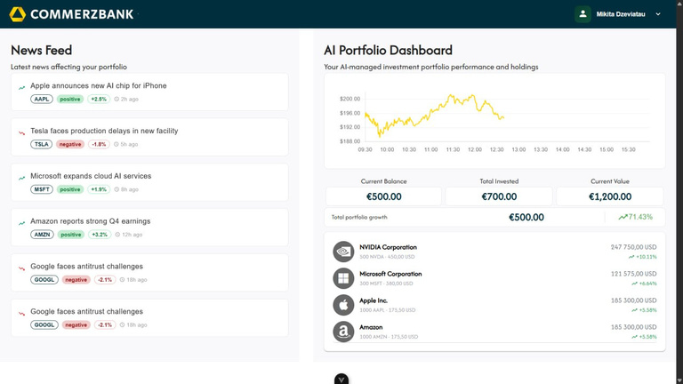
Want to Log In?
Simply scan it!
Fast
Simple
Safe

Slide 8






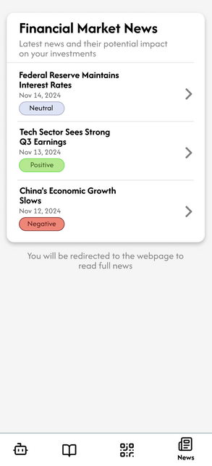





Website
AI News
Summarizer
Stock price
Simulation
Since we have test portfolio,
we simulating values as
Technical Realization
Framework: vue.js
App
Backend II
Framework:
Storage
Log In Verification
flutter
Pr-g. lang.:
dart

Slide 9
Thank You!
BETTER THAN NEVER

