Slide 1
COMP1516: Lesson 4 Strings

Slide 2
Learning outcomes:
Strings
Special characters in a string
String operators
Formatting a string
Data format : CSV
Data format: JSON
String indexing and slicing
String methods

Slide 3
String
A string is a sequence of zero or more alphanumeric characters or symbols enclosed in quotation marks (single or double)
Example:
“Hello World”
full_name = “John Doe”
full_name is a variable of type string
“John Doe” is a string literal (string value)

Slide 4
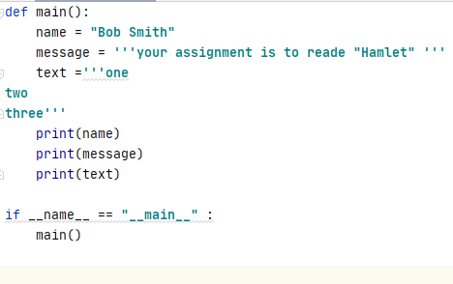
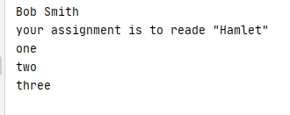
String
If the string contains single quotes, use double quotes to enclose the string
If the string literal contains single or double quotes use triple quotes(“”” or ‘’’) to enclose the string
Example: Output:

Slide 5
String : special characters
The special characters are symbols that have special, built-in meaning in a programming language.
Example :
In Python: ‘ ,”,
In python the backslash (\) character is used to escape characters that otherwise have special meaning.

Slide 6
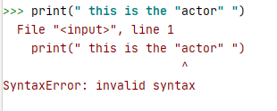

String: escape character
A string using a special character without the backslash.
A string using a special character with the backslash.

Slide 7
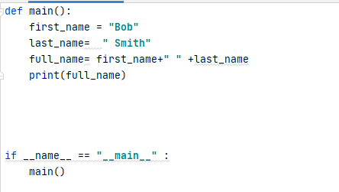

String: string operators
+ is used to join (concatenate Strings together).
Example:
Output:

Slide 8
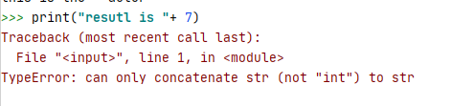

String: string operators
Any other type such as int will not be converted to a String with +
Example:
Use function str() to convert any type to string
Example:

Slide 9


String: string operators
Symbol Asterisk * is used to repeat the String
What will be the result of executing the following statement?
print(“ba” + “na” *2)
Example:
Output:

Slide 10
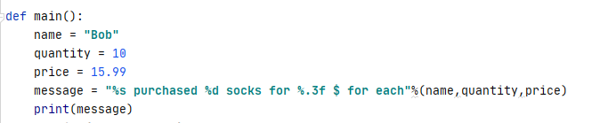

Formatting a string
String formatting expression is a String that is created with placeholders that are replaced by the values of variables.
Example:
Output:

Slide 11
Formatting a string
Some of the used specifiers in String formatting expression
%s - String (or any object with a string representation, like numbers)
%d – Integer
%f - Floating point number
%.< number of digits>f - Floating point numbers with a fixed amount of digits to the right of the dot.
%x/%X - Integers in hex representation (lowercase/uppercase)
%e/%E- Floating points in Exponential format (lowercase/uppercase (Ex: 1.7e3))
%% percentage sign (%)

Slide 12
Formatting a string
Minimal field width
%5s # minimum 5 characters reserved
%3d # minimum 3 digits
Zero padding
%03d # adds leading zeros to fill the space. So 20 displays as 020.
Left justification
%-5s # string is justified to the left rather than the right
Floating point precision
%.3f # Displays 3 decimal places so 1.5 displays as 1.500

Slide 13
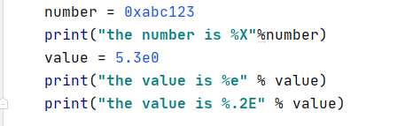

Formatting a string
Example:
Output:

Slide 14
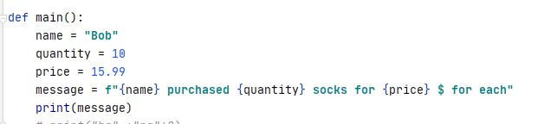

Formatting a string: using f-string
f-string is an alternate form of string formatting expressions recently introduced to Python.
It is specified by putting f in front of the starting quote of the string, i.e. f ”This is an f-string with a {placeholder}”
Example:
Output:

Slide 15
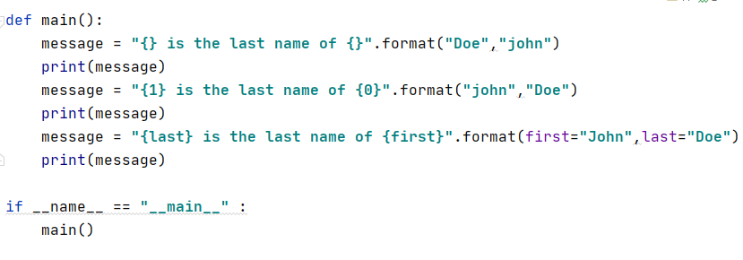
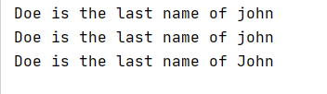
Formatting a string: format()
format method is an alternative way to format a string expression.
Just like f-string , the method uses {} as a place holder for the values.
Example:
Output:

Slide 16
Data formats: CSV
CSV – Comma-Separated Values for tabular data.
Each row represents a record.
Each column represents a field.
The comma separates the columns in the row.
Often stored as :
Susan,Lee,18,34.58
Robert,Smith,5,25.75
Jennifer,Chen,10,30.00
Susan | Lee | 18 | 34.58
Robert | Smith | 5 | 25.75
Jennifer | Chen | 10 | 30.00

Slide 17
Data formats: CSV
Given the following variables:
first_name = ”Bob”
last_name = “Smith”
years_employed = 10
hourly_rate_cad = 34.58
Create a string in a CSV format

Slide 18
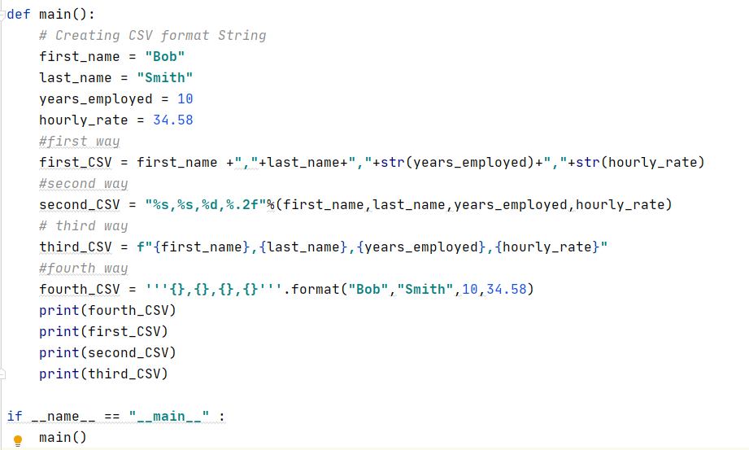
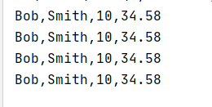
Data formats: CSV
The output:

Slide 19
Data formats: JSON
[
{
"first_name": "Susan",
"last_name": "Lee",
"experience": 18,
"wage": 34.58
},
{
"first_name": "Robert",
"last_name": "Smith",
"experience": 5,
"wage": 25.75
},
{
"first_name": "Jennifer",
"last_name": "Chen",
"experience": 10,
"wage": 30.00
}
]
JSON – JavaScript Object Notation
Derived from the JavaScript Programming Language
But it is used “everywhere”
Consists of arrays, objects and key/value pairs
Array
Key/Value Pairs
Object

Slide 20
Data formats: JSON
Given the following variables:
first_name = ”Bob”
last_name = “Smith”
years_employed = 10
hourly_rate = 34.58
Create a string in JSON format

Slide 21
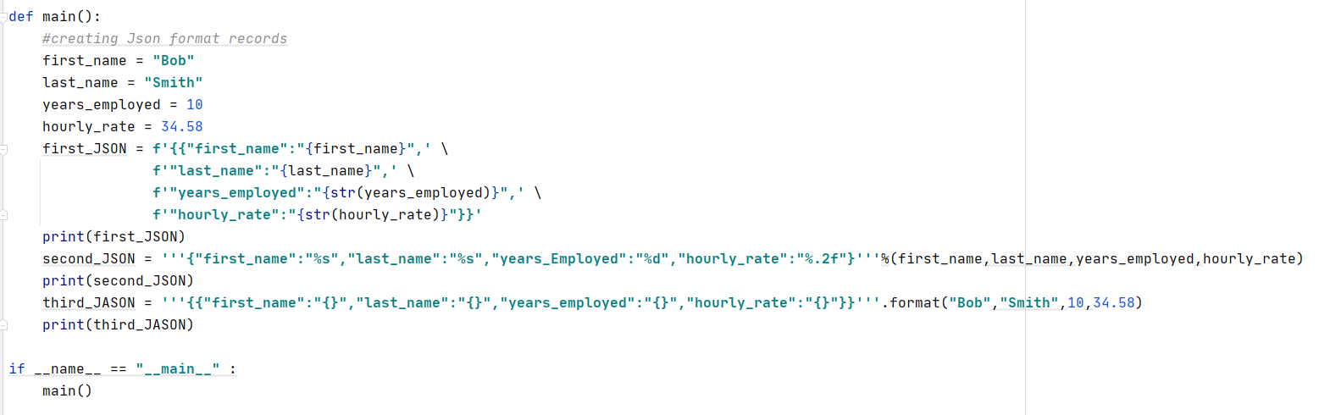
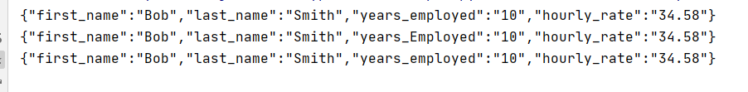
Data formats: JSON
The output is:

Slide 22
Data Formats
We’ll be using these data formats, and others, throughout the rest of the course.
CSV is commonly used with spreadsheets.
JSON is commonly used in web-based interfaces.

Slide 23
Strings: indexing and slicing
Remember that the string is a sequence of characters.
Each character has an int value to indicate its position in the string (index).
Each character in a string can be accessed using its index.
Indexing starts at 0 so the first character index is 0.
R | o | s | e | s |  | a | r | e |  | r | e | d
0 | 1 | 2 | 3 | 4 | 5 | 6 | 7 | 8 | 9 | 10 | 11 | 12

Slide 24
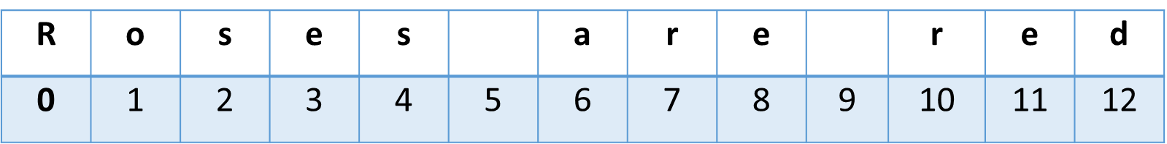
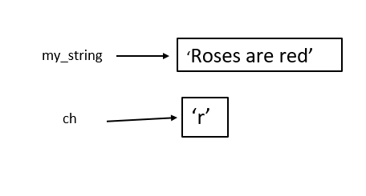
String: indexing and slicing
Example:
my_string = “Roses are red”
ch = my_string[7] print(ch)
The above code will display: r

Slide 25
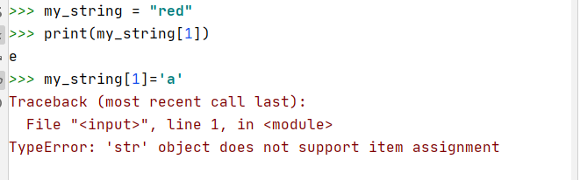
String: indexing and slicing
Be careful! You can use the index to access the character but you cannot use the index to change the character.
This is because a string is immutable; once it is created it cannot be changed.

Slide 26
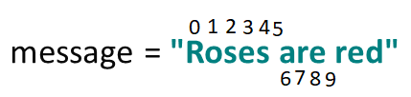
String slicing
A segment of a string is called a slice. Selecting a slice is similar to selecting a character.
When slicing a string you are creating a substring from the original string.
Example:
print(message[6:9])
The above code will display: are
The 6 is included; the 9 is not.

Slide 27
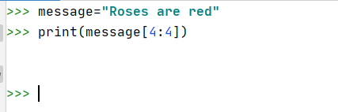
String slicing
The operator [n:m] returns the part of the string starting from n index inclusive to m index exclusive. n should always be less than m.
If the first index is the same as the last index the result is an empty string, an empty string (‘’) is a string with 0 characters.
Example:

Slide 28
String slicing
Negative numbers can be used as indexes to identify character positions relative to the end of the string.
The Python interpreter adds the negative index to the length of the string to determine the position of the character.
Index[-1] identifies the last character in a string,[ -2] identifies the next to last character and so forth.
my_str = “THIS IS A TEST!”
T | H | I | S |  | I | S |  | A |  | T | E | S | T | !
-15 | -14 | -13 | -12 | -11 | -10 | -9 | -8 | -7 | -6 | -5 | -4 | -3 | -2 | -1

Slide 29
String slicing
T | H | I | S |  | I | S |  | A |  | T | E | S | T | !
0 | 1 | 2 | 3 | 4 | 5 | 6 | 7 | 8 | 9 | 10 | 11 | 12 | 13 | 14
-15 | -14 | -13 | -12 | -11 | -10 | -9 | -8 | -7 | -6 | -5 | -4 | -3 | -2 | -1
my_str = “THIS IS A TEST!”
my_str[0:4] # “THIS”
my_str[:4] # “THIS”
my_str[0:7] # “THIS IS”
my_str[:7] # “THIS IS”
my_str[10:14] # “TEST”
my_str[10:] # “TEST!”
my_str[:-1] # “THIS IS A TEST” – all but the last character; chops off the final character

Slide 30
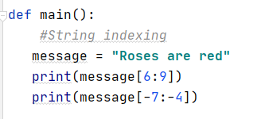

String slicing
Note if an index number is out of bounds, it is ignored and the slice will use the start or the end index.
Example:
Output:

Slide 31
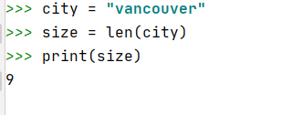
String methods: len()
Method len() returns the length (number of characters) of a string.
Example:

Slide 32
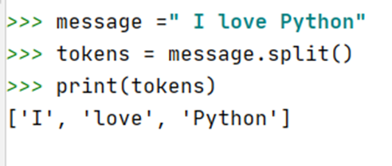
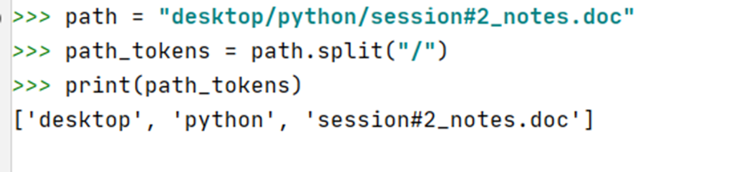
String methods: split()
Method split splits the string into a list based on a separator.
Example:

Slide 33
String methods: split()
m = "I love Python" tokens = m.split(" ") print(tokens) m = "I love Python" tokens = m.split("o") print(tokens)
['I', 'love', 'Python']
['I l', 've Pyth', 'n']

Slide 34
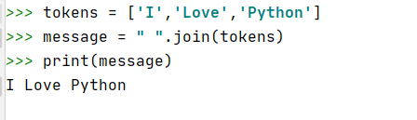
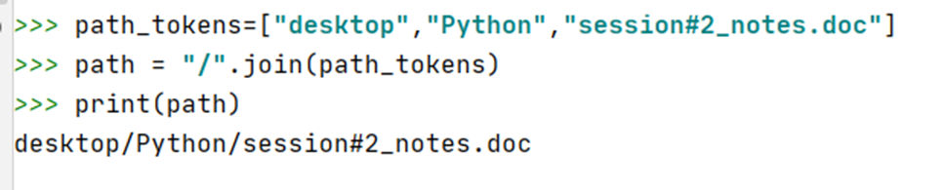
String methods: join()
Method join is opposite of split, it joins a list of strings with a separator.
Example:

Slide 35
String methods: join()
tokens = ["I", "love", "Python"]
m = "!!!".join(tokens)
print(m)
I!!!love!!!Python

Slide 36
More string methods
replace(old, new) -- Returns a copy of the string with all occurrences of the substring old replaced by the string new. The old and new arguments may be string variables or string literals.
replace(old, new, count) -- Same as above, except only replaces the first count occurrences of old.
find(x) -- Returns the position of the first occurrence of item x in the string, otherwise returns -1, if x was not in the string. x may be a string variable or string literal.
find(x, start) -- Same as find(x), but begins the search at position start
find(x, start, end) -- Same as find(x, start), but stops the search at position end
rfind(x) -- Same as find(x) but searches the string in reverse, returning the last occurrence in the string.
count(x) -- Returns the number of times x occurs in the string.

Slide 37
String methods: boolean return
isalnum() -- Returns True if all characters in the string are lowercase or uppercase letters, or the numbers 0-9.
isdigit() -- Returns True if all characters are the numbers 0-9.
islower() -- Returns True if all characters are lowercase letters.
isupper() -- Returns True if all cased characters are uppercase letters.
isspace() -- Returns True if all characters are whitespace.
startswith(x) -- Returns True if the string starts with x.
endswith(x) -- Returns True if the string ends with x.

Slide 38
String methods: string return
capitalize() -- Returns a copy of the string with the first character capitalized and the rest lowercased.
lower() -- Returns a copy of the string with all characters lowercased.
upper() -- Returns a copy of the string with all characters uppercased.
strip() -- Returns a copy of the string with leading and trailing whitespace removed.
title() -- Returns a copy of the string as a title, with first letters of words capitalized.

Slide 39




In
The in operator is used to check if an item exists in a sequence.
The in operator can be used to check if a substring exists in another string.
Example:
Output:
Output:

Slide 40
Comparing strings
Example | Expression result | Why?
'Hello' == 'Hello' | True | The strings are exactly identical values
'Hello' == 'Hello!' | False | The left hand string does not end with '!'
'Yankee Sierra' > 'Amy Wise' | True | The first character of the left side 'Y' is "greater than" (in ASCII value) the first character of the right side 'A'
'Yankee Sierra' > 'Yankee Zulu' | False | The characters of both sides match until the second word. The first character of the second word on the left 'S' is not "greater than" (in ASCII value) the first character on the right side 'Z'
'seph' in 'Joseph' | True | The substring 'seph' can be found starting at the 3rd position of 'Joseph'
'jo' in 'Joseph' | False | 'jo' (with a lowercase 'j') is not in 'Joseph' (with an uppercase 'J')

Slide 41
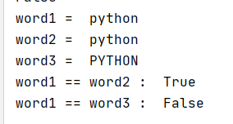
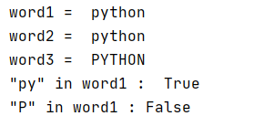
String comparison
Operator == is used to compare the equality of two String values
Example:
The in operator is used to check if one string is a substring of another.
Example:

Slide 42
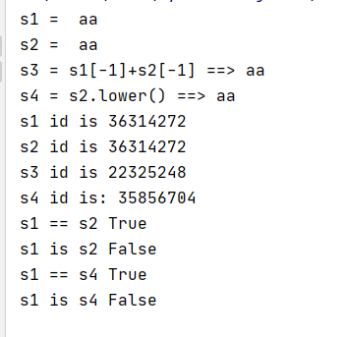
is
The is operator checks memory addresses of the String objects, not the letter contents of the string.
Example:

Slide 43
Homework
Complete the lab
Read from 8.1 to 8.9 in the book
http://do1.dr-chuck.com/pythonlearn/EN_us/pythonlearn.pdf
Prepare for next week’s quiz

