Slide 1
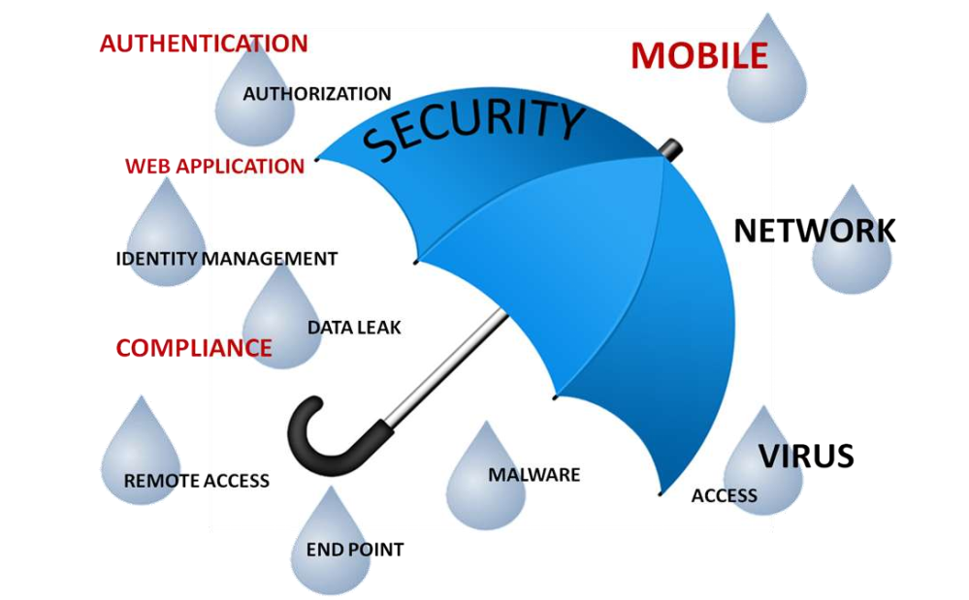
Chapter-5: Cloud Security

Slide 2
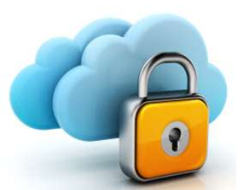
What is cloud security
Set of control-based technologies and policies designed to adhere to regulatory compliance rules and protect information, data applications and infrastructure associated with cloud computing use
Concern on
  Identity management
  Access control
  Data security and Privacy
  Business continuity
  Data breach➔ unauthorized access sensitive data
  Backup plan

Slide 3
Security Challenges
Data Protection – both in storage and transfer
User Authentication – access logs/audit trails
Contingency Planning – recovery
Service Provider Visibility & Translating Enterprise Requirements into the Cloud
Insider threat
Attacks like virtual host confusion
Shadow IT - inability of IT to monitor the activities of the user
Resource location
Multi-tenancy issue
System monitoring and logs
Cloud standards
SLA

Slide 4
Software-as-a-service Security
In this model, enterprise data is stored at the SaaS provider's data center, along with the data of other enterprises
Strong concerns about
  Data breaches
  Application vulnerabilities
  Availability that can lead to financial and legal responsibilities

Slide 5
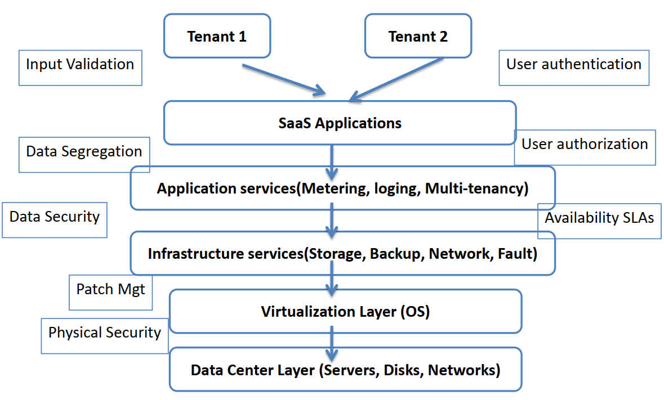
Software-as-a-service Security

Slide 6
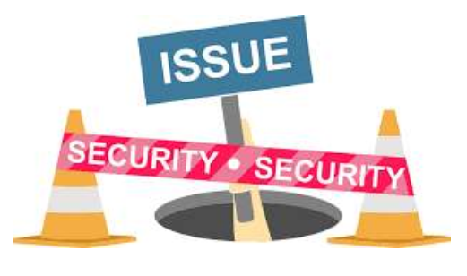
Software-as-a-service Security
Seven security issues to be discussed with cloud vendor by customer

Slide 7
Security Issues
Investigative support
Does the vendor have the ability to investigate any inappropriate or illegal activity?
Regulatory compliance
Make sure that the vendor is willing to experience external audits and/or security certifications
Data location
Does the provider allow for any control over the location of data?

Slide 8
Security Issues
Data separation
Make sure that encryption is available at all stages, and that these encryption schemes were designed and tested by experienced professionals
Recovery
  Find out what will happen to data in the case of a disaster ?
  Do they offer complete restoration? If so, how long would that take?

Slide 9
Security Issues
Privileged user access
Inquire about who has specialized access to data, and about the hiring and management of such administrators
Long-term feasibility
What will happen to data if the company goes out of business?
How will data be returned, and in what format?

Slide 10
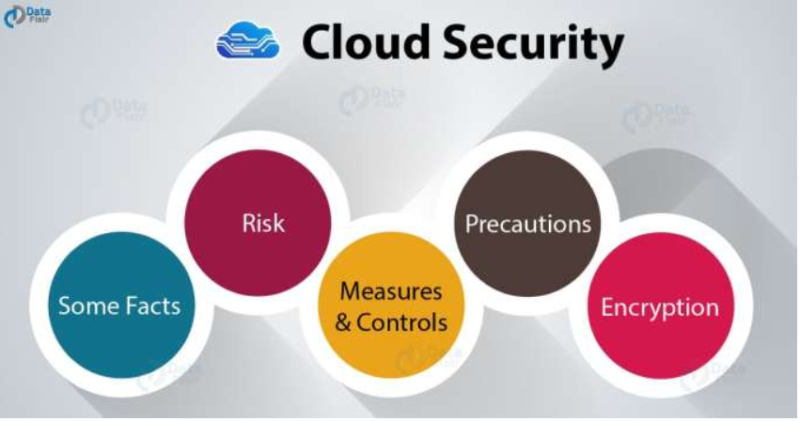
Security Issues
To address the security issues, SaaS providers need to incorporate and enhance security practices used by the managed service providers

Slide 11
Security Management (People)
Develop a formal charter for the security organization and program
A shared vision among the team of what security leadership is
In aligned with the strategic plan of the organization or company the security team works for
Clearly defined roles and responsibilities, and agreement on expectations and skills

Slide 12
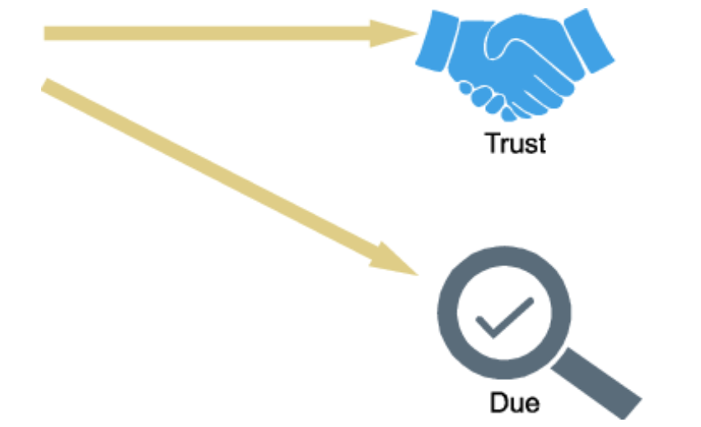
Security Governance

Slide 13
Security Governance
A security steering committee with objective of focusing on providing guidance about security initiatives and arrangement with business strategies
Clearly define the roles and responsibilities of the security team and other groups involved in performing information security functions
Security team is one of first deliverables from the steering committee.

Slide 14
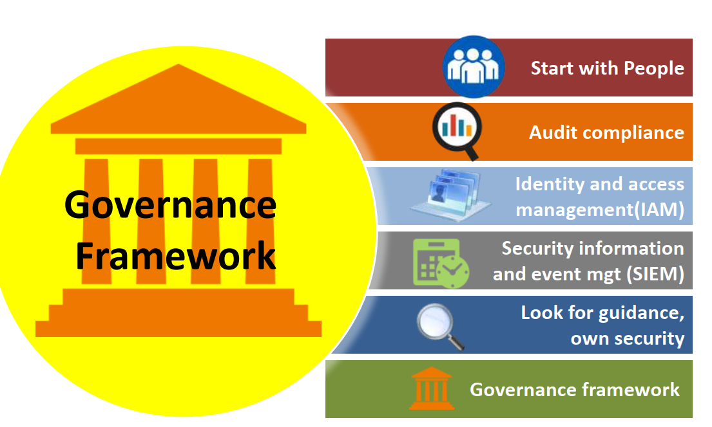
Security Governance

Slide 15
Security Governance
Start with your people: Awareness must be created among all employees about significance of
security, how it can affect the goodwill of organization and what they can and must do.
Audit compliance: It is required to make a horizontal audit compliance framework that provides a
view across all business units and combines the respective information streams.
Identity and access management (IAM): Insider threats can be overcome by a strict Identity and
Access Management solution that will allow IT managers to track privileged access to sensitive data
and also allow them to assign or revoke (cancel) these privileges.
Security information and event management (SIEM): Combines security incident and security
event management to ensure a complete view of the organization’s security posture.
Look for guidance but ensure your own security: Cloud Security Alliance (CSA) provides good
security guidance for cloud computing.
  Use standards as guidance and develop your own security policies to build security governance framework
Governance framework solution: Build a framework by using Business Service Management (BSM)
solution that has drill-down functionality to all IT governance, risk and compliance (GRC) and
security elements.

Slide 16
Risk Management
Risk management is the process of identifying, assessing and controlling threats to an organization’s capital earnings
The total process of identifying, controlling, and eliminating or minimizing uncertain events that may affect system resources. It includes:
  Risk analysis,
  Cost benefit analysis,
  Selection,
  Implementation and test,
  Security evaluation of safeguards, and
  Overall security review

Slide 17
Risk Management (Security)
Effective risk management requires:
  Identification of technology assets;
  Identification of data and its links to business processes, applications, and data stores;
  Assignment of ownership and safeguarding responsibilities
  A formal risk assessment process should be created that allocates security resources linked to business continuity

Slide 18
Risk Management (Security)
Owners have authority and accountability for information assets including
  Protection requirements,
  Implement confidentiality
  Integrity
  Availability
  Privacy controls
Risk Assessment
  should proactively assess information security risks as well as plan and manage them on a periodic or as-needed basis
  More detailed and technical security risk assessments in the form of threat modeling should also be applied to applications and infrastructure
  It can help the product management and engineering groups to be more proactive in designing and testing the security of applications and systems and to collaborate more closely with the internal security team
  Threat modeling requires both IT and business process knowledge, as well as technical knowledge of how the applications or systems under review work

Slide 19
Security Monitoring
  Centralized security information management systems should be used to provide notification of
  security vulnerabilities and to monitor systems continuously through automated technologies to identify potential issues
  They should be integrated with network and other systems monitoring processes
    security information management
    security event management
    security information and event management, and
    security operations centers that use these systems for dedicated 24/7 monitoring

Slide 20
Secure Software Development Life Cycle (SecSDLC)
It involves identifying specific threats and the risks they represent, followed by design and implementation of specific controls to counter those threats and assist in managing the risks they pose to the organization and/or its customers
The SDLC consists of six phases which are listed below:
  Investigation: Define project processes and goals, and document them in the program security
  policy.
  Analysis: Analyze existing security policies and programs, analyze current threats and controls,
  examine legal issues, and perform risk analysis.
  Logical design: Develop a security blueprint, plan incident response actions, plan business responses to disaster, and determine the feasibility of continuing and/or outsourcing the project.
  Physical design: Select technologies to support the security blueprint, develop a definition of a successful solution, design physical security measures to support technological solutions, and review and approve plans.
  Implementation: Buy or develop security solutions. At the end of this phase, present a tested package to management for approval.
  Maintenance: Constantly monitor, test, modify, update, and repair to respond to changing threats.

Slide 21
Security Architecture Design
A security architecture framework should be established with consideration of processes, operational procedures, technology specifications, people and organizational management, and security program compliance and reporting.
A security architecture document should be developed that defines security and privacy principles
to meet business objectives.
A design and implementation program should also be integrated with the formal system development life cycle to include a business case, requirements definition, design, and implementation plans.
Technology and design methods should be included, as well as the security processes necessary to provide the following services across all technology layers:
  Authentication
  Authorization
  Availability
  Confidentiality
  Integrity
  Accountability
  Privacy

Slide 22
Read More
Data Security
Application Security
Virtual Machine Security
Managing images
Monitoring VMs
Networking
Integrity, Confidentiality and Privacy

