Slide 1
Adding music to board games
MTA20436

Slide 2
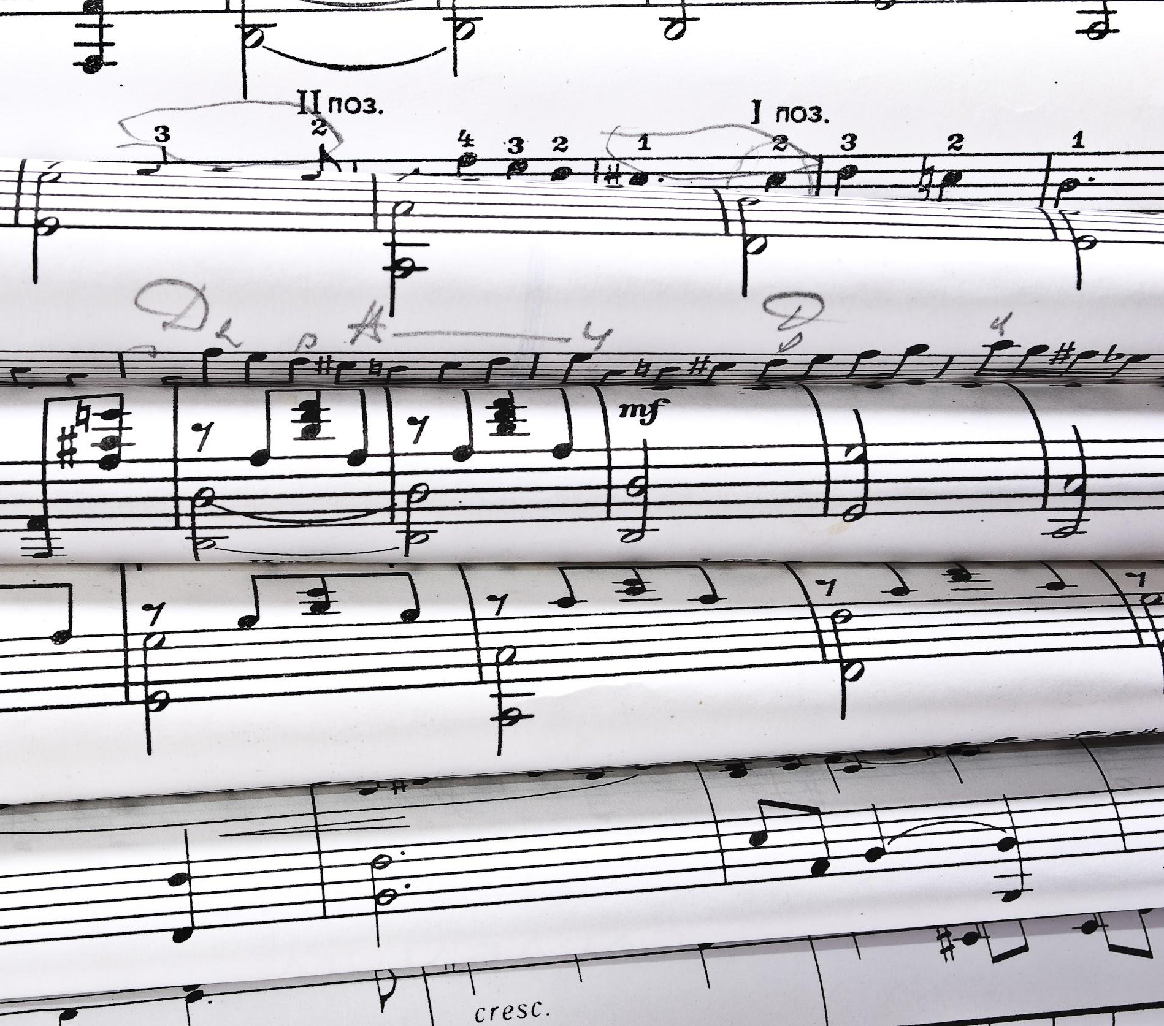
Music
An important aspect of our lives
Present in almost all media
Used to create an atmosphere or evoke emotions

Slide 3
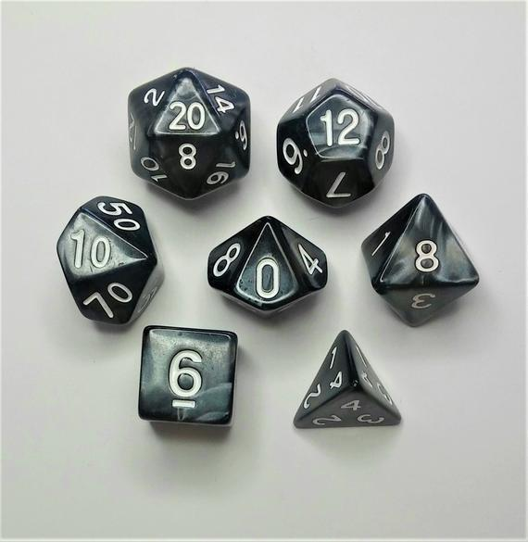
Board games
Most of them lack music/sounds
Tabletop role-playing games (TRPGs) can greatly benefit from music
Dungeons and Dragons (DnD) as an example
Immersion is an important aspect

Slide 4
Creating a solution
External device, eliminating the need of a computer or a smartphone
No need of internet connection
Designed for the person running the game - Dungeon master (DM)
Uses a memory card to store needed sounds
Has its own speaker

Slide 5
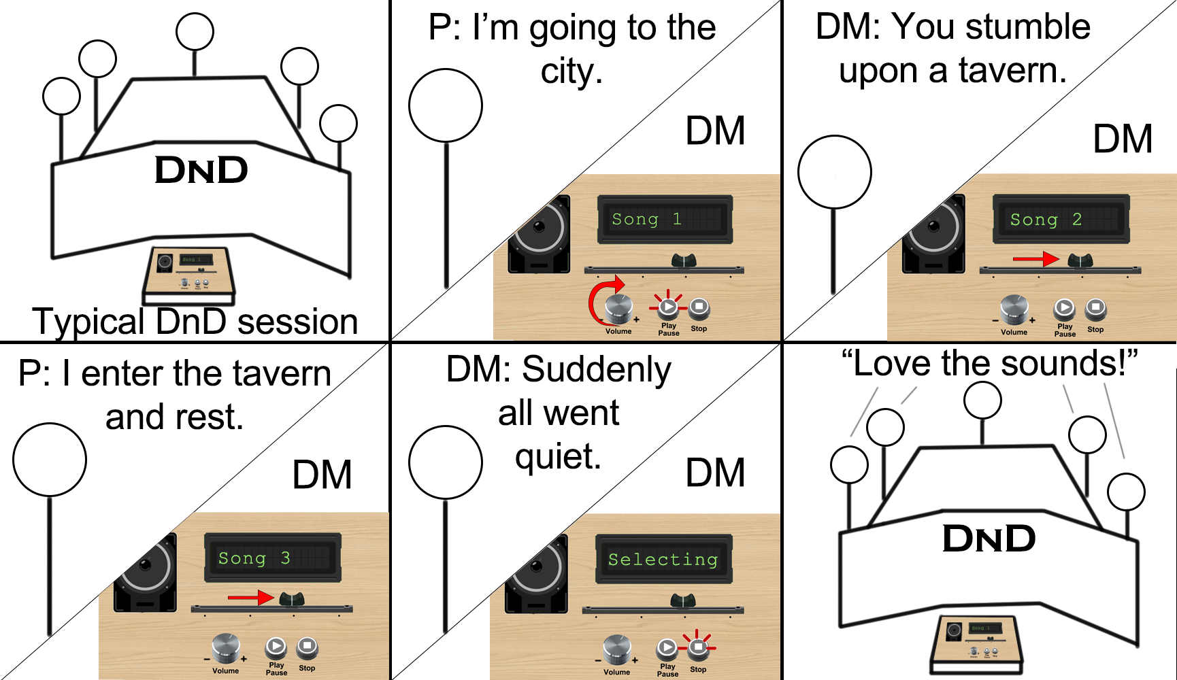

Slide 6
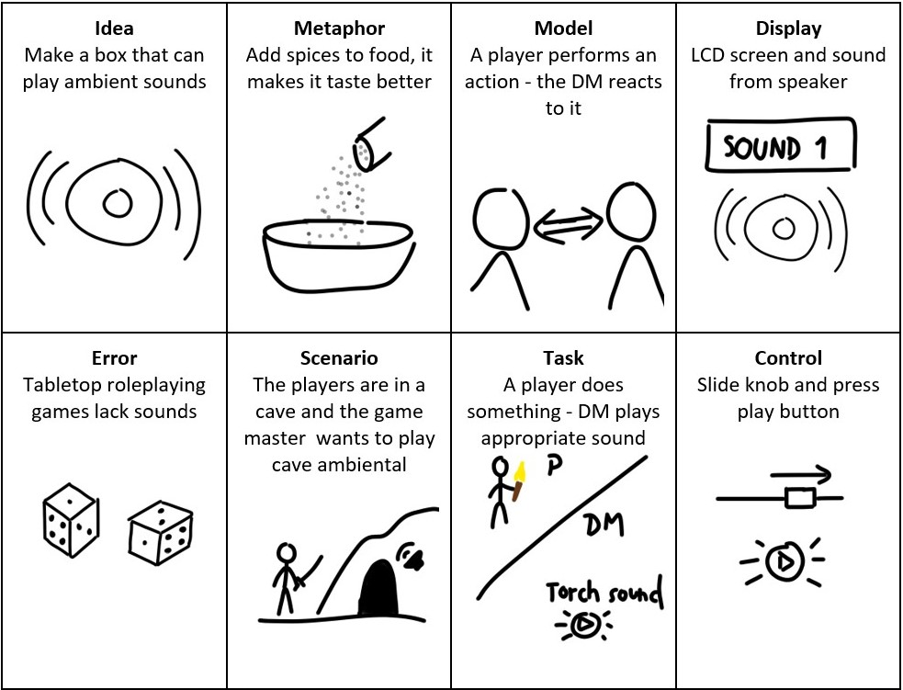
Interaction design framework

Slide 7
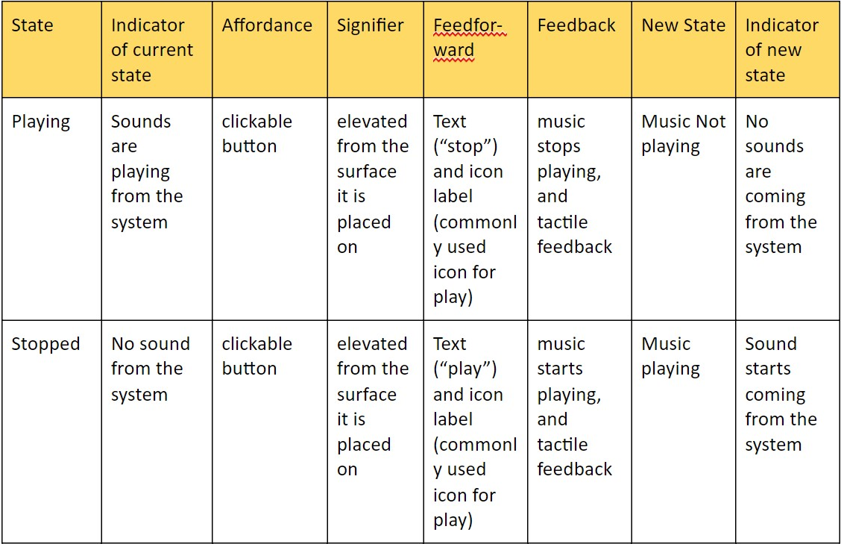
Mapping scheme

Slide 8
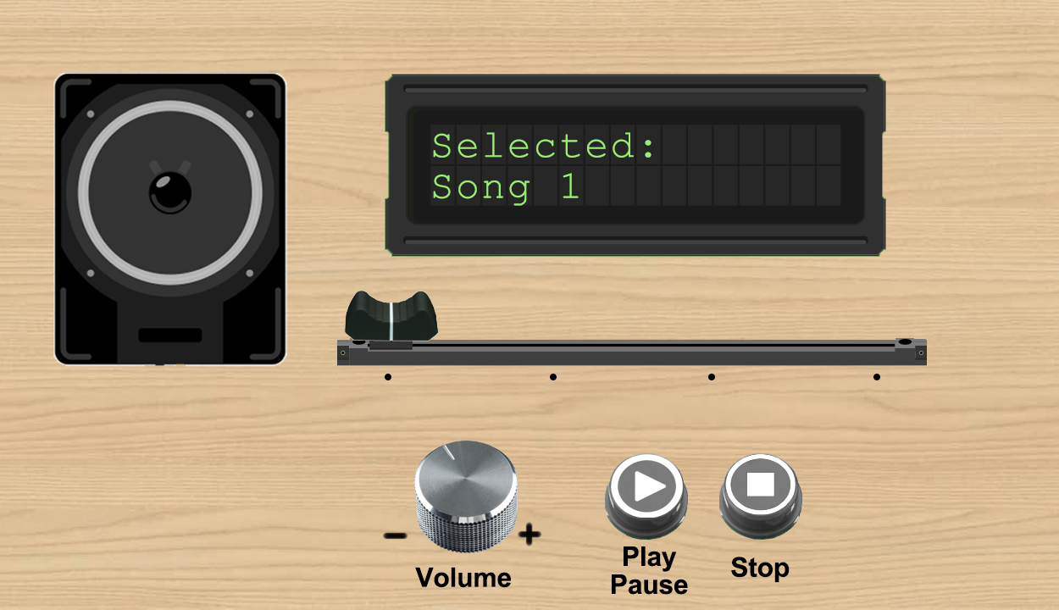

Slide 12
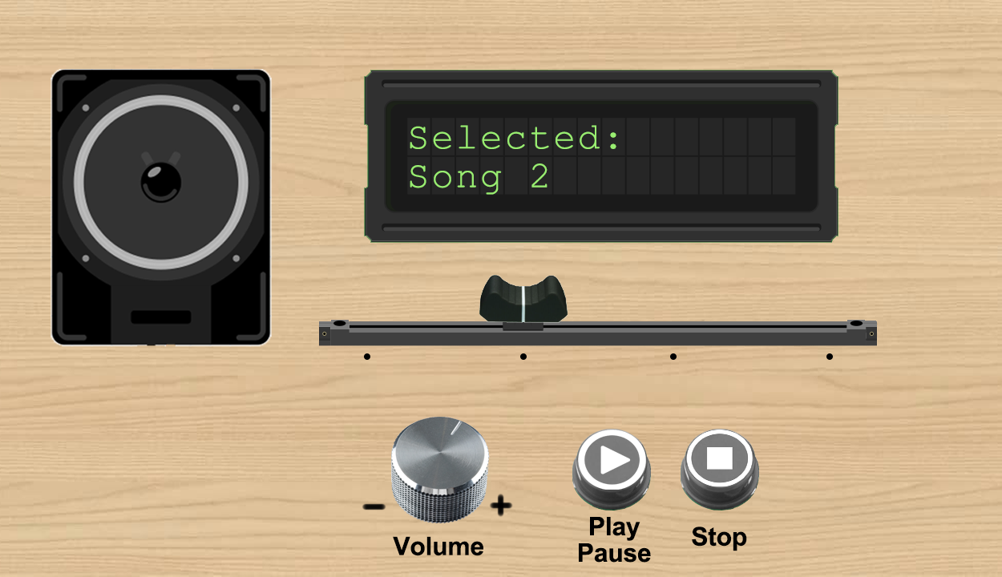

Slide 16
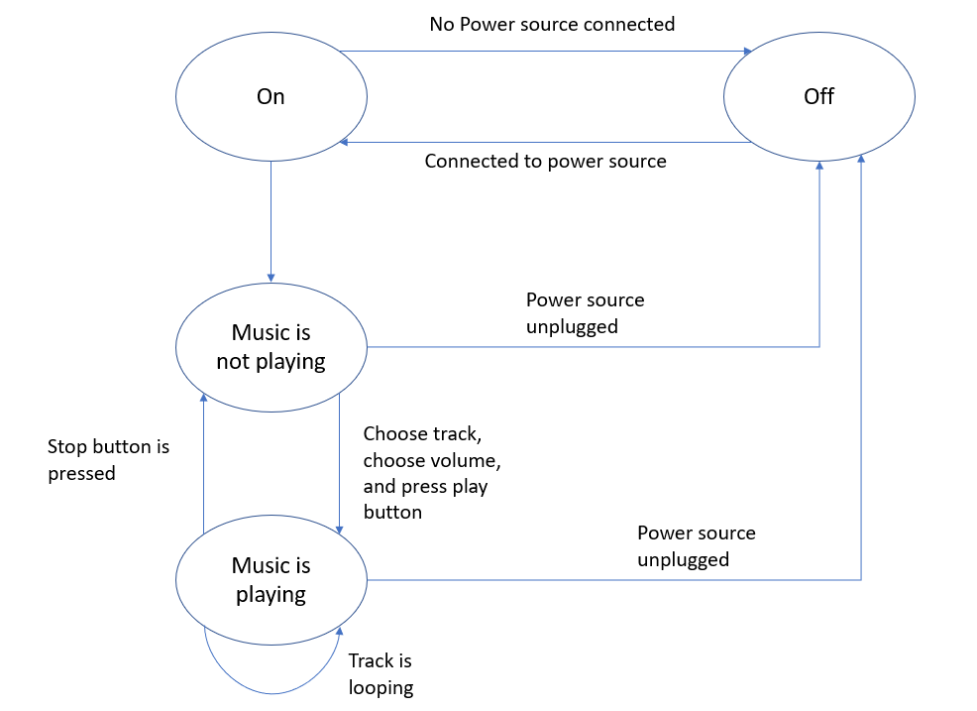
State diagram

Slide 17
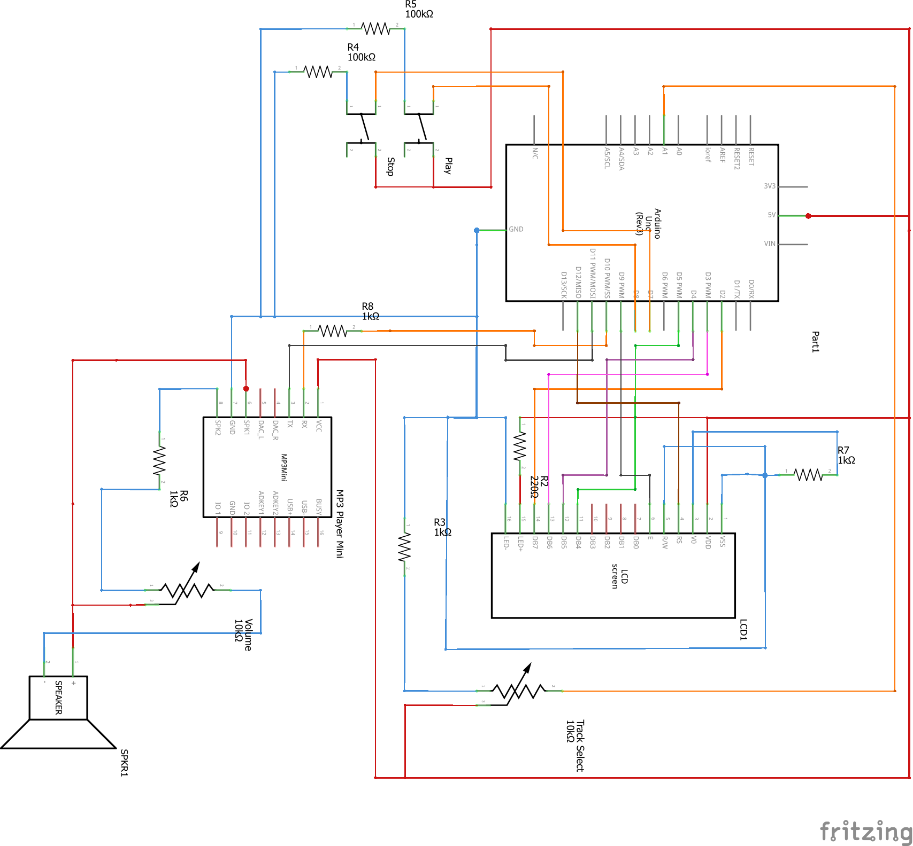
Schematics
Arduino
LCD screen
DF player mini
Speaker
Buttons
Slider
Resistors

Slide 18
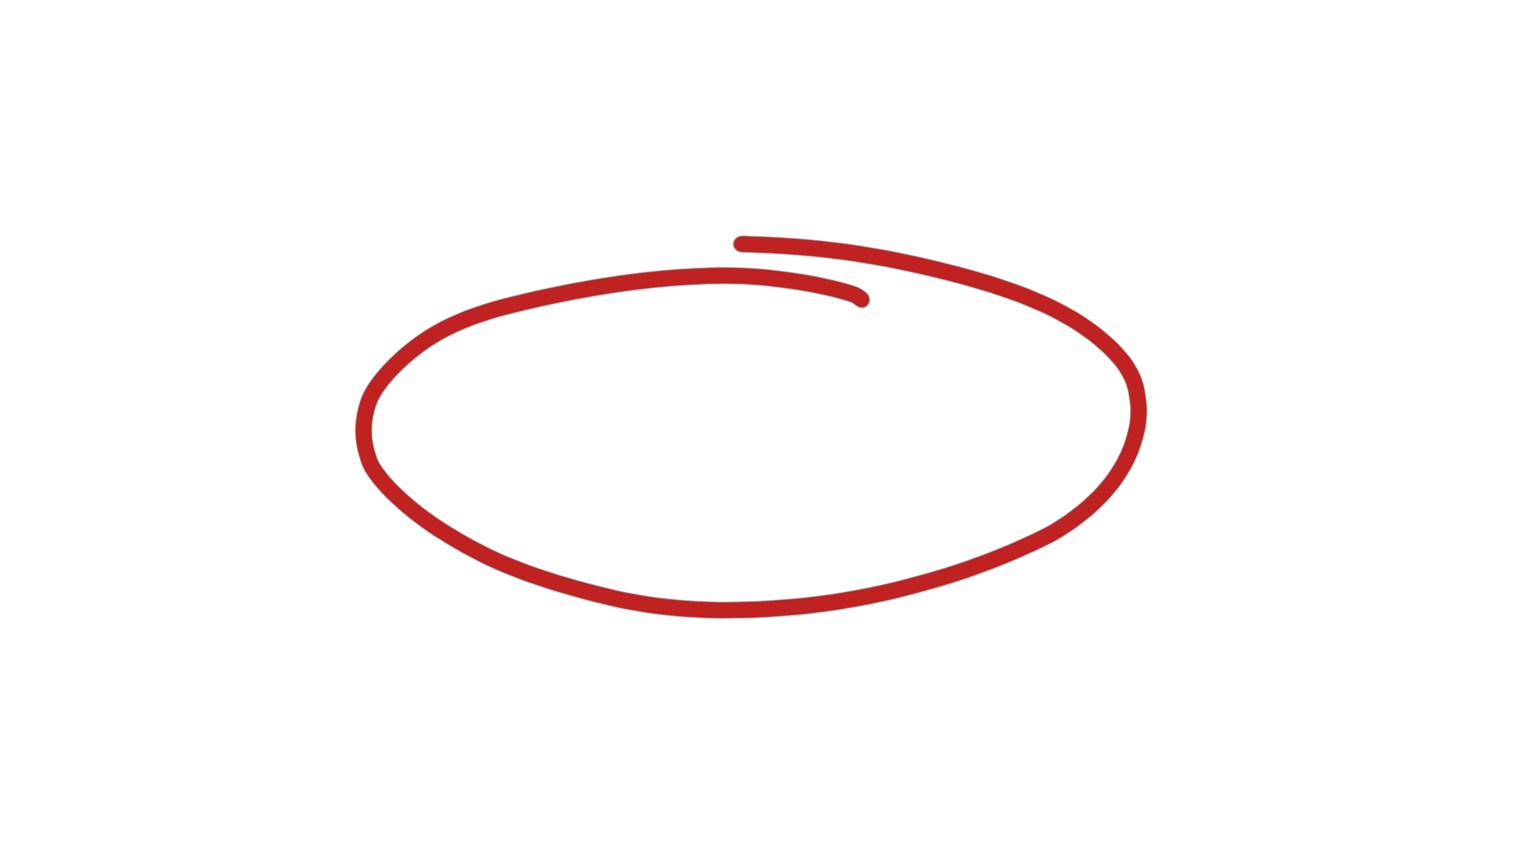
Schematics
Arduino
LCD screen
DF player mini
Speaker
Buttons
Slider
Resistors

Slide 19
Schematics
Arduino
LCD screen
DF player mini
Speaker
Buttons
Slider
Resistors

Slide 21
Sliding potentiometer
Used to change songs
Feedback on LCD screen
Values 0-1023

Slide 22
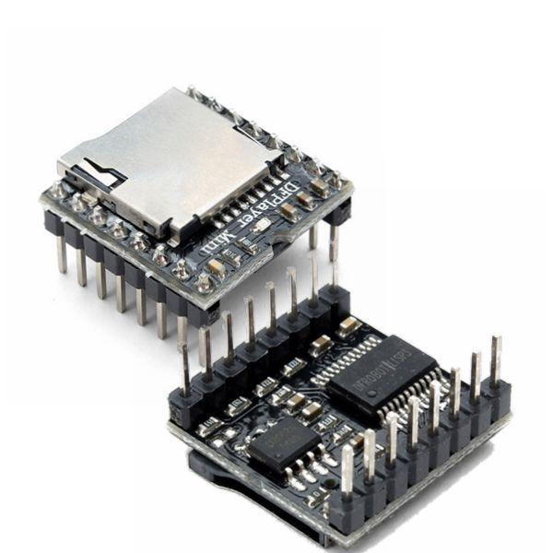
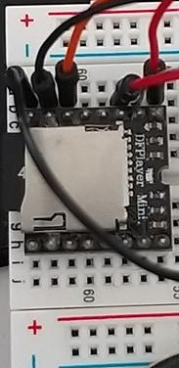

Slide 23
Speaker
Plays the selected tracks
Volume controlled by rotary potentiometer

Slide 24
Speaker
Plays the selected tracks
Volume controlled by rotary potentiometer

Slide 25

Evaluation plan
6 participants
Online evaluation
Using sketch of the device
Scenario
Tasks
GDPR

Slide 26

Tasks
Play song 1
Change the volume of the song
Stop song 1
Choose and play song 2
Stop song 2

Slide 27
The scenario
“You are the Dungeon Master of a small Dungeons and Dragons session in which you need to play certain tracks to immerse one of the players, which will be me, in the game by playing songs. You have a device in front of you, which is the sketch that we sent you previously. Your goal is to complete the following tasks and inform me once you think you completed each one of them.”

Slide 28
Evaluation results
Possible future improvements:
Comments about the slider
Speaker placement
Qualitative data
Tasks completed successfully

Slide 29
Thank you for your attention

Slide 30
Made by:
Magnus Kornbeck Thomsen
Freja Bøcher Kaastrup Johansen
Mikkel Sang Mee Baunsgaard
Oscar Bill Zhou
David Mockovsky
Andrei-Calin Mares
of MTA20436

