Slide 1



An introduction to Graph Databases
Mikkel Valentin Sørensen
https://www.linkedin.com/in/mikkelvalentinsorensen
https://github.com/mikkelvalentinsorensen

Slide 2
A bit of History
What has happen on a technology level

Slide 3
Flat-file Databese
/etc/passwd on *nix systems:
root:x:0:0:root:/root:/bin/bash
daemon:x:1:1:daemon:/usr/sbin:/usr/sbin/nologin
bin:x:2:2:bin:/bin:/usr/sbin/nologin
sys:x:3:3:sys:/dev:/usr/sbin/nologin
sync:x:4:65534:sync:/bin:/bin/sync
games:x:5:60:games:/usr/games:/usr/sbin/nologin
man:x:6:12:man:/var/cache/man:/usr/sbin/nologin
lp:x:7:7:lp:/var/spool/lpd:/usr/sbin/nologin
Examples:
CSV files
/etc/passwd and /etc/fstab (on Linux and Unix-like systems)

Slide 4
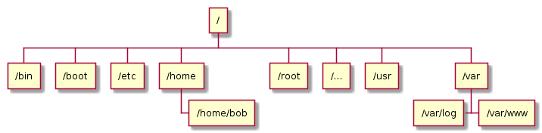
Hierarchical databases
Examples:
Filesystems
DNS
LDAP directories
Notes:
Initial introduction: 1960s

Slide 5
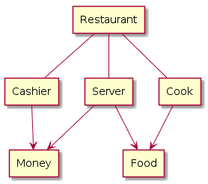
Network databases
Examples:
IDMS
Notes:
Initial introduction: late 1960s

Slide 6
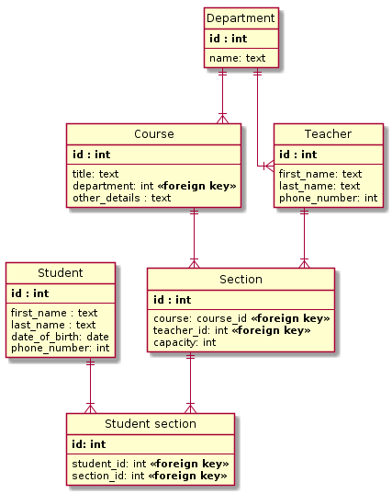
Relational databases
Examples:
MS-SQL
MySQL
PostgreSQL
SQLite
Notes:
Initial introduction: 1969

Slide 7
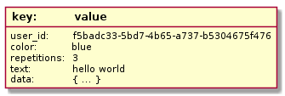
NoSQL databases (Key value pair)
Examples:
Redis
memcached
Notes:
Initial introduction: 1970s | Rise in popularity: 2000-2010

Slide 8
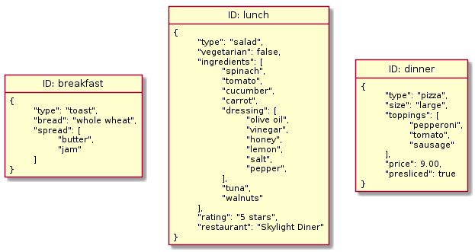
NoSQL (Document databases)
Examples:
MongoDB
RethinkDB
Notes:
Rise in popularity: 2009

Slide 9
How does data truly look?
If the data model does not represent the data it describes, the data will be incorrect.

Slide 10

Like this?

Slide 11
Probably more, like this.

Slide 12
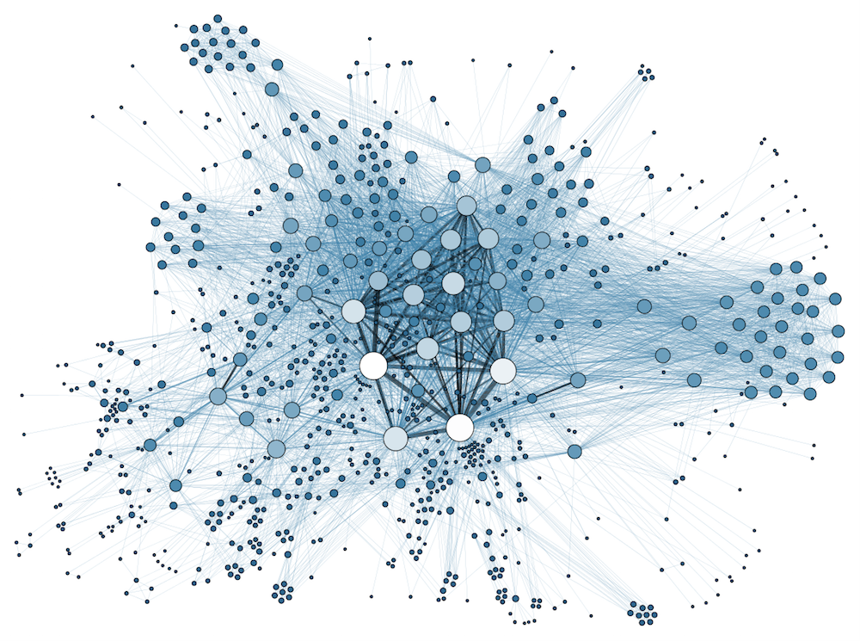
But how does it actually look

Slide 13
Modeling Challenges
Let us look at some of the current modeling challenges.

Slide 14
Modeling components
Entities – Noun: Person, Place, Thing
Relations – Verb: Action, Relations
Properties – Adjective: Definition, Elaboration

Slide 15
Strong Entities / Weak Relations
You have to extend a Entity to create an relation.
You have to create an Entity to elaborate on a Relation
Owners on Entities have to be aware off Relations
Many to many relations are trouble some

Slide 16
This is mikkel:Person
:Person
name: “Mikkel”

Slide 17
mikkel:Person > Works_At > valtech:Company
:Person
name: “Mikkel”
:Company
name: “Valtech”
Works_At
since: “2017-11-01”

Slide 18
Demo

Slide 19
Life is complicated
Model so you get it is correct

Slide 20

* This is Mikkel falling in love

Slide 21
Demo
I know you are thinking “Mikkel please show me how love looks like in a graph database.”

Slide 22
The reason for data is it’s relation to decisions
Make choices based on fact.

Slide 23
A “way to” quick look at Machine Learning

Slide 24
Traditional decisions
Traditional Programming
Data
Answers
Rules

Slide 25
Machines learn like this.
Machine Learning
Answers
Rules
Data

Slide 26
Continuous machine learning.
Machine Learning
Historical Answers
Rules
Historical Data
Machine Execution
Rules
Answers
New Data

Slide 27
Q&A

Slide 28
More info:
https://www.prisma.io/blog/comparison-of-database-models-1iz9u29nwn37
https://www.cleverism.com/graph-databases-effective-big-data-analytics/
https://oxygen.dk/indsigt/machine-learning

Slide 29
A node, which represents an entity. This can be a person, a place, a thing and so on.
A relationship, which is the connection between two separate nodes.

Slide 30
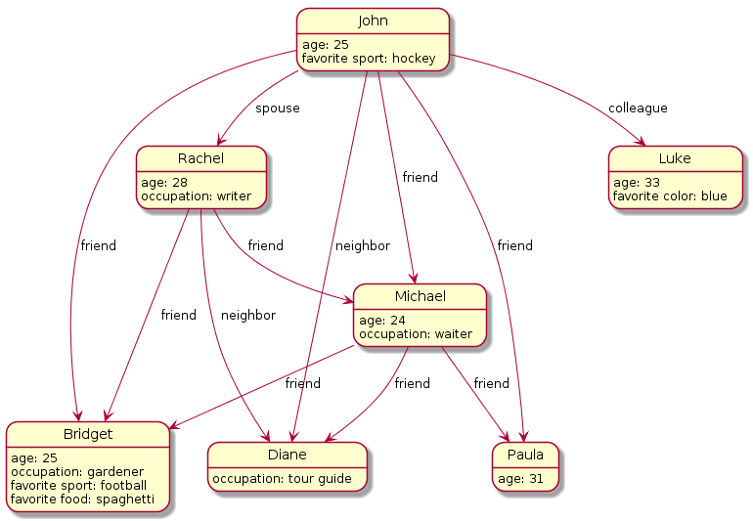
Graph databases
Examples:
Neo4j
JanusGraph
Dgraph
Notes:
Rise in popularity: 2000s

