Slide 1



An introduction to Graph Databases
Mikkel Valentin Sørensen
https://www.linkedin.com/in/mikkelvalentinsorensen
https://github.com/mikkelvalentinsorensen

Slide 2
The reason for data is it’s relation to decisions
Make choices based on fact.

Slide 3
A “way to” quick look at Machine Learning

Slide 4
Traditional decisions
Traditional Programming
Data
Answers
Rules

Slide 5
Machines learn like this.
Machine Learning
Answers
Rules
Data

Slide 6
Continuous machine learning.
Machine Learning
Historical Answers
Rules
Historical Data
Machine Execution
Rules
Answers
New Data

Slide 7
A bit of History
What has happen on a technology level

Slide 8
Flat-file Databese
/etc/passwd on *nix systems:
root:x:0:0:root:/root:/bin/bash
daemon:x:1:1:daemon:/usr/sbin:/usr/sbin/nologin
bin:x:2:2:bin:/bin:/usr/sbin/nologin
sys:x:3:3:sys:/dev:/usr/sbin/nologin
sync:x:4:65534:sync:/bin:/bin/sync
games:x:5:60:games:/usr/games:/usr/sbin/nologin
man:x:6:12:man:/var/cache/man:/usr/sbin/nologin
lp:x:7:7:lp:/var/spool/lpd:/usr/sbin/nologin
Examples:
CSV files
/etc/passwd and /etc/fstab (on Linux and Unix-like systems)

Slide 9
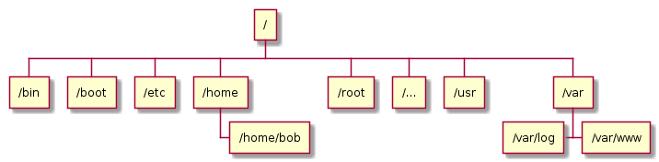
Hierarchical databases
Examples:
Filesystems
DNS
LDAP directories
Notes:
Initial introduction: 1960s

Slide 10
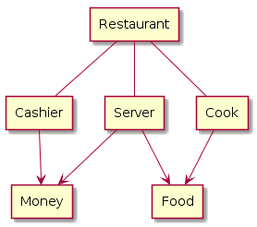
Network databases
Examples:
IDMS
Notes:
Initial introduction: late 1960s

Slide 11
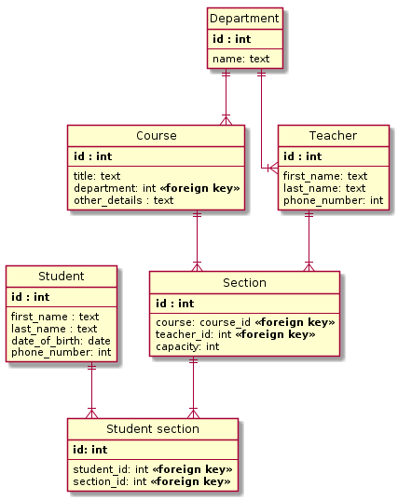
Relational databases
Examples:
MS-SQL
MySQL
PostgreSQL
SQLite
Notes:
Initial introduction: 1969

Slide 12
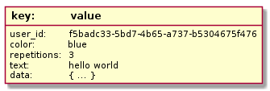
NoSQL databases (Key value pair)
Examples:
Redis
memcached
Notes:
Initial introduction: 1970s | Rise in popularity: 2000-2010

Slide 13
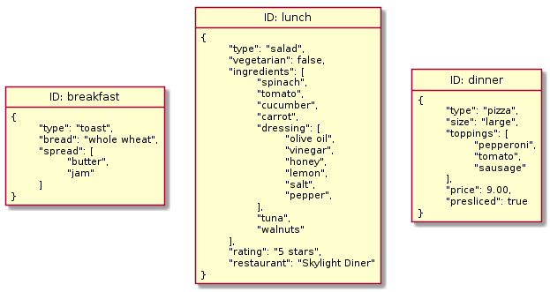
NoSQL (Document databases)
Examples:
MongoDB
RethinkDB
Notes:
Rise in popularity: 2009

Slide 14
How does data truly look?
If the data model does not represent the data it describes, the data will be incorrect.

Slide 15

Like this?

Slide 16
Probably more, like this.

Slide 17
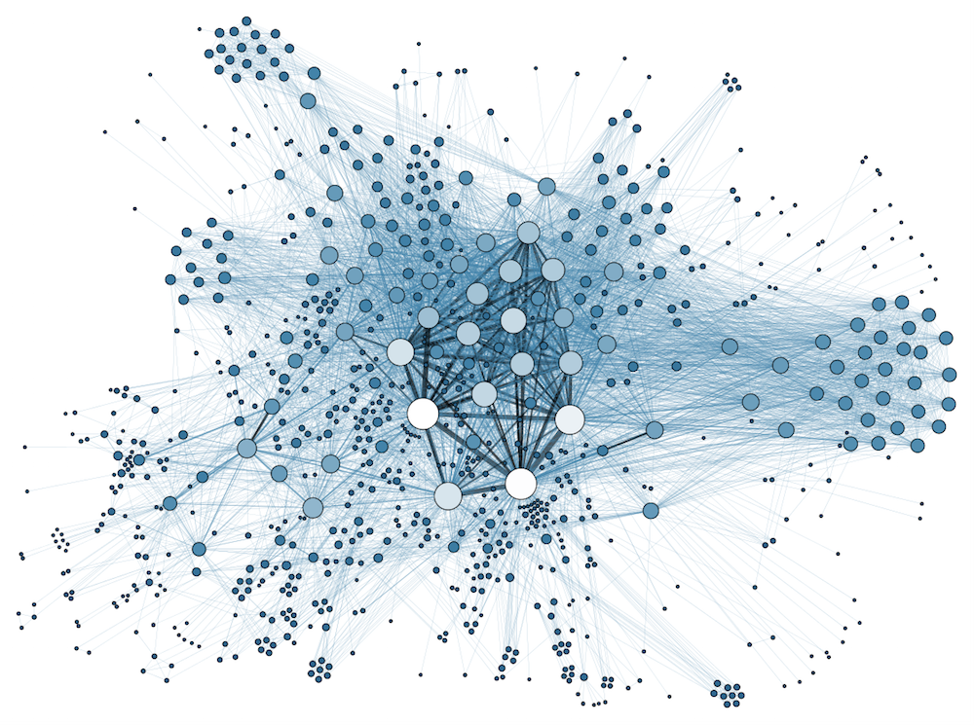
But how does it actually look

Slide 18
Modeling Challenges
Let us look at some of the current modeling challenges.

Slide 19
Modeling components
Entities – Noun: Person, Place, Thing
Relations – Verb: Action, Relations
Properties – Adjective: Definition, Elaboration

Slide 20
Strong Entities / Weak Relations
You have to extend a Entity to create an relation.
You have to create an Entity to elaborate on a Relation
Owners on Entities have to be aware off Relations
Many to many relations are trouble some

Slide 21
This is mikkel:Person
:Person
name: “Mikkel”

Slide 22
mikkel:Person > Works_At > valtech:Company
:Person
name: “Mikkel”
:Company
name: “Valtech”
Works_At
since: “2017-11-01”

Slide 23
Demo

Slide 24
Life is complicated
Model so you get it is correct

Slide 25

* This is Mikkel falling in love

Slide 26
Demo
I know you are thinking “Mikkel please show me how love looks like in a graph database.”

Slide 27
Take away
Model your data “more” like what is represents.

Slide 28
Q&A
Presentation, code and docker environment is downloadable at:
https://github.com/mikkelvalentinsorensen/MikValSor.GraphDBIntroTalk

