Slide 1


HEXATRONIC
ATTRIBUTES GUIDE
QGIS v3.28/3.22

Slide 2
MANDATORY
OPTIONAL
AUTO-GENERATED
MANUAL(IF NECESSARY)

Slide 3
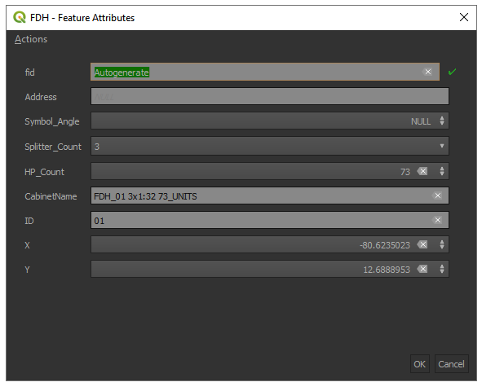
FDH
FDH Number, please include 0
(i.e. 01,02) for single digit numbers

Slide 4
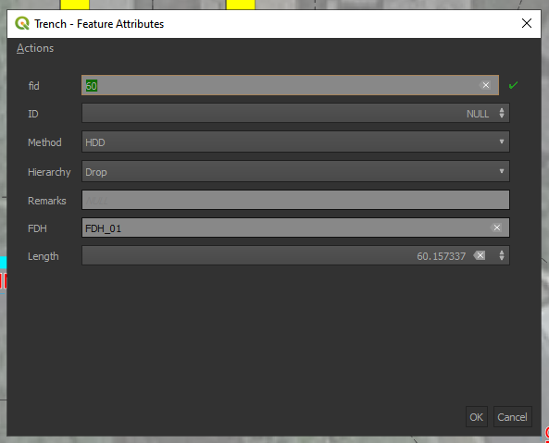
Trench
Customer_Trench, HDD, Open_Trench

Slide 5
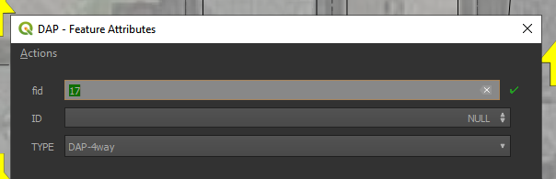
DAP
DAP, DAP-1way,DAP-2way, DAP-3way, DAP-4way

Slide 6
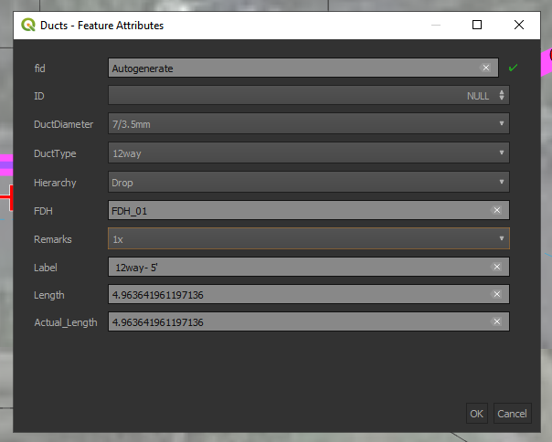
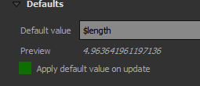
Duct
1way, 12way, 24way
Multiplier
Manual change needed(Length will come from actual trench route)
Turn this off when manually changing the value

Slide 7
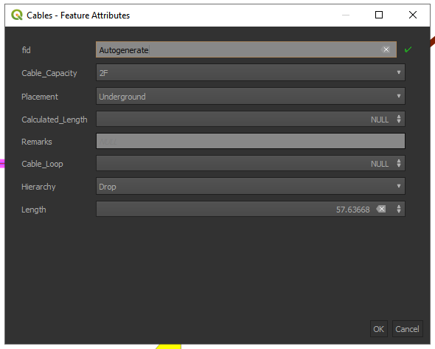
Cables

