Slide 1

Acme Gatekeeper
Enforcement and policy solution for production AI

Slide 2

What we will cover
01
The problem
governance lags adoption in enforcement
02
The gateway
one deterministic door in front of every model
03
Proof
what a customer got in under an hour
04
Roadmap and pricing
where this goes and what it costs

Slide 3

Fast-growing companies adopt AI faster than they can control it
A fifty-person engineering team might now connect eight model providers across product, support, and internal tools - with zero unified audit trail, unpredictable monthly token invoices, and no automated compliance checks.

Slide 4
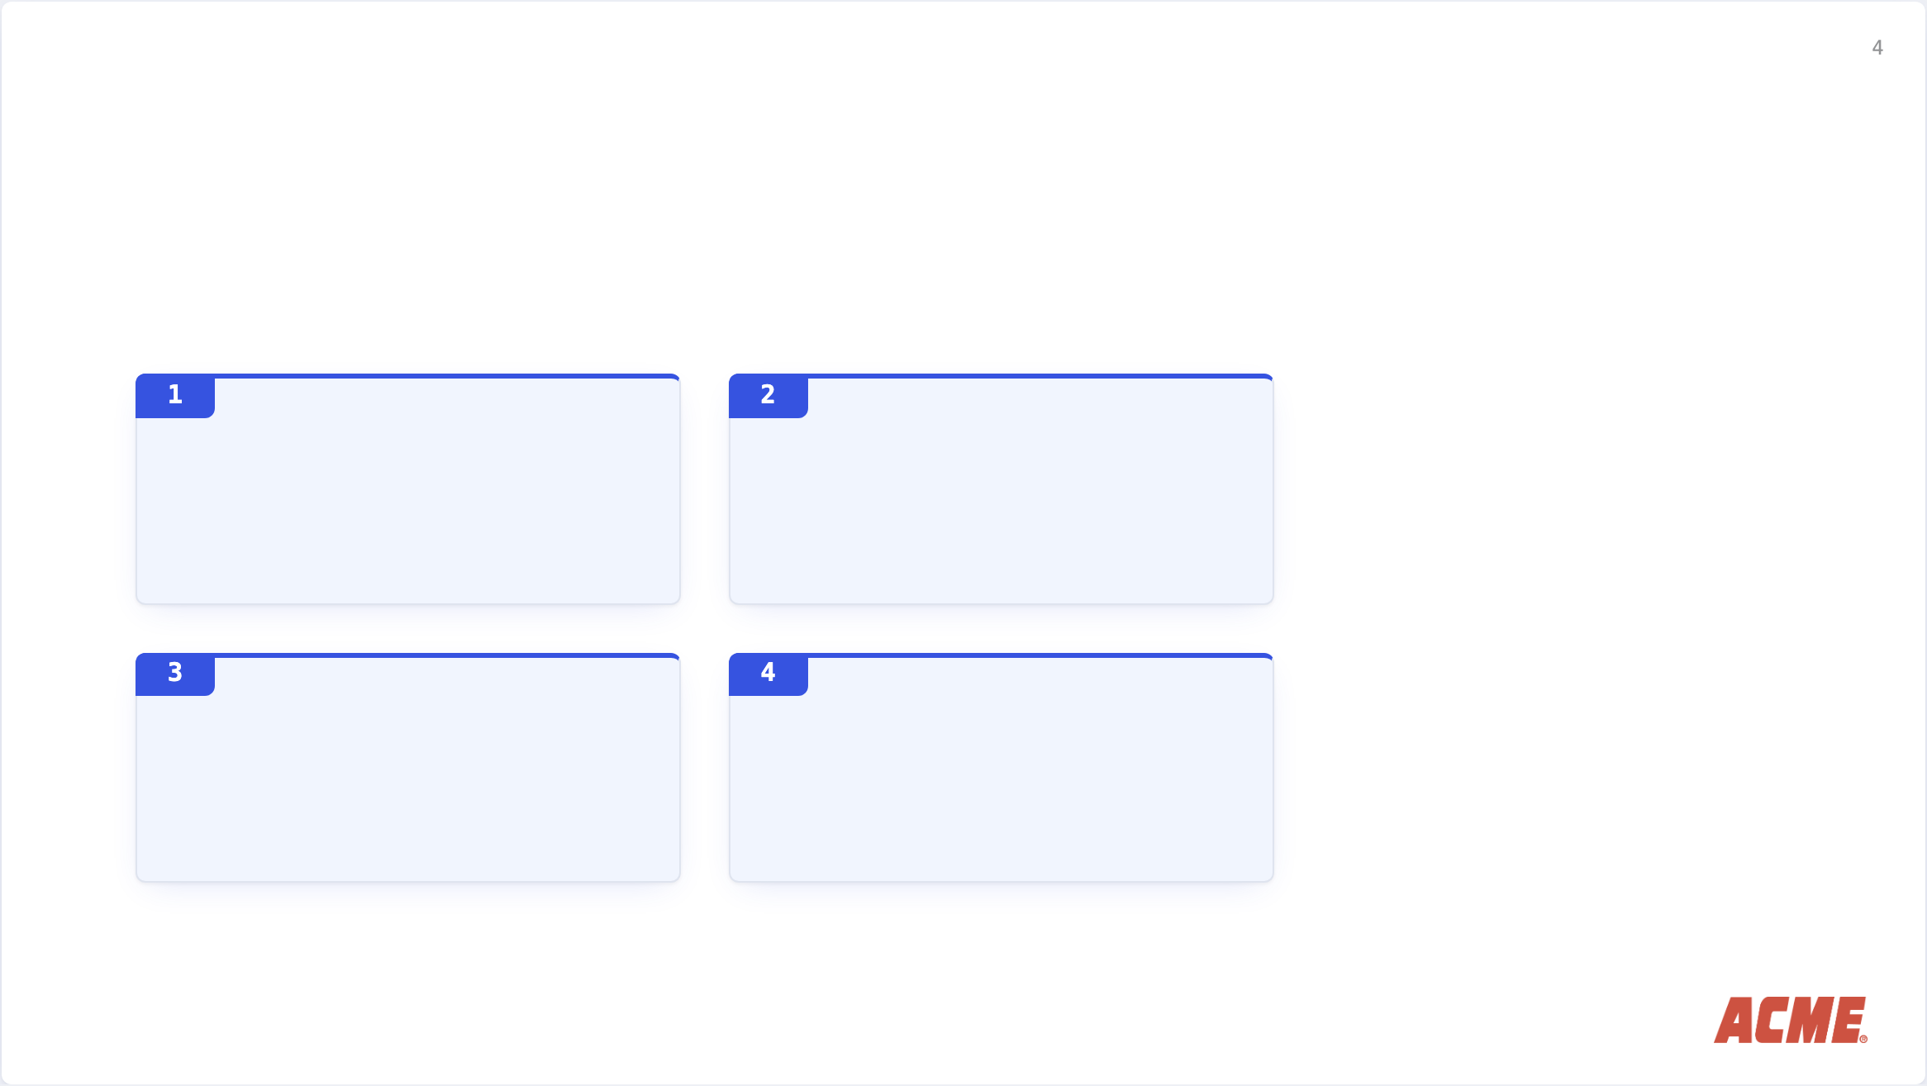
What that costs them
Customer audit failures when enterprise clients ask
Surprise token spikes discovered only at billing
Fragmented policies written in ad-hoc prompt code
Unchecked PII and secret leaks across shadow tools

Slide 5

How does it work
A single deterministic gateway in front of every model
Every outbound LLM call passes through Acme before reaching upstream providers.Policies evaluate through Open Policy Agent (OPA), keeping rules declarative, version-controlled, and testable in CI/CD.
Zero changes to existing application code: swap one base URL in your client configuration and enforce policy on day one.

Slide 6

How Acme protects your workload
Enforce
Record
Redact
Comply
OPA inspects and validates requests before egress.
Immutable event stream of prompt hashes, latency, and tokens.
Real-time PII masking and secret prevention at the wire.
Instant audit packages for ISO 27001, SOC 2, and GDPR.

Slide 7

Operating with & without Acme
Today
With Acme
Audit trail
Audit trail
Ad-hoc log queries
Signed event stream (7 yrs)
Cost allocation
Cost allocation
Aggregate month-end bill
Per-team attribution, live
Policy enforcement
Policy enforcement
Confluence guidelines
Declarative OPA bundles
Provider onboarding
Provider onboarding
Weeks of security review
15-minute credential update
Data residency
Data residency
Unknown routing
Guaranteed EU-only egress

Slide 8

When our enterprise bank clients asked for our AI data governance records, we delivered verified OPA enforcement logs in under an hour. Acme turned a potential sales blocker into our strongest trust proof.
VP of Engineering, Series B Fintech (Stockholm)

Slide 9

Where Acme plays
Prompt guidelines
ACME: Gateway policy
cheap, and nobody follows them
one URL swap, every call governed
impact on risk
Manual audits
Model retraining
weeks of work per review
months, and the risk moves elsewhere
effort to adopt

Slide 10

Acme by the numbers
5 min
500 000
$2.4M
200 Mtok/s
to first governed call
avg requests a day through customers' gateways
of token spend attributed to teams last quarter
peak throughput, no added latency

Slide 11

Product roadmap \ 2027
Q1
Q2
Q3
Q4
Turnkey OPA policy bundles for basic compliance.
Real-time semantic budget limits and anomalous spend throttling.
Air-gapped on-premise appliances and self-hosted VPC agents.
Native zero-trust egress connectors for sovereign European LLMs.

Slide 12

Transparent, usage-based pricing
Tier
Workspaces
Monthly Requests
Retention & Compliance
Price
Team
3
Up to 500k reqs
90-day signed logs
490 € / mo
Business
10
Up to 5M reqs
2-year audit vault
1 450 € / mo
Enterprise
Unlimited
Custom volume
7-year vault + VPC
Custom

Slide 13

Built by infrastructure engineers
Founded by former payment security and distributed systems leads from More Inc and Bank of Tor. We built Acme after managing compliance across 400+ LLM services internally. Today, Acme governs production traffic across 18 European tech companies.
400+
18
EU
LLM services governed internally before Acme
European tech companies in production today
residency and egress by default

Slide 14

Start enforcing AI in production today
Get in touch for a 30-minute architecture review or deploy a self-hosted trial.

