Slide 1

AI governance with Saidot
The product today, and the road to enforcement
Strawman for discussion
September 2026

Slide 2
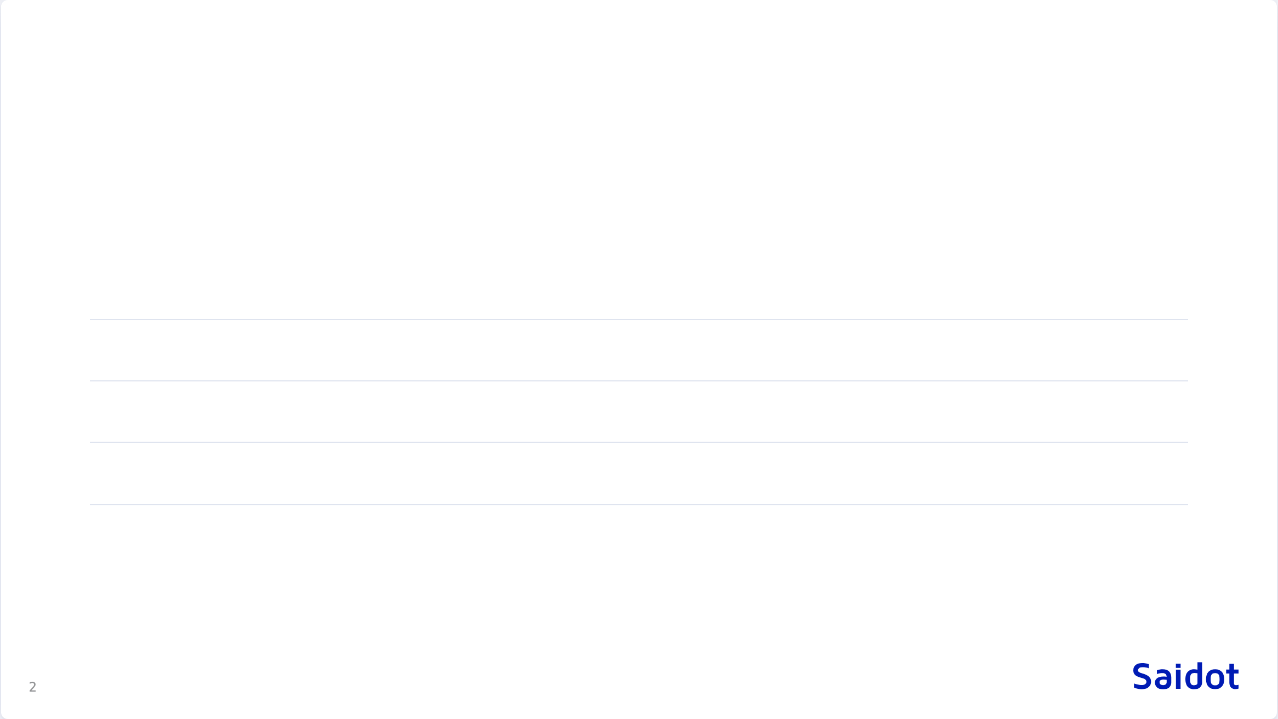
What we will cover
01
Saidot today
one graph, one library, one system of record
02
Agentic use
the API and the MCP servers
03
Two camps
semantics on one side, enforcement on the other
04
The layer model
governance, policy as code, runtime, compliance
05
Roadmap
what ships, what is proposed, what is open

Slide 3

Saidot today
Govern AI systems, models and agents in one connected graph.

Slide 4
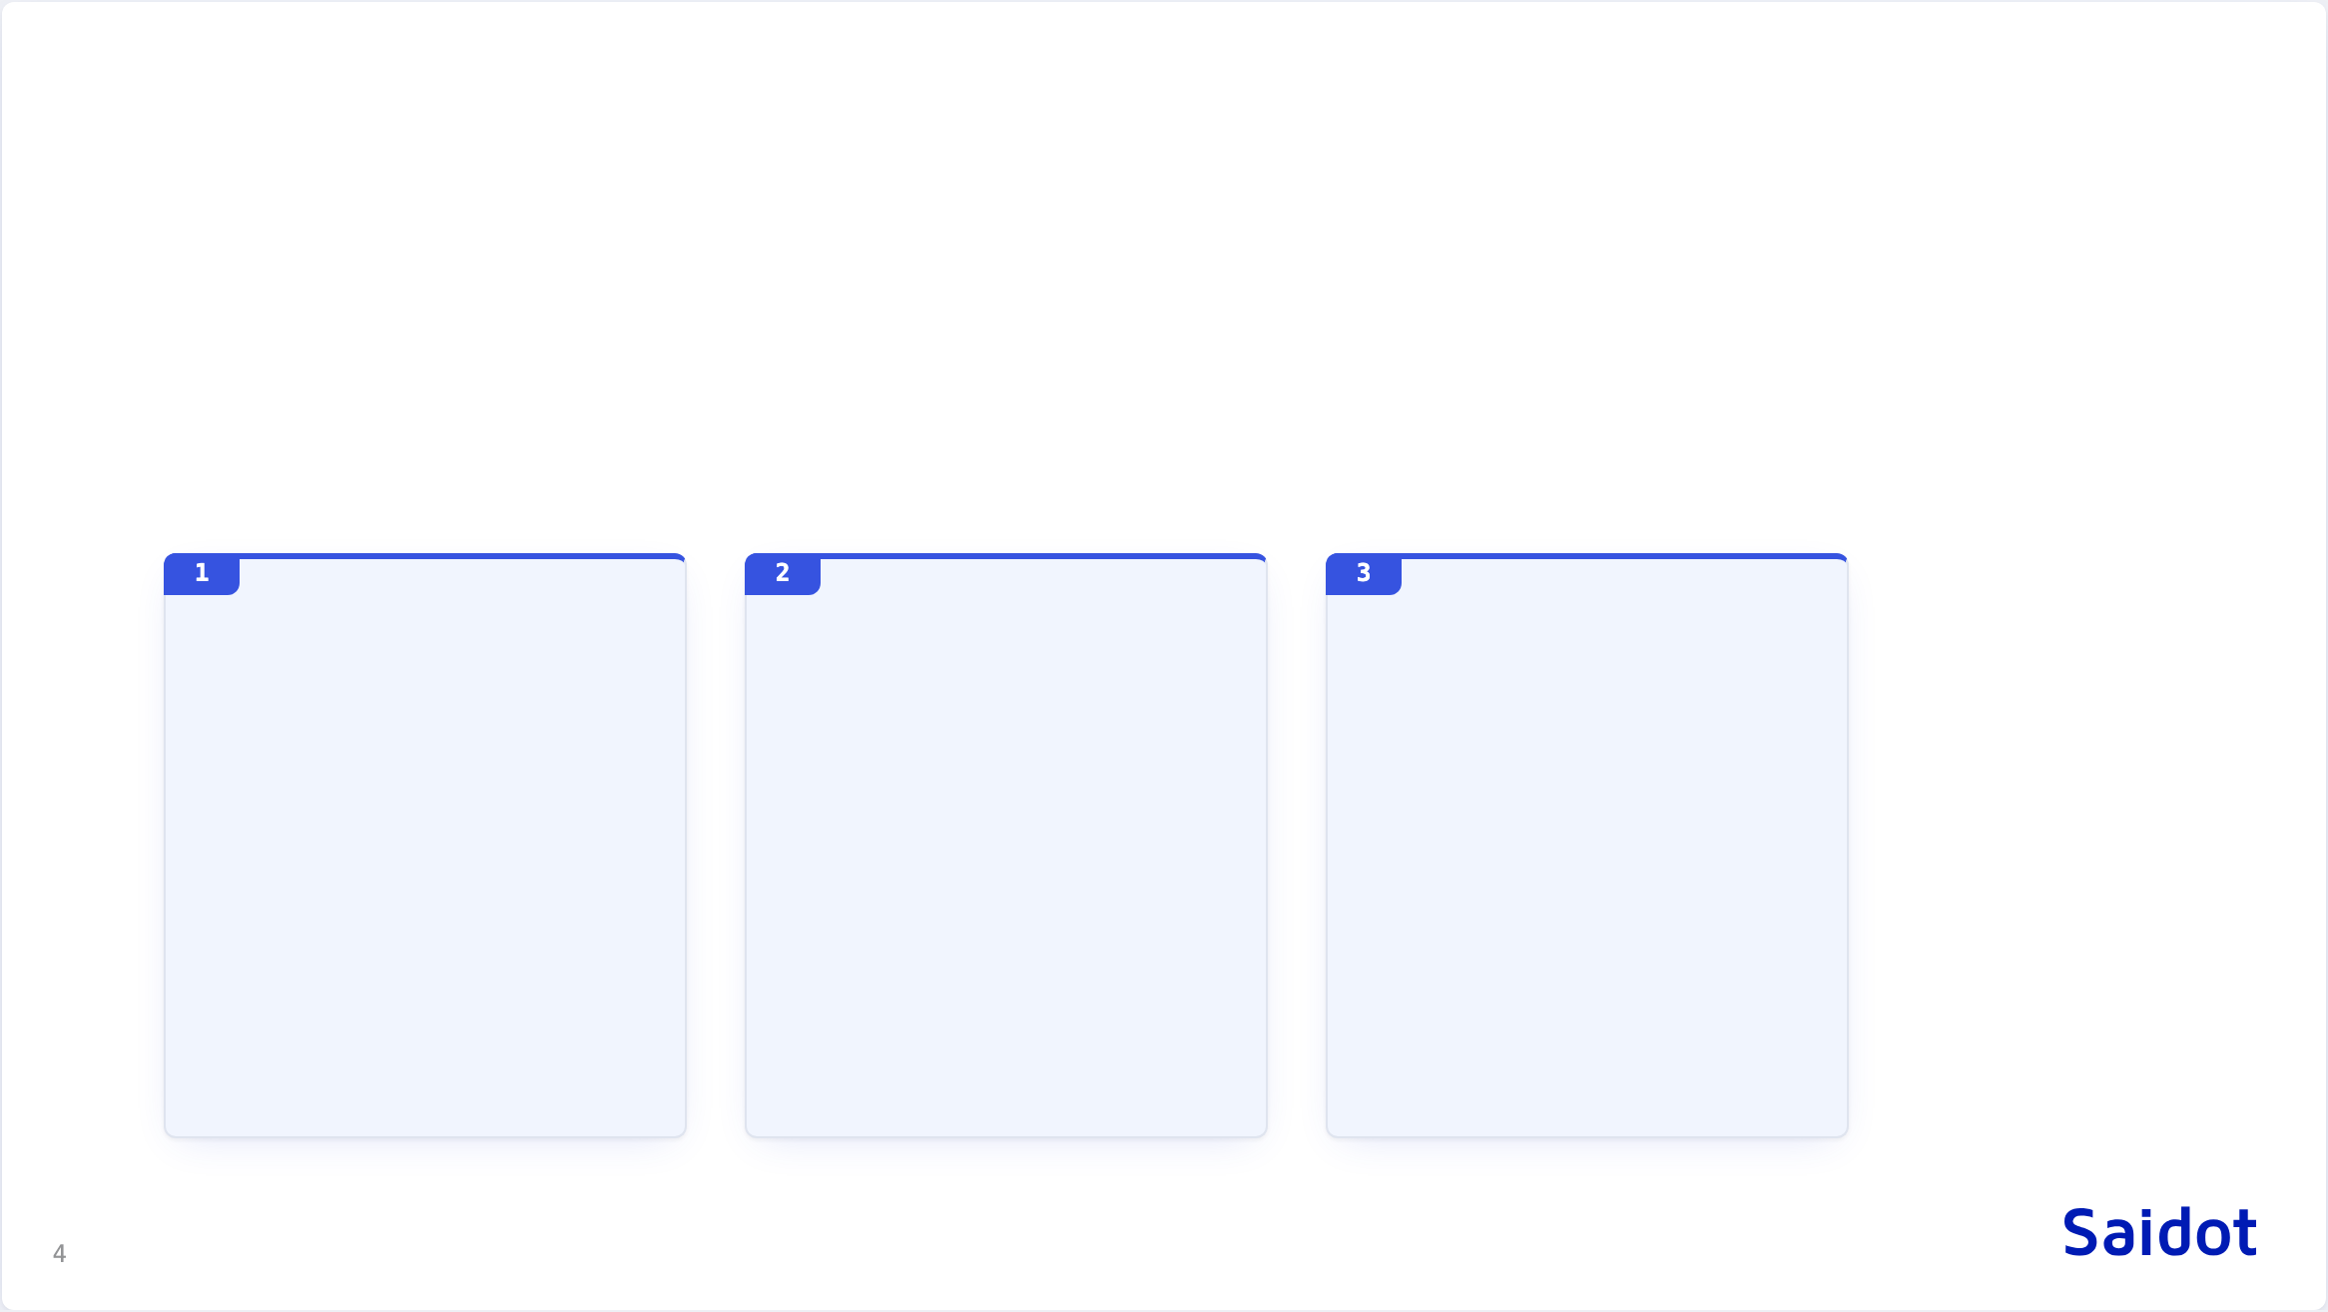
The problem
Governance cannot keep pace with AI in production
No single view of AI systems, models and agents
Every framework governed separately
Governance has become the bottleneck
EU AI Act, ISO 42001, NIST AI RMF and internal policy are each mapped by hand, then evidenced again. Every new jurisdiction restarts the work.
A mandate to move faster collides with manual review. Data scientists meet governance as a brake.
Models, agents, datasets and suppliers are tracked separately. Nobody can say which models power which products, or what breaks when one is swapped.

Slide 5
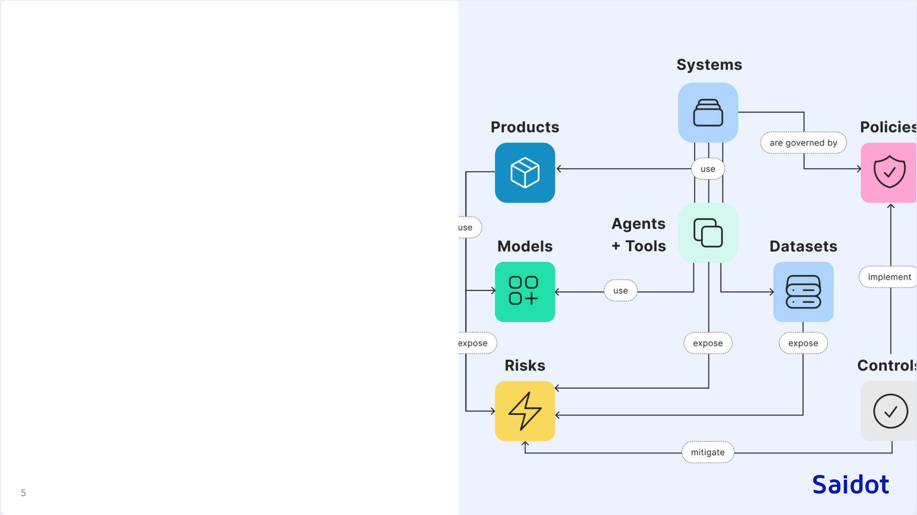
One graph
The Saidot graph connects products, systems, models, agents, tools, datasets, risks, policies, controls, evidence and incidents.
Govern once, inherit everywhere. A control set on a model reaches every system that uses it, and a risk exposed by a dataset reaches every agent reading from it.

Slide 6

The library
260+
620+
110+
170+
risks
controls
policies
third-party AI models
Curated and versioned by Saidot. Nobody starts AI governance from a blank page.

Slide 7

What sets Saidot apart
Graph-native governance
Expertise productised in the library
Integrated into AI infrastructure
Built on a graph, not on questionnaires. Scales to thousands of systems and inventories past fifty thousand entries, where form-based tools collapse under volume.
Software bundled with regulatory knowledge, delivered as a continuously updated service.
MCP servers and APIs connect runtimes to governance: set controls, collect evidence, orchestrate approvals. The system of record for AI governance, inside the AI infrastructure.

Slide 8

Agentic use
95% of the platform is operable through the API. The MCP servers put it in front of an agent.

Slide 9
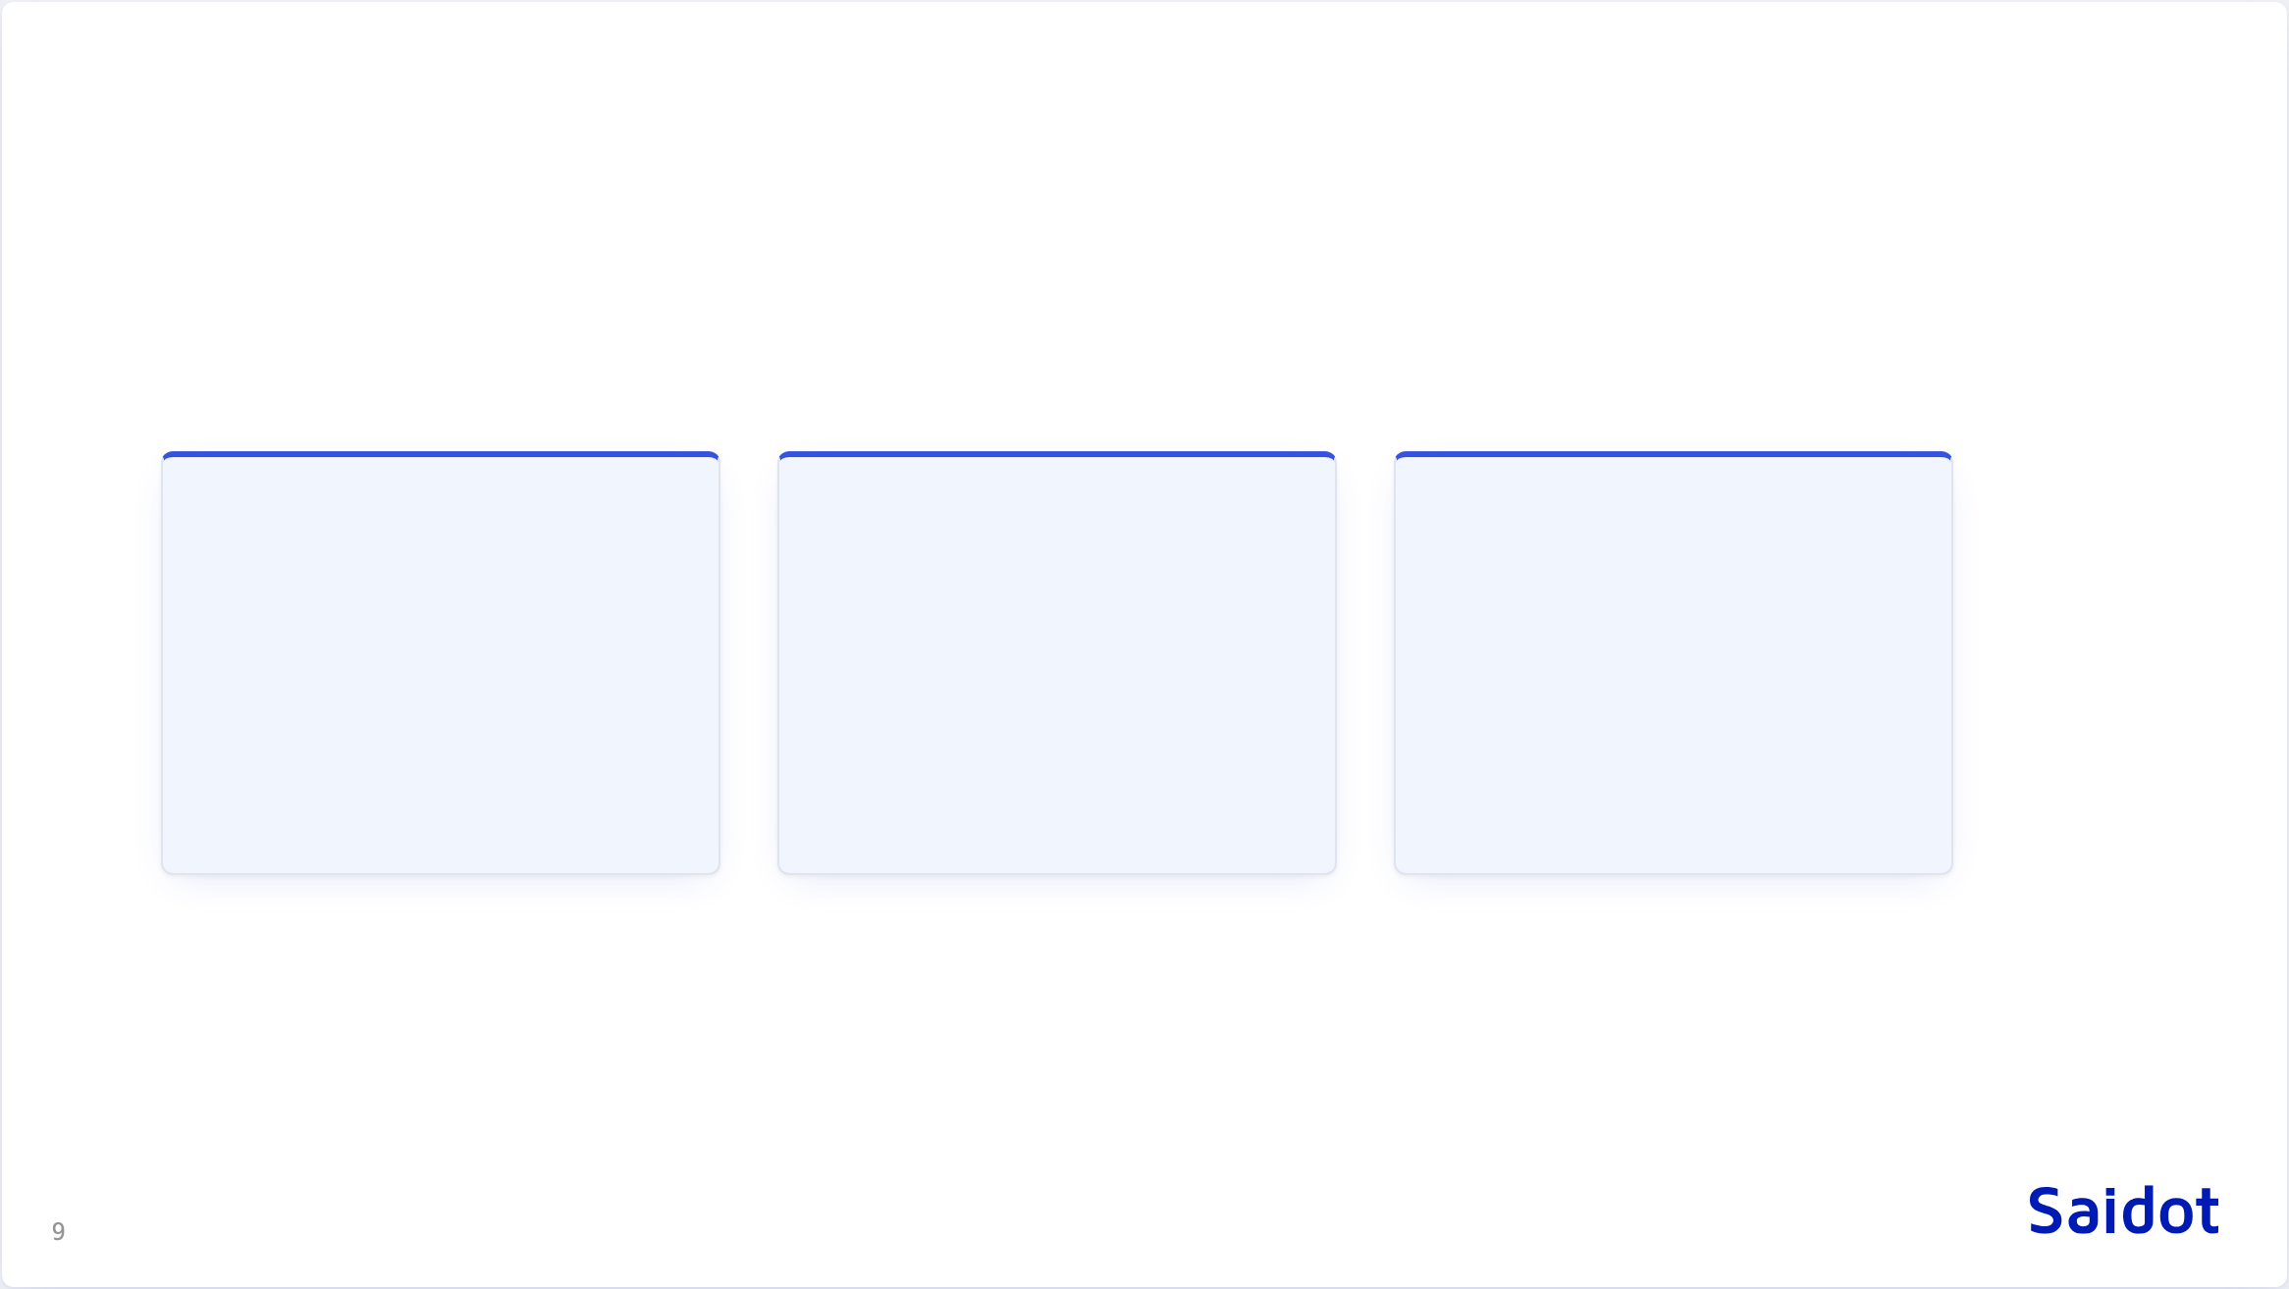
MCP servers
Governance MCP
Library MCP
Docs MCP
AI inventory and catalogue management: create, read and update systems, models, agents, datasets, risks and controls.
Read access to the curated library: policies, risks, models, products, evaluations and controls.
Governance documentation and methodology guidance.
Cloud hosted over HTTP for Claude Desktop, VS Code, Cursor and other MCP clients. Docker over stdio for local or on-premise use, alongside the IDE.

Slide 10
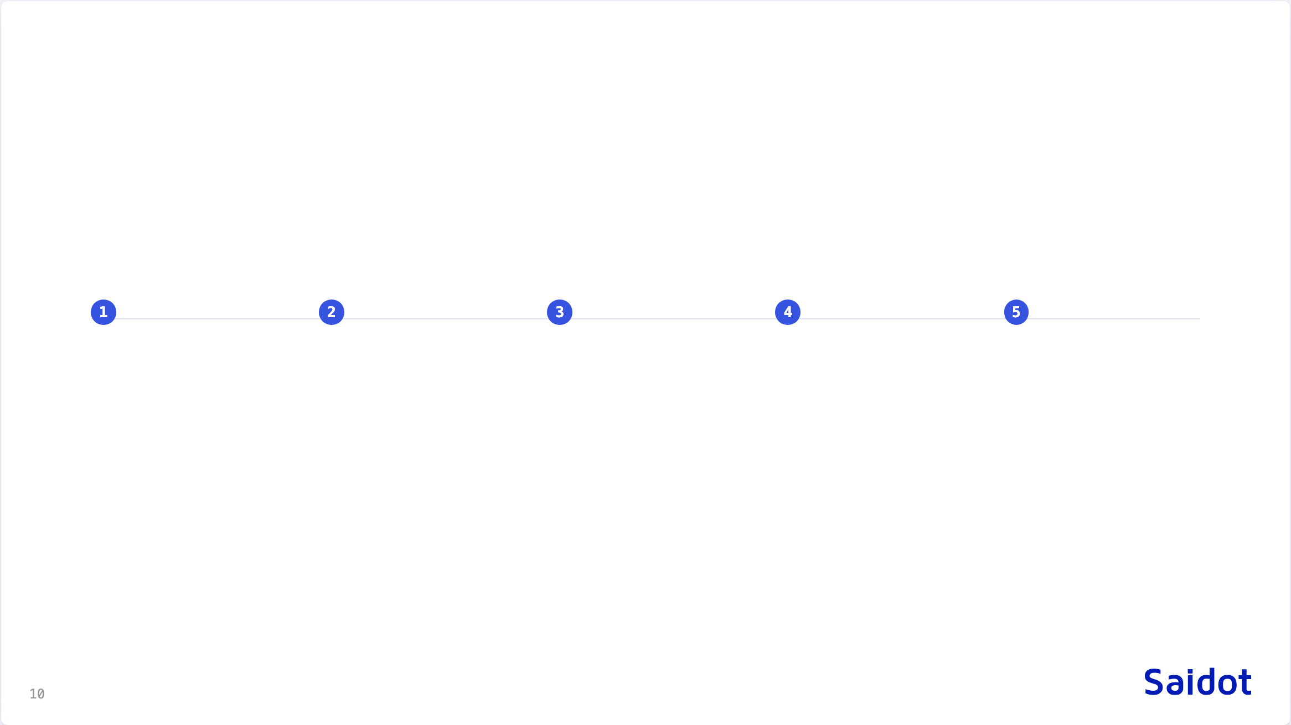
What an agent does today
Register
Classify
Inherit
Evidence
Report
an agent registers a system, its models and its datasets from the deployment it sees
rules propose a tier from the properties on record; a person ratifies it
the tier resolves its control set through the graph
the agent attaches evidence and opens the approvals the lifecycle asks for
the state of every control is queryable, by a person or by the next agent

Slide 11

Governance flows down, runtime signals flow back
Runtime enforcement tools police individual agent actions in the moment.
Saidot is the governance layer above: the graph that defines the policies, risks and controls worth enforcing, and the evidence proving them.
We enable enforcement. We do not sit in the hot path.

Slide 12

Two camps
Two communities solve the same problem and barely read each other.

Slide 13
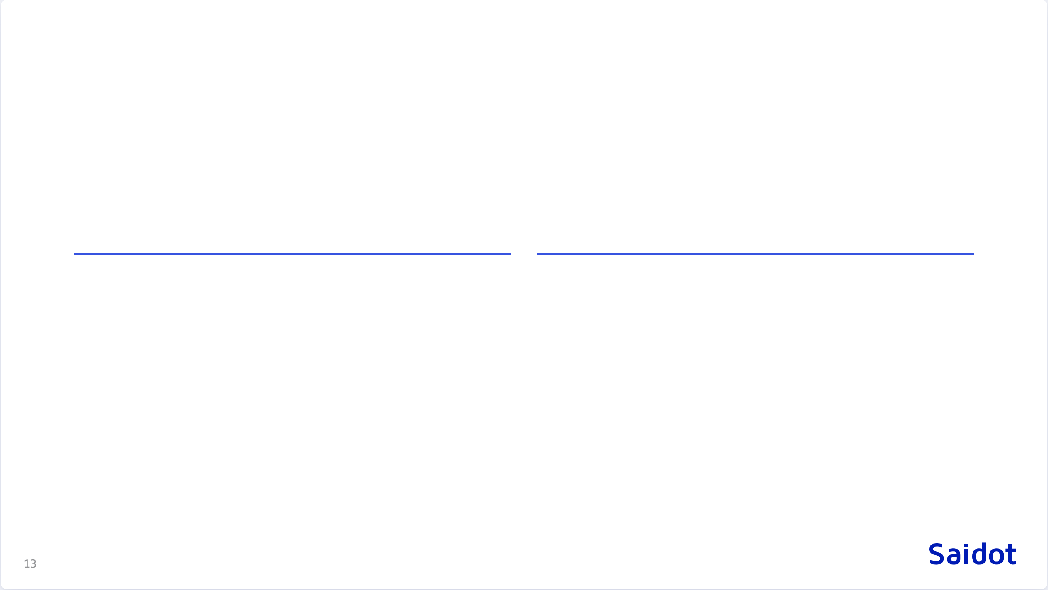
Semantics on one side, enforcement on the other
Semantic Web
Policy as code
Stack
Stack
RDF, SPARQL, ontologies: DPV, VAIR, AIRO
OPA and Rego, OSCAL, CI/CD gates
Good at
Good at
Describing risks and rights machine-readably, linking messy vocabularies
Enforcing and evaluating against a live system
Missing
Missing
Regulatory semantics
Execution. Nothing evaluates against a running system
Who runs it
Who runs it
Security teams, already in production
Research groups, standards bodies

Slide 14

The same premise on both sides
Prose does not scale
Provenance is evidence
Their output is our input
Obligations need a structured intermediate form that machines process and people review, on standard vocabularies.
Their graph traces a risk to an incident. Our record traces a control decision to the obligation, the property values checked and the rule version. An assertion without a trail is not evidence.
A completed assessment is, to us, an event: who, when, attached evidence, expiry. What happens inside it is their domain.
A risk described in VAIR does not block a deployment or create an audit artefact. The missing piece is the runtime, and that is the bridge to build.

Slide 15
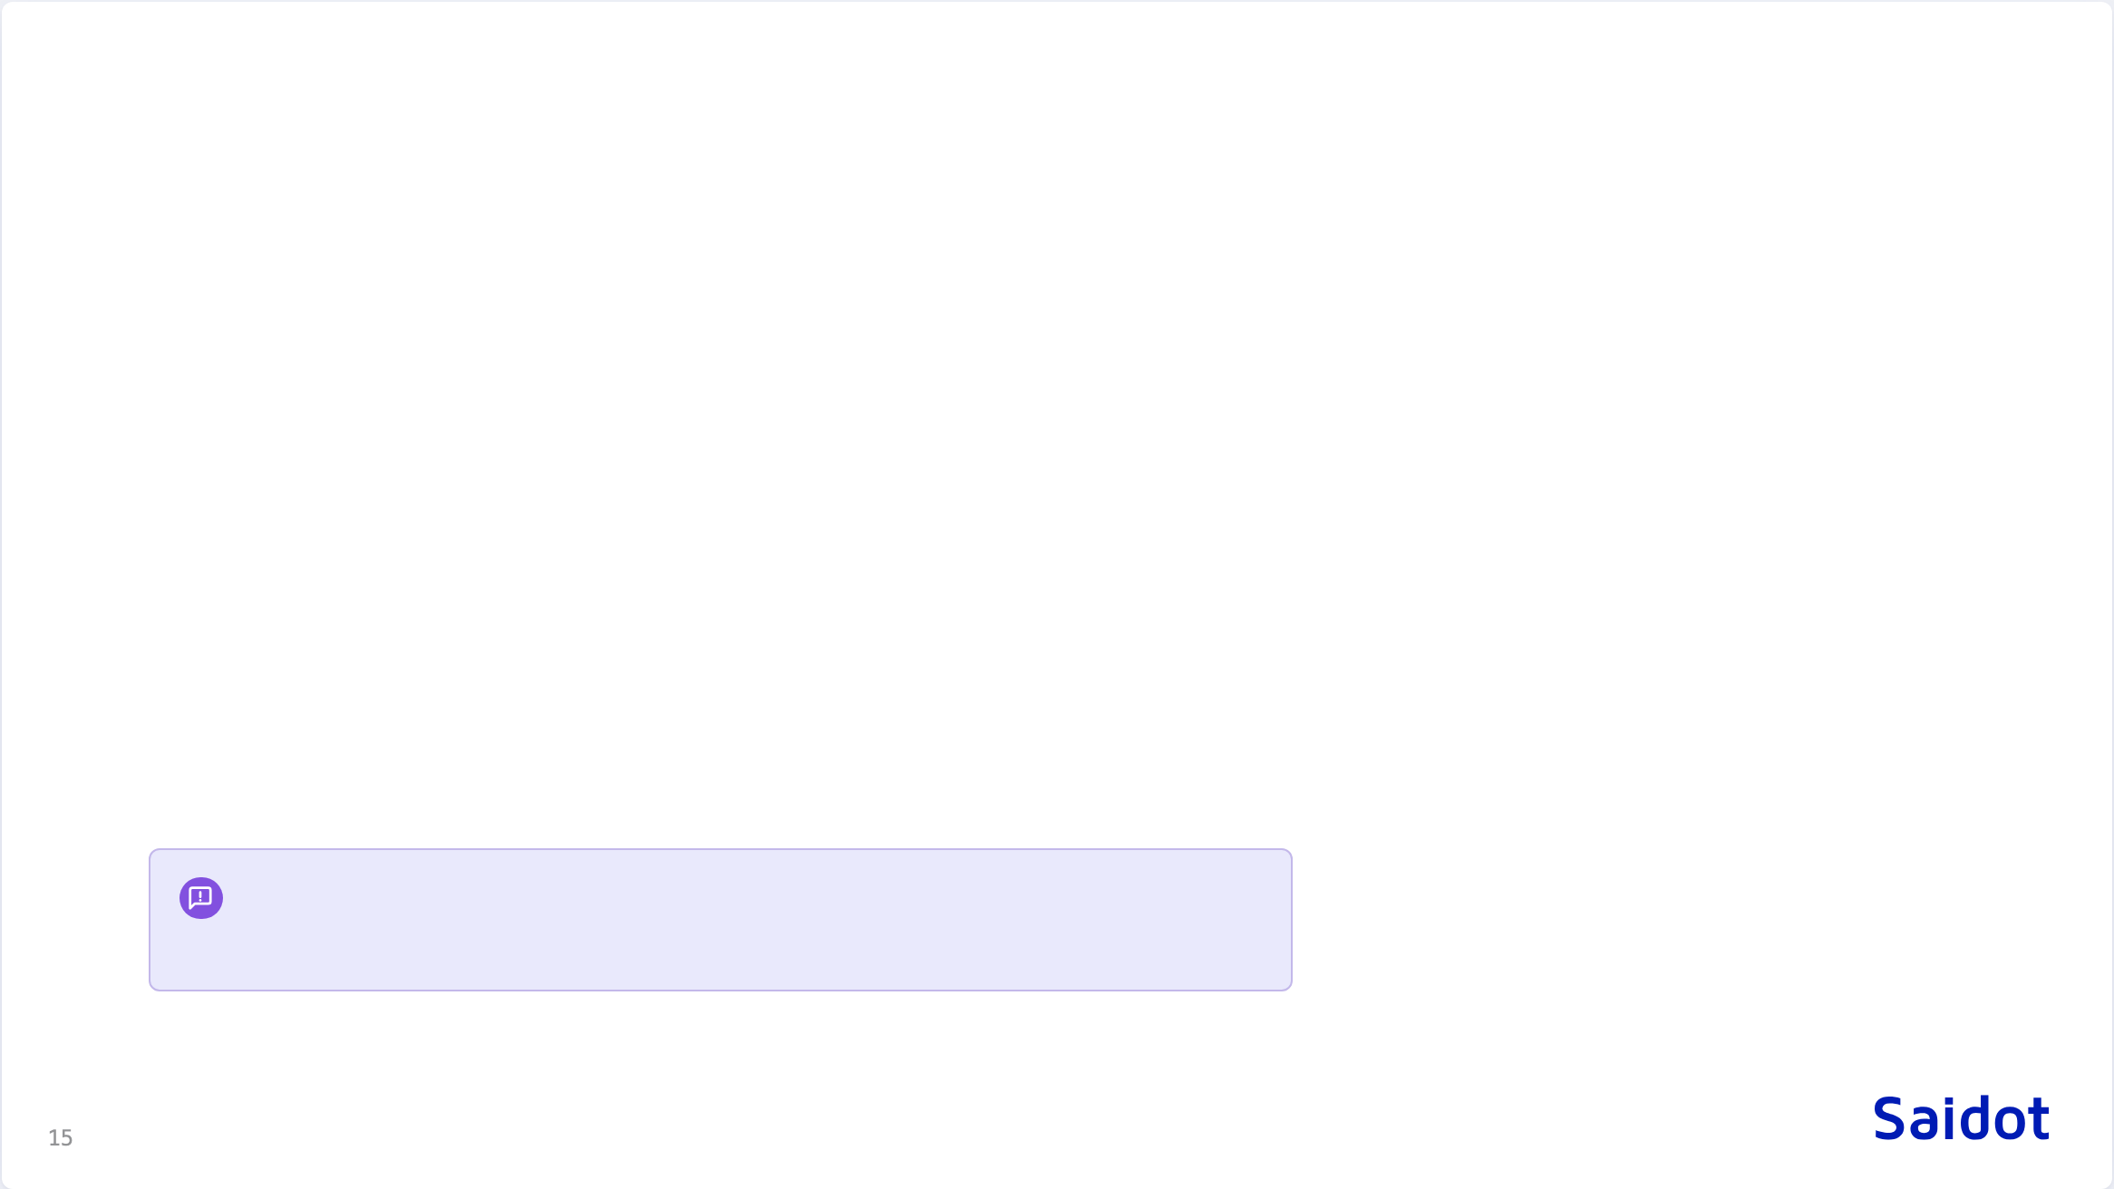
Two points of conflict
Automated classification is a coin toss
The ontologies exist
Their evaluation found LLM classification of the employment domain matched human experts about as often as chance, across two models. The AI Act risk tier must be a human-ratified property with provenance and expiry. Rules may suggest a tier. A person confirms it, because that one property scopes every downstream obligation.
DPV, VAIR and AIRO are published, versioned, and have carried AI Act semantics for years. The accurate claim is narrower: they are not integrated into any working compliance pipeline. That is a better pitch, because it is true.
This limits what can honestly be promised on automation. The customers-and-law side of that trade is the question for this room.

Slide 16

The layer model
Governance and compliance are separate layers, and a loop joins them.

Slide 17

Four layers, one loop
Governance
the human side: strategy, risk appetite, custom policies, tiering, scoping, thresholds
Policy as code
obligations mapped to properties and thresholds, compiled into an assessment policy and an enforcement policy
Runtime
enforces inline, reports state, discovers what is actually deployed
Compliance
evaluates to pass, fail or unknown, emits evidence and remediation items, and loops back to governance to change the system or change the rule

Slide 18
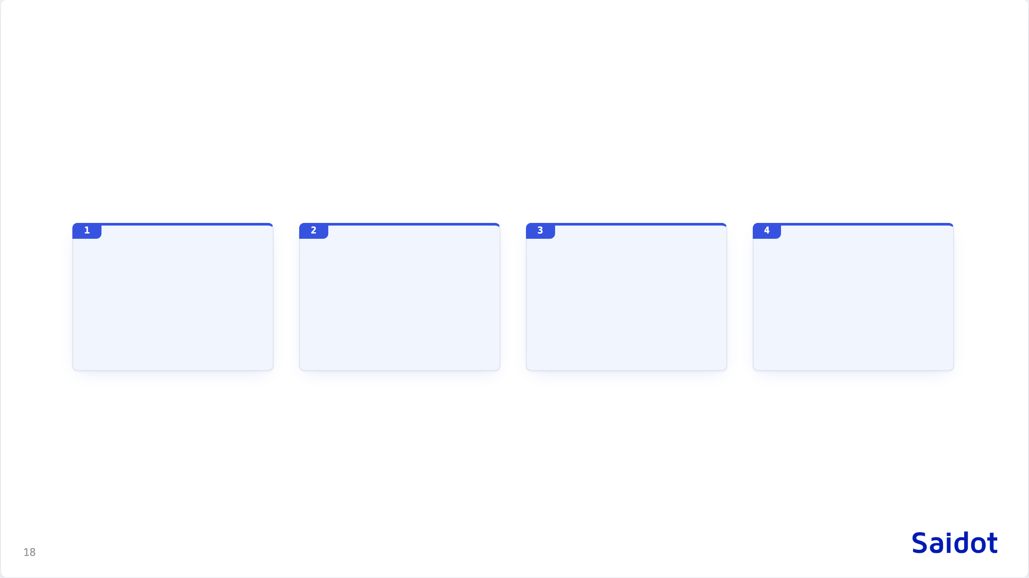
A property is a fact with a subject, a source and a trust level
System of record
Integration
Human declaration
Unknown
Read directly from production configuration, HR, the learning system. Highest trust.
Pushed by a connected system. Trusted as far as the connector is.
Stated by a person, with evidence and an expiry date.
Nothing answered. Recorded as a gap, never as a default.
Process obligations are not a separate class. "Staff trained" has a learning system behind it, "DPIA done" may be a declaration. The split is whether a system of record exists, which turns the gap list into a connector roadmap. Claims are events with expiry, never booleans: a boolean that cannot go stale cannot be audited.

Slide 19

OSCAL as the neutral format
One catalogue
Crosses boundaries
Neutral language
AI, information security and privacy controls merged in one library, so the same evidence is never collected twice.
Import and export in a format auditors and other tools already read, not a document export bolted on at the end.
Controls stated once, in neutral terms, with a mapper translating them into what a given runtime can check and emitting Rego for it.

Slide 20
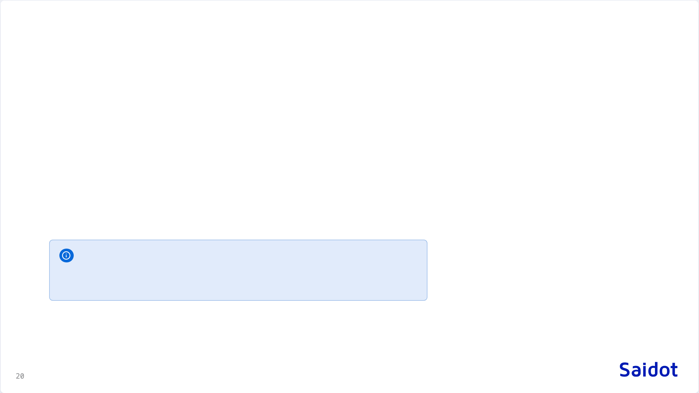
Applicability and enforcement
Scoping rules
Tailoring rules
Coverage
Does this control family apply to this system at all?
Does this specific control apply, given the system's own properties?
Rules plus a coverage list, and the statement of applicability generates itself per system.
A runtime that cannot check a control returns unknown and routes the question to the learning system or to a person. If nothing answers, it stays a gap, and the gap says: find out.

Slide 21

What is actually new
Applicability per system instance
Capability negotiation
Computed from the instance's own properties. Cross-framework mapping at the organisation level already exists at Vanta and Drata. Per system, it does not.
A runtime explicitly replies that it cannot evaluate a check. The unknown persists as a gap until something else answers, instead of a silent pass or fail.
Saidot already holds the systems and the workflows that assign controls. That is why these two lead.

Slide 22

Roadmap
Shipped, in development, proposed.

Slide 23
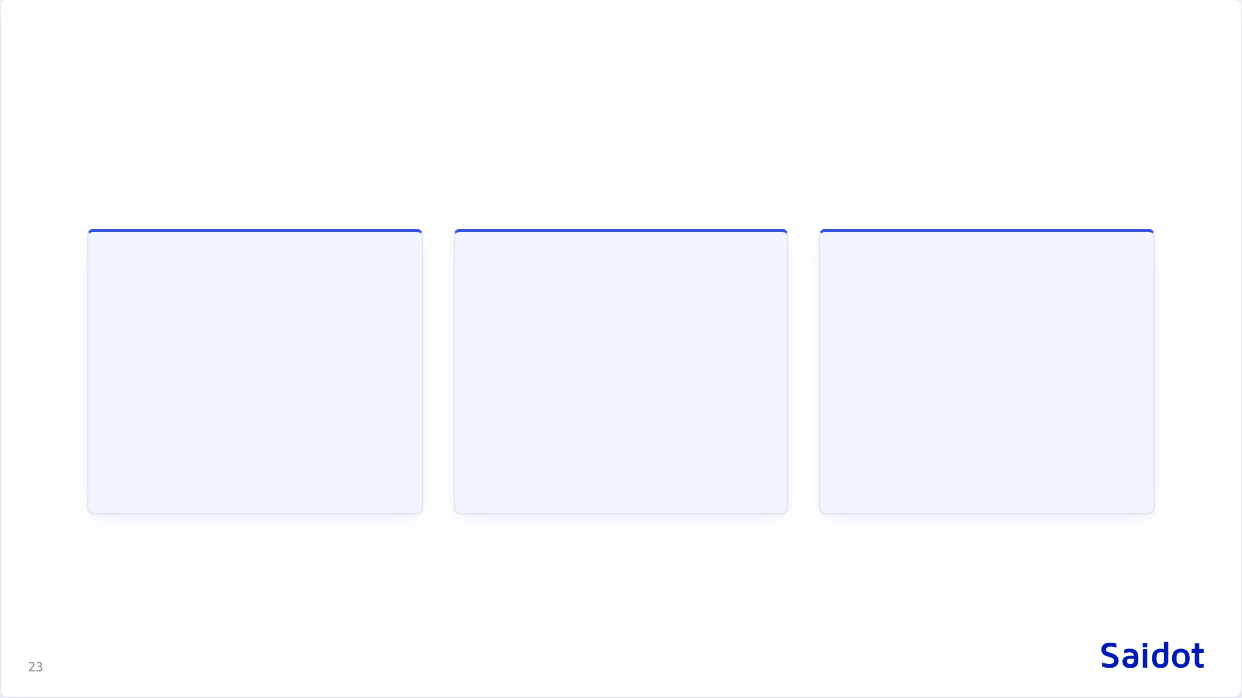
From governance to enforcement
Shipped
In development
Proposed
Governance, Library and Docs MCP servers. REST API over most of the platform. Observability API.
Orchestrator MCP. Workflow automation: classification, approvals, reassessment triggers, evidence capture. Customisation of lifecycles, roles, thresholds and templates per organisation.
Properties with source and trust level. OSCAL import and export. Applicability rules per system. Policy compiled per runtime, with capability negotiation and unknown as a first-class outcome.
The proposed column is this strawman, not a commitment.

Slide 24

Still open
Rule precedence
Coverage decomposition
Point in time
Two rules conflict on one control. XACML's combining algorithms are the candidate, not yet chosen.
How a unified control decomposes into what each runtime can attest to.
Auditors ask what the state was on a given date. Data is mutated today, not appended, so last Tuesday cannot be reconstructed. The primitives exist. The design does not.

Slide 25

Two questions for this room
Pass, fail, unknown
Applicability rules
Does a three-outcome model survive contact with a real auditor?
Can they carry real legal nuance, or do they collapse at the first genuinely ambiguous article?

Slide 26

A strawman, not a position
Poke holes in it.

