Slide 1


Governance & runtime enforcement
Separate layers, and the record that joins them
The record is the register itself: every system with its tier, the controls that apply to it, the evidence behind each one, and the log of who changed what.
CTO Mikko KämäräinenSaidot

Slide 2
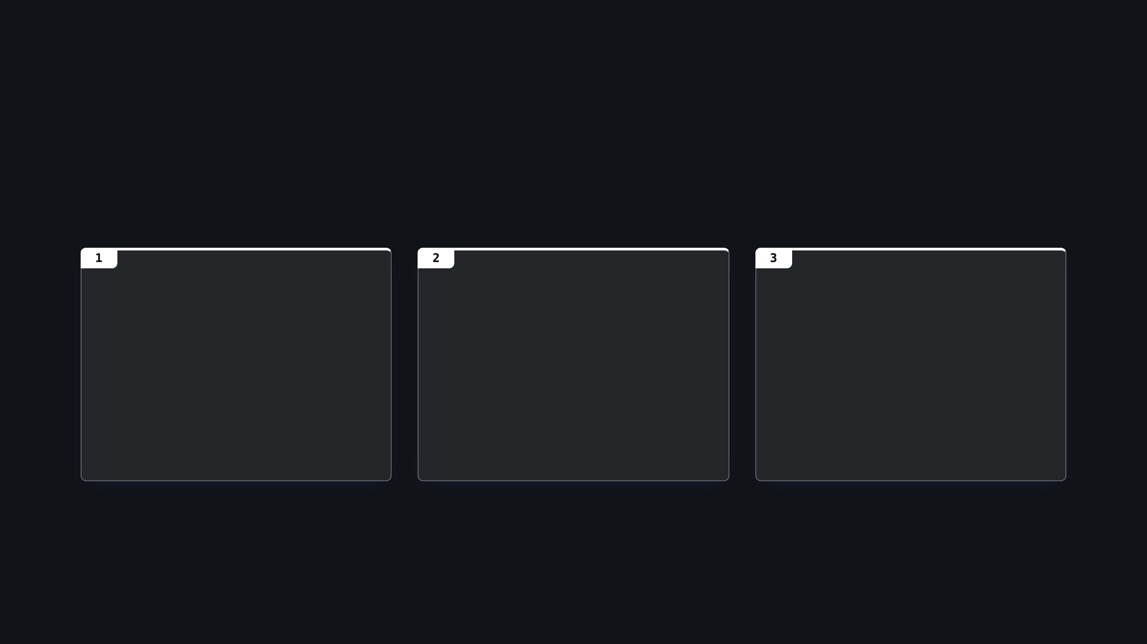

Governance and enforcement
The systems being governed are in flux
Models
Platforms, systems & agents
AI inside the tools already in use
Swapped for a newer version, a cheaper provider or a fine-tune, and every system built on the old one inherits the change.
Built on Foundry, Bedrock, Google or in-house orchestration, acting on business systems through tools, replaced in weeks.
Copilots in productivity suites, assistants inside SaaS, GenAI in the delivery pipeline. Adopted faster than any review cycle, often without anyone registering them.
Three clouds, four agent platforms, a hundred systems? The decisions about them cannot live in a single runtime platform.
2

Slide 3
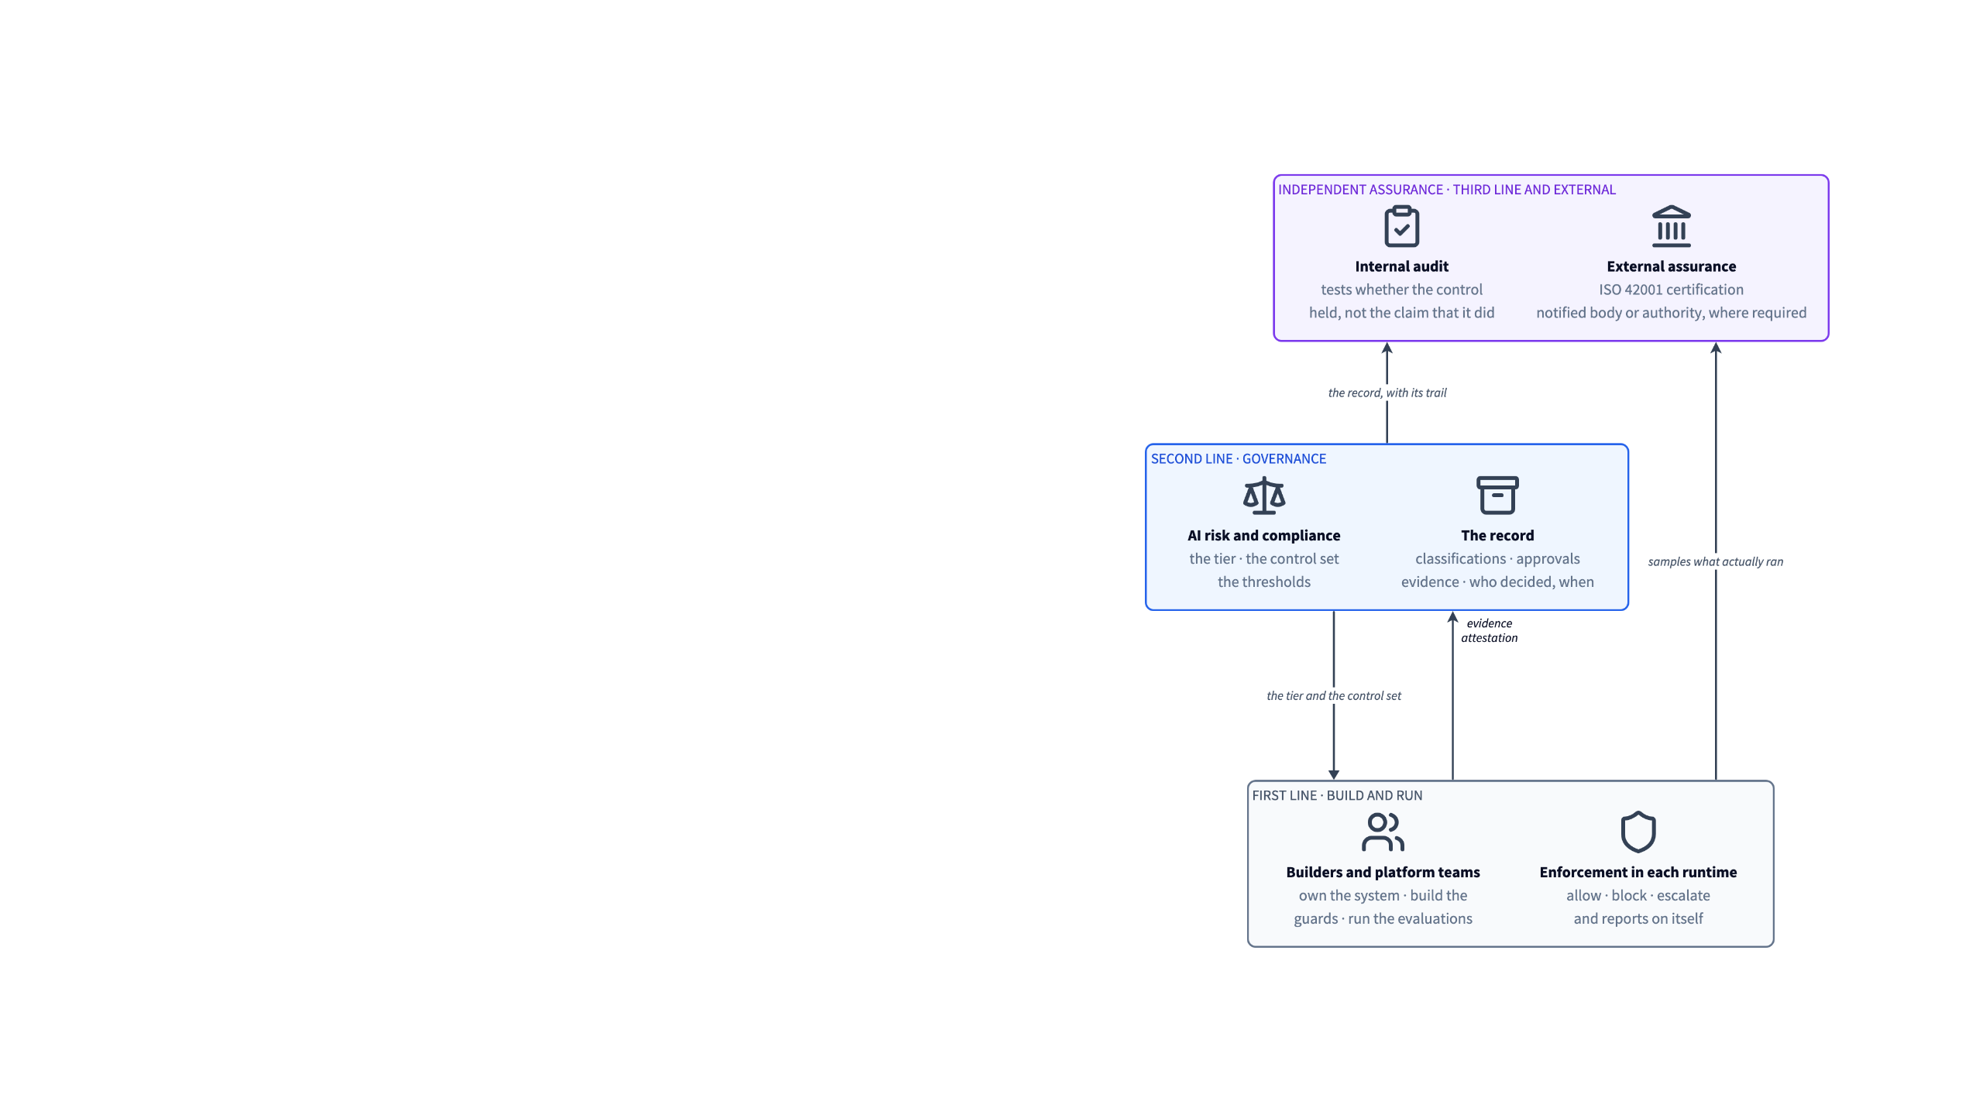

Three lines, one record
The model is not new. What is new is what sits in the first line: a platform that enforces its own controls and reports on itself.
The second line needs its own record. The first line emits the evidence. It does not hold the register, set the tier, or decide when a control is satisfied.
The third line tests that record against what actually ran, sampling the runtime directly. Neither internal audit nor an external assessor should have to ask the teams under audit to assemble their own evidence.
ISO/IEC 42001 asks for internal audit and management review. The EU AI Act asks high-risk providers for a conformity assessment, in most cases their own, and the technical documentation behind it. Both assume the record exists.
3

Slide 4
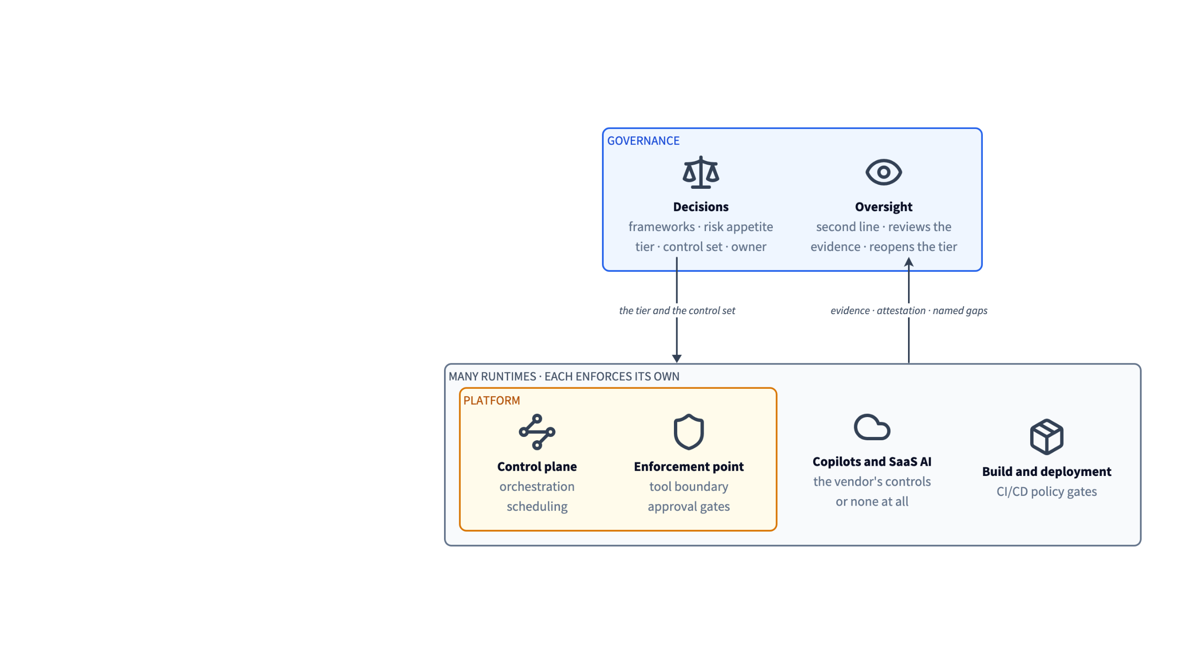
Governance is a separate role
The decisions are the organisation's: which frameworks apply, the risk appetite, the tier of each system, the controls it must satisfy, who is accountable. They have to survive a platform swap - or systems covering many - so they live above all of the platforms, in one place.
A runtime enforces what it runs and reports on itself. Oversight of that enforcement is a different accountability. The first line cannot be its own second.
The platform knows who ran a workflow. It does not know the system's purpose, its tier or its owner. Risk is contextual, so that is decided where the use case is.
4

Slide 5
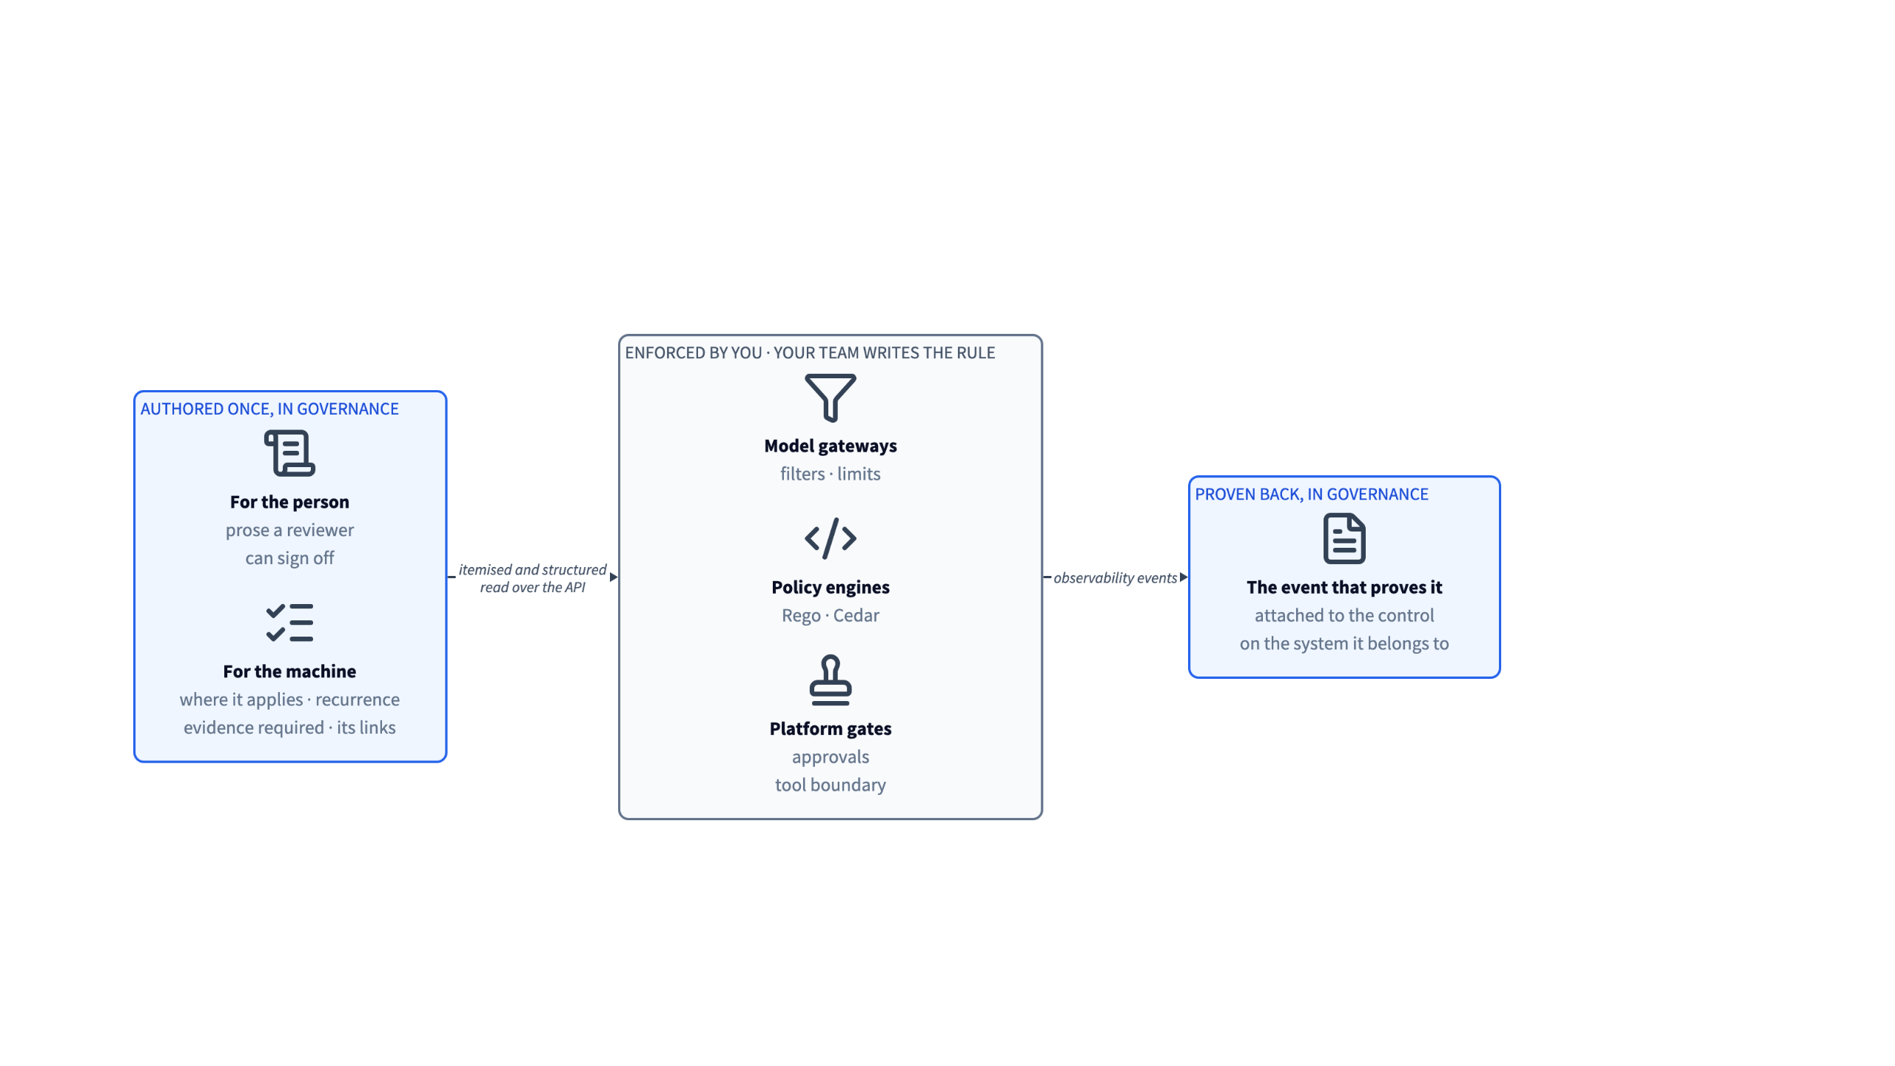
Enforcement stays in the runtime
Enforcement on platforms: largely solved; and the hot path is where it belongs. What is missing sits at both ends: a control authored once, and the event that proves it held.
Current: Your team writes the rule, as it does today. No new component sits between your agents and your models. Planned: Working to automate or help creating rules.
5

Slide 6
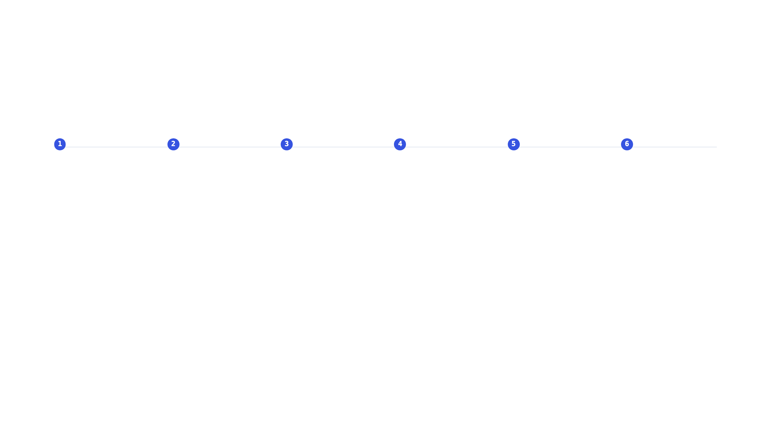
How a decision travels
Register
Classify
Map
Assign
Evidence
Report
Systems, models, agents, datasets and tools land in one graph, by hand, by connector, or by an agent over MCP.
Rules read the metadata, region, use, linked components, and set the tier. A person ratifies it.
The tier and the linked risks resolve the control set through the graph. Each control is itemised, carrying its scope, its recurrence, the evidence it requires and its links, all readable over the API.
Each control gets an owner and a due date. Lifecycle stages gate on approval, and a review goes to a named reviewer, internal or external.
Observability events come back from the runtime and attach to the control. An event can open an incident, a review or a reclassification.
Reviews and transparency reports are generated from the record, current on the day they are asked for.
Registering, classifying and mapping run through the MCP servers as well, so a client's own agents can operate the loop.
6

Slide 7

Your governance model, configured
01
Your controls, as entities
Your own controls sit in the graph beside the 110+ policies in the library, linked to systems, risks and evidence like anything else. Not documents attached to a record. Authoring your own policy frameworks is in preview.
02
Your process, as roles and tasks
Roles are assigned per system: owner, compliance specialist, reviewer, oversight manager. Lifecycle stages, approval gates and review cadence are set per organisation. Modelling the wider process as tasks is in development.
03
Your automation, at your pace
Every rule is a workflow you switch on: classification, inheritance, control assignment, lifecycle approvals. What is not automated stays a task for a person.
7

Slide 8

Governance stays a gate. It stops being a queue.
Rules-based tiering
Rules-based control profiles
Lifecycle approvals
Event-based triggers
Properties decide the tier. A person ratifies it, because that one property scopes every obligation downstream.
The tier resolves its own control set. Nobody has to manually maps controls per system (but they can edit the set).
A stage transition gates on approval, and reviews go to the role that owns them, when due.
Drift, an incident or a change reopens the assessment. Production keeps the record current.
Where this goes: the same loop at the scale of the whole AI estate of an organisation - with more of it automated and a person still deciding.
8

