Slide 1
Assignment A: Fisukortti
Susanna Rajamäki & Mikko Vallaskivi

Slide 2
What is Fisukortti?
Fisukortti is an online service which gathers fishing spots from Finland.
Users can browse rivers, lakes, archipelago and shorelines to find fishing spots that suit their need.
The spot listing shows important info about the spot, regulations, recommended fishing methods and other nearby spots.
Users can search spots per fishing method, fish species or location.
Users can review a spot and add a specific spot to their 'Favorite Spots'-list.

Slide 3

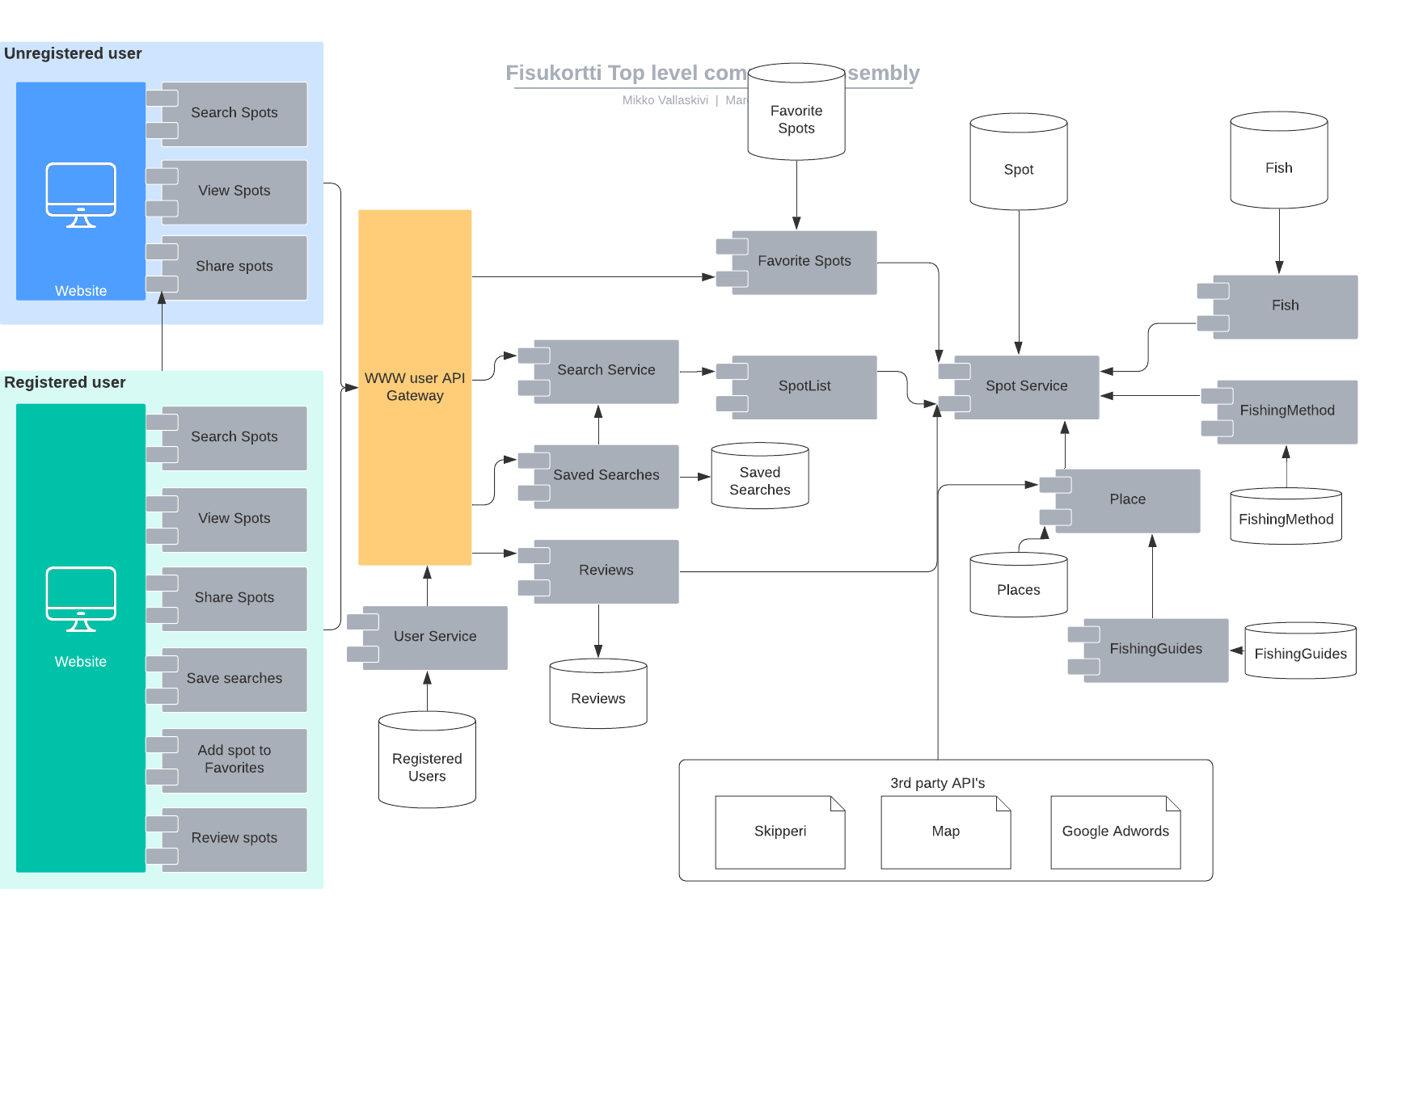
Microservices Architecture
API Gateway for WWW users
Components and services follow single responsibility principle
Application architecture follows Microservice architecture
Access token-based security managed within the API Gateway
Each service exposes their own RESTful API

Slide 4
Functionality scenario
Name: Arttu and Jonna search pike fishing spots in Nauvo.
Initial State: Fisukortti web service is active and and it is July summer holiday season.
Actors: Arttu, Jonna, Fisukortti
Sequence chart on the next slide

Slide 5
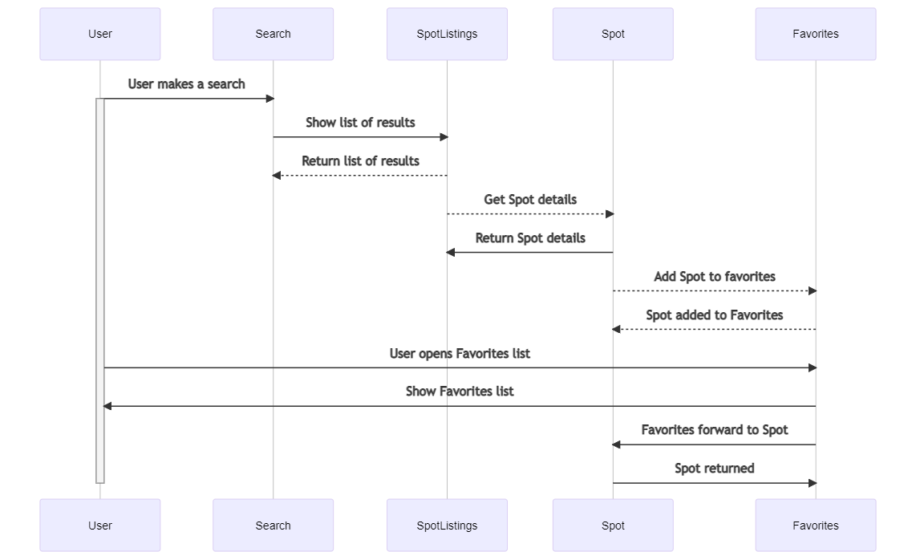

Slide 6
Thank you!

