Slide 1

Subjective Experiment Data Analysis
Lucjan Janowski
Notes:
This is what we are doing on a daily basis.
We say multimedia here, but we mainly work with videos (usually w/o sound). Such a limitation of context necessary because we are dealing with a difficult problem.

Slide 2
Presentation Outline
Data description
Reading data
Subjective score model
Cleaning data
Predicting quality
Summary

Slide 3
Presentation Outline
Data description
Reading data
Subjective score model
Cleaning data
Predicting quality
Summary

Slide 4



Type of Data
Nominal
Numeric
Ordinal
Notes:
It is nice to reference such forecasts in an introduction section of your thesis (if it is related with multimedia).
Larger volume & larger demand begs for better quality (and also is a result of better quality being used).
This is a 4 fold growth in the plot on the right.
EB = exabytes = 1 million TB
There are much more forecasts so do not hesitate to take a look on your own.

Slide 5


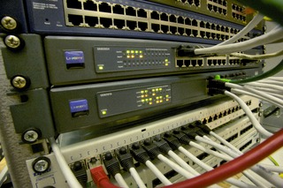
Nominal
We can calculate fractions - how often specific value appears
We can find mode – the most common value
We divide a set to specific parts

Slide 6

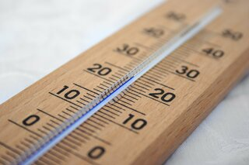
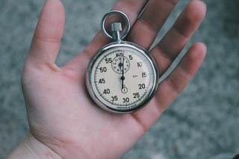
Numeric
Fractions without aggregation does not make sense
We can do any numerical operations
Often use mean, standard deviation
Quantiles are very useful

Slide 7

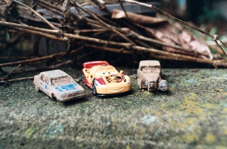

Ordinal
The data with an order
Often, they are analyzed bit like numerical bit like nominal
Formally they should be analyzed differently
We are using ordinal scoring data as numeric data aggregated to discrete values

Slide 8
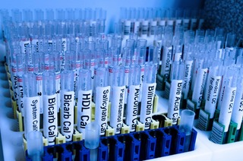
Mixed Variables
There are variables which are mixed – they have more than one nature
For example: length of telephone call including not answering -> 0
Analysis is trickier but can be done

Slide 9
Code

Slide 10
Presentation Outline
Data description
Reading data
Subjective score model
Cleaning data
Predicting quality
Summary

Slide 11


You Need To Plan
Picture_land_340x320_34.mp4
Picture_580x240_2.mp4
Picture_800x560_3.5.mp4
Picture_land_SRC.yuv

Slide 12

Save All Information
Score – obvious
For which sequence – obvious, but what does it mean specific sequence?
Answer time – often missed
Information about a tester
…

Slide 13
Tidy Data
 | Variable1 | Variable2 | Variable3
Measurement1
Measurement2
Measurement3
Measurement4
Measurement5

Slide 14
Typical Data
Variables:
User id
SRC
Resolution
Bitrate/QP/CRF
Type of Codec
Score
Answer time
Metrics values
Device type
Conditions
…
Measurements:
Single answer

Slide 15
Code

Slide 16
Regular Expression
^(?P<SRC>[^_]+)_(?P<resw>\d+)x(?P<resh>\d+)_(?P<bitrate>\d+)M$
^ - start of string
?P<SRC> - name of column
[^_] – look for _
[^_]+ - any number of characters
\d – digits
$ - end of string

Slide 17
Presentation Outline
Data description
Reading data
Subjective score model
Cleaning data
Predicting quality
Summary

Slide 18
Subject Score Model

Slide 19
Presentation Outline
Data description
Reading data
Subjective score model
Cleaning data
Predicting quality
Summary

Slide 20
Correlation
Tester with low correlation is suspicious
We can use subject model – it weights the influence of a subject
Standard ITU-T P.910 calls for removing subjects with correlation lower than 0.75

Slide 21
Code

Slide 22
Presentation Outline
Data description
Reading data
Subjective score model
Cleaning data
Predicting quality
Summary

Slide 23
Quality Prediction
Predicting from subjective scores – done
Predicting from sequences – using metrics
Predicting from sequences – developing metric
Considering different factors

Slide 24
Comparing Solutions
Subjective experiments can answer question which system is better
We would like to test if codec/solution/algorithm A is better than B
Only final math is changed; the principle is the same

Slide 25
Presentation Outline
Data description
Reading data
Subjective score model
Cleaning data
Predicting quality
Summary

Slide 26
Summary
We should prepare an experiment, so it is easy to analyze
We should collect as much data as possible
Data analysis goes in two directions:
MOS, after cleaning data
Metrics analysis

Slide 27
Next Time
Describe your experiment
Present the results

