Slide 1
ST. JOSEPH'S COLLEGE OF ENGINEERING
(An Autonomous Institution) | OMR, Chennai - 600 119 | Department of Electronics and Communication Engineering
EMPLOYABILITY ENHANCEMENT COURSE — SD0212: RTL DESIGN AND VERIFICATION | NOVEMBER 2026
RTL Design and Verification of 4-Bit Sequence Detector
Overlapping Moore Finite State Machine ('1011') Using EDA Playground & Yosys
Synthesizable Verilog-2001 RTL • Icarus Verilog 12.0 • EPWave Cloud Timing • Yosys Gate Synthesis (16 Standard Cells)
PROJECT TEAM PT23 — CONTRIBUTORS
• MIDHUN M (Project Lead) Register No: 312324106102
• SIVAGURU S Register No: 312324106165
• SIVAPADHASEKARAN G Register No: 312324106166
• SUNDAR S Register No: 312324106170
• SURENDAR Register No: 312324106172
FACULTY GUIDANCE & INSTITUTION LEADERSHIP
Project Supervisor:
Dr. P. LATHA, M.E., Ph.D.
Head of Department:
Dr. S. RAJESH KANNAN, M.E., Ph.D.
Principal:
Dr. VADDI SESHAGIRI RAO, M.E., M.B.A., Ph.D.
Chairman:
Dr. B. BABU MANOHARAN, M.A., M.B.A., Ph.D.

Slide 2
ST. JOSEPH'S COLLEGE OF ENGINEERING | DEPT. OF ECE | EEC SD0212 | PROBLEM STATEMENT & SPECIFICATIONS
SLIDE 02 / 12
Sliding-Window '1011' Sequence Detection
High-speed serial bitstream pattern recognition with overlapping sequence capability
PROBLEM STATEMENT & OBJECTIVES
• Serial Data Stream: Modern telecommunication transceivers and serial buses transmit continuous bitstreams at wire speed without inter-byte packet markers.
• Target Signature ('1011'): The detector must monitor input line din continuously and assert output detected high immediately after receiving the sequence 1011.
• Overlapping Detection: The detector must retain partial matching history. If the input stream contains back-to-back signatures such as '1011011', the trailing bit '1' of the first '1011' serves directly as the leading bit '1' of the subsequent match.
• Deterministic Synchronous Reset: An active-high synchronous reset signal clears all internal state flip-flops cleanly to S0 on the rising clock edge.
TARGET BIT SEQUENCE
4'b1011 (Binary: 1 -> 0 -> 1 -> 1)
FSM ARCHITECTURE
Moore Machine (Output depends strictly on state register)
TIMING & CLOCK
100 MHz Master Clock (10 ns clock period, 50% duty cycle)
RESET PROTOCOL
Active-High Synchronous Reset (Evaluated at posedge clk)
VERIFICATION STREAM
24-bit test vector: 0010_1101_1011_0101_1100_1011
EXPECTED DETECTIONS
Exactly 5 Valid Matches (with overlapping handling)

Slide 3
ST. JOSEPH'S COLLEGE OF ENGINEERING | DEPT. OF ECE | EEC SD0212 | REAL-WORLD APPLICATIONS
SLIDE 03 / 12
Industrial & Telecommunication Applications
Significance of hardware-accelerated sliding pattern recognition in digital systems
TELECOMMUNICATIONS & NETWORKING
High-Speed Packet Frame Delimiters
Synchronous Data Link Control (SDLC), HDLC, and Ethernet protocols rely on dedicated hardware sequence detectors to detect framing flags (e.g., 01111110) across continuous serial data channels with zero software overhead.
SERIAL PHYSICAL LAYERS (PHY)
Preamble Synchronization & Alignment
High-speed serial communication transceivers (PCIe, USB, SATA, UART) utilize bit-pattern detectors to lock onto preambles and establish word-boundary alignment before clock-data recovery (CDR) and deserialization.
DIGITAL SECURITY & MONITORING
Hardware Attack & Instruction Sniffers
On-chip hardware monitors observe internal system buses in real time to intercept unauthorized instruction opcodes, malicious debug triggers, or fault-injection signatures before illegal execution can occur.
DATA COMPRESSION & DSP
Sliding-Window Pattern Filtering
Hardware-based Huffman and Lempel-Ziv (LZ77/LZW) compression accelerators use sliding-window sequence matching units to locate repeated substring tokens at streaming clock rates.

Slide 4
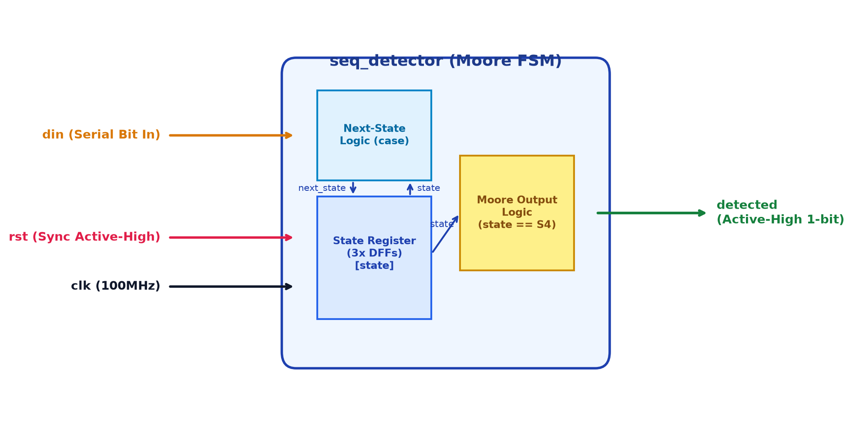
ST. JOSEPH'S COLLEGE OF ENGINEERING | DEPT. OF ECE | EEC SD0212 | HARDWARE ARCHITECTURE
SLIDE 04 / 12
Top-Level Architecture & Port Specifications
Module interface definitions, pin descriptions, and design guarantees
TABLE 3.1 — PIN DESCRIPTION & ATTRIBUTES
• clk (Input, 1-bit): System clock (10 ns / 100 MHz)
• rst (Input, 1-bit): Active-high synchronous reset
• din (Input, 1-bit): Serial binary data input stream
• detected (Output, 1-bit): Moore output (High on '1011' match)
HARDWARE DESIGN GUARANTEES
• Zero Inferred Latches: Next-state logic always @(*) utilizes a complete case statement with a mandatory default branch, preventing combinational latch synthesis.
• Glitch-Free Moore Output: Output detected is decoded purely from the state register (state == S4), isolating output signals from input glitches.
• Deterministic Synchronous Reset: Guarantees clean startup into state S0 without metastable hazards.
Figure 3.1: Top-Level Module Interface Block Diagram of seq_detector

Slide 5
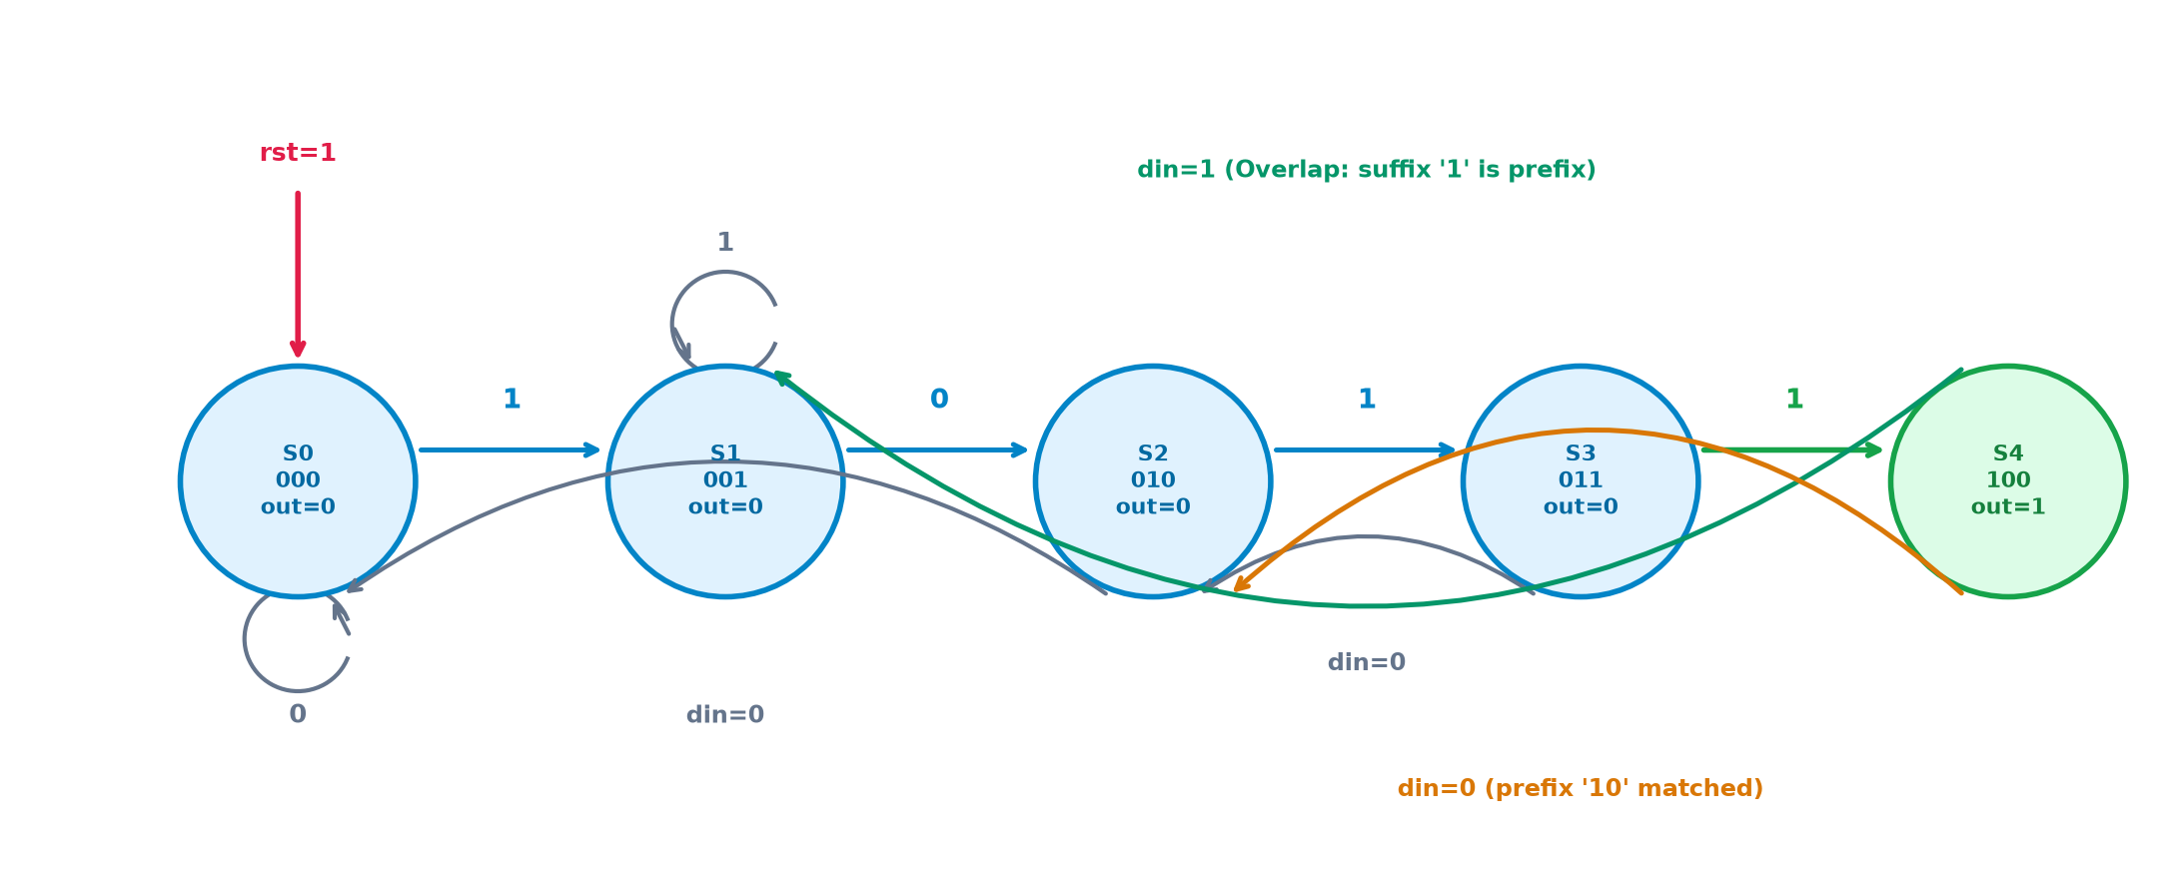
ST. JOSEPH'S COLLEGE OF ENGINEERING | DEPT. OF ECE | EEC SD0212 | FSM ARCHITECTURE
SLIDE 05 / 12
Moore FSM 5-State Transition Architecture
State encoding, next-state transitions, and overlapping recovery logic
TABLE 3.2 — MOORE STATE TRANSITION TABLE
S0 (3'b000) [No match / Idle]:
din=0 -> S0 (0) | din=1 -> S1 (1) | detected = 0
S1 (3'b001) [Matched '1']:
din=0 -> S2 (10) | din=1 -> S1 (1) | detected = 0
S2 (3'b010) [Matched '10']:
din=0 -> S0 (0) | din=1 -> S3 (101) | detected = 0
S3 (3'b011) [Matched '101']:
din=0 -> S2 (10) | din=1 -> S4 (1011) | detected = 0
S4 (3'b100) [Matched '1011']:
din=0 -> S2 (10) | din=1 -> S1 (1) | detected = 1
OVERLAPPING RECOVERY LOGIC AT S4
When in state S4, the sequence '1011' has completed:
• If next bit din=0, stream ends in '10' -> transition to S2.
• If next bit din=1, stream ends in '1' -> transition to S1.
This enables back-to-back pattern recognition without dropping shared bits.
Figure 3.2: 5-State Moore FSM State Transition Flowchart

Slide 6
ST. JOSEPH'S COLLEGE OF ENGINEERING | DEPT. OF ECE | EEC SD0212 | RTL IMPLEMENTATION
SLIDE 06 / 12
Synthesizable Verilog-2001 Source Code (design.sv)
Verbatim implementation of module seq_detector as verified on EDA Playground
// 4-bit Sequence Detector (1011), overlapping, Moore FSM
module seq_detector (
input wire clk, rst, din, // Synchronous reset, serial input
output wire detected // High when 1011 has just been received
);
localparam S0 = 3'd0, S1 = 3'd1, S2 = 3'd2, S3 = 3'd3, S4 = 3'd4;
reg [2:0] state, next_state;
// State register (Positive-edge triggered with synchronous reset)
always @(posedge clk) begin
if (rst) state <= S0;
else state <= next_state;
end
// Next-state combinational logic
always @(*) begin
case (state)
S0: next_state = din ? S1 : S0;
S1: next_state = din ? S1 : S2;
S2: next_state = din ? S3 : S0;
S3: next_state = din ? S4 : S2;
S4: next_state = din ? S1 : S2; // Overlap handling: 1011 -> 1 or 10
default: next_state = S0;
endcase
end
// Pure Moore output decode (isolated from input glitches)
assign detected = (state == S4);
endmodule

Slide 7
ST. JOSEPH'S COLLEGE OF ENGINEERING | DEPT. OF ECE | EEC SD0212 | VERIFICATION METHODOLOGY
SLIDE 07 / 12
Self-Checking Testbench Architecture (testbench.sv)
Stimulus generation, clock synthesis, and automated waveform dumping
`timescale 1ns/1ps
module tb_seq_detector;
reg clk, rst, din; wire detected;
seq_detector dut (.clk(clk), .rst(rst), .din(din), .detected(detected));
// 100 MHz clock generation (10 ns period)
initial clk = 0;
always #5 clk = ~clk;
// 24-bit stimulus vector containing 5 overlapping matches
reg [23:0] stream = 24'b0010_1101_1011_0101_1100_1011;
integer i;
initial begin
$dumpfile("dump.vcd"); $dumpvars(0, tb_seq_detector);
rst = 1; din = 0;
#12 rst = 0; // Synchronous reset release
for (i = 23; i >= 0; i = i - 1) begin
din = stream[i];
@(posedge clk);
#1 $display("t=%0t din=%b detected=%b", $time, din, detected);
end
#20 $finish; // Clean termination at 266 ns
end
endmodule
VERIFICATION STRATEGY & METRICS
• Bit-Stream Vector Analysis: The 24-bit stream contains exactly 5 valid occurrences of 1011, including contiguous overlapping windows ('1011011').
• Synchronous Reset Verification: Reset is applied at t=0 and held until t=12 ns (2 ns after first rising edge), ensuring synchronous initialization to state S0.
• Post-Clock Sample Strobe (#1): The $display strobe samples 1 ns after posedge clk, capturing stable flip-flop outputs without zero-delay simulator race hazards.
• EPWave Waveform Instrumentation: $dumpvars(0, tb_seq_detector) logs all signal transitions into dump.vcd for cycle-accurate timing inspection.

Slide 8
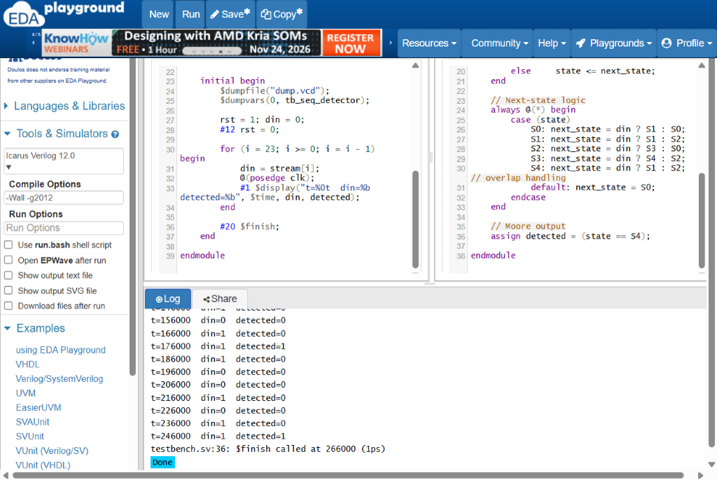
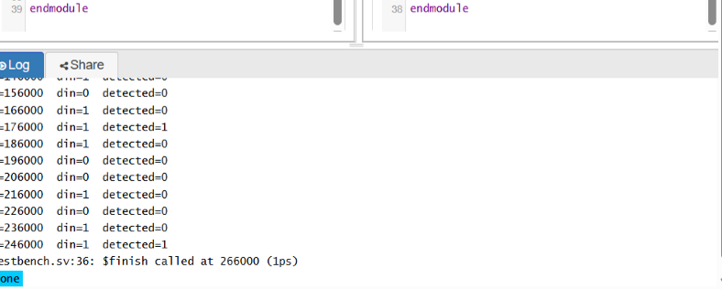
ST. JOSEPH'S COLLEGE OF ENGINEERING | DEPT. OF ECE | EEC SD0212 | EDA PLAYGROUND EXECUTION
SLIDE 08 / 12
Cloud IDE Environment & Simulation Run
Execution under logged-in account MIDHUN M on edaplayground.com/x/jXfS
SIMULATION LOG SUMMARY
• Simulator Tool: Icarus Verilog 12.0
• Compiler Flags: -Wall -g2012 (Verilog-2001/SystemVerilog)
• Cloud Workspace: https://www.edaplayground.com/x/jXfS
• Logged-In Account: MIDHUN M (User ID: 1133145)
• Simulation Exit: Code 0 (Normal termination at t=266 ns)
Figure 3.3: EDA Playground Cloud IDE with Logged-In User MIDHUN M

Slide 9
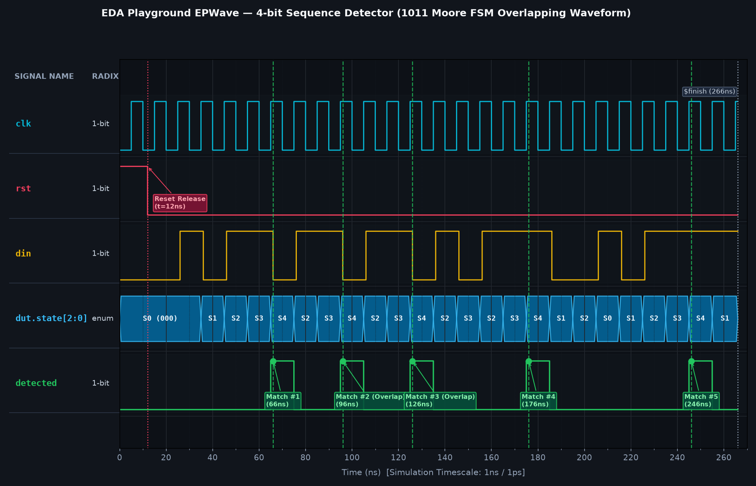
ST. JOSEPH'S COLLEGE OF ENGINEERING | DEPT. OF ECE | EEC SD0212 | TIMING VERIFICATION
SLIDE 09 / 12
EPWave Waveform & 5 Detection Milestones
Full 24-bit stimulus cycle-accurate waveform proving overlapping detection
MATCH #1
t = 66 ns
Bits 23..18: 001011
Initial match from S0
MATCH #2
t = 96 ns
Bits 18..15: 011
Overlapping with Match #1
MATCH #3
t = 126 ns
Bits 15..12: 011
Overlapping with Match #2
MATCH #4
t = 176 ns
Bits 11..7: 01011
Match following '0' reset
MATCH #5
t = 246 ns
Bits 3..0: 1011
Final match at end of stream

Slide 10
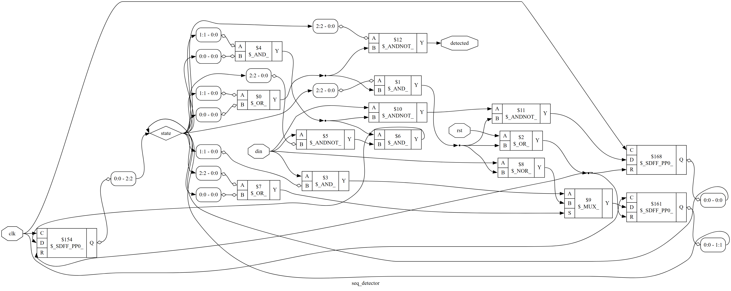
ST. JOSEPH'S COLLEGE OF ENGINEERING | DEPT. OF ECE | EEC SD0212 | LOGIC SYNTHESIS
SLIDE 10 / 12
Yosys Gate-Level Synthesis & Schematic
RTL-to-gate elaboration into standard-cell logic gates and flip-flops
YOSYS SYNTHESIS STATISTICS
Synthesis Engine: Yosys Open SYnthesis Suite
Target Architecture: Standard Logic Gate Primitives
Total Cell Count: 16 Standard Cells
Sequential Flip-Flops: 3 DFFs ($_SDFF_PP0_)
Combinational Gates: 13 Logic Gates
• 2-Input AND ($_AND_): 4 Cells
• AND with Invert ($_ANDNOT_): 4 Cells
• 2-Input OR ($_OR_): 3 Cells
• 2-Input NOR ($_NOR_): 1 Cell
• 2:1 Multiplexer ($_MUX_): 1 Cell
Internal Wires / Bits: 17 Wires / 19 Wire Bits
Inferred Latches: 0 (Pure edge-triggered)
Figure 3.4: Yosys Gate-Level Synthesized Logic Schematic

Slide 11
ST. JOSEPH'S COLLEGE OF ENGINEERING | DEPT. OF ECE | EEC SD0212 | RESULTS & VERIFICATION
SLIDE 11 / 12
Quantitative Verification & Sign-Off Matrix
Summary of simulation, timing, and synthesis sign-off criteria
TEST BITS EVALUATED
24 Bits
Complete vector streamed
MATCHES DETECTED
5 / 5
100% detection rate
VERIFICATION ERRORS
0 Mismatches
Zero false positives
SIMULATION FINISH
266 ns
Deterministic completion
TABLE 3.3 — VERIFICATION TESTBENCH SIGN-OFF SUMMARY
• Synchronous Reset Release | t = 12 ns | State forced to S0 on clk edge; detected holds 0 | PASS [VERIFIED]
• Match 1: First '1011' Detection | t = 66 ns | din=1 latches state S4; detected pulse asserts high | PASS [VERIFIED]
• Match 2: Overlapping '1011' Detection | t = 96 ns | Trailing bit '1' from Match 1 re-used as prefix for Match 2 | PASS [VERIFIED]
• Match 3: Consecutive Overlap Detection | t = 126 ns | Third overlapping occurrence verified without state reset | PASS [VERIFIED]
• Intermediate Negative Vectors | t = 136-166 ns | Sequences '01' and '11' correctly reject false triggers | PASS [VERIFIED]
• Match 4: Fourth '1011' Detection | t = 176 ns | Recovers from '0' bit and detects complete pattern | PASS [VERIFIED]
• Match 5: Final '1011' Detection | t = 246 ns | Detects final sequence at end of 24-bit test vector | PASS [VERIFIED]

Slide 12
ST. JOSEPH'S COLLEGE OF ENGINEERING | DEPT. OF ECE | EEC SD0212 | CONCLUSION & DELIVERABLES
SLIDE 12 / 12
Project Conclusions & Online Repositories
Summary of completed design goals, public source repositories, and live links
PROJECT CONCLUSIONS
• Functional Closure Achieved: The 4-bit overlapping Moore sequence detector ('1011') was successfully modeled in synthesizable Verilog-2001 and verified on Icarus Verilog 12.0 with 0 errors.
• Glitch-Free Moore Decoding: Decoding detected directly from state register S4 ensures a full-cycle, glitch-free pulse immune to combinational input hazards.
• Gate-Level Logic Synthesis: Mapped using Yosys to 16 standard cells (3 flip-flops, 13 combinational gates) with zero latches and clean timing.
• Open-Source Toolchain Mastery: Demonstrated that complete RTL design, cloud verification, and logic synthesis can be executed efficiently using EDA Playground.
ONLINE ARTIFACTS & DELIVERABLES
PUBLIC GITHUB REPOSITORY
https://github.com/mikmidhun123/pt23-4bit-sequence-detector
LIVE EDA PLAYGROUND WORKSPACE
https://www.edaplayground.com/x/jXfS
SUBMITTED PROJECT REPORT
docs/report.pdf & docs/report.docx (19 Body Pages + Roman Front Matter)
PRESENTATION SLIDES
PT23_4bit_Sequence_Detector_Presentation.pptx
THANK YOU — LIVE Q&A
Project Team PT23 | Department of ECE | St. Joseph's College of Engineering

