Slide 1
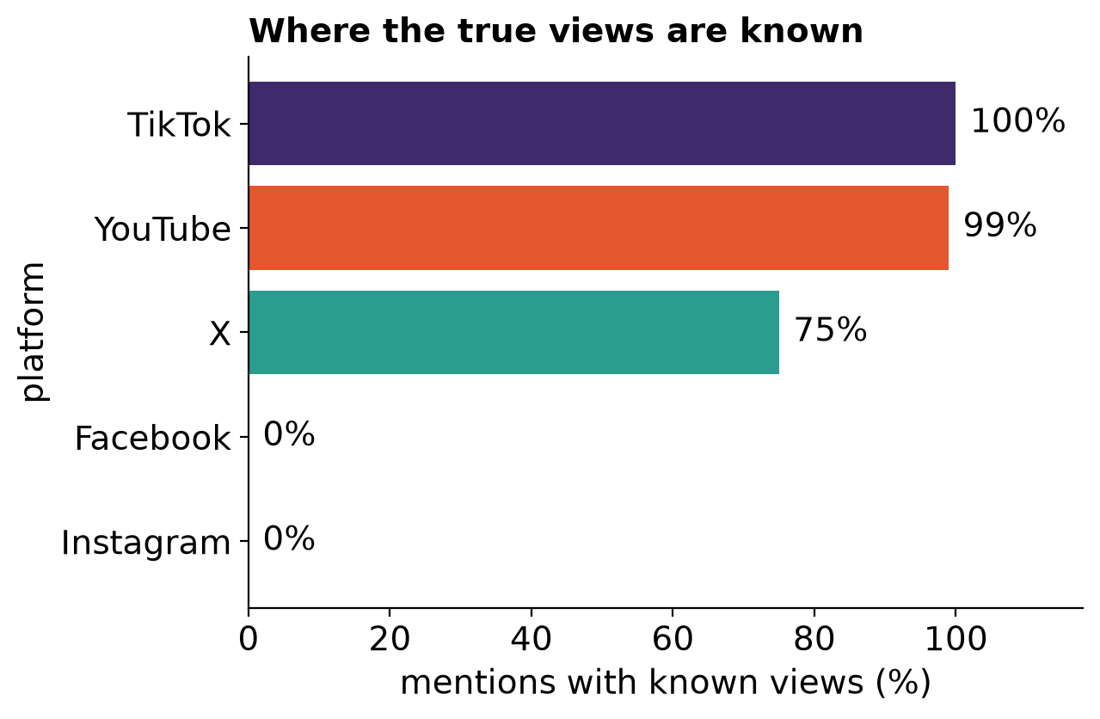
1 · DATA AND BASELINE
We know views on only three of five platforms, and Brand24's rule on X is off by a factor of about 12
TikTok and YouTube: Brand24 reach is exactly the view count, so this is our ground truth.
X: views exist for 75% of posts, and Brand24's reach is a separate estimate that is off by 1.08 log10 on average.
Facebook and Instagram: no views at all, so no estimate can be checked directly.
12,500 mentions, 2,500 per platform. The sample is not uniform in time (about 85% from April to August 2026).
Notes:
Starting point: we know the truth only where the platform reports views.

Slide 2
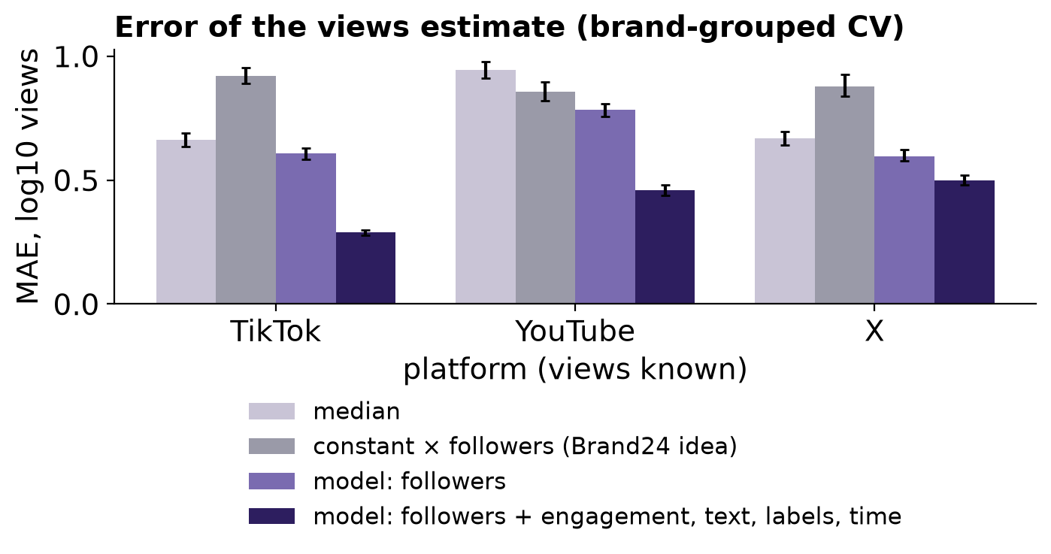
2 · WHAT DRIVES VIEWS
Views are explained mainly by likes and comments, not by followers, text or mention type
Engagement: adding likes, comments and shares cuts the error from 0.61 to 0.29 on TikTok and from 0.78 to 0.46 on YouTube.
Constant × followers: the worst model, worse than guessing the median on TikTok and X.
Text, our labels, time: do not improve the result beyond noise.
MAE on log10: 0.3 means a typical error of about a factor of 2. Validation: 5 brand groups, bars = 95% CI (brand-cluster bootstrap). Association, not cause.
Notes:
A plain log-log linear model is nearly as good as gradient trees on TikTok and X.

Slide 3
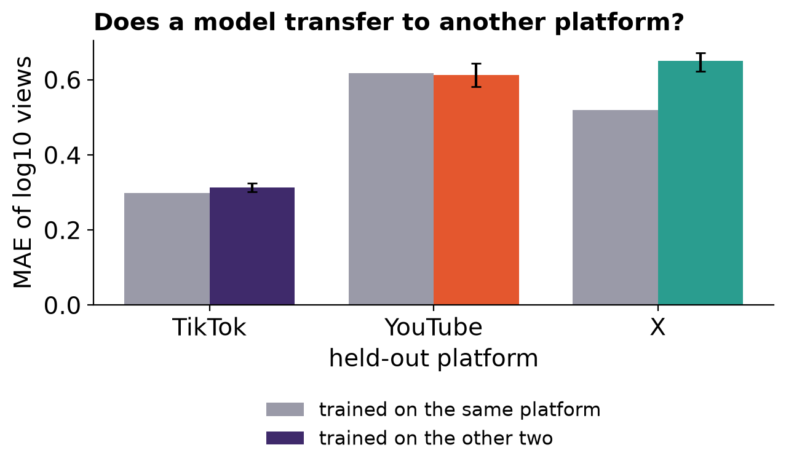
3 · TRANSFER TO PLATFORMS WITHOUT GROUND TRUTH
On Facebook and Instagram views can only be estimated, with an uncertainty of about ×14 each way
Transfers well: on TikTok and YouTube the error after training on other platforms is 0.31 and 0.61, as good as training on the platform itself.
Facebook: Brand24 reports about 21 times more than engagement implies, but there is no ground truth.
Caution: intervals built from other platforms cover only 82% of cases against a 90% target, so they are optimistic.
Labels (type, sentiment) come from an AI instrument: kappa 0.77-0.79 and 0.71-0.73 between three models. Consistency, not accuracy.
Notes:
Honest conclusion: an estimate with a wide interval, not a number to quote as the truth about Facebook.

Slide 4
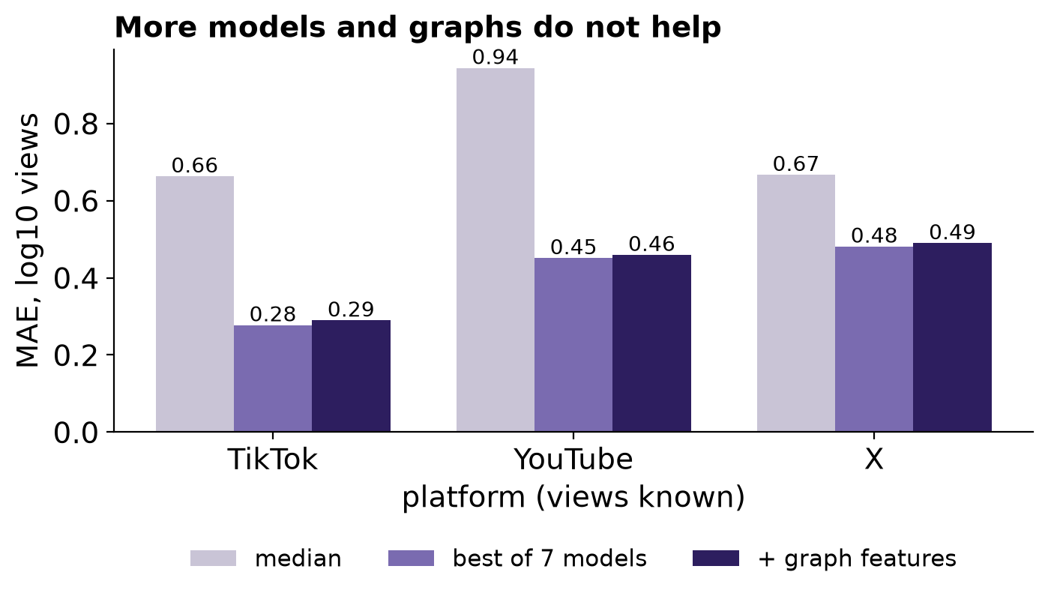
4 · WHAT ELSE WE TRIED
Six model families, author and text graphs and splitting into groups did not beat likes and comments alone
Models: ridge, kNN, forests, boosting and a blend sit within each other's CI (TikTok 0.28, YouTube 0.45, X 0.48).
Graphs: author mean, text-similarity neighbours and neighbour smoothing give at most 0.009 on YouTube, within noise.
Where the error is largest: posts with the fewest reactions (YouTube 0.72 vs 0.30 in the top quartile) and spam on X (0.56 vs 0.47).
Same validation as before (5 brand groups, MAE on log10). Features that use views are computed from the training fold only. One model per follower tier was worse than one pooled model.
Notes:
A negative but strong result: the signal is in engagement, not in the learner.

Slide 5
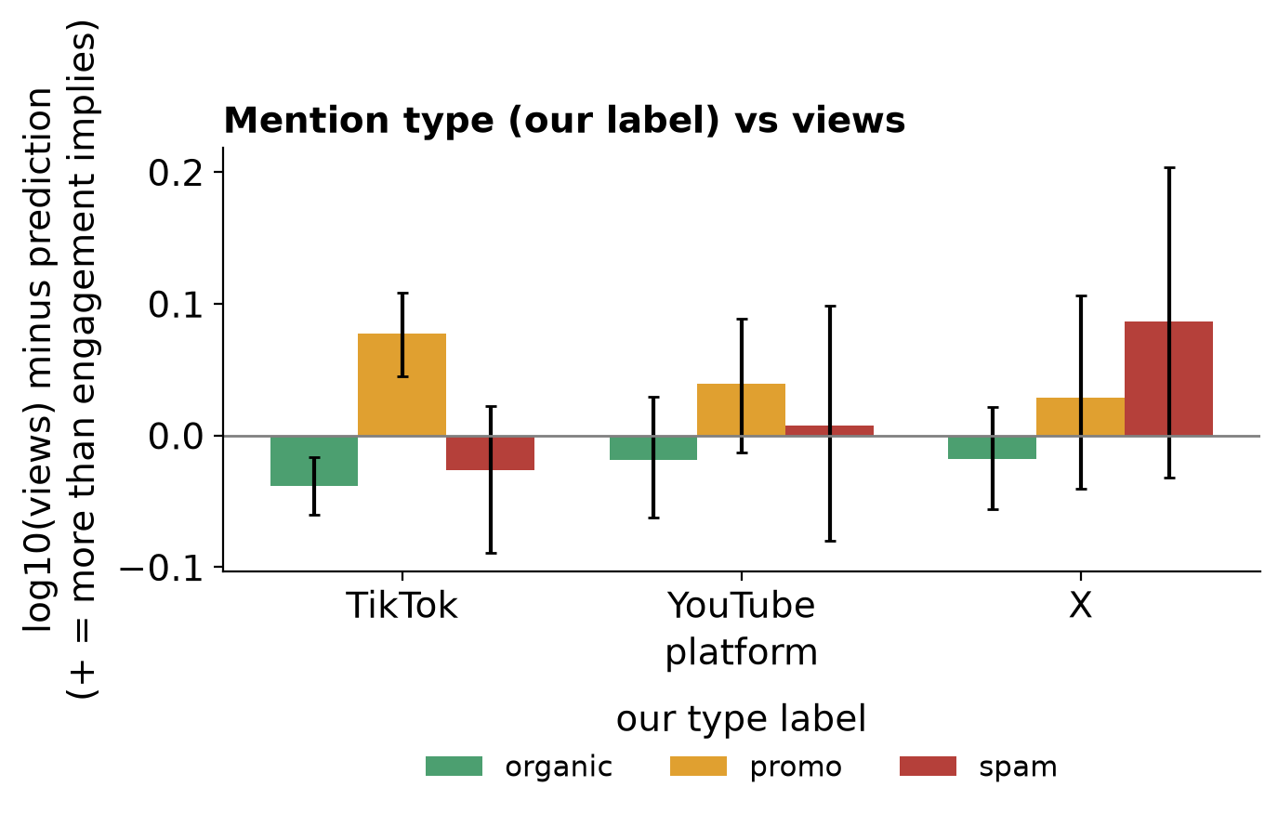
5 · OUR LABELS VS VIEWS
Our AI labels barely change views at equal engagement: promo on TikTok gets about 20% more
What we measure: the gap between actual views and what likes and comments predict, for organic, promo and spam separately.
TikTok: promo +0.08 log10 (about +20%), CI above zero; the rest within noise.
Takeaway: the type labels do not improve the views estimate; at equal engagement, promo and spam posts do not stand out clearly from ordinary ones.
Labels come from three Haiku coders, with Sonnet adjudicating 4,668 disputed mentions. All three agree on 79%, type kappa 0.77-0.79. This is machine-machine agreement, not a check against a human gold standard.
Notes:
Intervals are brand-cluster bootstrap. Labels are machine-coded, so the effect is treated with caution.

Slide 6
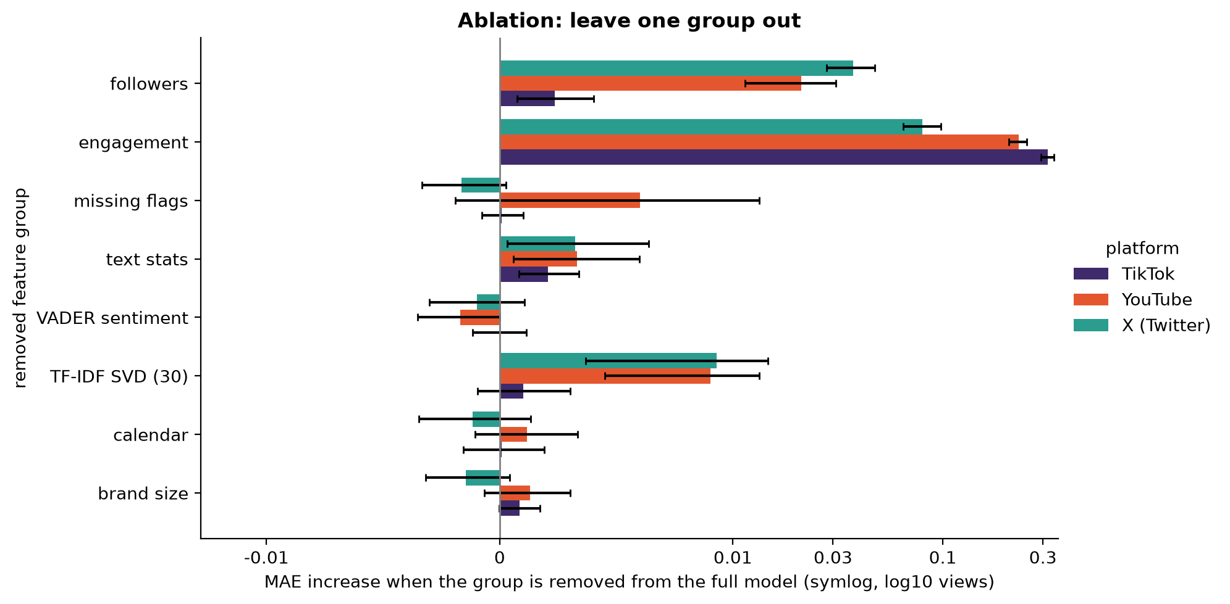
6 · EXTRA COLUMNS AND ABLATION
Text adds a small but real gain on YouTube and X; engagement is essential, while followers and a brand graph help only in places
Text (statistics and TF-IDF topics): improves the error by 0.014 on YouTube and 0.016 on X; nothing on TikTok. Small, but the CI excludes zero.
Ablation: removing engagement raises the error by 0.32 (TikTok) and 0.23 (YouTube). VADER sentiment, calendar and brand size add nothing.
The other way round: likes, comments and shares are predictable (R² 0.76 for TikTok likes), followers hardly (R² 0.22). The brand graph helps only X, by 0.011.
Bars = error increase when a group is removed from the full model (symlog axis), 95% brand-cluster bootstrap CI. Engagement explains most; the rest are corrections around 0.01.
Notes:
Intervals are paired on the same folds. Text and calendar features use no views.

Slide 7
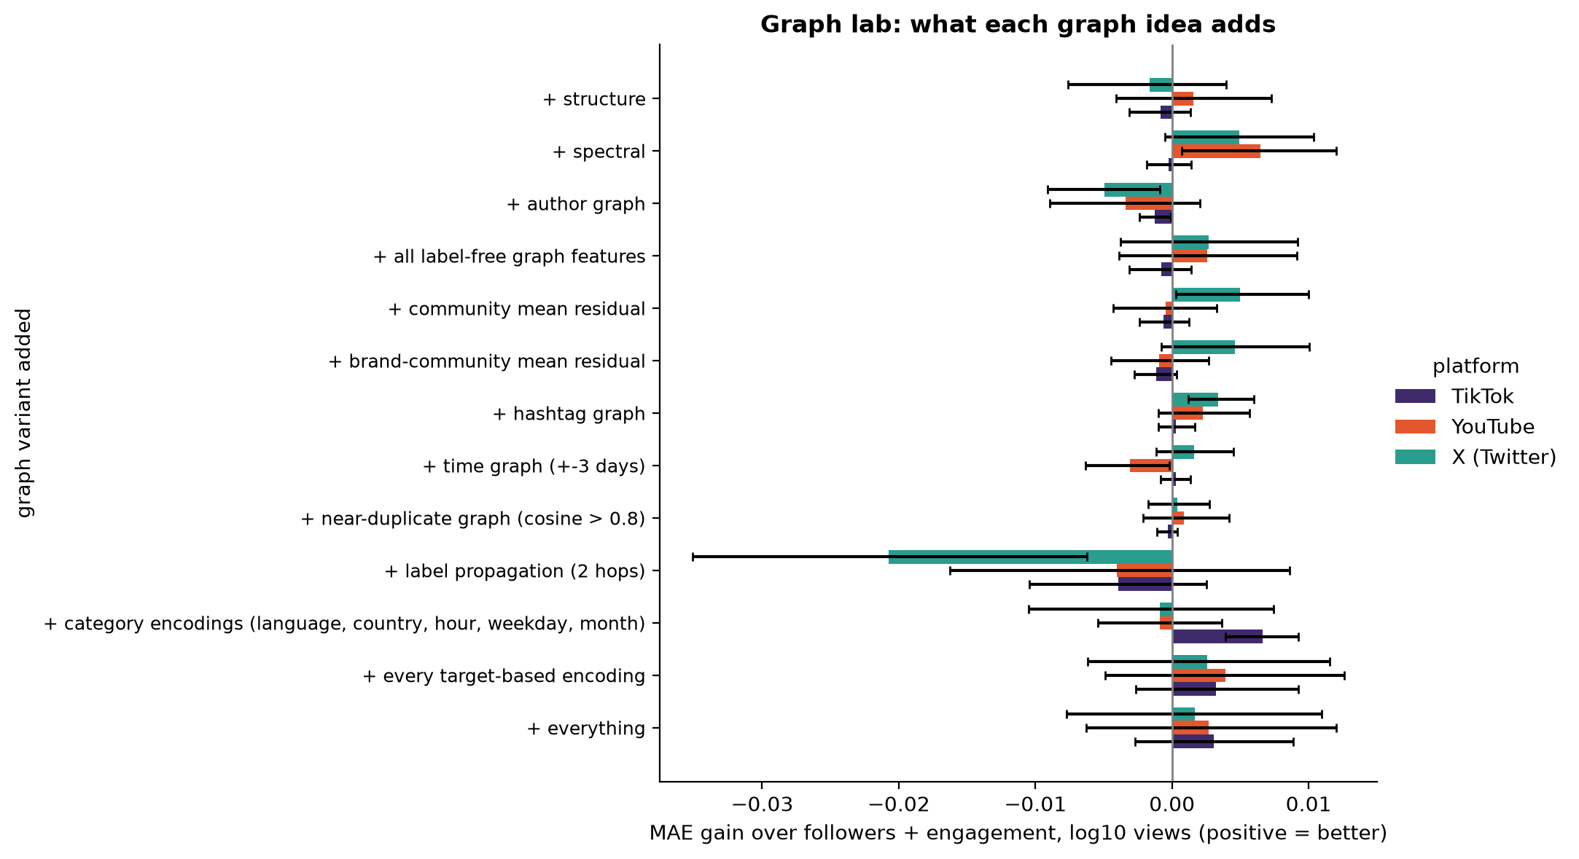
7 · GRAPH LAB
Ten graph and encoding ideas do not improve the views estimate, and label propagation makes it worse
What we tried: communities (Louvain), PageRank, spectral embedding, author-brand graph, hashtags, time, near-duplicates and category encodings.
Result: the biggest gains are about 0.007 (category encodings, TikTok) and 0.006 (spectral, YouTube), practically zero.
Label propagation: hurts on all platforms (X -0.021) because on the training fold it sees its own results reflected through graph loops.
Paired gain over followers + engagement, brand-grouped CV, 95% bootstrap. Features using views are computed from the training fold only.
Notes:
A negative result after a wide search: there is no hidden structure in the data that a graph would extract.

Slide 8
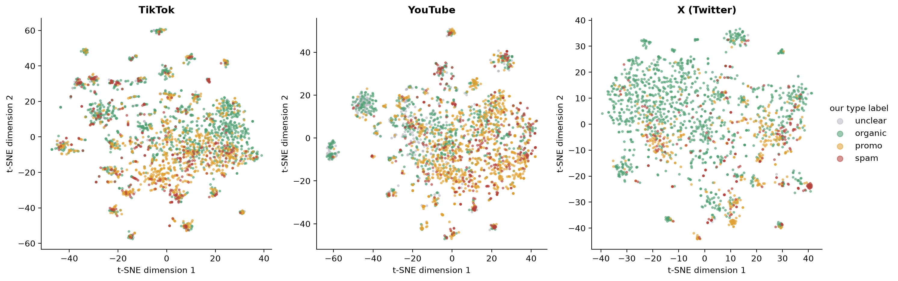
8 · WHAT THE GRAPH SHOWS ABOUT MENTIONS
The graph does not improve the estimate, but it exposes copy-paste campaigns: promo and spam form tight clusters of near-identical posts
Copies:
Views of copies:
Labels and type:
6% to 14% of mentions have a near-identical copy; spam is 38% among them vs 9% on X.
copy pairs have correlated views (0.66 to 0.82) against about 0 for random pairs.
edges link the same type more often than by chance (65% vs 52% on X), but a neighbour vote does not improve type prediction (F1 0.63 from text alone).
t-SNE map of 30 TF-IDF topics, colour = our type label. Duplicates: cosine > 0.8. Communities are mostly industries (cars, banks, fast food, airlines).
Notes:
Too few mentions have a copy in another brand for this to improve the estimate in brand-grouped CV.

Slide 9
9 · ARCHITECTURE AND HOW WE USE AI TOOLS
From raw CSV to result: every step is a script or notebook; AI codes mentions and helps with code but does not write the paper
Raw data
AI coding
Labels
Features
Validation and models
Results
CSV, 12,500 mentions, read-only
3x Haiku + Sonnet on disputes; codebook
type and sentiment, kappa, decision source
followers, engagement, missingness, text, labels, graph
brand-grouped CV, bootstrap, intervals, transfer
notebooks, figures, slides built from JSON numbers
Where we use AI: coding mentions (the instrument), help with code and notebooks, bug checks.
Control: a log of every session in the repo, small commits, fixed seeds, code from raw data to figure.
What AI does not do: does not write the preprint or poster text, never touches raw data.
Limit: AI labels were not scored against a human gold standard; this is our main limitation.
Notes:
5-10 minutes on architecture and AI tools for class.

