Slide 1
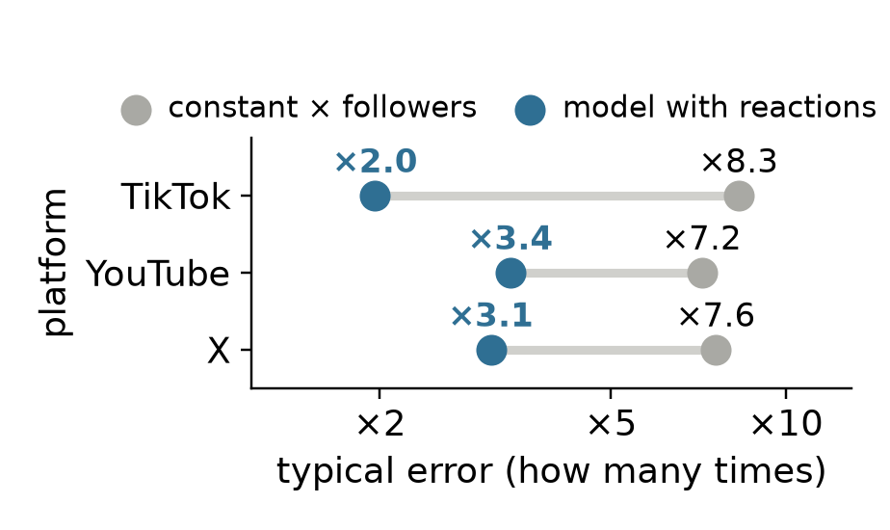
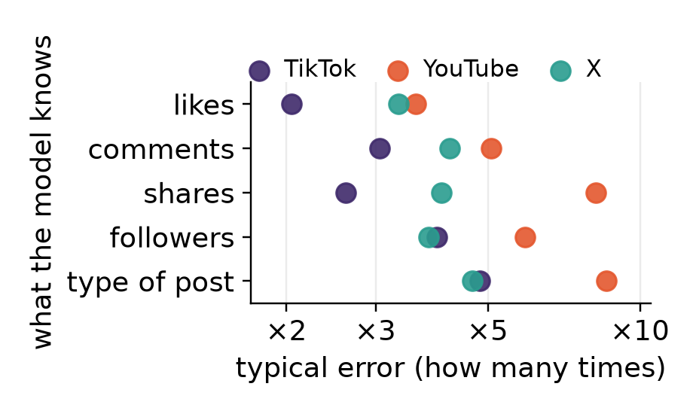
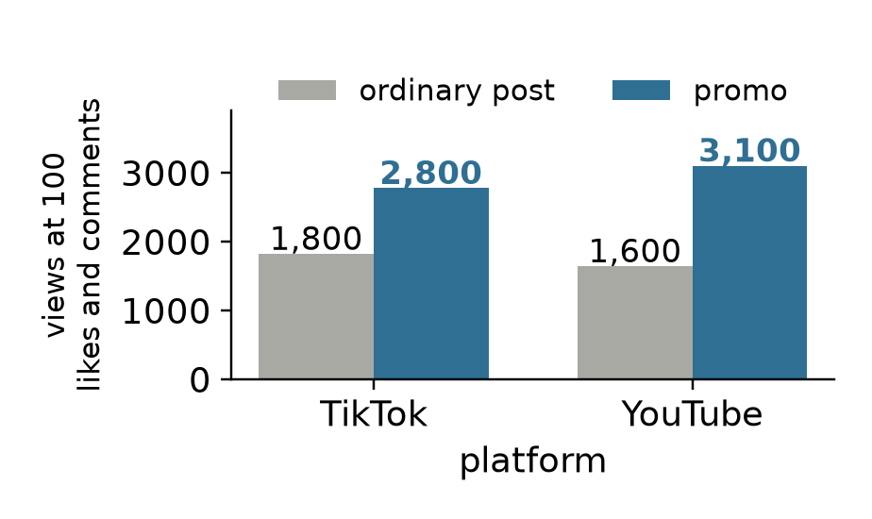
1 · WHAT THE DATA SHOW
Likes say far more about views than the follower count
Platforms often hide how many people saw a post, so Brand24 has to estimate it. We have 12,500 posts from 5 platforms. True views exist only on TikTok, YouTube and part of X, so that is where we test what works.
How far off are we?
What matters most?
Does the kind of post help?
A constant × followers is off 7-8 times. A simple model with reactions is off 2-3 times, even without tuning. On X, where we can compare, Brand24's reach is off about 12 times and our model about 3 times.
A model that knows just one thing about a post does best with likes. On TikTok likes alone give an error of about ×2. The type of post alone says almost nothing.
AI labelled each post as ordinary, promo or spam, plus its tone. This barely improves the estimate. It does show that at the same reactions, promo gets 1.5-1.9 times the views.
"Off by ×3": typically 3 times too high or too low. The range for 90% of posts is wider: ×4 (TikTok), ×10 (YouTube), ×11 (X) each way. Tested on brands the model has not seen. Reactions are likes, comments and shares. Brand24's reach may not be the same as views.
Notes:
Full text: docs/en/class_slides_script.md. The left chart's model is HistGradientBoosting without tuning; the comparison on X and the middle chart use extra trees. On X the promo difference points the same way but has wide intervals.

Slide 2
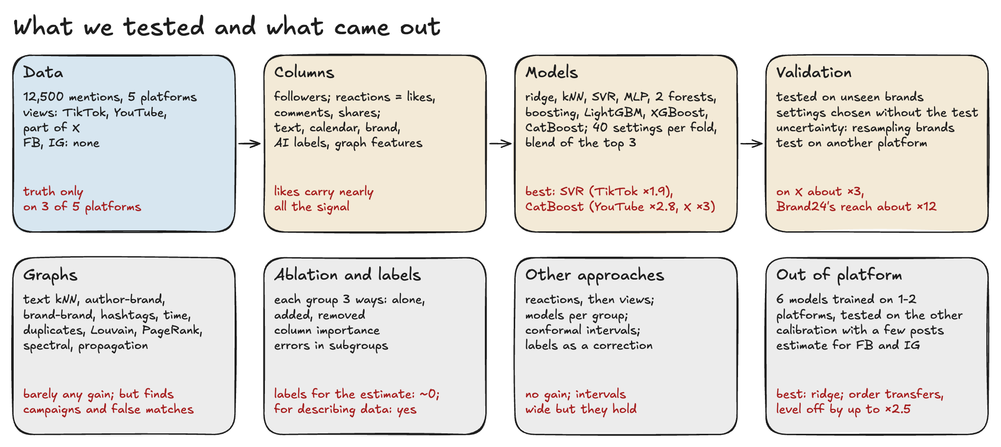
2 · WHICH MODELS AND APPROACHES
We tested 10 kinds of model: the best are off 2-3 times, and extra data and graphs barely change that
Best after tuning: SVR on TikTok, CatBoost on YouTube and X. Input: followers, reactions, missing-value flags. 40 sets of settings per model. Main limitation: no human has checked the AI labels yet.
Notes:
Tuning matters only for models that overfit by default (extra trees on X 0.59 to 0.47). After tuning the families converge, except ridge on YouTube (0.55).

Slide 3
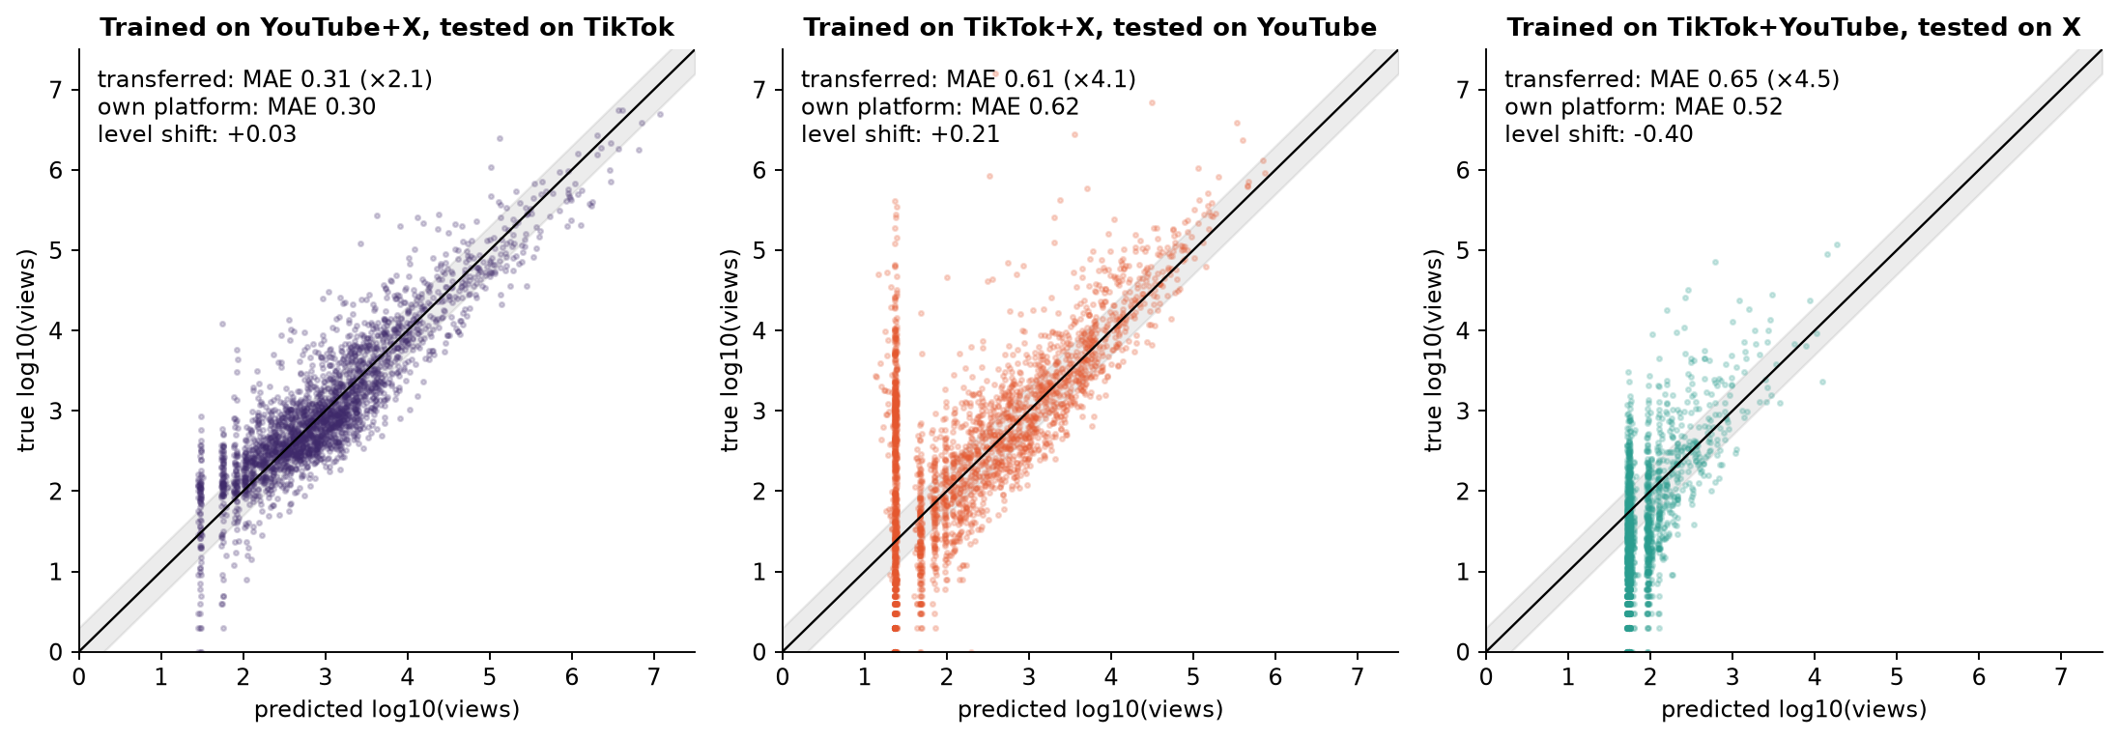
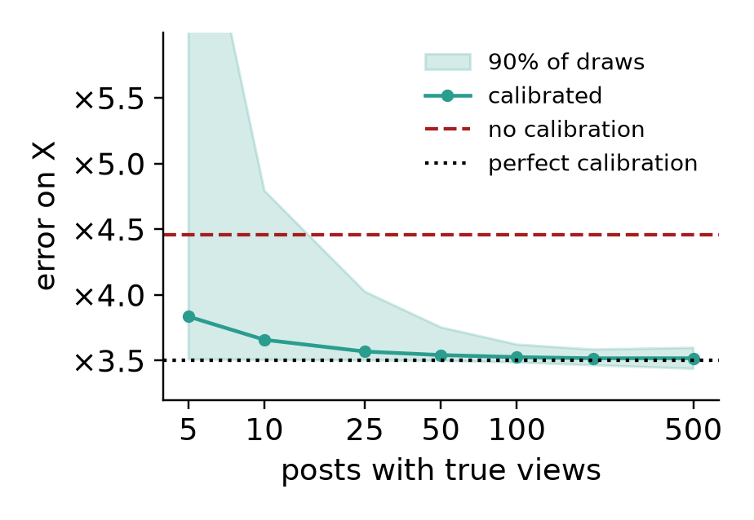
3 · ANOTHER PLATFORM AND CALIBRATION
A model from another platform ranks posts well but can miss the scale; about 50 posts fix that
Another platform
A small sample is enough
A simple model (ridge) trained on two platforms, using only likes and comments. Off by: TikTok ×2.1, YouTube ×4.1, nearly as on own data. On X ×4.5 against ×3.3, because all posts are overestimated about 2.5 times.
On X about 50 posts with true views remove the overestimate: the error falls from ×4.5 to ×3.5, close to perfect calibration (×3.5). Brand24 has no such Facebook or Instagram sample, so we plan to collect our own.
Left: ridge trained on two platforms, tested on the third, test brands removed from training. Log10 axes. Calibration was tested only where the truth is known. On FB and IG the estimate depends on the source by ×1.7 and ×2.4.
Notes:
Columns on the left are posts without reactions: they get the same prediction. Calibration: shift all predictions by the median error of n posts and score the rest. TikTok and YouTube have nothing to fix.

Slide 4
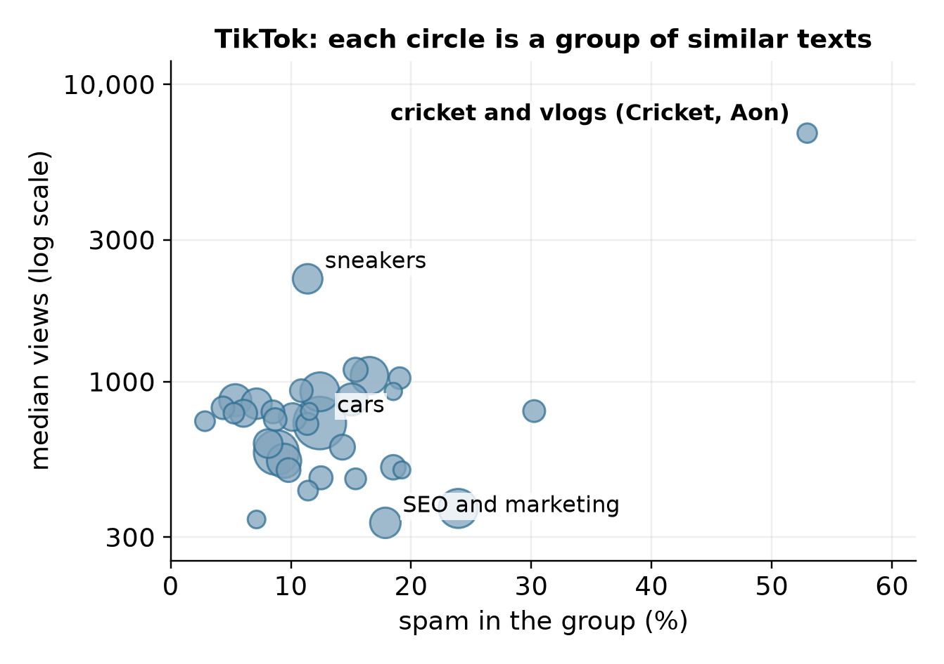
4 · GRAPHS
Graphs barely improve the estimate, but they show what is really in the data
How it works: each post is a point and similar texts are linked. The Louvain algorithm splits the graph into groups by itself, with no views or labels.
For the estimate: 18 variants of graph features give at most +0.009 (YouTube). Label propagation even makes it worse.
For describing the data: industries emerge: cars, hotels, fast food. 38% of near-identical posts on X are spam, against 9% in the rest.
A curiosity: mentions of the Cricket Wireless mobile network on TikTok are about the sport: 0 of 20 about the company. Keyword monitoring caught something else. Small sample.
Groups are moderately stable (ARI 0.61-0.71). They match brands (NMI 0.49-0.65), not post type (NMI 0.04-0.08). False matches were checked on one example; their frequency is unknown.
Notes:
Text graph: each post links to its 10 most similar (TF-IDF, cosine). Louvain finds dense groups. We also tried author-brand, hashtag, time and duplicate graphs, PageRank, spectral features and label propagation.

Slide 5
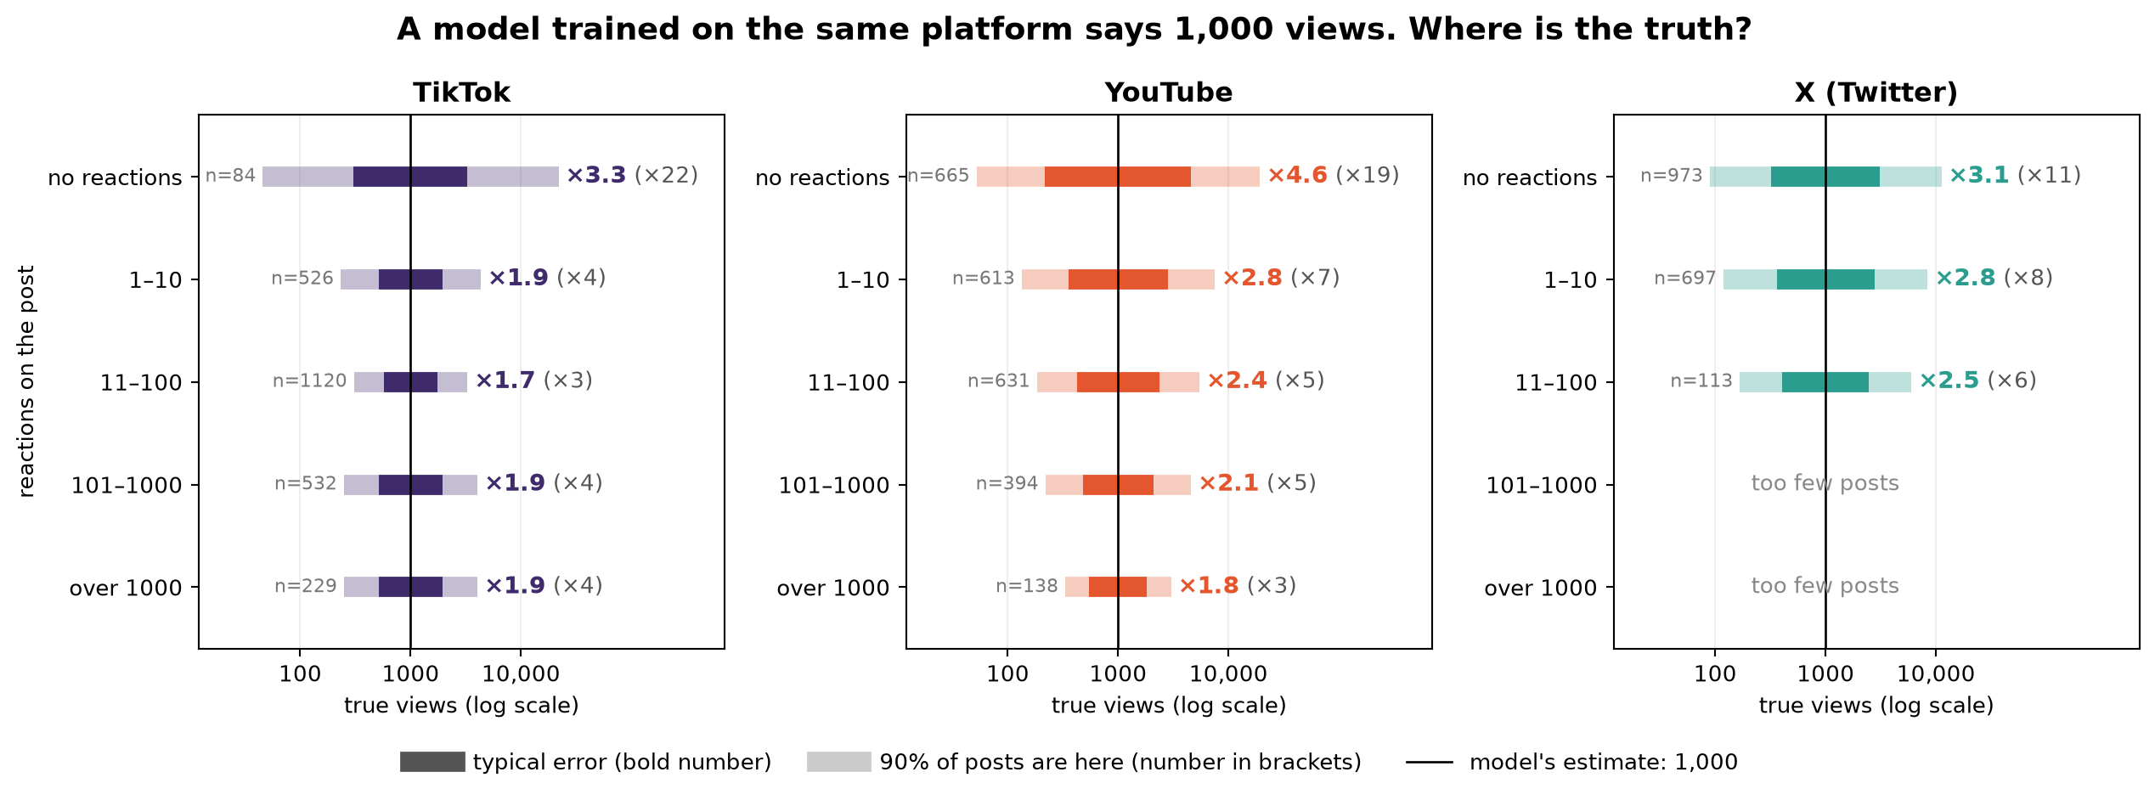
BACKUP · UNCERTAINTY
Without reactions the estimate is uncertain; with reactions the range narrows sharply
Model: CatBoost trained on the same platform, on followers and reactions, tested on unseen brands. The range at zero reactions is wide, so such an estimate should be marked as uncertain. An interval per reaction tier covers about 90% of posts; the exception is TikTok at zero reactions, with too little data.
Notes:
Read it this way: the black line is the estimate, here 1,000. The dark bar is the typical error. The light bar is the range for 90% of posts, and the number beside it says how many times each way.

