Slide 1


TAKE THE MOST OUT OF:
Text Data Augmentation Strategies for intent clustering and induction based on DSTC 11 Track 2

Slide 2
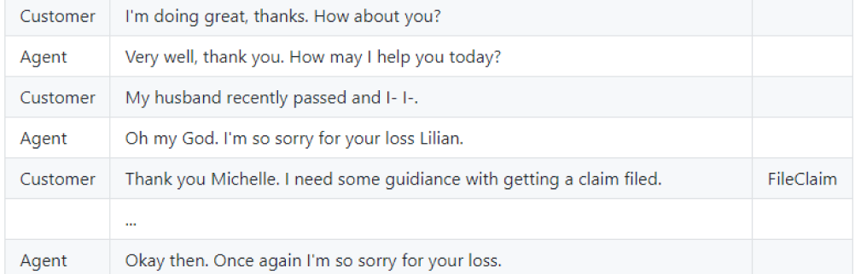
DSTC11 TRACK 2
„This track aims to evaluate methods for the automatic induction of customer intents in the realistic setting of customer service interactions between human agents and customers.”
Organizers: James Gung, Raphael Shu, Jason Krone, Salvatore Romeo, Arshit Gupta, Yassine Benajiba, Saab Mansour and Yi Zhang [1] [2]

Slide 3
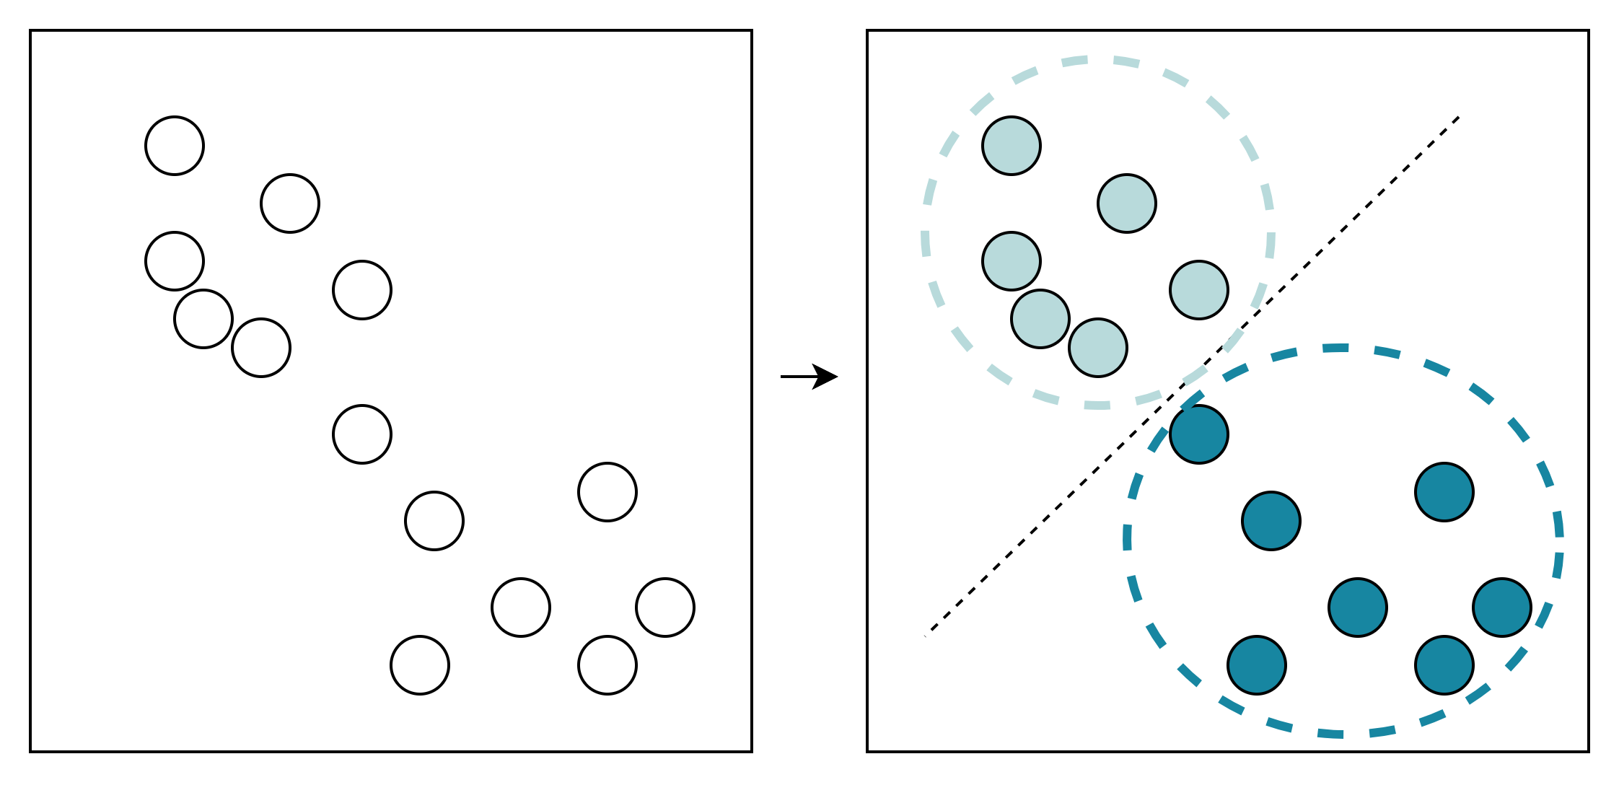
Task 1 Intent Clustering

Slide 4
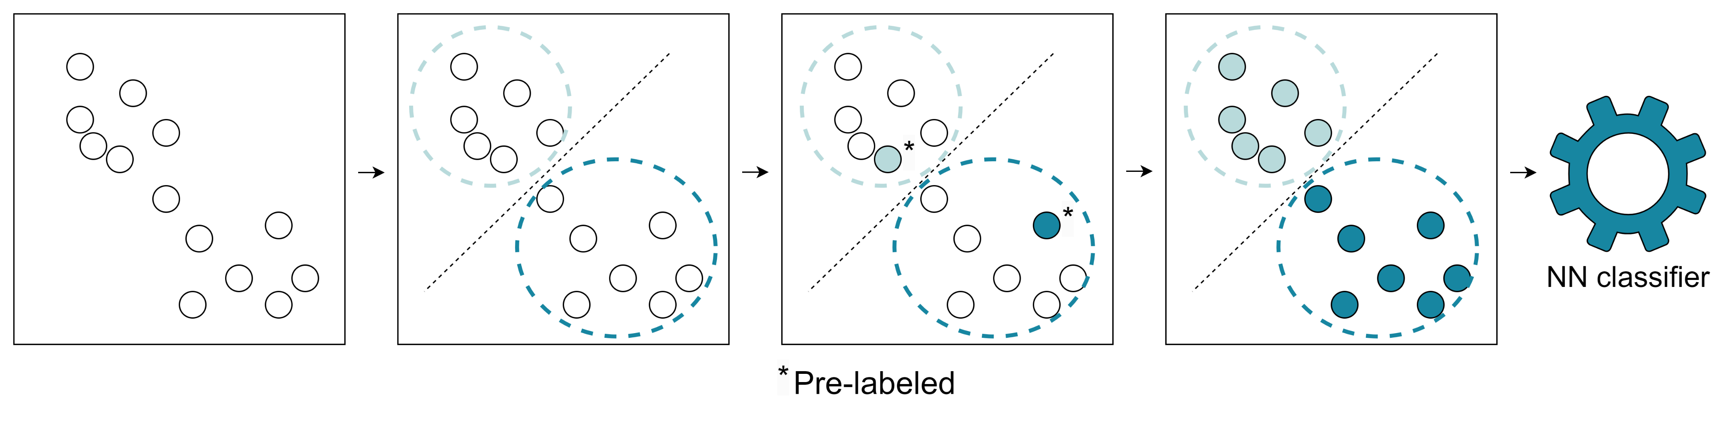
Task 2 Open Intent Induction

Slide 5

IDEA
The idea behind exploiting the DA came from observing the influence of the methods in supervised tasks. The methods are widely known to improve various language models in NLP challenges [3]. Utilizing DA is expected to improve the overall quality of the dataset thus it may be beneficial to use in clustering.

Slide 6
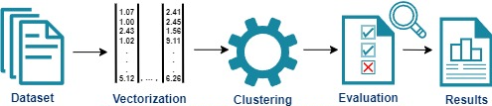

APPROACH
The adopted solution is to modify only the given datasets, not the clustering algorithm. The text augmentation method is back-translation en->de->en, with the utilization of Opus-MT [5].

Slide 7
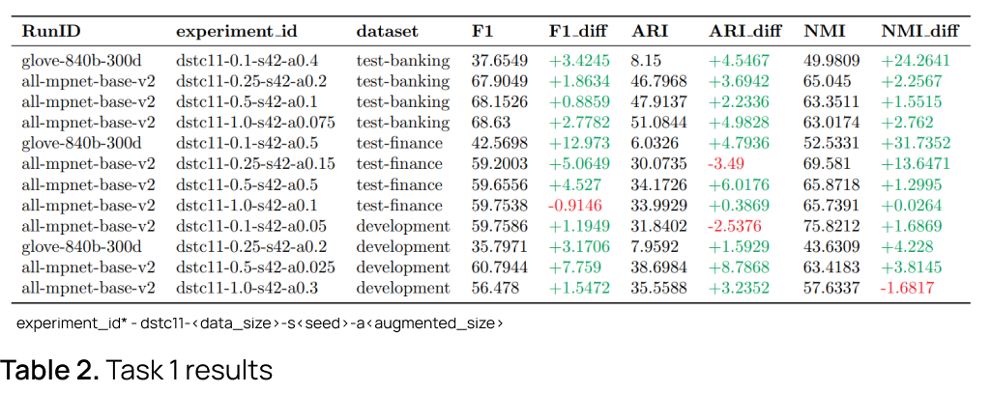
RESULTS

Slide 8
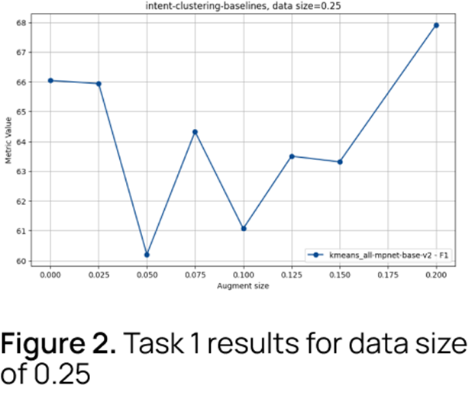
RESULTS
The results showed an improvement in the performance of the clustering and induction methods (see Table 1, Figure 6, 7), which means that the data augmentation is beneficial to use in unsupervised techniques alike in the supervised methods.

Slide 9
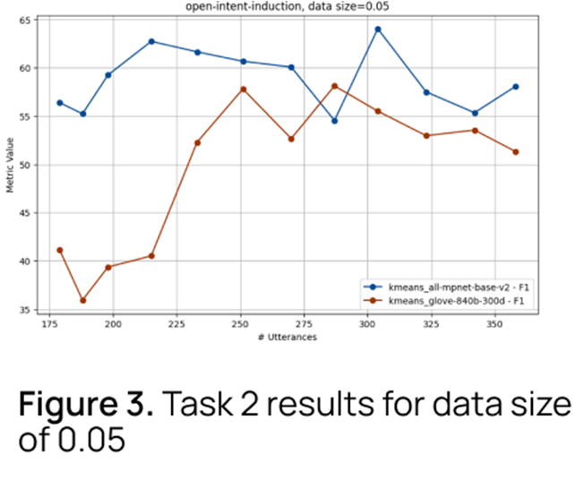
RESULTS
The glove 300d representation is more susceptible to the effects of back translation augmentation than for all-mpnet-base-v2, although all-mpnet-base-v2 performance better in both tasks.

Slide 10
FUTURE WORK
Examine described method in DSTC11 Track 2 on the entire dataset with number of experiments with different configurations. Further investigation of other augmentation methods including: generative LLMs, character, word, sentence level, and synonym replacement. Utilization of DA for the winning systems of DSTC11.

Slide 11
REFERENCES
Gung, J., Moeng, E., Rose, W., Gupta, A., Zhang, Y., & Mansour, S. (2023). NatCS: Eliciting Natural Customer Support Dialogues.
Gung, J., Shu, R., Moeng, E., Rose, W., Romeo, S., Benajiba, Y., … Zhang, Y. (2023). Intent Induction from Conversations for Task-Oriented Dialogue Track at DSTC 11.
Bayer, M., Kaufhold, M., Reuter, C. 2022. A Survey on Data Augmentation for Text Classification. ACM Comput. Surv. 55, 7, Article 146 (July 2023).
Lim, S. K., Loo, Y., Tran, N.-T., Cheung, N.-M., Roig, G., & Elovici, Y. (2018). DOPING: Generative Data Augmentation for Unsupervised Anomaly Detection with GAN.
Tiedemann, J., & Thottingal, S. (2020). OPUS-MT — Building open translation services for the World. Proceedings of the 22nd Annual Conferenec of the European Association for Machine Translation (EAMT). Lisbon, Portugal.
Ido, Y., Sharkov, S., Yang, E. Data augmentation with adversarial examples and ... - Stanford University.

