Slide 1
AutoScanner:
Portable Photometric 3D Reconstruction
Mikola Lysenko
Chris Hopman

Slide 2
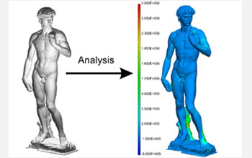
Project Goals
Implement a portable 3D scanner
Needs to be transportable on an airplane
Quick processing time
Must work on marble statues

Slide 3

Our Approach
Structure from motion + Multiview stereo
Structure from
Motion
Camera Calibration
Multiview Stereo
Keyframes
Geometry!!

Slide 4
Structure From Motion
Currently using Bundler [Snavely & Seitz]
  Developed at University of Washington
Takes as input a bunch of pictures
Produces camera calibration + feature points
Sometimes a bit finicky...
  Need to add option for fixed focal length, radial distortion didn't seem to work
  ~10% bad cameras

Slide 5
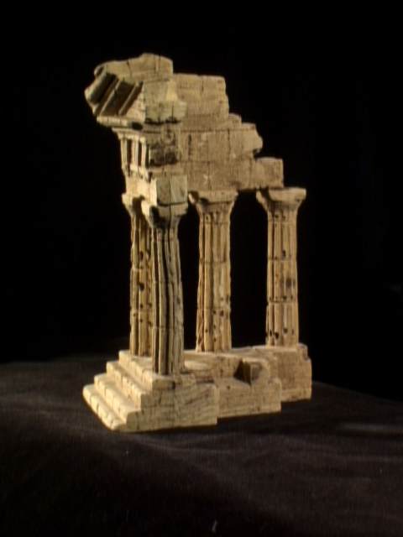
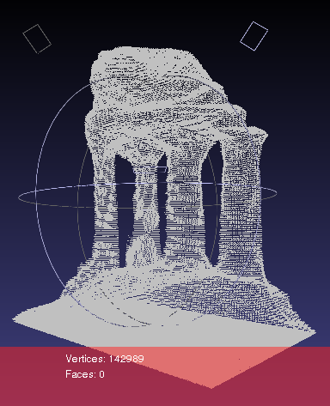
Multiview Stereo
Currently using PhotoHull
  Not enough time to debug volumetric graph cuts
Some results:

Slide 6
Test Movie

Slide 7
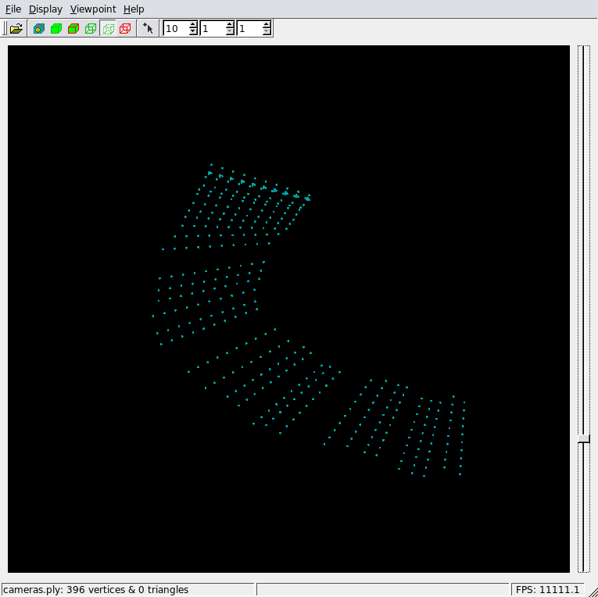
Camera Data

Slide 8
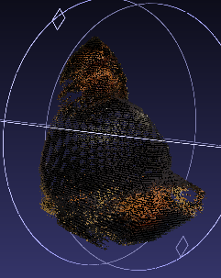
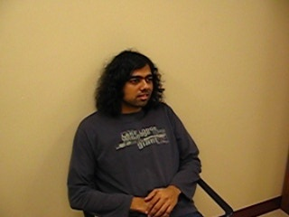
3D Reconstruction

Slide 9
Conclusions
It works
Data acquisition in < 1 minute !!!
  No calibration, no special markers
Uses standard digital camera
  Highly portable, easy to transport
Could have other practical applications:
  Graphics, Video games, Analysis

Slide 10
Additional Project Information
Source code available online:
  http://code.google.com/p/autoscanner/
Using several open source libraries:
  OpenCV, Boost::Graph, Blitz++
Developed on Linux
Plans to continue project development through winter break

Slide 11
Future Work
Can probably do better than bundler, given that we know we are using a video
  Optical flow vs. SIFT matching
  Need better bounding box placement code
Regularization term in multiview stereo
  Reduces 'ballooning'
  Should improve robustness
Must fix before trip to Getty museum

