Slide 1



Ask not what you can do for the compiler
Ask what the compiler can do for you
Notes:
Hallo und herzlich willkommen allerseits zu meiner Praesentation hier bei der Devcom

Slide 2

A few opening words...
Mikołaj Radwan
Senior Game Programmer @ Techland
Notes:
My name is Mikołaj Radwan and I’m a senior game programmer at Techland’s studio in Warsaw. We’re currently working on a new, unannounced title, while the studio in Wrocław is on their way to releasing Dying Light 2 in spring 2020.
If you have any questions that I can answer quickly please ask them as we go. For larger ones please wait until the end of the presentation. I’ll be using some constructions from the newer version of the language standard so If anything in the code listings isn’t obvious it’s probably good to just ask.
then:
So to be honest, I was trying to be clever with the presentation title, a more informative one would be ->

Slide 3
Topic
How can we use C++ language features to make the compiler do some extra work for us?
Notes:
The language features I mean here are mostly C++’s strong type-safety and static assertions.
Most of you probably know what “strong type-safety” means, but just to make sure...

Slide 4
C++ is a strongly-typed language
struct Number { /* ... */ };
struct String { /* ... */ };
Number sum(Number lhs, Number rhs);
int main() {
sum(Number{42}, Number{42});
}
Notes:
* If you have two types: Number and String
* And define a function accepting two Numbers
* And call it with Number parameters
Everything will be fine, whereas ->

Slide 5
C++ is a strongly-typed language
struct Number { /* ... */ };
struct String { /* ... */ };
Number sum(Number lhs, Number rhs);
int main() {
sum(String{"42"}, Number{42});
}
Error: could not convert {} from String to Number
Notes:
if you try replacing one of the Number parameters with a String parameter - * an error will occur. This error will be emitted at compile-time since type-checking in c++ is static. Thanks to this, c++’s type system is ->

Slide 6
C++ is a strongly-typed language
free (sort of)
always checked
Notes:
* Free (well, sort of - things are rarely actually free) - what I mean by this is that type checking is performed at compile-time, so it doesn’t incur any runtime penalties
* Always checked - while runtime checks are only performed when a line of code actually executes, which means that an assertion may not ever fail on your machine, but then during your E3 presentation everything magically crashes; compile-time checks are performed always, in every compiled branch of code.

Slide 7
Type-rich programming - a simple case
function signature
    void Object::rotate(float angle);
call-site
    object.rotate(2.0f);
variable declaration
    float angle = 2.0f;
variable access
    std::cerr << angle << " deg";
Notes:
Bjarne Stroustrup in his article “Software development for infrastructure” introduced the expression “type-rich programming” (at least as far as I know). I heartily recommend reading this article.
The idea of type-rich programming is to prefer the usage of user-defined types instead of using primitive types. Let’s start with a very simple example - angles.
* cue Angle image
Angles come in two main flavours - degrees or radians. If floats are used to represent them, it may be hard to figure out which “unit” type we’re actually working with.
The cases to consider are
* the function signature - what the person reading the code sees when they read the interface of a class / header file. In this case - they see that an angle is accepted, but they don’t know what unit it’s in. This could be improved by adding documentation or calling the parameter angle_deg or angle_rad
* function call-site - what you see when reading a line of code where a function is being called. In this case - we can guess from context that the accepted parameter is an angle, but it’s hard to tell what unit it’s in (in case of angles one can probably guess). This one is harder to improve. Documentation and parameter name in the header file doesn’t help without jumping to declaration or trying to read incredibuild suggestions.
* variable declaration - similar to function call-site but in this case one has to find this value being used and then try to find out what type of parameter is actually accepted. Can be improved, again, by adding a comment or changing the name of the variable.
* variable access - call of an external function expecting a floating point value, the literal value of the angle.

Slide 8
Type-rich programming - a simple case
struct RadiansTag {};
struct DegreesTag {};
class Angle {
public:
Angle(RadiansTag, float r) : radians_(r) {}
Angle(DegreesTag, float d) : radians_(d * DEG_TO_RAD) {}
float radians() const { return radians_; }
float degrees() const { return radians_ * RAD_TO_DEG; }
private:
float radians_;
};
Notes:
Let’s see how we can improve this by creating an Angle class.
* the class will hold the angle in radians or degrees - that’s entirely up to the implementer to decide and is invisible to the user
* an object of Angle type may be constructed using a value in radians or degrees, which is always explicitly specified using a tag
* the literal value may be retrieved by calling an appropriate function - again explicitly specifying the type of unit we want to work with.

Slide 9
Type-rich programming - a simple case
void Object::rotate(float angle); void Object::rotate(Angle angle);
object.rotate(2.0f); object.rotate(Angle{degreesTag, 2.0f});
float angle = 2.0f; Angle angle = Angle{degreesTag, 2.0f};
std::cerr << angle << " deg"; std::cerr << angle.degrees() << " deg";
Notes:
Our original code using angle literals now changes in the following manner:
* functions will accept and return angle objects instead of float values
* function calls make it obvious that the argument is an angle and what unit it’s in
* variables are initialised with a specified unit
* variable reads are also safe

Slide 10
Type-rich programming - a simple case
Notes:
I like to think of this problem and the solution of this problem in terms of how deep is the context, the knowledge about what numerical values actually represent. Because in the end, in memory it will just be numbers. But the moment contextual values turn into bare numbers is different.

Slide 11

Type-rich programming - a simple case
const auto angle = 2.0f;
Notes:
For a literal value, with a variable that provides no information about the unit, with no documentation - the context is only in the head of the original programmer.

Slide 12

Type-rich programming - a simple case
const auto angle_deg = 2.0f;
Notes:
If the variable has a more informative name, or there is a comment somewhere - you could say the context is in the code - it’s visible to the programmer that reads it. For the compiler and at runtime this is still just a floating point value.

Slide 13

Type-rich programming - a simple case
const auto angle = Angle{degreesTag, 2.0f};
Notes:
With a user-defined type, not only is the code readable understandable from the get-go - the compiler has the context in which the value is defined and can enforce that the value is used correctly.

Slide 14
Type-rich programming - a simple case
Angle operator+(Angle lhs, Angle rhs);
Angle operator+(Angle lhs, float rhs);
Angle operator+(float lhs, Angle rhs);
Angle operator*(Angle a, float scalar);
Angle operator*(float scalar, Angle a);
Angle operator*(Angle lhs, Angle rhs);
bool operator==(Angle lhs, Angle rhs) {
return std::abs(lhs.radians_ - rhs.radians_) < EPSILON;
}
Notes:
Now that the compiler has the context, we can tell it what can be done with the type
* we can allow only those arithmetic operations that actually make sense. E.g. addition of angles makes sense, while addition of a “scalar” to an angle doesn’t.
* conversely multiplication...
* as a bonus: we can make floating point values comparable in a more numerically-stable way
A float is a very broad data type and you can do anything with it, even things that don’t actually make sense for the data we store in it. However, providing a user-defined type allows us to limit the operations to only those that are correct and the compiler will enforce it.

Slide 15
Type-rich programming - a simple case
Angle operator""_deg(long double d) {
return Angle{degreesTag, static_cast<float>(d)};
}
Angle operator""_deg(unsigned long long d) {
return Angle{degreesTag, static_cast<float>(d)};
}
Angle{degreesTag, 42.0f} 42_deg;
Angle{degreesTag, 12.3f} 12.3_deg;
constexpr
Notes:
* C++11 gave us user-defined literals. We can create _deg and _rad suffixes that will allow us to create literals in a more compact and readable manner.
* Last but not least, we can make everything in this class constexpr, because it’s so much cooler. Also, will allow us to use it in static_asserts and metaprogramming.

Slide 16
Type-rich programming - stepping it up
1 [ m ] * 3 [ m ] = 3 [ m ² ]
4 [ m ] / 2 [ s ] = 2 [ m * s ⁻¹ ]
2 [ kg ] * 3 [ m * s ⁻² ] = 6 [ kg * m * s ⁻² ] = 6 [ N ]
Notes:
Now we have a pretty neat implementation of an Angle class. Let’s see something more complicated. For physical properties there are many other dimensions (distance, mass, time). These can be raised to a power (distance^2 => area) and should work with each other yielding even more complicated types (distance / time^2 => acceleration). Writing a value class similar to Angle would mean a lot of typing and duplicated code. Thankfully we have templates to the rescue.
I'm going to show you an implementation inspired by a class proposed by Bjarne Stroustrup in an article about type-rich programming.
We're going to limit ourselves to three dimensions: distance, mass and time. Adding more is pretty straightforward and probably unnecessary.

Slide 17
Type-rich programming - stepping it up
const auto width = 1_m;
const auto height = 3_m;
const auto area = width * height;
decltype(width) Value<m>
decltype(height) Value<m>
decltype(area) Value<m ²>
Notes:
We would like to be able to conveniently create variables storing values of these physical properties.
* perform operations on them
* and these operations should yield values of correct types

Slide 18
Type-rich programming - stepping it up
const auto mass = 1_kg;
const auto acceleration = 3_m / 1_s / 1_s;
const auto force = mass * acceleration;
decltype(mass) Value<kg>
decltype(acceleration) Value<m * s ⁻²>
decltype(force) Value<kg * m * s ⁻²> = Value<N>
Notes:
We should also be able to easily combine values of different types, but be limited ot operations that make sense.
Before next slide: We can see that each of these data types can be described by the exponent next to the unit of mass, distance and time ->

Slide 19
Type-rich programming - stepping it up
const auto mass = 1_kg;
const auto acceleration = 3_m / 1_s / 1_s;
const auto force = mass * acceleration;
decltype(mass) Value<kg ¹ * m ⁰ * s ⁰>
decltype(acceleration) Value<kg ⁰ * m ¹ * s ⁻²>
decltype(force) Value<kg ¹ * m ¹ * s ⁻²> = Value<N>

Slide 20
Type-rich programming - stepping it up
template <int KG_EXP, int M_EXP, int S_EXP> class Unit;
using Kilograms = Unit<1, 0, 0>;
using Metres = Unit<0, 1, 0>;
using Seconds = Unit<0, 0, 1>;
using MetresPerSecond = Unit<0, 1, -1>;
using Newtons = Unit<1, 1, -2>;
Notes:
We can define a unit class as a template parametrised by these three exponents. This would mean that we can define a unit of kilogram as...

Slide 21
Type-rich programming - stepping it up
template <class UnitT>
class Value {
public:
Value(UnitT, float value) : value_(value) {}
template <class WantedUnitT>
float value() const {
static_assert(std::is_same_v<UnitT, WantedUnitT>)
return value_;
}
private:
float value_;
};
Notes:
* We’ll define a value class parametrised by the unit type.
* Similarly to our angle class we’ll want the user to be forced to specify the used unit when initialising it and * retrieving the numerical value. I’ll explain why in a moment.

Slide 22
Type-rich programming - stepping it up
using Distance = Value<Metres>;
using Mass = Value<Kilograms>;
using Time = Value<Seconds>;
using Speed = Value<MPS>;
using Acceleration = Value<MPS2>;
using Force = Value<Newtons>;
auto dist = Distance{ Metres{}, 20.0f };
Notes:
* To make things look nicer we can define a bunch of aliases for value types.
* This is reason one for why we want to make it obligatory to specify the value’s unit when constructing it. Otherwise this line would just say Distance{20.0f} which we already know is a no-no.

Slide 23
Type-rich programming - stepping it up
Insert code for value / unit multiplication
Notes:
Now how do we go about defining the result of multiplication of two values? The value part is pretty obvious, it’s the result of multiplying the two values, but what about the unit?
* Well, we can make units multipliable, and just return a value in a unit that’s the result of multiplying the operand’s units
* Defining unit multiplication is pretty obvious – it’s the sum of exponents
Other arithmetic operations should be trivial to implement.

Slide 24
Type-rich programming - stepping it up
auto prettyFar = Distance{ Kilometres{}, 2.1f };
auto notThatFar = Distance{ Milimetres{}, 5.0f };
Notes:
As an icing on the cake, we can allow the definition of other compatible unit types, e.g. make distance values constructible from metres, centimetres, miles, nautical miles and whatnot.
* This way we could construct unit values from whatever units we wanted
* And retrieve them in whatever unit we wanted, as long as the unit would be compatible. This is reason number two why we want to make it obligatory to specify a unit at construction / retrieval

Slide 25
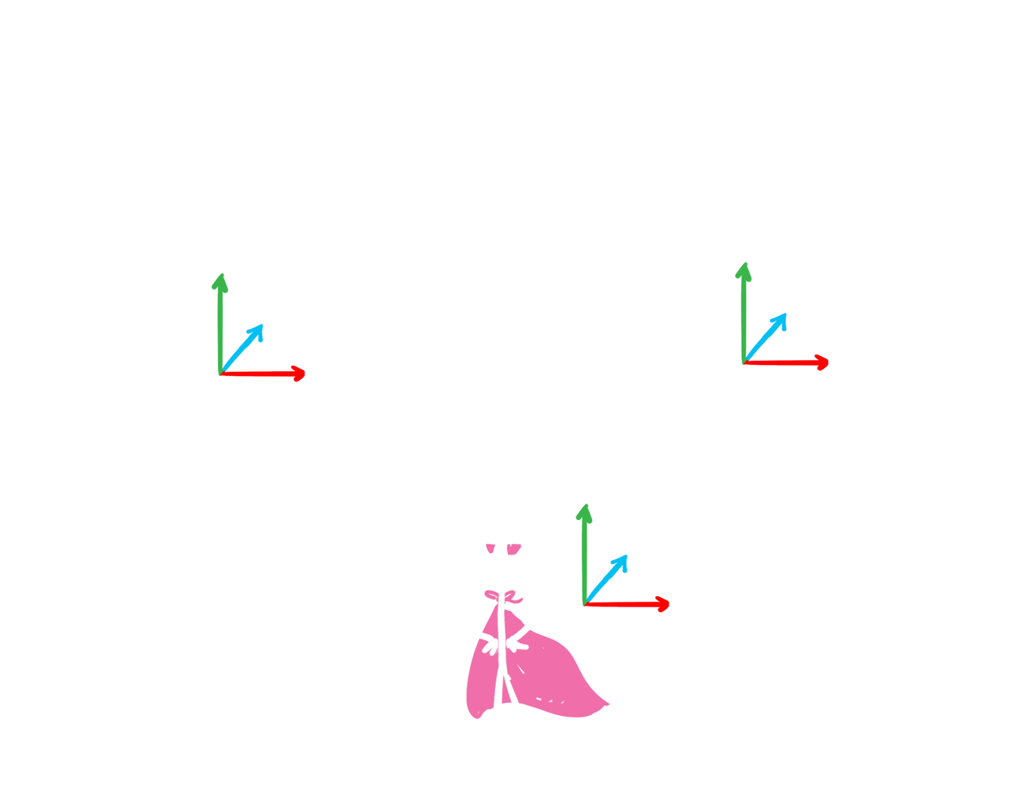
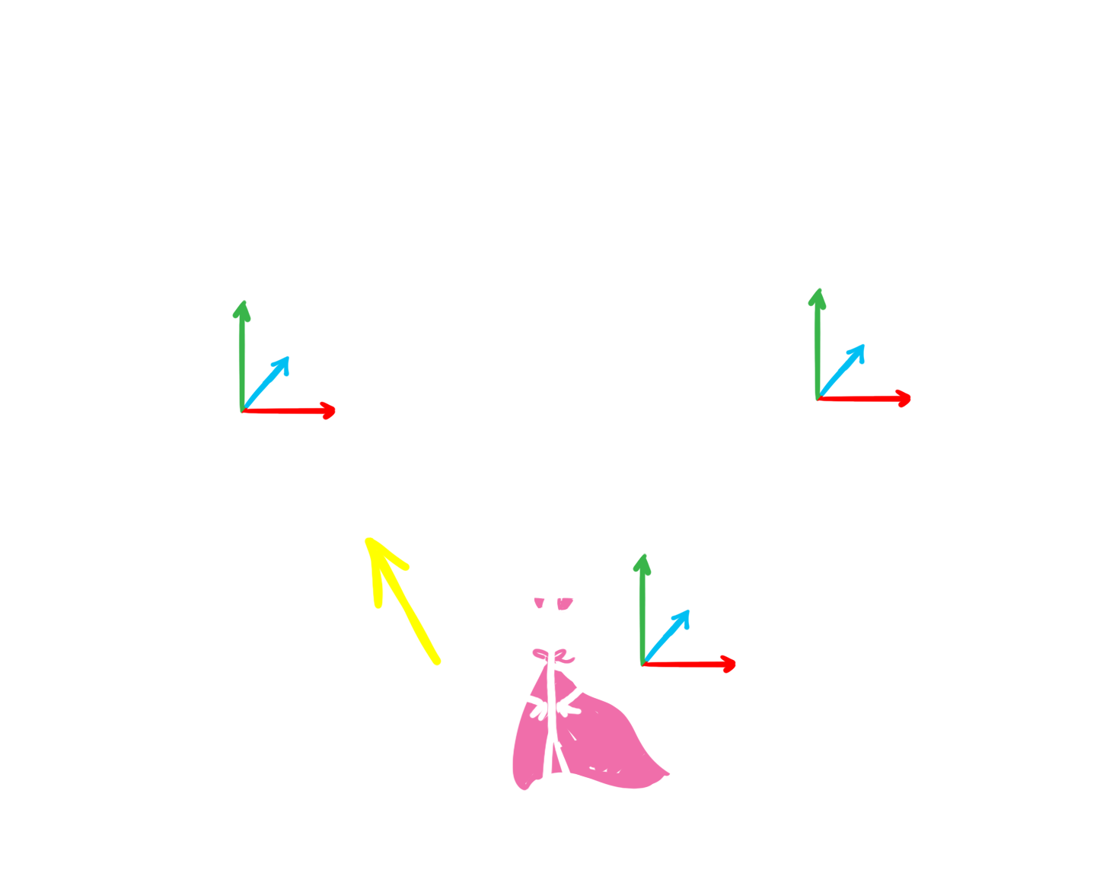
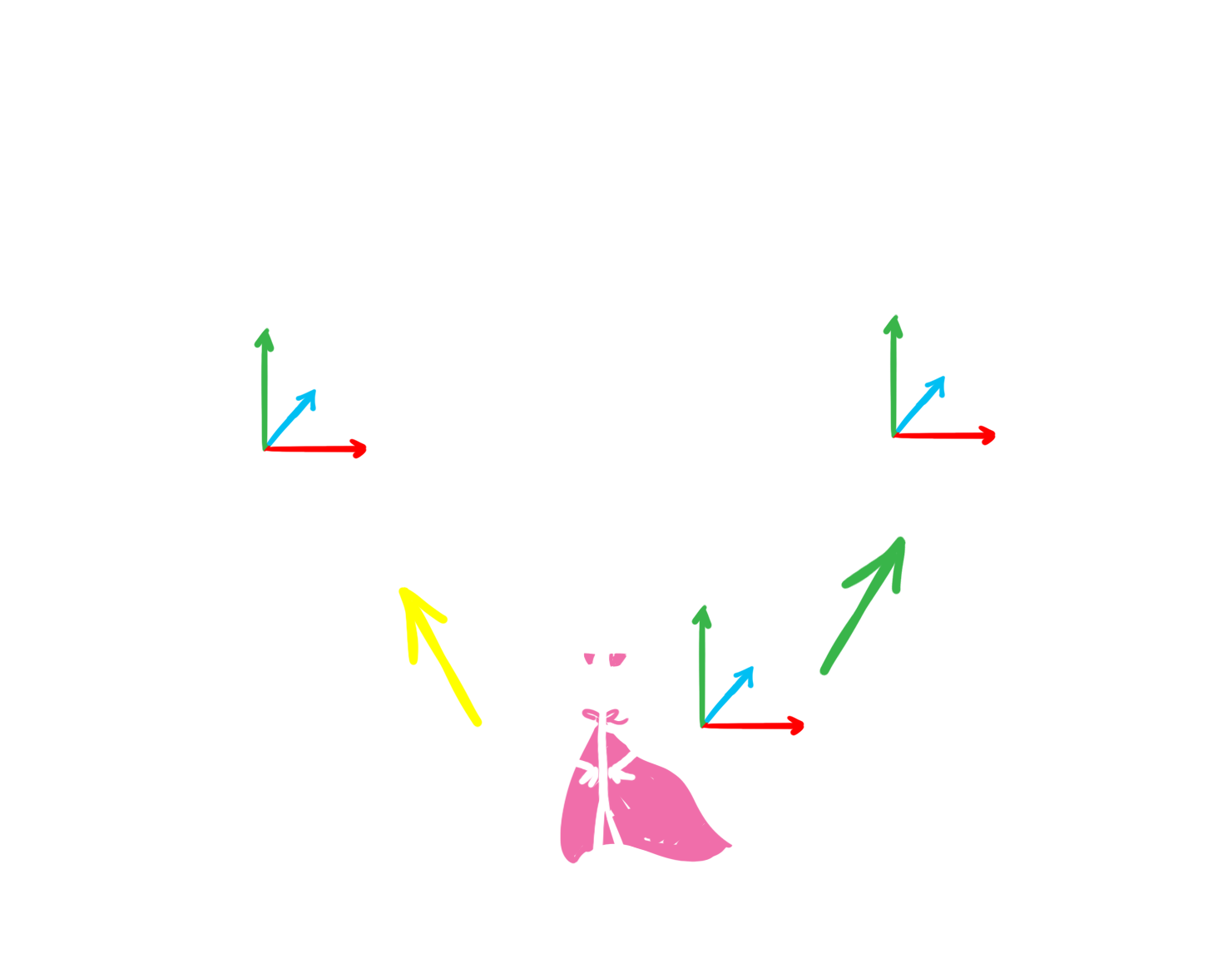
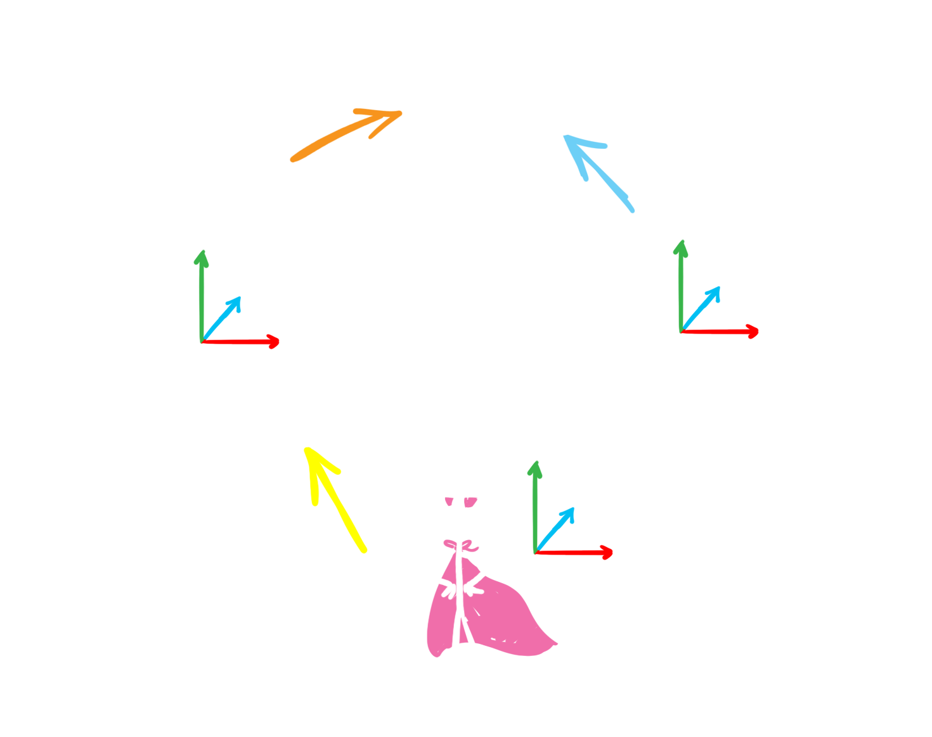
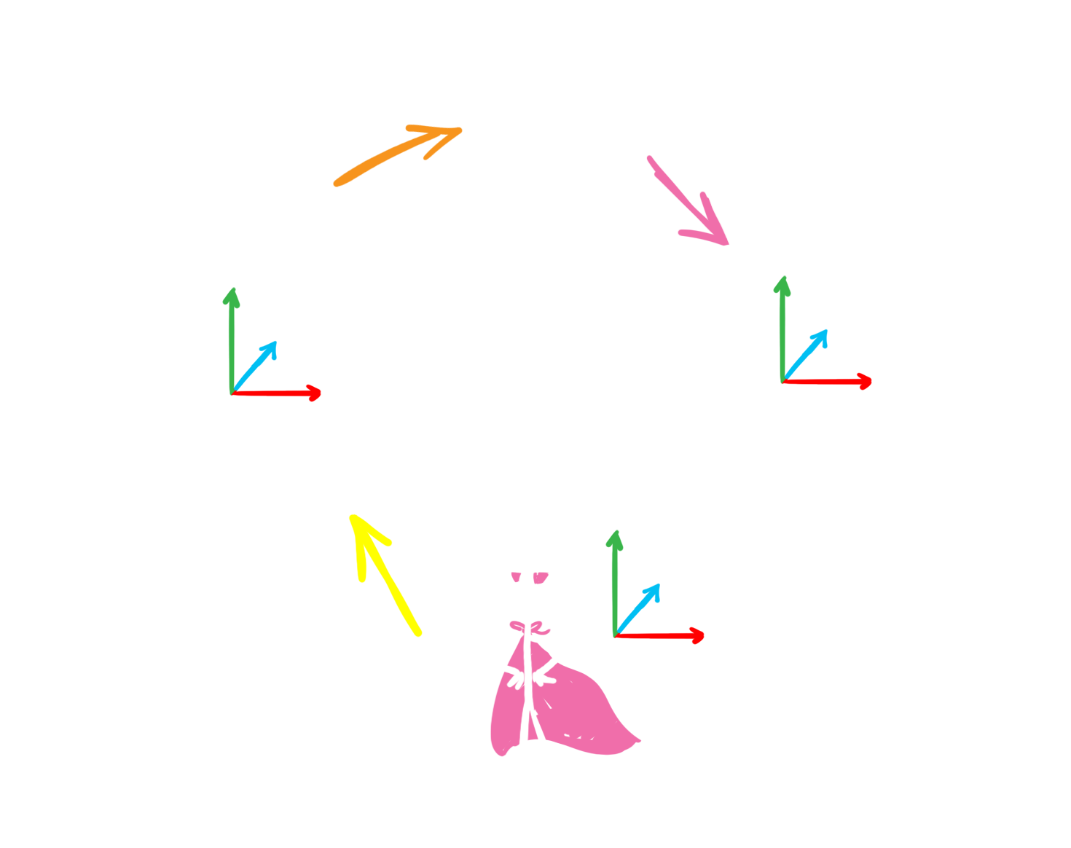
Something a bit more relevant...
M = M → M → M⁻¹
Notes:
What we have so far is, in my opinion, pretty cool and nice. Useful, but not groundbreaking, especially not in terms of game-dev.
I would like to show you a different example of leveraging the compiler's capabilities and c++'s type-safety. For this we need a bit of context. I'm currently working on a system that needs to move the player character in relation to some objects on the scene. Some data is stored in player space, some in object space, other in animation space (for an animation that can be played on the player), in the end most need to also be moved to world space. There are a lot of possible combinations and because this system is still in development at a pretty fundamental level, we often need to refactor stuff and change our opinion about what space some entities should be stored or processed at.
Keeping track of what space everything is in is one problem, but making sure you fix everything after changing something is another level. This is because while we can make stuff visible by naming them in a good way, it's hard to follow all possible references and function calls etc.
Same as reducing all physical values to a float loses too much information for the compiler to be helpful, so is reducing all 3-d transforms to a Matrix type.
Let's see how an Xform class could make sure it's being used in the right context. Xforms normally work in two spaces - a source and target (e.g. a player's "world" matrix is a transform from player to world space). A concatenation of two matrices is only valid if the target space of the left-hand-side transform is the source space of the right-hand-side transform. Such checks could be performed in compile-time if Xform were a template with spaces denoted by template parameters. A simple solution could be <click>
Describe code, then
Note also that having a clear InSequence function helps us with the issue of having to remember whether transforms are applied right-to-left or left-to-right in the used engine. These are famously easy to confuse and hard to fix.

Slide 26
Something a bit more relevant...
enum class Space { PLAYER, OBJECT, WORLD, ... };
template <Space s>
class Vector { ... };
template <Space s>
class Point { ... };
template <Space from, Space to>
class Xform { ... };
Notes:
A possible solution (and our current implementation) is

Slide 27
Something a bit more relevant...
Vector operator+(const Vector& lhs, const Vector& rhs);
Vector operator-(const Vector& lhs, const Vector& rhs);
Vector operator-(const Point& lhs, const Point& rhs);
Point operator+(const Point& lhs, const Vector& rhs);
Notes:
Having separate vector/point classes allows us to, again, limit the use of the data type to operations that make sense.

Slide 28
Something a bit more relevant...
Point<toSpace> Xform::apply(const Point<fromSpace>& p) const;
Vector<toSpace> Xform::apply(const Vector<fromSpace>& v) const;
template <Space lhsFrom, Space lhsTo, Space rhsFrom, Space rhsTo>
auto inSequence(
const Xform<lhsFrom, lhsTo>& lhs,
const Xform<rhsFrom, rhsTo>& rhs)
{
static_assert(
lhsTo == rhsFrom, "Trying to join two incompatible transforms");
return Xform<lhsFrom, rhsTo>{rhs.matrix() * lhs.matrix()};
}
Notes:
But most importantly, we can keep track of the space everything is in →
This is very useful (how useful…)

Slide 29

Type-rich programming - a simple case
Notes:
Keeping spaces in a xform template took us from having the context only in code, to the compiler understanding it. We can go further though. A lot of information that is important is only present at runtime. Let’s see how can we level up there

Slide 30
Something a bit more relevant...
struct World {};
struct Camera {};
struct Player {};
template <class LhsSpace, class RhsSpace>
constexpr auto spacesMatch(LhsSpace, RhsSpace) {
return std::is_same_v<LhsSpace, RhsSpace>;
}
Notes:
Instead of an enum, we can use types. The basic types would be defined as empty and the default way to check whether spaces match would be to check if they have the same type.

Slide 31
Something a bit more relevant...
struct Object {
#ifdef DO_SPACE_RUNTIME_CHECKS
Entity* entity;
explicit Object(Entity* entity) :
entity(entity)
{
}
#else
explicit Object([[maybe_unused]] Entity* entity) {}
#endif /* DO_SPACE_RUNTIME_CHECKS */
};
#ifdef DO_SPACE_RUNTIME_CHECKS
bool spacesMatch(Object lhs, Object rhs) {
return lhs.entity == rhs.entity;
}
#endif
Notes:
We can also define spaces that store actual data – the runtime context. So for an Object space, we could store the pointer to the object in question. We can keep this data optionally, only when we want to verify that all the spaces used are correct.

Slide 32
Something a bit more relevant...
template <class SpaceT>
class Vector : SpaceT;
template <class SpaceT>
class Point : SpaceT;
template <class FromSpaceT, class ToSpaceT>
class Xform : CompressedPair<FromSpaceT, ToSpaceT>;
Notes:
Providing the space as a template parameter is not enough now, we need to have access to the instance data. EBO makes all of this free if not used.

Slide 33
Something a bit more relevant...
Free?
Notes:
Beware of performance issues related to copying of matrices / vectors

Slide 34
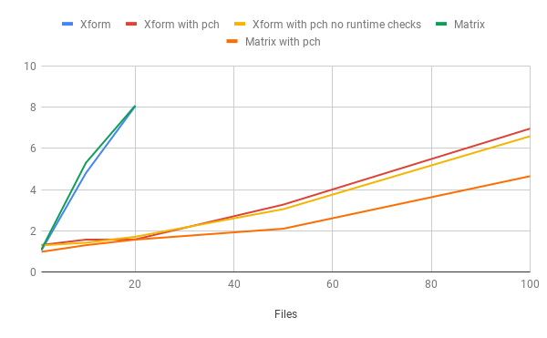
Something a bit more relevant...
Notes:
Beware of performance issues related to copying of matrices / vectors

Slide 35
Thank you!
Questions?
mikolaj.radwan@techland.pl
https://github.com/mikosz/type-safety
Notes:
Come and grab a business card at the Techland booth

