Slide 1



A few things you should consider, before typing "float" again
Notes:
Hallo und herzlich willkommen allerseits zu meiner Praesentation hier bei der Devcom

Slide 2

A few opening words...
Mikołaj Radwan
Senior Game Programmer @ Techland
Notes:
My name is Mikołaj Radwan and I’m a senior game programmer at Techland’s studio in Warsaw. We’re currently working on a new, unannounced title, while the studio in Wrocław is on their way to releasing Dying Light 2 in spring 2020.
If you have any questions that I can answer quickly please ask them as we go. For larger ones please wait until the end of the presentation, hopefully we’ll have some time left then.
I’ll be using some constructions from the newer version of the language standard so If anything in the code listings isn’t obvious it’s probably good to just ask.

Slide 3

A few opening words...
Notes:
I would also like to extend my thanks to Agnieszka Bobrowska, a storyboard artist at our Warsaw studio for kindly creating the beatiful drawings used in this presentation.
then:
So to be honest, I was trying to be clever with the presentation title, a more informative one would be ->

Slide 4

Welcome NDAFPC!
Notes:
Also let me introduce you to our NDA-friendly player character, who’s going to guide us through this journey.

Slide 5
Topic
float is by far the most commonly occurring value type in game code
Notes:
Floats are definitely the most popular value type found in c++ code written in gamedev. But the topic of this presentation is not relevant only to floats, it’s relevant to any built-in type (float, int, char, double etc) or indeed any type. What I want you take away from this presentation is that it’s always valuable to take into account what types you use and when and whether you could simplify your code and have the compiler do some extra work so that you don’t have to.

Slide 6
C++ is a strongly-typed language
struct Number { /* ... */ };
struct String { /* ... */ };
Number sum(Number lhs, Number rhs);
int main() {
sum(Number{42}, Number{42});
}
Notes:
Most of you probably know what “strong type-safety” means, but just to make sure...
* If you have two types: Number and String
* And define a function accepting two Numbers
* And call it with Number parameters
Everything will be fine, whereas ->

Slide 7
C++ is a strongly-typed language
struct Number { /* ... */ };
struct String { /* ... */ };
Number sum(Number lhs, Number rhs);
int main() {
sum(String{"42"}, Number{42});
}
Error: could not convert {} from String to Number
Notes:
if you try replacing one of the Number parameters with a String parameter - * an error will occur. This error will be emitted at compile-time since type-checking in c++ is static. Thanks to this, c++’s type system is ->

Slide 8
C++ is a strongly-typed language
free (sort of)
always checked
Notes:
* Free (well, sort of - things are rarely actually free) - what I mean by this is that type checking is performed at compile-time, so it doesn’t incur any runtime penalties. Having said that, I think compilation times are important and they should be considered when introducing big changes in code. Also, the examples that will follow may affect your debug build performance, which, while not critical, should not be completely ignored.
* Always checked - while runtime checks are only performed when a line of code actually executes, which means that an assertion may not ever fail on your machine, but then during your E3 presentation everything magically crashes; compile-time checks are performed always, in every compiled branch of code.

Slide 9
1. Type-rich programming - a simple case
Notes:
Bjarne Stroustrup in his article “Software development for infrastructure” introduced the expression “type-rich programming” (at least as far as I know). I heartily recommend reading this article.
The idea of type-rich programming is to prefer the usage of user-defined types instead of using primitive types. Let’s start with a very simple example – angles.

Slide 10

Type-rich programming - a simple case
Notes:
Angles come in two main flavours - degrees or radians. If floats are used to represent them, it may be hard to figure out which “unit” type we’re actually working with.
The cases to consider are <click>

Slide 11
Type-rich programming - a simple case
function signature
    void Object::rotate(float angle);
call-site
    object.rotate(2.0f);
variable declaration
    float angle = 2.0f;
variable access
    std::cerr << angle << " deg";
Notes:
* the function signature - what the person reading the code sees when they read the interface of a class / header file. In this case - they see that an angle is accepted, but they don’t know what unit it’s in. This could be improved by adding documentation or calling the parameter angle_deg or angle_rad
* function call-site - what you see when reading a line of code where a function is being called. In this case - we can guess from context that the accepted parameter is an angle, but it’s hard to tell what unit it’s in (in case of angles one can probably guess). This one is harder to improve. Documentation and parameter name in the header file doesn’t help without jumping to declaration or trying to read incredibuild suggestions.
* variable declaration - similar to function call-site but in this case one has to find this value being used and then try to find out what type of parameter is actually accepted. Can be improved, again, by adding a comment or changing the name of the variable.
* variable access - call of an external function expecting a floating point value

Slide 12
Type-rich programming - a simple case
struct RadiansTag {};
struct DegreesTag {};
class Angle {
public:
Angle(RadiansTag, float r) : radians_(r) {}
Angle(DegreesTag, float d) : radians_(d * DEG_TO_RAD) {}
float radians() const { return radians_; }
float degrees() const { return radians_ * RAD_TO_DEG; }
private:
float radians_;
};
Notes:
Let’s see how we can improve this by creating an Angle class.
* the class will hold the angle in radians or degrees - that’s entirely up to the implementer to decide and is invisible to the user
* an object of Angle type may be constructed using a value in radians or degrees, which is always explicitly specified using a tag
* the literal value may be retrieved by calling an appropriate function - again explicitly specifying the type of unit we want to work with.

Slide 13
Type-rich programming - a simple case
void Object::rotate(float angle); void Object::rotate(Angle angle);
object.rotate(2.0f); object.rotate(Angle{degreesTag, 2.0f});
float angle = 2.0f; Angle angle = Angle{degreesTag, 2.0f};
std::cerr << angle << " deg"; std::cerr << angle.degrees() << " deg";
Notes:
Our original code using angle literals now changes in the following manner:
* functions will accept and return angle objects instead of float values
* function calls make it obvious that the argument is an angle and what unit it’s in
* variables are initialised with a specified unit
* variable reads are also safe

Slide 14

Type-rich programming - a simple case
Notes:
I like to think of this problem and the solution to this problem in terms of how deep is the context, the knowledge about what numerical values actually represent. Because in the end, in memory it will just be numbers. But the particular moment contextual values turn into bare numbers is different.

Slide 15

Type-rich programming - a simple case
const auto angle = 2.0f;
Notes:
For a literal value, with a variable that provides no information about the unit, with no documentation - the context is only in the head of the original programmer.

Slide 16

Type-rich programming - a simple case
const auto angle_deg = 2.0f;
Notes:
If the variable has a more informative name, or there is a comment somewhere - you could say the context is in the code - it’s visible to the programmer that reads it. For the compiler and at runtime this is still just a floating point value.

Slide 17

Type-rich programming - a simple case
const auto angle = Angle{degreesTag, 2.0f};
Notes:
With a user-defined type, not only is the code readable and understandable from the get-go - the compiler has the context in which the value is defined and can enforce that the value is used correctly.

Slide 18
Type-rich programming - a simple case
Angle operator+(Angle lhs, Angle rhs);
Angle operator+(Angle lhs, float rhs);
Angle operator+(float lhs, Angle rhs);
Angle operator*(Angle a, float scalar);
Angle operator*(float scalar, Angle a);
Angle operator*(Angle lhs, Angle rhs);
bool operator==(Angle lhs, Angle rhs) {
return std::abs(lhs.radians_ - rhs.radians_) < EPSILON;
}
Notes:
Now that the compiler has the context, we can tell it what can be done with the type
* we can allow only those arithmetic operations that actually make sense. E.g. addition of angles makes sense, while addition of a “scalar” to an angle doesn’t.
* conversely multiplication...
* as a bonus: we can make floating point values comparable in a more numerically-stable way
A float is a very broad data type and you can do anything with it, even things that don’t actually make sense for the data we store in it. However, providing a user-defined type allows us to limit the operations to only those that are correct and the compiler will enforce it.
Having said that – for the time being, creating such types means a lot of typing a lot of boilerplate code. There are some ideas to solve this in the upcoming standards, but we’ll still have to wait for it.

Slide 19
Type-rich programming - a simple case
Angle operator""_deg(long double d) {
return Angle{degreesTag, static_cast<float>(d)};
}
Angle operator""_deg(unsigned long long d) {
return Angle{degreesTag, static_cast<float>(d)};
}
Angle{degreesTag, 42.0f} 42_deg;
Angle{degreesTag, 12.3f} 12.3_deg;
constexpr
Notes:
* C++11 gave us user-defined literals. We can create _deg and _rad suffixes that will allow us to create literals in a more compact and readable manner.
* Last but not least, we can make everything in this class constexpr, because it’s so much cooler. Also, will allow us to use it in static_asserts and metaprogramming.

Slide 20
Type-rich programming - a simple case
animation playback progress
distance
weight
Notes:
In my opinion you should consider introducing a user-defined type to represent your primitive value whenever you use a dimension that can be represented using different units and you need to keep track of what unit you’re currently using by adding comments, a naming convention, or indeed neither and you have to repeatedly check what type is required at a given moment.
An example of a dimension that I decided to introduce a user-defined type for most recently is animation playback progress or offset, which may be represented as an absolute time value (seconds from the beginning of the animation), relative time value (seconds from the current progress) or progress (where 0.0 is the beginning of the animation, 1.0 the end and so on)
You may also consider using a user defined type for distance (metres, centimetres, miles)
Weight (kilograms, grams, pounds)
Having said that, SI units are an interesting case for a different reason – they can be combined introducing more complex types. This brings us to the next section of this presentation...

Slide 21
2. Type-rich programming - stepping it up

Slide 22


Type-rich programming - stepping it up
Notes:
There are many different dimensions of physical values – distance, mass, time. You could introduce a separate class for each of them (say a Mass class akin to our Angle class), but physical values should work with each other. So for example, if our brave NDA friendly player character drops the weight * we get acceleration, which leads to change in velocity, then we hit the ground, so there’s a new force and so on and so forth. Writing value classes similar to Angle for all possible combinations would mean a lot of typing and duplicated code. Thankfully we have templates to the rescue.
I'm going to show you an implementation inspired by a class proposed by Bjarne Stroustrup in an article about type-rich programming.
We're going to limit ourselves to three dimensions: distance, mass and time. Adding more is pretty straightforward and probably unnecessary.

Slide 23
Type-rich programming - stepping it up
const auto width = 1_m;
const auto height = 3_m;
const auto area = width * height;
decltype(width) Value<m>
decltype(height) Value<m>
decltype(area) Value<m ²>
Notes:
We would like to be able to conveniently create variables storing values of these physical properties.
* perform operations on them
* and these operations should yield values of correct types

Slide 24
Type-rich programming - stepping it up
const auto mass = 1_kg;
const auto acceleration = 3_m / 1_s / 1_s;
const auto force = mass * acceleration;
decltype(mass) Value<kg>
decltype(acceleration) Value<m * s ⁻²>
decltype(force) Value<kg * m * s ⁻²> = Value<N>
Notes:
We should also be able to easily combine values of different types, but be limited to operations that make sense.
Before next slide: We can see that each of these data types can be described by the exponent next to the unit of mass, distance and time ->

Slide 25
Type-rich programming - stepping it up
const auto mass = 1_kg;
const auto acceleration = 3_m / 1_s / 1_s;
const auto force = mass * acceleration;
decltype(mass) Value<kg ¹ * m ⁰ * s ⁰>
decltype(acceleration) Value<kg ⁰ * m ¹ * s ⁻²>
decltype(force) Value<kg ¹ * m ¹ * s ⁻²> = Value<N>

Slide 26
Type-rich programming - stepping it up
template <int KG_EXP, int M_EXP, int S_EXP> class Unit;
using Kilograms = Unit<1, 0, 0>;
using Metres = Unit<0, 1, 0>;
using Seconds = Unit<0, 0, 1>;
using MetresPerSecond = Unit<0, 1, -1>;
using Newtons = Unit<1, 1, -2>;
Notes:
We can define a unit class as a template parametrised by these three exponents. This would mean that we can define a unit of kilogram as...

Slide 27
Type-rich programming - stepping it up
template <class UnitT>
class Value {
public:
Value(UnitT, float value) : value_(value) {}
template <class WantedUnitT>
float value() const {
static_assert(std::is_same_v<UnitT, WantedUnitT>)
return value_;
}
private:
float value_;
};
Notes:
* We’ll define a value class parametrised by the unit type.
* Similarly to our angle class we’ll want the user to be forced to specify the used unit when initialising it and * retrieving the numerical value. I’ll explain why in a moment.

Slide 28
Type-rich programming - stepping it up
using Distance = Value<Metres>;
using Mass = Value<Kilograms>;
using Time = Value<Seconds>;
using Speed = Value<MPS>;
using Acceleration = Value<MPS2>;
using Force = Value<Newtons>;
auto dist = Distance{ Metres{}, 20.0f };
Notes:
* To make things look nicer we can define a bunch of aliases for value types.
* This is reason one for why we want to make it obligatory to specify the value’s unit when constructing it. Otherwise this line would just say Distance{20.0f} which we already know is a no-no.

Slide 29
Type-rich programming - stepping it up
template <class LHSUnit, class RHSUnit>
auto operator*(Value<LHSUnit> lhs, Value<RHSUnit> rhs) {
using UnitProduct = decltype(LHSUnit{} * RHSUnit{});
return ...;
}
template <class LHSUnit, class RHSUnit>
auto operator*(LHSUnit, RHSUnit) {
return Unit<
LHSUnit::M_EXP + RHSUnit::M_EXP,
LHSUnit::KG_EXP + RHSUnit::KG_EXP,
LHSUnit::S_EXP + RHSUnit::S_EXP
>{};
}
Notes:
Now how do we go about defining the result of multiplication of two values?
*The value part is pretty obvious, it’s the result of multiplying the two values, the interesting part is the unit. But then units can also be easiliy multiplied...
* It’s the sum of exponents
Other arithmetic operations should be trivial to implement.

Slide 30
Type-rich programming - stepping it up
auto prettyFar = Distance{ Kilometres{}, 2.1f };
auto notThatFar = Distance{ Milimetres{}, 5.0f };
prettyFar.value<Milimetres>();
notThatFar.value<NauticalMiles>();
Notes:
As an icing on the cake, we can allow the definition of other compatible unit types, e.g. make distance values constructible from metres, centimetres, miles, nautical miles and whatnot.
* This way we could construct unit values from whatever units we wanted
* And retrieve them in whatever unit we wanted, as long as the unit would be compatible. This is reason number two why we want to make it obligatory to specify a unit at construction / retrieval
To save time I’m not showing you listings of code that do this, but it should be straightforward. You can check out my version on github

Slide 31
3. Something a bit more relevant...
Notes:
What we have so far is, in my opinion, pretty cool and nice. Useful, but not groundbreaking, especially not in terms of game-dev.
I told you at the beginning of this lecture, that you should consider adding user-defined types as a level of abstraction replacing the omnipresent floats, but also other, more complex types. Let’s look into it now.
I would like to show you a different example of leveraging the compiler's capabilities and c++'s type-safety that has helped us tremendously in developing the system I’m working on. For this we need a bit of context and this will be tricky, because I can’t really tell you anything about what I’m doing and yet I have to, but let’s try.

Slide 32

Something a bit more relevant...
Notes:
I'm currently working on a system that needs to move the player character in relation to some objects on the scene that may also move. We have found that the easiest way to do this is to store the player’s orientation in the space of the object they’re attached to. Some other data is stored in player space, other in animation space (for an animation that can be played on the player), in the end most need to also be moved to world space. There are a lot of possible combinations and because this system is still in development at a pretty fundamental level, we often need to refactor stuff and change our opinion about what space some entities should be stored or processed at.
Let’s take a look at what happens if our brave hero decides to jump from one car to the other. Bear in mind this is not actual game footage.

Slide 33
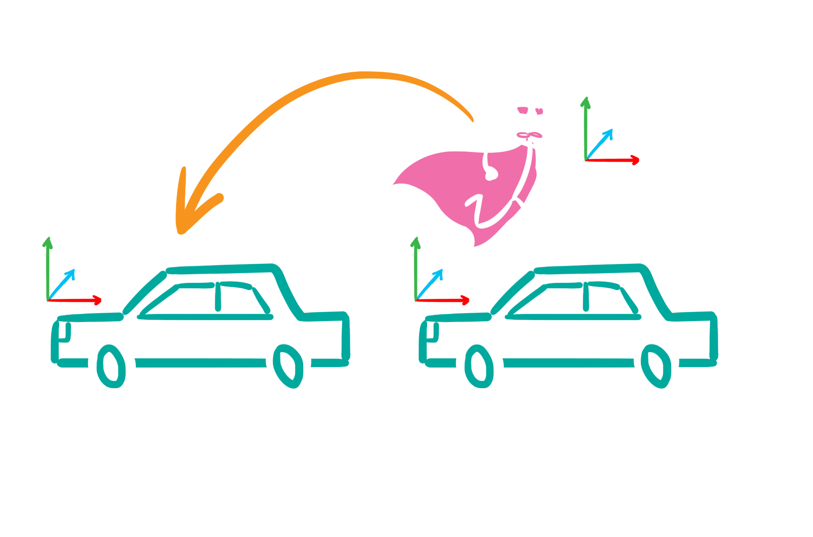
Something a bit more relevant...
Notes:
So initially we know his orientation with regard to the first car

Slide 34
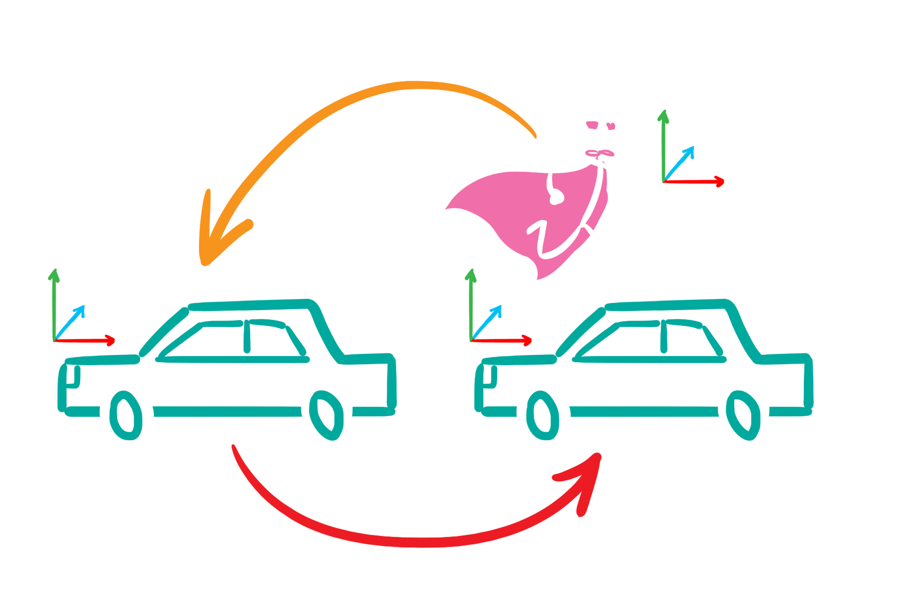
Something a bit more relevant...
Notes:
We need to know what the transform from car one to car two is (that we can get by appending the inverted car two to world transform to the car one to world transform)

Slide 35

Something a bit more relevant...
Notes:
The append one to the other et voilla – we have our new player to car transform.
So to recap – the new player to object transform is:
- player to object one
- times object one to world
- times object two to world inverted
It’s not the most complicated of our transforms and yet it’s not hard to mix them up.
Keeping track of what space everything is in is one problem, but making sure you fix everything after changing something is another level. It's hard if not impossible to follow all possible references and function calls etc. We were triying to solve this by good naming conventions but naming conventions won’t help if you change the function parameter from player-to-object to player-to-anim and forget to update it in one place.
Same as reducing all physical values to a float loses too much information for the compiler to be helpful, so is reducing all 3-d transforms to a Matrix type.
Let's see how an Xform class could make sure it's being used in the right context. Xforms normally work in two spaces - a source and target (e.g. a player's "world" matrix is a transform from player to world space). A concatenation of two matrices is only valid if the target space of the left-hand-side transform is the source space of the right-hand-side transform. Such checks could be performed in compile-time if Xform were a template with spaces denoted by template parameters. A simple solution could be <click>

Slide 36
Something a bit more relevant...
enum class Space { PLAYER, OBJECT, WORLD, ... };
template <Space s>
class Vector { ... };
template <Space s>
class Point { ... };
template <Space from, Space to>
class Xform { ... };
Notes:
* define an enum of possible coordinate spaces.
* create vector and point classes that wrap a 3-d vector and are templates accepting a space parameter
* create an xform class wrapping a matrix, accepting two space parameters – source and target

Slide 37
Something a bit more relevant...
Point<toSpace> Xform::apply(const Point<fromSpace>& p) const;
Vector<toSpace> Xform::apply(const Vector<fromSpace>& v) const;
template <Space lhsFrom, Space lhsTo, Space rhsFrom, Space rhsTo>
auto inSequence(
const Xform<lhsFrom, lhsTo>& lhs,
const Xform<rhsFrom, rhsTo>& rhs)
{
static_assert(
lhsTo == rhsFrom, "Trying to join two incompatible transforms");
return Xform<lhsFrom, rhsTo>{rhs.matrix() * lhs.matrix()};
}
Notes:
* Xform’s apply functions apply the transform to a point or a vector in source space and return a point or vector in the target space.
* The inSequence function joins two transforms, verifying that the first one’s target space is the second one’s source space
Note that I chose to create named functions instead of implementing a multiplication operator. This is because I find it another place for potential errors to have to remember the order in which matrices must be multiplied. Having a separate point and vector class allows us to omit the normal trouble of multiplying a 3-d vector by a 4x4 matrix.

Slide 38
Something a bit more relevant...
Vector operator+(const Vector& lhs, const Vector& rhs);
Vector operator-(const Vector& lhs, const Vector& rhs);
Vector operator-(const Point& lhs, const Point& rhs);
Point operator+(const Point& lhs, const Vector& rhs);
Notes:
We can also define operators for vectors and points that make sense (e.g. no sense to allow addition of points, subtraction of points yields a vector)

Slide 39
Something a bit more relevant...
Notes:
Keeping spaces in a xform template took us from having the context only in code, to the compiler understanding it. Applying this solution has been tremendously useful for us. Implementing our “safe-math” library took only a few days, changing all matrices, points, vectors and rotations to the new classes in our system another few days. Then the code stopped compiling – but why did it stop compiling? Because of the plethora of situations where we had our xform spaces messed up. I’ve found numerous bugs thanks to this. Most of these bugs were very subtle, because for instance they always contained only tiny rotations which resulted in the player being either moved slightly the wrong way or would shake. These situations were very hard to debug by just looking at numbers in the debugger.
Introducing changes in existing code is now much simpler. When we want to change a space a transform is in, we just change its type and fix compiler errors. This makes making such modifications much less stressful, quicker and error-free.

Slide 40


Something a bit more relevant...
Notes:
There is one more step we can take to make our safe math library even safer. * In our example we have the player character switch his context from one entity to another. In reality this will mean applying an entity-to-entity xform. Because the entities only exist at runtime * there is no way for the compiler to know which entity is which. We can’t check whether we’ve applied the transform in all necessary places and whether we’ve applied them correctly. This could be solved by replacing the enum denoting a coordinate space, by a class containing extra data.

Slide 41
Something a bit more relevant...
struct World {};
struct Camera {};
struct Player {};
template <class LhsSpace, class RhsSpace>
constexpr auto spacesMatch(LhsSpace, RhsSpace) {
return std::is_same_v<LhsSpace, RhsSpace>;
}
Notes:
The basic types would be defined as empty and the default way to check whether spaces match would be to check if they have the same type.

Slide 42
Something a bit more relevant...
struct Object {
#ifdef DO_SPACE_RUNTIME_CHECKS
Entity* entity;
explicit Object(Entity* entity) :
entity(entity)
{
}
#else
explicit Object([[maybe_unused]] Entity* entity) {}
#endif /* DO_SPACE_RUNTIME_CHECKS */
};
#ifdef DO_SPACE_RUNTIME_CHECKS
bool spacesMatch(Object lhs, Object rhs) {
return lhs.entity == rhs.entity;
}
#endif
Notes:
We can also define spaces that store actual data – the runtime context. So for an Object space, we could store the pointer to the object in question. We can keep this data optionally, only when we want to verify that all the spaces used are correct.

Slide 43
Something a bit more relevant...
template <class SpaceT>
class Vector : SpaceT;
template <class SpaceT>
class Point : SpaceT;
template <class FromSpaceT, class ToSpaceT>
class Xform : CompressedPair<FromSpaceT, ToSpaceT>;
Notes:
Providing the space as a template parameter is not enough now, we need to have access to the instance data. EBO makes all of this free if not used.

Slide 44

Something a bit more relevant...

Slide 45
Thank you!
Questions?
My e-mail: mikolaj.radwan@techland.pl
Job offers: techland.net/company/careers
This presentation & code: github.com/mikosz/type-safety
Bjarne’s article: www.stroustrup.com/Software-for-infrastructure.pdf

