Slide 1
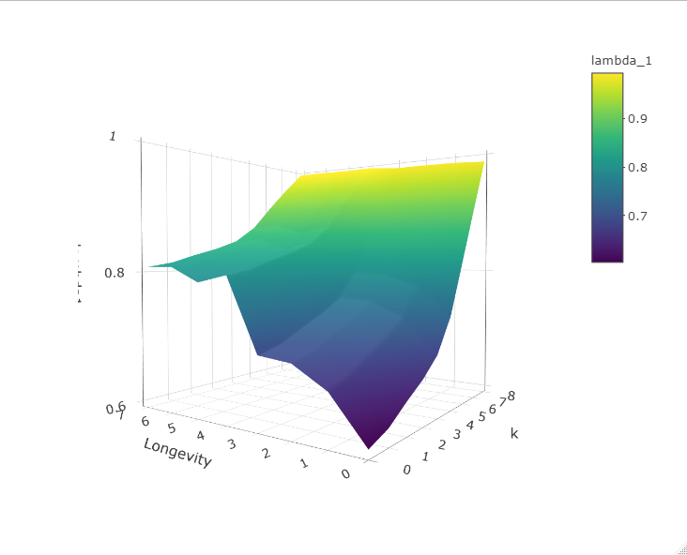


$$λ_{1}$$
$$λ_{1}$$
k
Longevity

