Slide 1
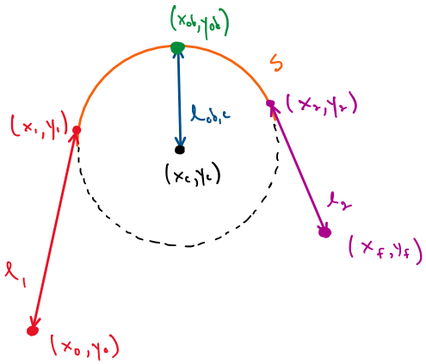
Problem set up
Obstacle Vertex
Arc Exit
Arc Entry
Arc Center
End
Start

Slide 2
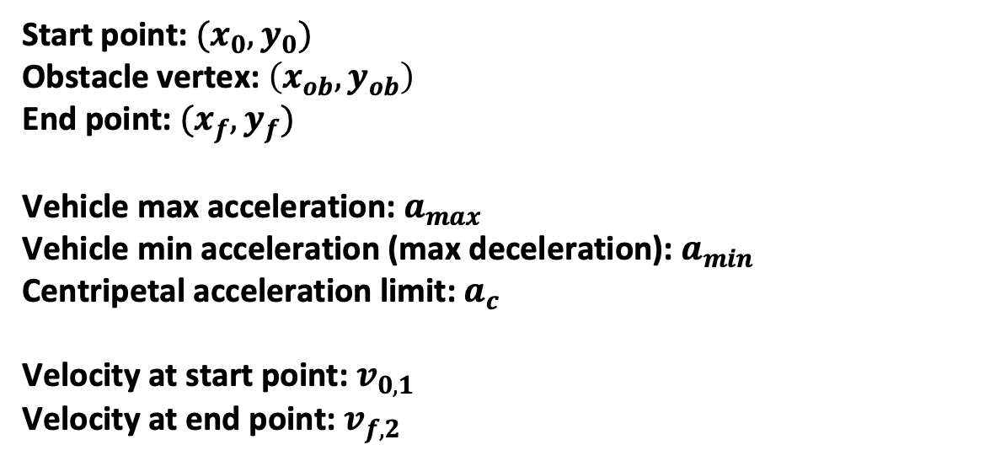
Variables given in the problem set up:
Start point: $(x_{0},y_{0})$
Obstacle vertex: $\left(x_{ob},y_{ob}\right)$
End point: $(x_{f},y_{f})$
Vehicle max acceleration: $a_{max}$
Vehicle min acceleration (max deceleration): $a_{min}$
Centripetal acceleration limit: $a_{c}$
Velocity at start point: $v_{0,1}$
Velocity at end point: $v_{f,2}$

Slide 3

The desired result is total time as a function of arc center position.
$$t_{tot}(x_{c},y_{c})$$
We will systematically work through the geometry and kinematics of the problem to build this function.

Slide 4
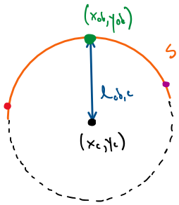


The arc radius should be equal to the distance from the center of the arc to the vertex of the obstacle.
Distance from the center to the obstacle vertex:
$$l_{ob,c}=\sqrt{{\left(x_{ob}−x_{c}\right)}^{2}+{\left(y_{ob}−y_{c}\right)}^{2}}$$
We want the arc to pass as close as possible to the vertex of the obstacle:
$$R =l_{ob,c}$$

Slide 5


Now we have R as a function of the arc center position.
$$R\left(x_{c},y_{c}\right)=$$

Slide 6
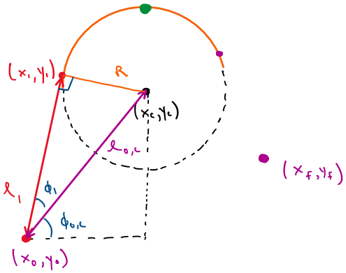


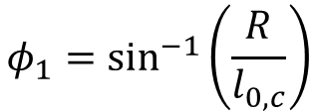
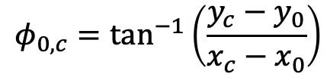
A line segment will extend from the start point to the arc tangent.
Distance from start point to arc center:
$$l_{0,c}=\sqrt{{\left(x_{0}−x_{c}\right)}^{2}+{\left(y_{0}−y_{c}\right)}^{2}}$$
Angles:
$$φ_{0,c}=tan^{−1}\left(\frac{y_{c}−y_{0}}{x_{c}−x_{0}}\right)$$
$$φ_{1}=sin^{−1}\left(\frac{R}{l_{0,c}}\right)$$
Length of segment:
$$l_{1}=l_{0,c}∗cos(φ_{1})$$

Slide 7


We now have the first segment length as a function of arc center position.
$$l_{1}\left(x_{c},y_{c}\right)=$$

Slide 8


The arc entry point can be found using the angles and segment length.
X position of entry point:
$$x_{1}=x_{0}+l_{1}∗cos(φ_{1}+φ_{0,c})$$
Y position of entry point:
$$y_{1}=y_{0}+l_{1}∗sin\left(φ_{1}+φ_{0,c}\right)$$

Slide 9









We now have arc entry point as a function of arc center position.
$$x_{1}\left(x_{c},y_{c}\right)=$$
$$y_{1}\left(x_{c},y_{c}\right)=$$
$$σ_{1}=$$
$$σ_{2}=$$
$$σ_{2}=$$

Slide 10
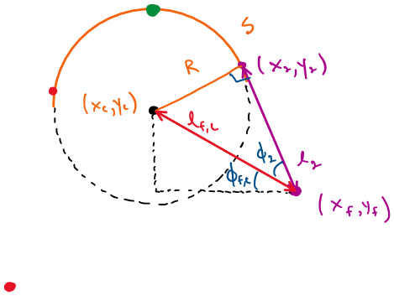
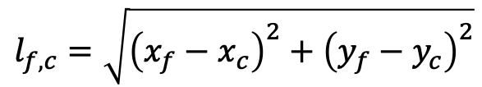

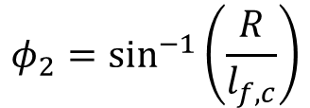
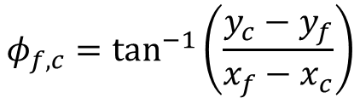
A second line segment will extend from the arc tangent to the end point.
Distance from end point to arc center:
$$l_{f,c}=\sqrt{{\left(x_{f}−x_{c}\right)}^{2}+{\left(y_{f}−y_{c}\right)}^{2}}$$
Angles:
$$φ_{f,c}=tan^{−1}\left(\frac{y_{c}−y_{f}}{x_{f}−x_{c}}\right)$$
$$φ_{2}=sin^{−1}\left(\frac{R}{l_{f,c}}\right)$$
Length of segment:
$$l_{2}=l_{f,c}∗cos(φ_{2})$$

Slide 11


We now have the second segment length as a function of arc center position.
$$l_{2}\left(x_{c},y_{c}\right)=$$

Slide 12


The arc exit point can be found with trigonometry
X position of exit point:
$$x_{2}=x_{f}+l_{2}∗cos(φ_{2}+φ_{f,c})$$
Y position of exit point:
$$y_{2}=y_{f}+l_{2}∗sin\left(φ_{2}+φ_{f,c}\right)$$

Slide 13





We now have arc exit point as a function of arc center position.
$$x_{2}\left(x_{c},y_{c}\right)=$$
$$y_{2}\left(x_{c},y_{c}\right)=$$
$$σ_{1}=$$
$$σ_{2}=$$
$$σ_{2}=$$

Slide 14
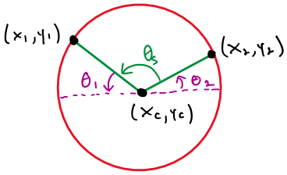
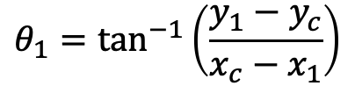


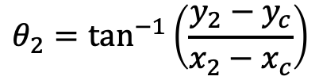
The length of the arc can be found using the radius, entry point, and exit point.
Angles:
$$θ_{1}=tan^{−1}\left(\frac{y_{1}−y_{c}}{x_{c}−x_{1}}\right)$$
$$θ_{2}=tan^{−1}\left(\frac{y_{2}−y_{c}}{x_{2}−x_{c}}\right)$$
$$θ_{s}=π−(θ_{1}+θ_{2})$$
Arc length:
$$s=R∗θ_{s}$$

Slide 15














We now have arc length as a function of arc center position.
$$s\left(x_{c},y_{c}\right)=$$
$$σ_{1}=$$
$$σ_{5}=$$
$$σ_{6}=$$
$$σ_{2}=$$
$$σ_{7}=$$
$$σ_{3}=$$
$$σ_{4}=$$

Slide 16

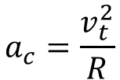


The total time on the arc is found using the constant tangential velocity governed by the centripetal acceleration limit.
Definition of centripetal acceleration:
$$a_{c}=\frac{v_{t}^{2}}{R}$$
Since we want to drive as fast as possible, velocity on the arc will be the tangential velocity limit:
$$v_{t}=\sqrt{a_{c}∗R}$$
Distance traveled with constant velocity:
$$s=v_{t}∗t_{s}$$
Solving for arc time:
$$t_{s}=\frac{s}{v_{t}}$$

Slide 17
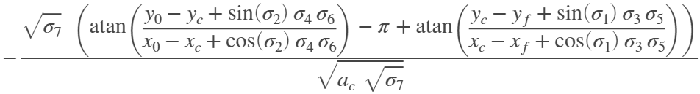












We now have arc time as a function of arc center position.
$$t_{s}\left(x_{c},y_{c}\right)=$$
$$σ_{1}=$$
$$σ_{5}=$$
$$σ_{6}=$$
$$σ_{2}=$$
$$σ_{7}=$$
$$σ_{3}=$$
$$σ_{4}=$$

Slide 18


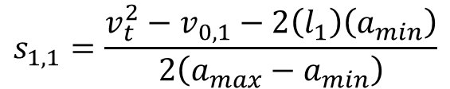
The total time on the first segment is found using the constant-acceleration kinematics derived last week.
Final velocity for first segment is the tangential velocity:
$$v_{f,1}=v_{t}$$
Length of segment:
$$s_{2,1}=\sqrt{{\left(x_{0}−x_{1}\right)}^{2}+{\left(y_{0}−y_{1}\right)}^{2}}=l_{1}$$
Distance to point of max velocity:
$$s_{1,1}=\frac{v_{t}^{2}−v_{0,1}−2\left(l_{1}\right)\left(a_{min}\right)}{2\left(a_{max}−a_{min}\right)}$$

Slide 19

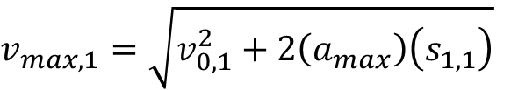
The total time on the first segment is found using the constant-acceleration kinematics derived last week.
Max velocity:
$v_{max,1}=\sqrt{v_{0,1}^{2}+2\left(a_{max}\right)\left(s_{1,1}\right)}$
Total time on segment:
$$t_{1}=\frac{v_{max,1}−v_{0,1}}{a_{max}}+\frac{v_{t}−v_{max,1}}{a_{min}}$$

Slide 20

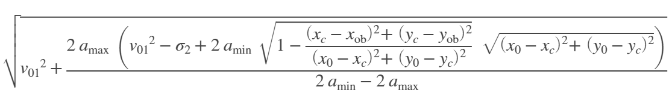




We now have the total time on the first segment as a function of arc center position.
$$t_{1}\left(x_{c},y_{c}\right)=$$
$$σ_{1}=$$
$$σ_{2}=$$

Slide 21
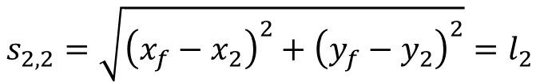

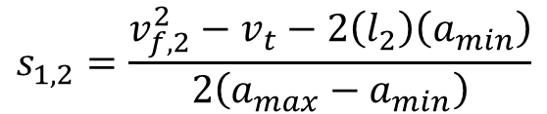
In the same way, the total time on the second segment is found.
Initial velocity for second segment is the tangential velocity:
$$v_{0,2}=v_{t}$$
Length of segment:
$$s_{2,2}=\sqrt{{\left(x_{f}−x_{2}\right)}^{2}+{\left(y_{f}−y_{2}\right)}^{2}}=l_{2}$$
Distance to point of max velocity:
$$s_{1,2}=\frac{v_{f,2}^{2}−v_{t}−2\left(l_{2}\right)\left(a_{min}\right)}{2\left(a_{max}−a_{min}\right)}$$

Slide 22

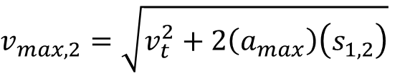
In the same way, the total time on the second segment is found.
Max velocity:
$v_{max,2}=\sqrt{v_{t}^{2}+2\left(a_{max}\right)\left(s_{1,2}\right)}$
Total time on segment:
$$t_{2}=\frac{v_{max,2}−v_{t}}{a_{max}}+\frac{v_{f,2}−v_{max,2}}{a_{min}}$$

Slide 23

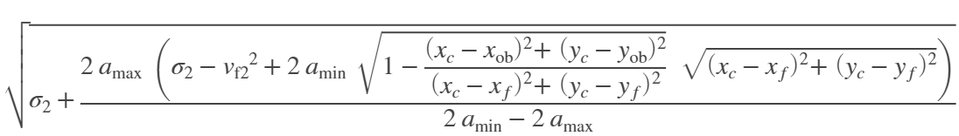

We now have the total time on the second segment as a function of arc center position.
$$t_{2}\left(x_{c},y_{c}\right)=$$
$$σ_{1}=$$
$$σ_{2}=$$

Slide 24
Total time on the whole path is a summation of each segment time.
We now have total time as a function of arc center position:
$$t_{tot}(x_{c},y_{c})=t_{1}(x_{c},y_{c})+t_{s}(x_{c},y_{c})+t_{2}(x_{c},y_{c})$$

Slide 25
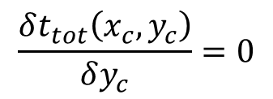
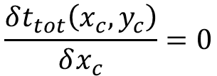
To find the optimal position, the total time function must be a minimum, i.e. its partial derivatives are zero.
$$\frac{δt_{tot}\left(x_{c},y_{c}\right)}{δx_{c}}=0$$
$$\frac{δt_{tot}\left(x_{c},y_{c}\right)}{δy_{c}}=0$$

Slide 26
If the y positions of the start and end points are equal…

