Slide 1

RoboGen Project: Group 12
Presented by:
Nay Abi Akl
Mickael Achkar
Nicolas Bichon
Yehya El Hassan

Slide 2
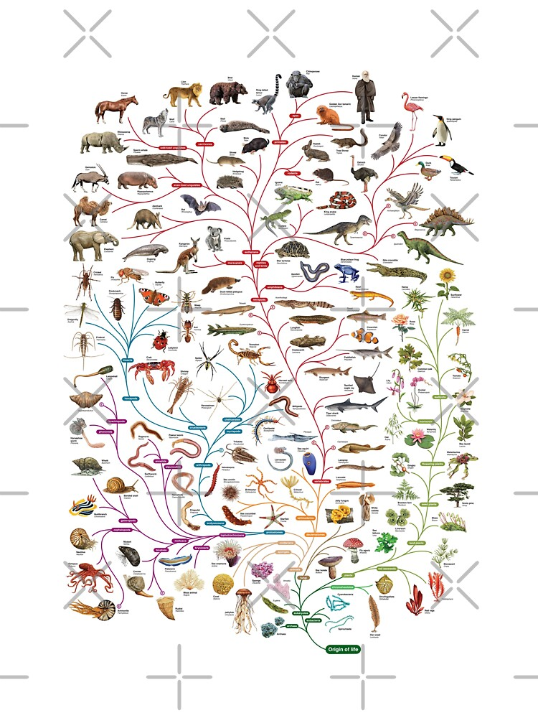
Problem Statement
Every biological system is an outcome of the evolutionary process.
The elegance, resilience, and adaptability of biological systems are important motivators for software and hardware design.
One of the major differences between biological evolution and artificial evolution is the definition of the fitness function.
The fitness in artificial evolution is a function that evaluates how well an evolved individual performs on the specified task.
The fitness function is critical to the evolution procedure's success.

Slide 3
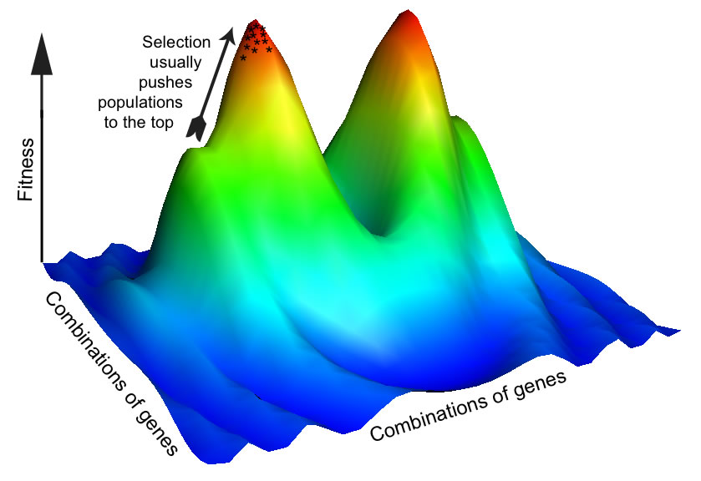
Explored Case study
With that given, we will explore the effect of the fitness function on evolution of a modular robot capable of:
Locomoting through a rugged terrain.
Avoiding obstacles along its trajectory.
Stabilizing it’s core component while moving.
Figure 1.0: Fitness​ Landscape
Landscape Khan, R. (2019, November 20). A thousand little adaptive platoons. Discover Magazine. Retrieved May 28, 2022, from https://www.discovermagazine.com/health/a-thousand-little-adaptive-platoons ​
​

Slide 4
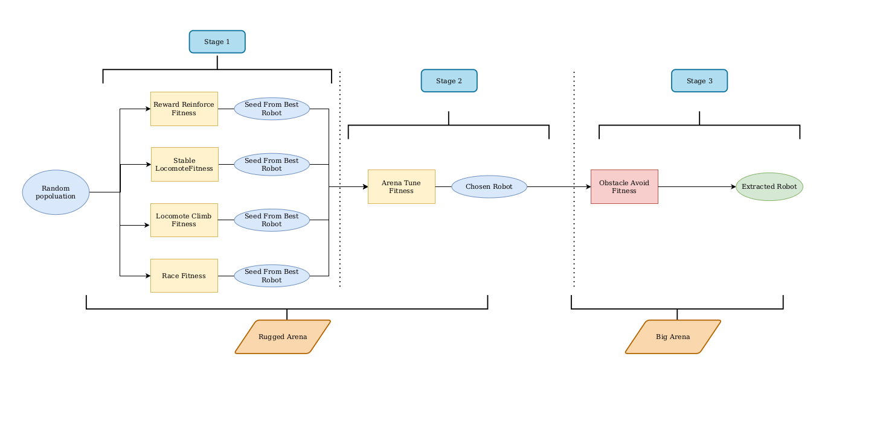
Followed Strategy
Three-stage procedure:
Fitness Exploration*
Robot Selection.
Obstacle Avoidance.
Followed Multi-step strategy for the Grand Challenge project. (2022)
* Various Fitness functions are utilized in step one where each fitness function has a different fitness landscape resulting in different optimal robots.

Slide 5
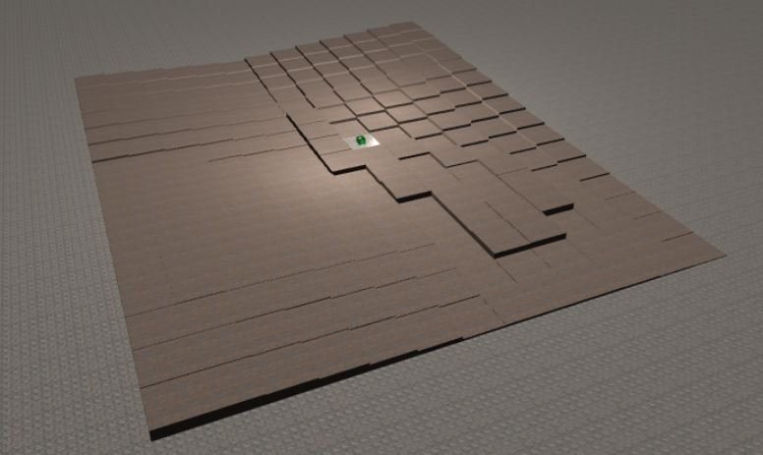
Experimental Method: Stage 1 - Common parameters
Number of Generations | 100
Replacement | Plus
Tournament size Mu Lambda | 2 25 40
Brain parameters: pBrainMutate pBrainSigma pAddHiddenNeuron pOscillatorNeuron | 0.7 0.7 0.6 0.7
Body parameters: numInitialParts addBodyParts maxBodyParts bodyParamSigma pNodeInsert pSubtreeRemove pSubtreeDuplicate pSubtreeSwap pNodeRemove pParameterModify | 4:10 All 15 0.7 0.7 0.3 0.3 0.3 0.3 0.3
Figure 2.0: Rugged Arena
Terrain Friction | Noise | Direction shifts / s | Time steps
1.0 | 0.04 | 16 | 3000
Table 2.0 Evolution Parameters
Table 1.0 Simulation Parameters

Slide 6
Experimental Method: Stage 1 - Fitness Functions
Fitness Function 1 - Reward Reinforce (Brain/Body)
Fitness Function 2 - Stable Locomote (Brain/Body)
Fitness Function 3 - Locomote Climb (Brain/Body)
Fitness Function 4 - Race Baseline (Brain/Body)

Slide 7
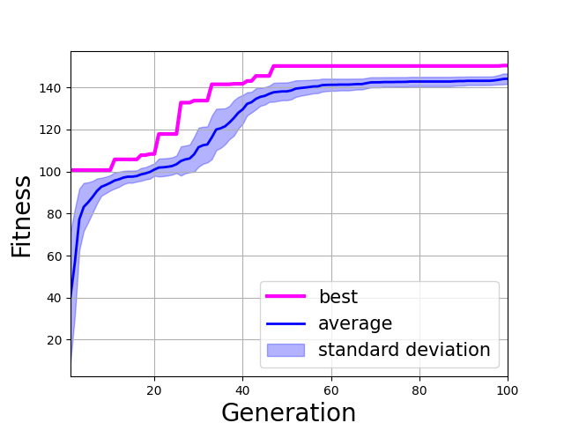
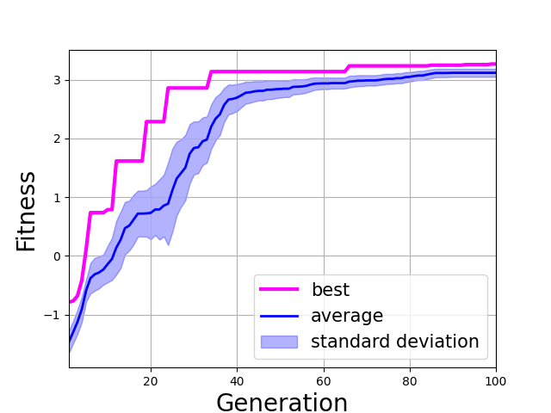
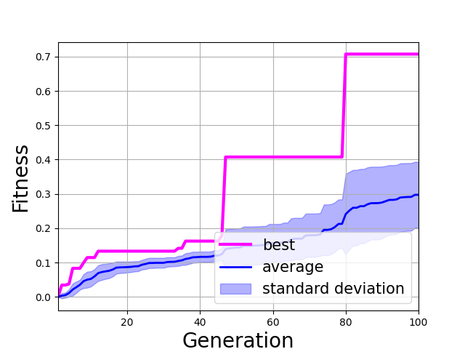
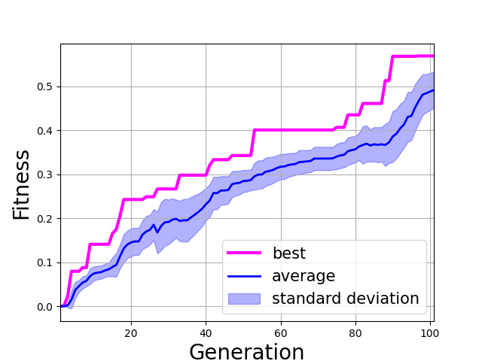
Experimental Method: Stage 1 - Evolution Results
Reward Reinforce Robot
Stable Locomote Robot
Locomote Climb Robot
Race Robot
Figure 3.0: Evolution results

Slide 8
Experimental Method: Tune Stage - Common parameters
Number of Generations | 100
Replacement | Plus
Tournament size Mu Lambda | 2 25 40
Brain parameters: pBrainMutate pBrainSigma pAddHiddenNeuron pOscillatorNeuron | 0.7 0.7 0.6 0.7
Body parameters: numInitialParts addBodyParts maxBodyParts bodyParamSigma pNodeInsert pSubtreeRemove pSubtreeDuplicate pSubtreeSwap pNodeRemove pParameterModify | 4:10 All 15 0.5 0.3 0.3 0.3 0.3 0.3 0.3
Figure 4.0: Rugged Arena
Terrain Friction | Noise | Direction shifts / s | Time steps
1.0 | 0.04 | 16 | 3000
Table 3.0 Simulation Parameters
Table 4.0 Evolution Parameters
Notes:
Only mention the highlighted parameters in the body parameters.

Slide 9
Experimental Method: Tune Stage - Fitness

Slide 10
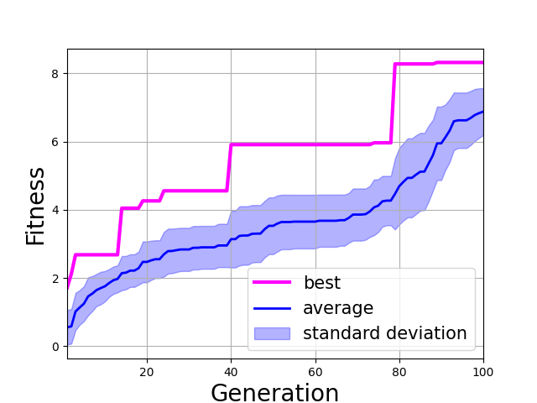
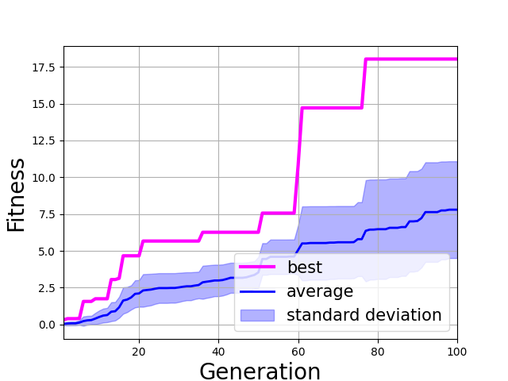
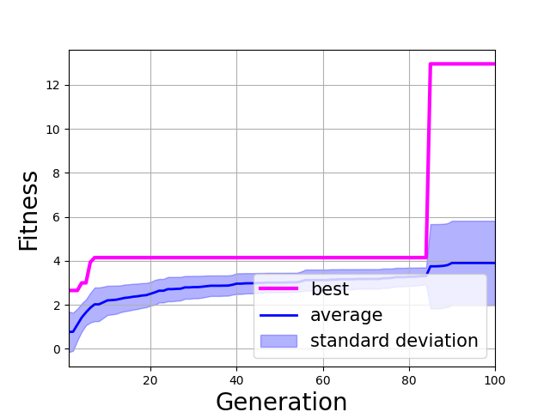
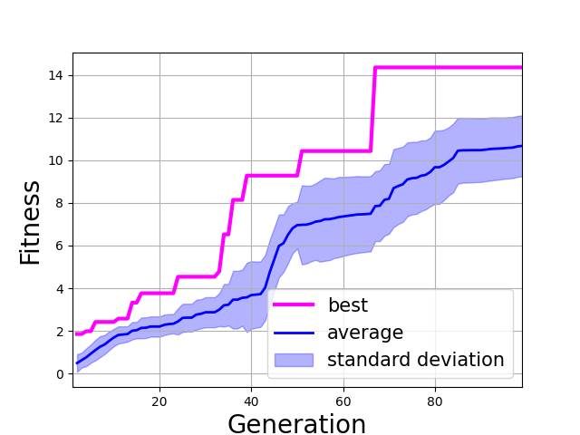
Experimental Method: Tune Stage - Evolution Results
Reward Reinforce Robot
Stable Locomote Robot
Locomote Climb Robot
Race Robot
Figure 5.0: Evolution results

Slide 11
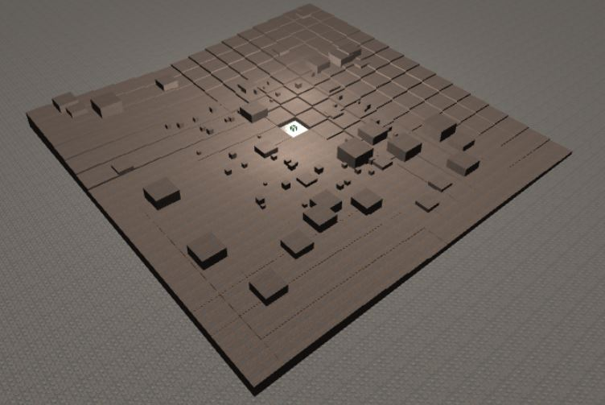
Experimental Method: Stage 2 - Common parameters
Number of Generations | 100
Replacement | Plus
Tournament size Mu Lambda | 2 25 40
Brain parameters: pBrainMutate pBrainSigma pAddHiddenNeuron pOscillatorNeuron | 0.7 0.7 0.6 0.7
Body parameters: numInitialParts addBodyParts maxBodyParts bodyParamSigma pNodeInsert pSubtreeRemove pSubtreeDuplicate pSubtreeSwap pNodeRemove pParameterModify | N.A. N.A. N.A. N.A. N.A. N.A. N.A. N.A. N.A.
Figure 6.0: Big Arena
Terrain Friction | Noise | Direction shifts / s | Time steps
1.0 | 0.04 | 16 | 3000
Table 5.0 Simulation Parameters
Table 6.0 Evolution Parameters
Notes:
Only mention the highlighted parameters in the body parameters.

Slide 12
Experimental Method: Stage 2 - Fitness Function
Obstacle Avoidance (Brain)

Slide 13
Experimental Method: Stage 2 - Evolution Results
Figure 7.0: Evolution results

Slide 14
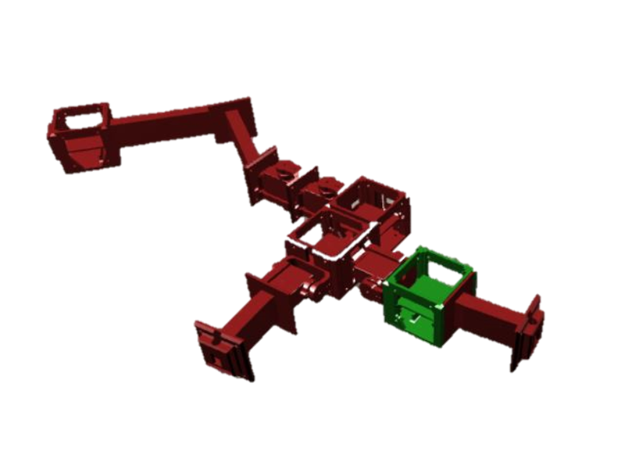
Result Analysis
Add a video of the robot moving through the arena and a Sea Turtle Video
Figure 8.0: Chosen robot

Slide 15
Video of the chosen robot

Slide 16
Conclusion

Slide 17
Workload Distribution
Student | Tasks
Nay Abi Akl | Strategy brainstorming Stable locomote fitness Tuning fitness formulation Assembly & printing
Mickael Achkar | Literature Review Reward reinforce fitness formulation Obstacle avoidance fitness formulation Assembly & printing
Nicolas Bichon
Yehya El Hassan | Strategy brainstorming Climb locomote fitness formulation Obstacle avoidance fitness formulation Assembly & printing Literature Review

Slide 18
References
Floreano, D., & Mattiussi, C. (2008). Bio-inspired artificial intelligence: theories, methods, and technologies. MIT press.
Nelson, A. L., Barlow, G. J., & Doitsidis, L. (2009). Fitness functions in evolutionary robotics: A survey and analysis. Robotics and Autonomous Systems, 57(4), 345-370.

