Slide 1
RoboGen Project: Group 1
Figure 1: Final image of robot body
First A. Author,
Second B. Author,
MICRO-515 Evolutionary robotics
Date

Slide 2
Introduction
Specify the problem to solve and the task of the robot here (project description)

Slide 3
Experimental Method
In this section, the experimental method is summarized. The following points must be briefly discussed:
Single step or multi-step evolutions. At least one body-brain evolution must be performed. The reasons for choosing them must be clearly stated.
OPTIONAL: Initial body and brain (if used) are described and represented with a figure of the body and table of the neural network. The reasons for choosing them must be clearly stated.
 | Input Neuron 1 (Ex. IMU) | Hidden Neuron 1 (Ex. Oscillator 1 or Spiking 1) | Output Neuron 1 (Ex. Servo Oscillator 1 or Servo Spiking 1)
Input Neuron 1 (Ex. IMU) | Weight | Weight | Weight
Hidden Neuron 1 (Ex. Oscillator or Spiking 1) | Weight | Weight | Weight
Output Neuron 1 (Ex. Servo Oscillator 1 or Spiking 1) | Weight | Weight | Weight
Table 1: Final robot neural network (input neuron red, hidden neuron blue and output neuron green)

Slide 4
Experimental Method
The evolution step(s) are then described including the following information for each evolution:
The arenas used for the evolution step
Fitness function is shown and described (including a legend of all the terms involved)
Simulation parameters table
Evolution parameters table
Evolution graph
Brief conclusions and discussion on following evolutionary step if necessary
Figure 2: Arena of evolutionary step 1
Friction | Sensor noise | Simulation time | …
Table 2 : Simulation parameters
Population |  |  | Replacement strategy | …
Table 3: Evolution parameters

Slide 5
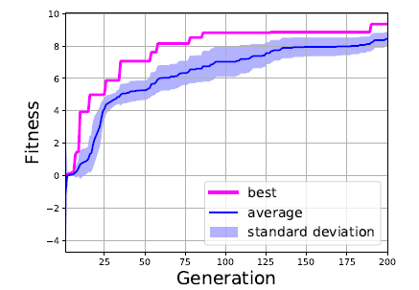
Results
The final results of your evolution are here described, and compared. Images of the final robot performances can be included.
Figure 3: Evolution Graph step 1
Figure 5: Multi step evolution
Figure 6: Final robot during simulation
Figure 4: Example of evolutions with different noise levels (scales are similar).

Slide 6
Conclusion
Conclusions and discussion on the project.

Slide 7
Workload distribution
 | Student 1 | Student 2
Task 1
Task 2
Task 3

