Slide 1
Collections & Generics

Slide 2
Collection
Java Collection Framework

Slide 3
Why?
Reduced Development Effort – It comes with almost all common types of collections and useful methods to iterate and manipulate the data. So we can concentrate more on business logic rather than designing our collection APIs.
Increased Quality by using core collection classes that are well tested increases our program quality rather than using any home developed data structure.
Reusability and high degree of Interoperability
Reduce effort to learn any new API if we use core collection API classes

Slide 4
What?
Collections are like containers that groups multiple items in a single unit
Collections Framework is the architecture to represent and manipulate Collections in java in a standard way
Java Collections Framework consists of following parts:
Interfaces
Implementation Classes
Algorithms

Slide 5
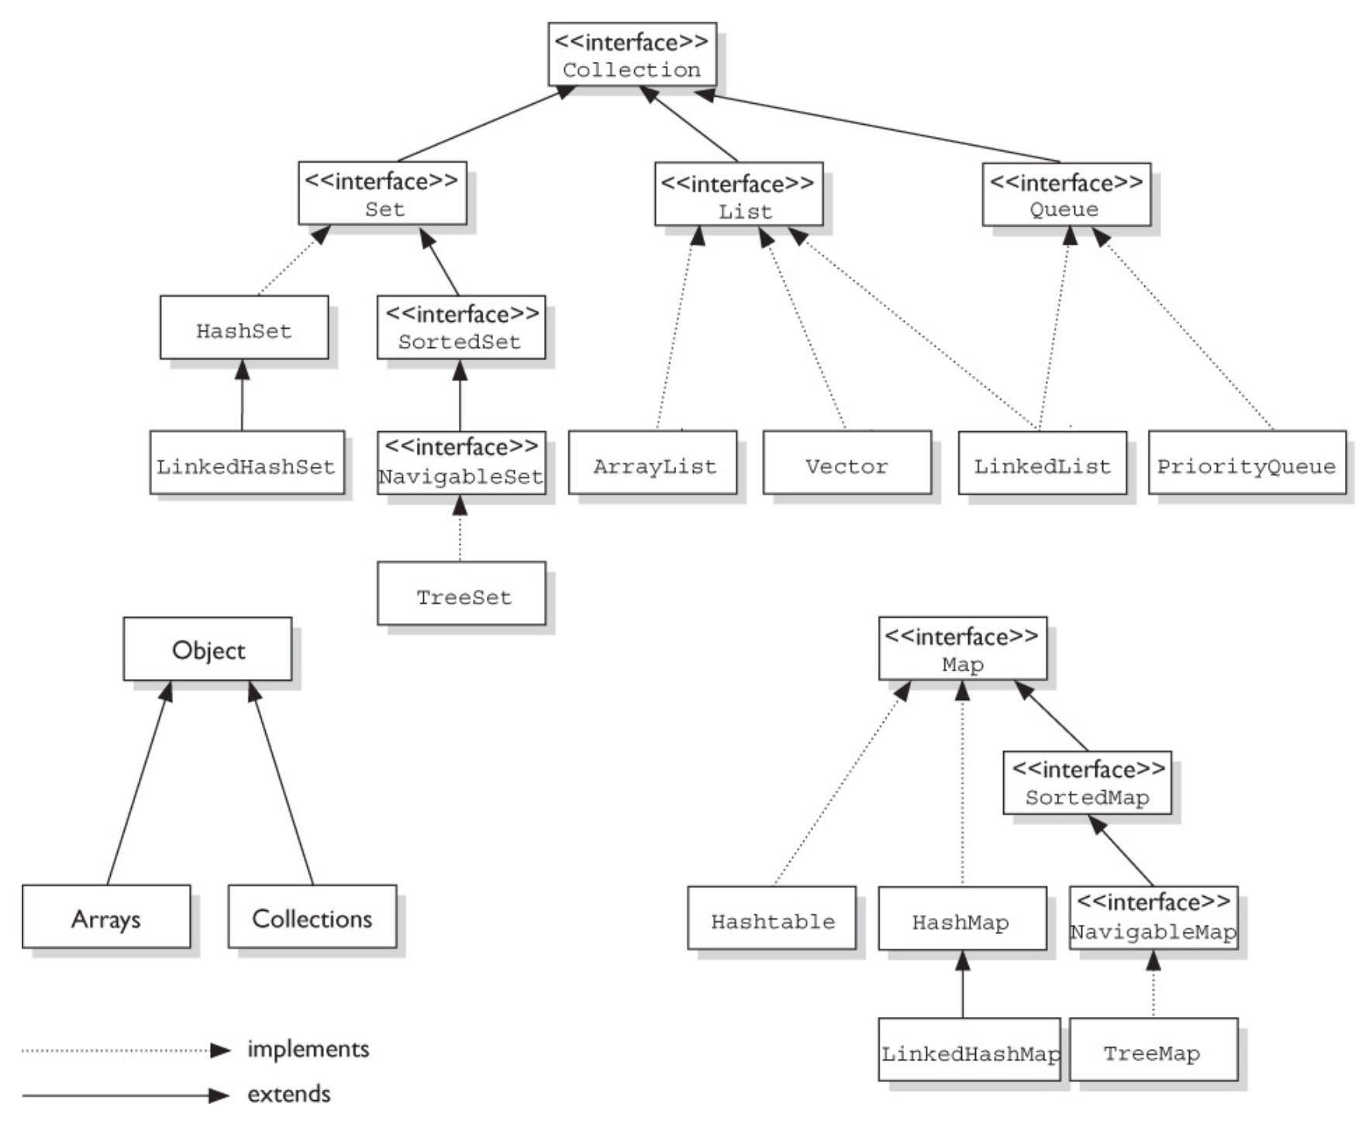
Java Collections Hierarchy tree

Slide 6
Java Collections Interfaces
Collection Interface: Root of collection hierarchy. The interface have common methods:
how many elements are in the collection (size, isEmpty)
Whether given object is in the collection (contains)
To add and remove an element from the collection (add, remove)
Provide an iterator over the collection (iterator)

Slide 7
Java Collections Interfaces: List
List is an ordered collection and can contain duplicate elements
We can access any element from it’s index
List is more like array with dynamic length
ArrayList and LinkedList are implementation classes of List interface
List interface provides useful methods to add an element at specific index, remove/replace element based on index and to get a sub-list using index

Slide 8
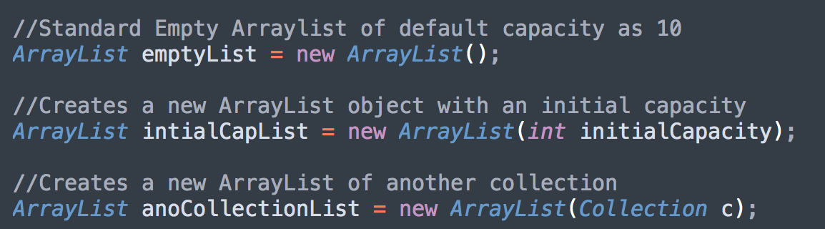
Java Collections Interfaces: List
ArrayList
Maintains the insertion order
Allows duplicate entries and null insertions
Implements the RandomAccess interface which guarantees access to any random element with the same speed
Suggested collection for frequent retrival operation logics

Slide 9
Java Collections Interfaces: List
LinkedList
Maintains the insertion order
Allows duplicate entries and null insertions
Suggested Collection if there are frequent inserts and removal operations

Slide 10
Java Collections Interfaces: Vector
All methods in Vector are synchronized for thread safety
One of the legacy class
Vector increments 100% means doubles the array size if the total number of elements exceeds than its capacity whereas ArrayList increments to 50%
Vector is slower than ArrayList as its synchronized

Slide 11
Java Collections Interfaces: Set
Set is a collection that cannot contain duplicate elements
The Java platform contains three general-purpose Set implementations: HashSet, TreeSet, and LinkedHashSet
Set interface doesn’t allow random-access to an element in the Collection

Slide 12
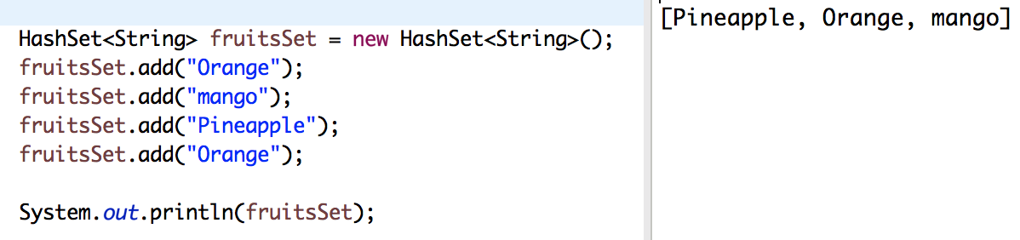
Java Collections Interfaces: Set
HashSet
HashSet stores the elements by using a mechanism called hashing
Contains unique elements only

Slide 13
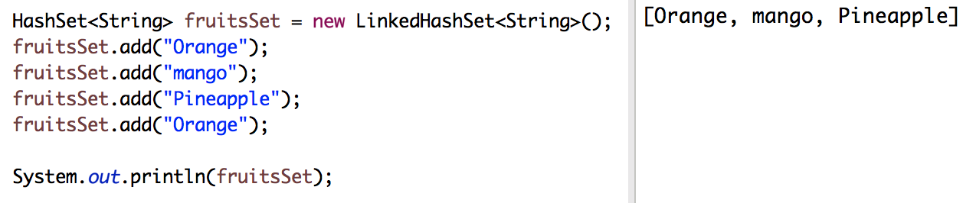
Java Collections Interfaces: Set
LinkedHashSet
Like HashSet, Contains only unique elements
Provides all optional set operations, and permits null elements
Maintains the insertion order

Slide 14
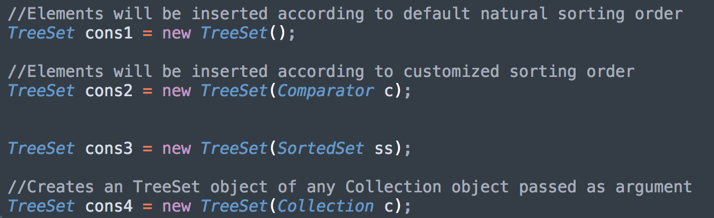
Java Collections Interfaces: Set
TreeSet
Like HashSet, Contains only unique elements
Do not Maintains the insertion order
Objects will be inserted according to some sorting order
TreeSet Constructors:

Slide 15
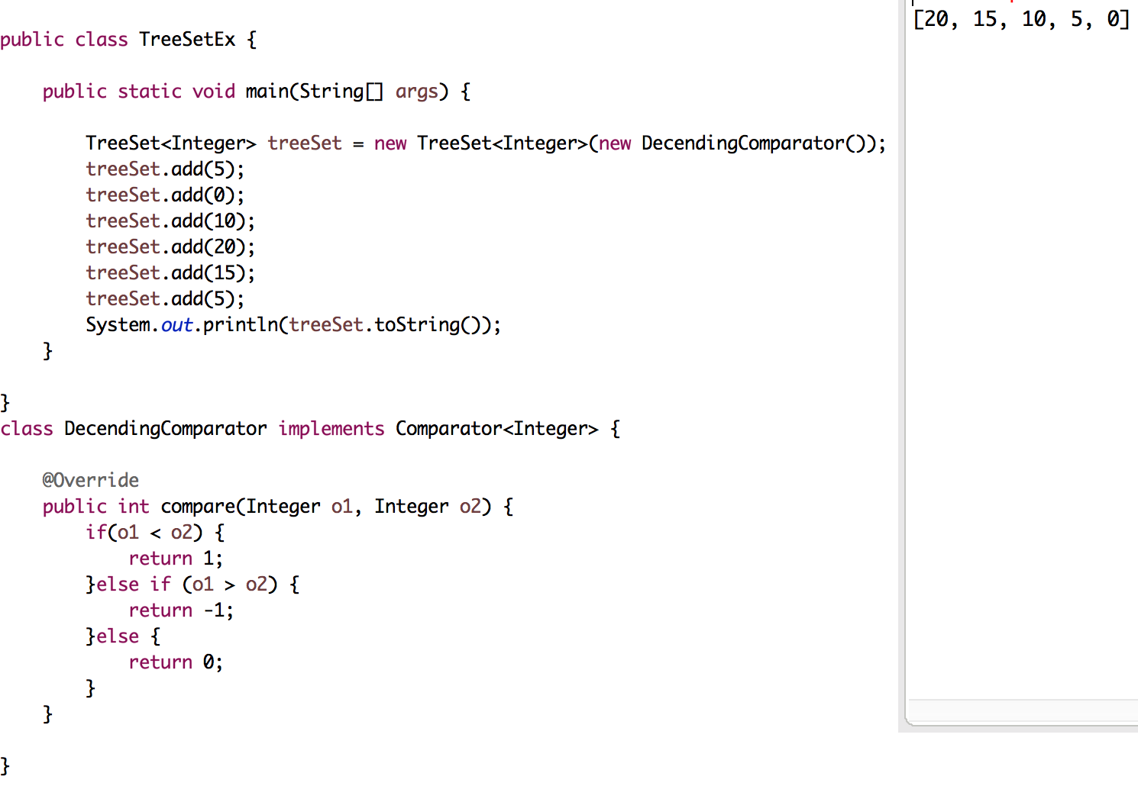
Java Collections Interfaces: Set
TreeSet with Comparator

Slide 16
Java Collections Interfaces: Map
Map Interface: Map is an object that maps keys to values
A map cannot contain duplicate keys
The Java platform contains three general-purpose Map implementations: HashMap, TreeMap, and LinkedHashMap

Slide 17
Java Collections Interfaces: Map
HashMap is a Map based collection class that is used for storing Key&value pairs
Similar to the Hashtable class except that it is unsynchronized and permits nulls(null values and null key)
It maintains no order

Slide 18
Java Collections Interfaces: Map
LinkedHashMap
A LinkedHashMap contains values based on the key
It is same as HashMap instead maintains insertion order

Slide 19
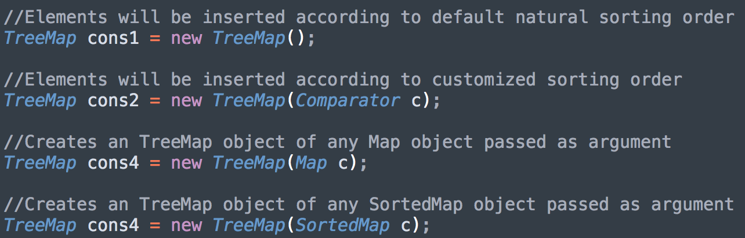
Java Collections Interfaces: Map
TreeMap
It contains only unique elements.
It cannot have null key but can have multiple null values.
It is same as HashMap instead maintains natural ordering

Slide 20
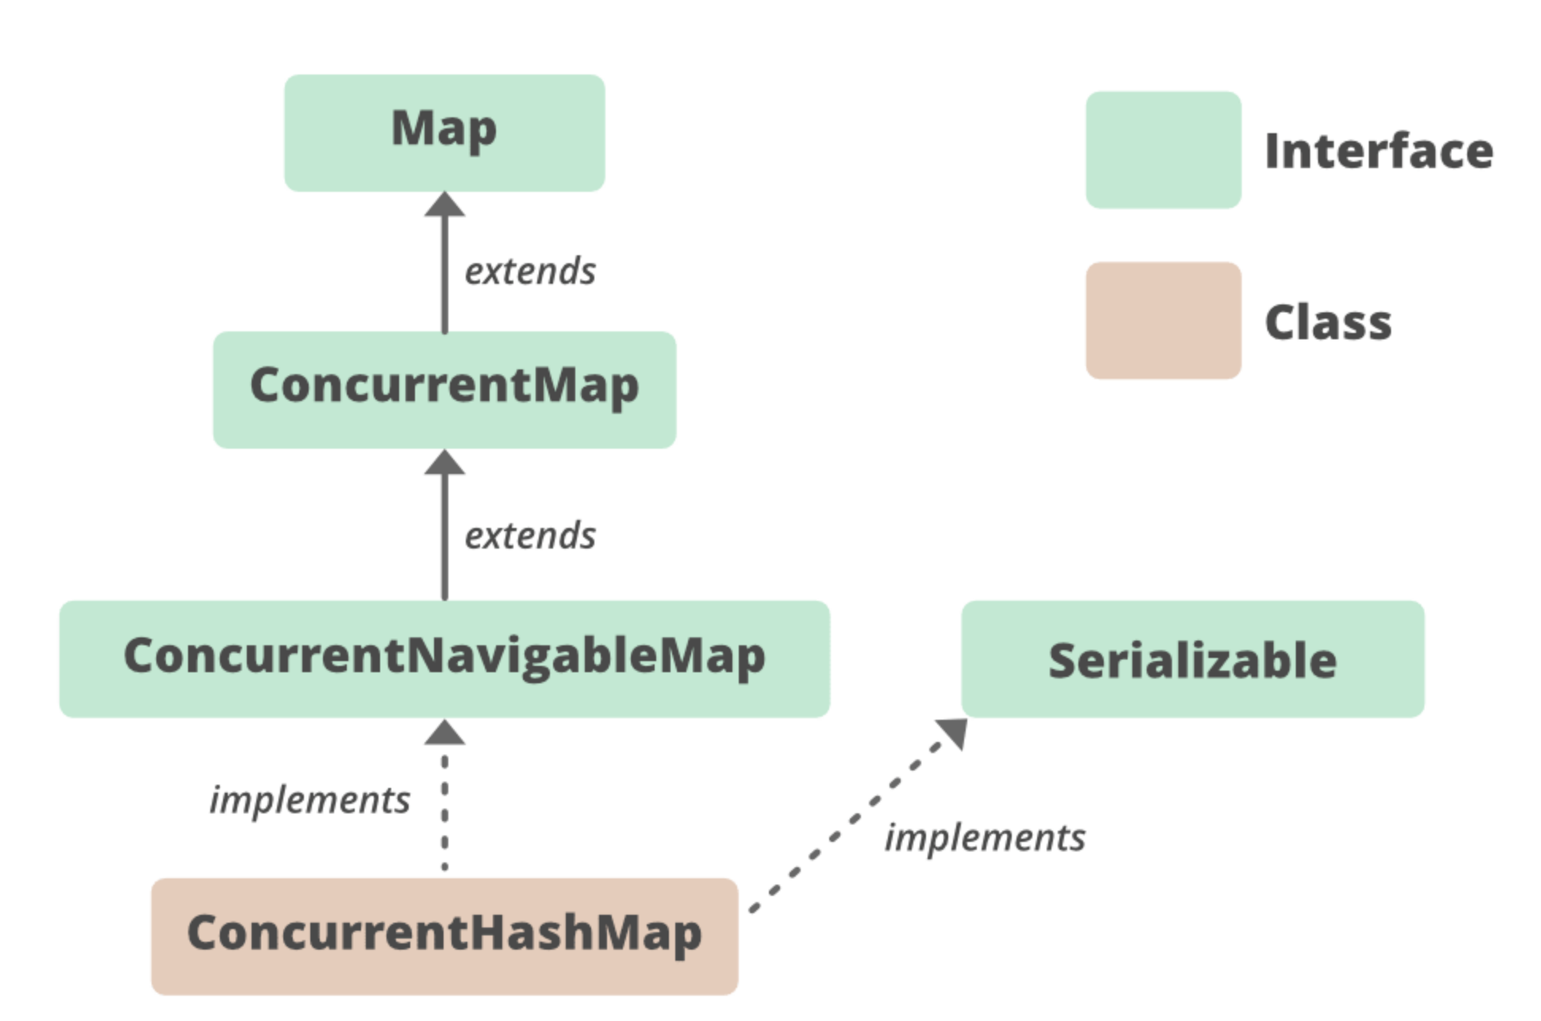
ConcurrentHashMap
ConcurrentHashMap class is thread-safe i.e. multiple threads can operate on a single object without any complications.
At a time any number of threads are applicable for a read operation without locking the ConcurrentHashMap object which is not there in HashMap.
In ConcurrentHashMap, the Object is divided into a number of segments according to the concurrency level.
The default concurrency-level of ConcurrentHashMap is 16.
In ConcurrentHashMap, at a time any number of threads can perform retrieval operation but for updated in the object, the thread must lock the particular segment in which the thread wants to operate. This type of locking mechanism is known as Segment locking or bucket locking. Hence at a time, 16 update operations can be performed by threads.

Slide 21
Java Collections Interfaces: Queue
Holds elements to be processed FIFO(First In First Out) order
Ordered list, inserting element at the end and deleting from start
Concrete classes:
PriorityQueue
LinkedList
ArrayDeque
PriorityBlockingQueue

Slide 22
Java Collections Interfaces: Queue
PriorityBlockingQueue
unlike standard queue, adding an elements should satisfy one of the below:
Adding elements which implement Comparable
Adding elements which do not implement Comparable, on the condition that you provide a Comparator as well
PriorityBlockingQueue implements the BlockingQueue interface, which gives us some extra methods that allow us to block when removing from an empty queue
take() -> Retrieves and removes the head of the queue, waiting if necessary until an element becomes available
put(E e) -> Inserts the specified element into this queue, waiting if necessary for space to become available

Slide 23
Generics

Slide 24
Why?
Generics add stability to your code by making more of your bugs detectable at compile time
old version 1.4 Java collections were Object-based and required the use of ugly casts
cannot specify the exact type of elements
must cast to specific classes while accessing
Java generics lets you write code that is safer and easier to read especially useful for general data structures, such as ArrayList
Generic programming = programming with classes and methods parameterized with types

Slide 25
Generics basics
Generics is enforced by adding a type in angle brackets (<>)immediately following the collection type in BOTH the variable declaration and the constructor call, including any place you declare a variable (so that means arguments and return types too)
List<Integer> genericList =new ArrayList<Integer>();
With this generics declaration genericList Object will allow addition of only Integers to this collection
As compiler ensures type safety with the help of generics, type casting can be avoided during runtime
Generic type information does not exist at runtime—it is for compile-time safety only. Mixing generics with legacy code can create compiled code that may throw an exception at runtime

Slide 26
Polymorphism and Generics
Generics does not allow polymorphism
ArrayList<Object> genList = new ArrayList<String>(); //This will be an compilation error
List<String> genList = new ArrayList<String>(); //Compiles fine as polymorphism applies to the collection
The type of the variable declaration must match the type you pass to the actual object type

Slide 27
Generic Methods
Generics enforce strict type checking with respect to method arguments
public void checkAnimals(ArrayList<Animal> animals) {
for(Animal a : animals) {a.checkup();}
}
List<Dog> dogs = new ArrayList<Dog>(); dogs.add(new Dog());
List<Cat> cats = new ArrayList<Cat>(); cats.add(new Cat());
checkAnimals(dogs); //Compiler error
checkAnimals(cats); //Compiler error

Slide 28
Wild Cards
A question mark, or wildcard, is used in generics to represent an unknown type. It can have three forms:
Unbounded Wildcards: List<?> represents a list of unknown type
Upper Bounded Wildcards: List<? extends Number> represents a list of Number or its sub-types such as Integer and Double
Lower Bounded Wildcards: List<? super Integer> represents a list of Integer or its super-types Number and Object
Now, since Object is the inherent super-type of all types in Java, we would be tempted to think that it can also represent an unknown type. In other words, List<?> and List<Object> could serve the same purpose. But they don’t.

Slide 29
Wild Cards: extends
wildcard<?> IS a mechanism to tell the compiler that you can take any generic subtype of the declared argument type because you won't be putting anything in the collection
public void checkAnimals(ArrayList<? extends Animal> animals) {}
The keyword extends in the context of a wildcard represents BOTH subclasses and interface implementations
public void checkAnimals(ArrayList<? extends Serializable> animals) {}

Slide 30
Wild Cards: super
There is another scenario where you can use a wildcard AND still add to the collection, but in a safe way—the keyword super
public void addAnimal(List<? super Dog>animals) {
animals.add(new Dog());// adding is sometimes OK with super
}
List<Animal>animals = new ArrayList<Animal>();
animals.add(new Dog());
animals.add(new Dog());
doc.addAnimal(animals); // passing an Animal List

Slide 31
Generic class
class Pair <T> { public T first; public T second; public Pair (T f, T s) { first = f; second = s; } public Pair () { first = null; second = null; } }
you instantiate the generic class by substituting actual types for type variables, as: Pair <String>
you can think the result as a class with a constructor
public Pair (String f, String s), etc . .
you can then use the instantiated generic class as it were a normal class (almost):
Pair <String> pair = new Pair <String> ("1","2");

Slide 32
Multiple type Parameters
you can have multiple type parameters
class Pair <T, U> { public T first; public U second; public Pair (T x, U y) { first = x; second = y; } public Pair () { first = null; second = null; } }
to instantiate: Pair <String, Number>

