Slide 1
Virtualization
Dr. Noman Islam

Slide 2
Introduction
Virtualization typically refers to the creation of virtual machine that can virtualize all of the hardware resources, including processors, memory, storage, and network connectivity
With the virtualization, physical hardware resources can be shared by one or more virtual machines

Slide 3
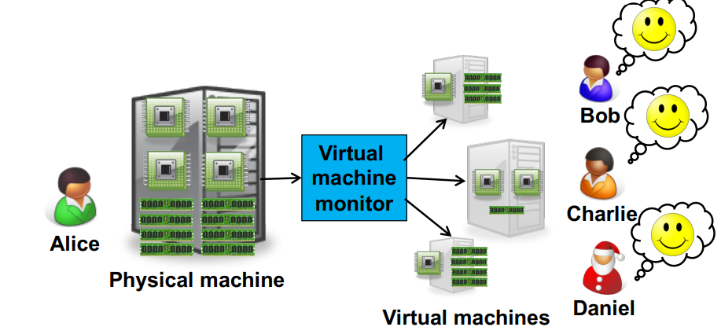

Slide 4
Definition
A technique for hiding the physical characteristics of computing resources from the way in which other systems, applications, or end users interact with those resources.
This includes making a single physical resource appear to function as multiple logical resources; or it can include making multiple physical resources appear as a single logical resource

Slide 5
Early days of VM
Technology was initially popularized in 1960’s by IBM.
IBM 370 /VM
1990 VMware released its virtualization product: slow, based on x86 platform (no multi-core), expensive
Now, we have
VMware suite;
MS virtual PC, Hypervisor;
QEMU (Quick Emulator): open source
XEN
OpenVZ
KVM
VirtualBox

Slide 6
Requirements of virtualization
The virtualization should provide an equivalent environment to run a program compared to a native system. If the program shows a different behavior under the virtualization, it may not be eligible as a virtualized environment.
The virtualization also needs to provide a secured control of virtualized resources. Having a full control of resources is important to protect data and resources on each virtual environment from any threats or performance interference in sharing physical resources

Slide 7
Virtualization often expects performance degradation due to the additional tasks for virtualization, but good performance should be achieved with a software or hardware support in handling privileged instructions.

Slide 8
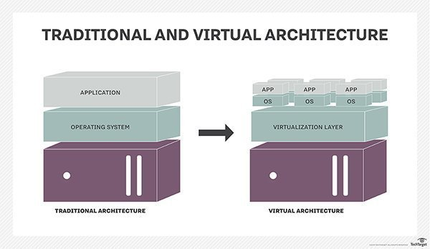

Slide 9
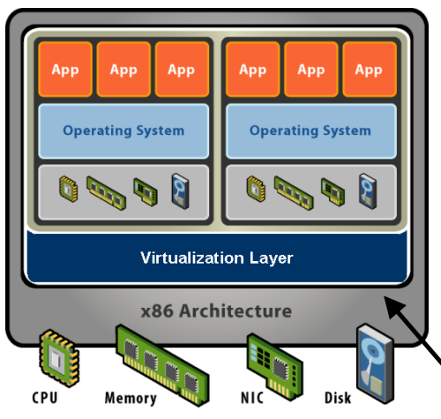
What is a virtual machine?

Slide 10
Software Abstraction
Behaves like hardware
Encapsulates all OS and application state
Virtualization Layer
Extra level of indirection
Decouples hardware, OS
Enforces isolation
Multiplexes physical hardware across VMs

Slide 11
Virtualization properties
Isolation
Fault isolation
Performance isolation (+ software isolation, …)
Encapsulation
Cleanly capture all VM state
Enables VM snapshots, clones
Portability
Independent of physical hardware
Enables migration of live, running VMs (freeze, suspend,…)

Slide 12
Interposition
Transformations on instructions, memory, I/O
Enables transparent resource overcommitment, encryption, compression, replication …

Slide 13
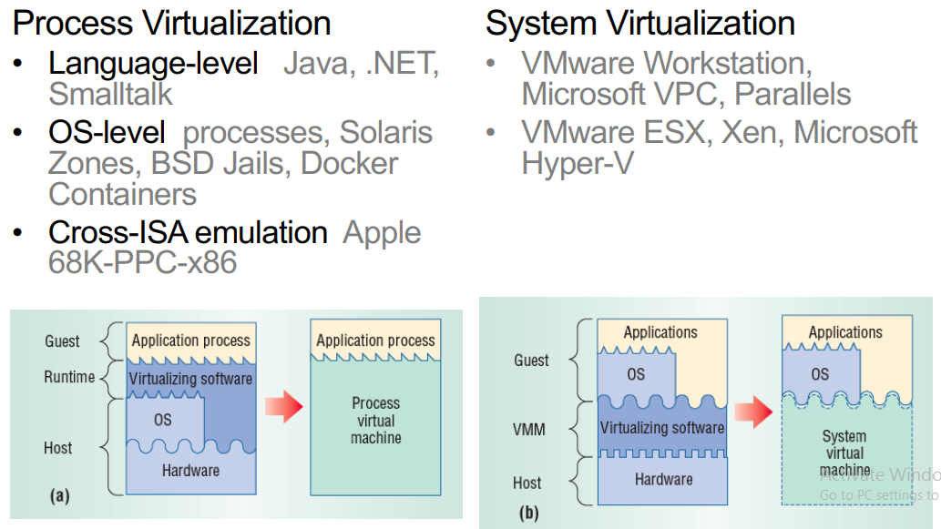
Types of virtualization

Slide 14
X86 privileges level
x86 architecture has certain restrictions related to resource access such as kernel execution for machine instructions, memory and I/O functions.
x86 operating systems can perform these tasks by running in a most privileged level, although user applications do not have access to the level

Slide 15
These privilege levels are also called protection rings since it protects access to hardware resources with four different layers of privileges
Hypervisor has to manage these privilege levels to offer virtualized resources.
Virtualization offers different techniques for handling the privilege levels, and the resource sharing can be achieved with a software, a hardware support, or both.

Slide 16
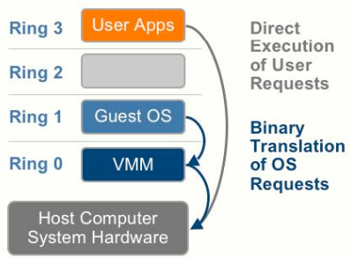
Full Vs Para virtualization
Full virtualization provides virtualization without modifying guest operating system
VM looks exactly like a physical machine

Slide 17
Para Virtualization
Paravirtualization (PV) requires the modified OS kernel with system calls to deal with privileged instructions
It is a virtualization technique that presents a software interface to virtual machines that is similar but not identical to that of the underlying hardware
Better performance at cost of transparency

Slide 18
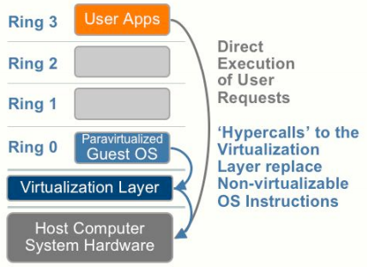

Slide 19
Hypervisor
Hypervisor enables communication between hardware and a virtual machine so that the virtualization accomplishes with this abstraction layer (hypervisor)
A virtual machine monitor (VMM) is a software that manages CPU, memory, I/O data transfer, interrupt, and the instruction set on a given virtualized environment.
A hypervisor may refer to an operating system (OS) with the VMM.

Slide 20
There is a slight distinction between hypervisor and VMM but in this presentation, we consider these terms to have identical meanings to represent a software for virtual machine.

Slide 21
Type 1 hypervisor
Typically, a hypervisor can be divided into Type 1 and Type 2 hypervisor based on the different level of implementation.
Type 1 is sitting on hardware and the communication between hardware and virtual machine is direct.
A system is installed directly on the hardware rather than on the host operating system
Difficult parts of the underlying hardware need not be virtualized
The host operating system is not required in Type 1 hypervisor since it runs directly on a physical machine

Slide 22
Due to this reason, it is sometimes called a ’bare metal hypervisor’.
VMware vSphere/ESXi, Microsoft Windows Server 2012 Hyper-V, Citrix XenServer, Red Hat Enterprise Virtualization (RHEV) and open-source Kernel-based Virtual Machine (KVM) are identified in this category.

Slide 23
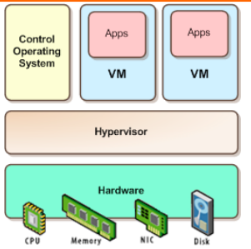

Slide 24
Type 2 hypervisor
Type 2 hypervisor is on the operating system to manage virtual machine easily with the support of hardware configuration from operating system.
The extra layer between hardware and virtual machine in the type 2 hypervisor causes inefficiency compared to the type 1 hypervisor.
VirtualBox and Vmware Workstation are in this category

Slide 25
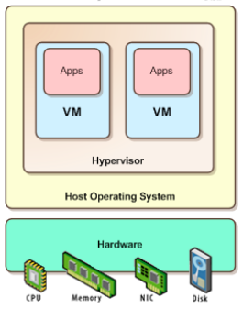

Slide 26
Host machine and guest machine
Host machine (domain) contains a hypervisor to manage virtual machines, and Guest machine (domain) means each virtual machine sitting on a hosted machine in a secure and isolated environment with its own logical domain.

Slide 27
Hypervisor and virtual machine
The hypervisor is a software layer that creates a virtual environment with virtualized CPU, memory and I/O (storage and network) devices by abstracting away the underlying physical hardware.
Virtual machine (VM) typically refers to an encapsulated entity including the operating system and the applications running in it as well.

Slide 28
Virtualizing the CPU
Timeslice the VMs, each VM runs OS/Apps
Use simple CPU scheduler
Round robin, work-conserving (give extra to other VM)
Can oversubscribe and give more #VCPUs that actual

Slide 29
Memory virtualization
x86 CPUs include a Translation Lookaside Buffer (TLB) and Memory Management Unit (MMU) to deal with translation of virtual memory addresses to physical memory addresses with page tables.
TLB is a cache of recently used mappings from the page tables, and MMU is a hardware unit that contains page table entries (PTEs) to map virtual address to physical address.

Slide 30
Network virtualization
Network virtualization is a method of combining the available resources in a network by splitting up the available bandwidth into channels, each of which is independent from the others and can be assigned -- or reassigned -- to a particular server or device in real time.
The idea is that virtualization disguises the true complexity of the network by separating it into manageable parts, much like your partitioned hard drive makes it easier to manage your files.

Slide 31
Storage virtualization
It is the pooling of physical storage from multiple network storage devices into what appears to be a single storage device that is managed from a central console. Storage virtualization is commonly used in storage area networks.

