Slide 1
Digital Twin Coffee Room Application – Kahvibotti
Pekka Sillberg, Jere Grönman, Mika Saari, Mikko Nurminen, Teemu Jönkkäri, Petri Rantanen and Pekka Abrahamsson
May 23, 2024
Tampere University Faculty of Information Technology and Communication Sciences
Finland
Notes:
Pekka

Slide 2
Background: DIGI2 –project at 2023-2025
Our research was done as a part of DIGI2 project, funded by the European Regional Development Fund and the Regional Council of Satakunta
Goal: New kind of experimental environment and co-creation methods for the joint use of Satakunta business life and developer organisations that produce technology concepts
Google: “Tuni Digi2”
https://www.tuni.fi/en/research/practical-applications-digital-twins-satakunta-region

Slide 3
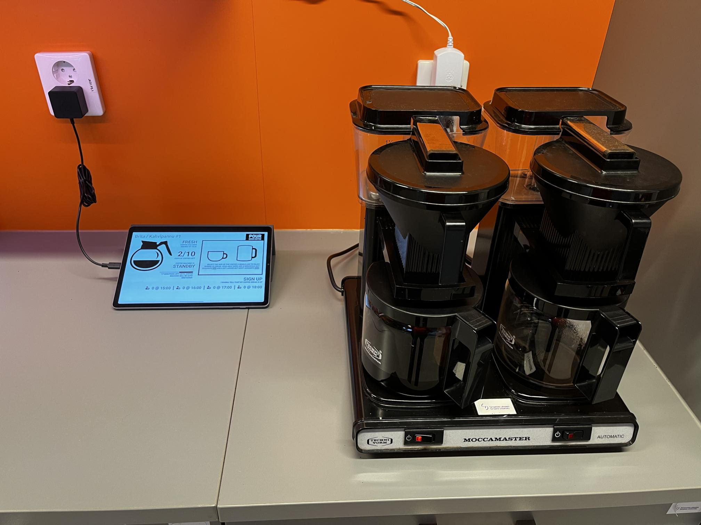
The research - Kahvibotti
Basic Idea: Remote sensing system for coffee machine status
Digital Twin - approach
Focus on 'non-smart' devices
IoT can influence user decisions and encourage energy-efficient behavior
Mixed-methods approach
Prototype IoT-enabled home appliance
Real-time operational data
Interaction monitored through usage statistics and feedback
Objective: evaluate influence of IoT feedback on user decision-making
Observe trends towards energy-efficient practices
Results offer insights into role of IoT in promoting sustainable living and energy efficiency.

Slide 4

The research questions:
RQ1: What are the challenges and technical limitations of retrofitting existing household appliances with IoT capabilities for energy monitoring and saving?
Technical Limitations and challenges
Compatibility with existing hardware and software
Integration with existing energy monitoring systems
Cost of retrofitting
Reliability and security of IoT devices
RQ2: How does real-time feedback on energy consumption from IoT devices affect user behavior?

Slide 5
Results – System diagram
Shelly

Slide 6
Results – System diagram
Client software communicates through GraphQL interface of server software
Server software receives data from IoT/MQTT component
IoT/MQTT component subscribes to topics of original MQTT message broker
MQTT topics can be subscribed using wild card characters
Easy to add more coffee machines to system
Data collection utilizes Docker Compose script
Used for bootstrapping Telegraf, InfluxDB, Chronograf, and Kapacitor (TICK Stack)
Bundled with additional services such as Grafana and MQTT
InfluxDB and TICK Stack chosen for ability to easily implement simple dashboards
MQTT message broker service is most important component
Supports two way communication for advanced DT applications
Only one way communication utilized in this use case
Fully automatic

Slide 7
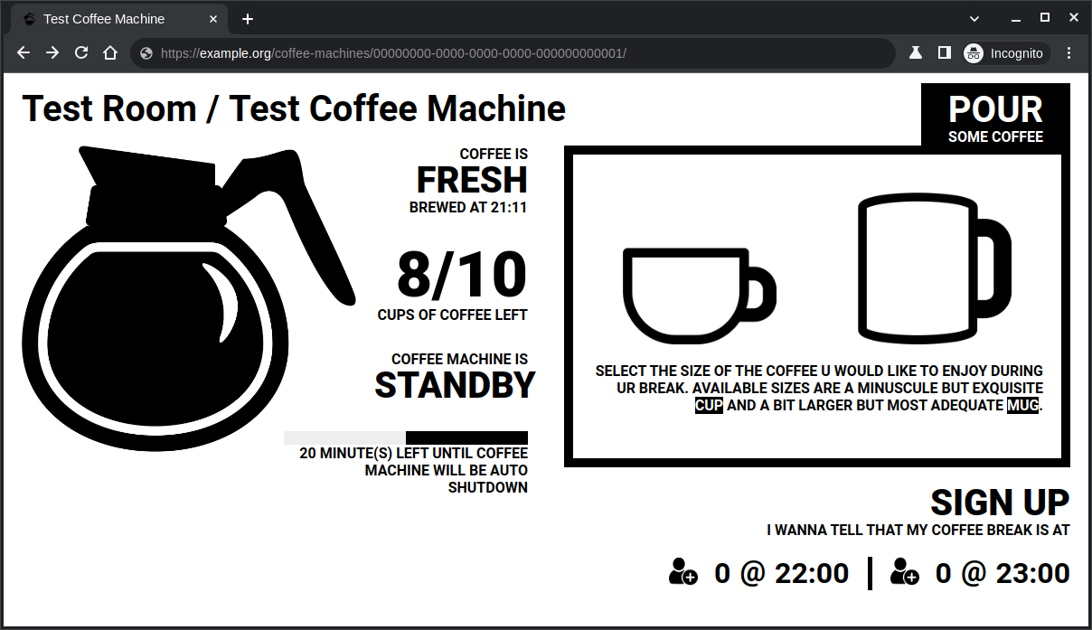
Results - web client
Features:
Coffee machine status display
Displays estimated amount of remaining coffee
Enrollment for Upcoming Hours
Interactive user input function
Reporting Coffee Consumption

Slide 8
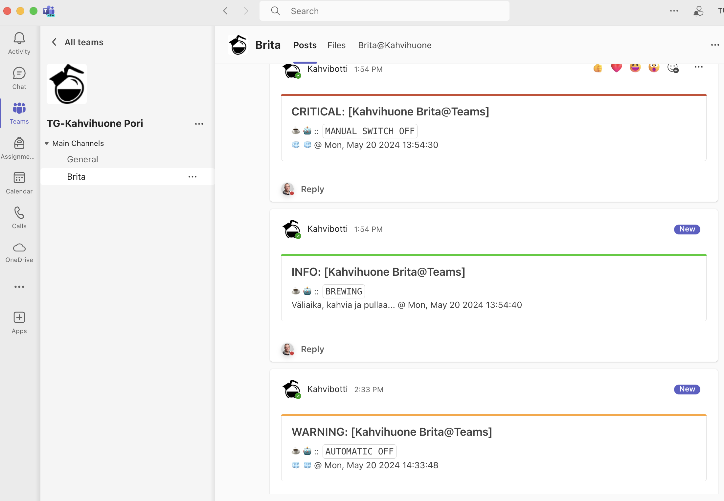
Teams messages
Brewing
Automatic off
Manual switch off

Slide 9
Summary
In technical(RQ1) – The system is working
Energy meter measure
Data was collected
The collected data are used to suply information.
Real-time energy consumption information from IoT device.
Social research (RQ2)
This need more research: Questionnaire? Interviews?
Backend system is ready for system expansion…

Slide 10
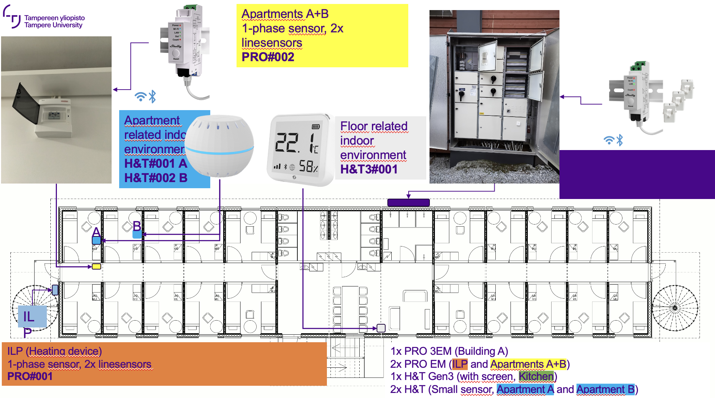
Future research
GenAI?
Possibilties of Generative AI and LLMs
GenAI for analysis
GenAI for messages
Other possibilities
Real-time energy consumption
Testing environment extension
Energy measurement of rental apartments
Several different sensor devices
Mainly energy measuring

Slide 11

Thank you – Questions?

Slide 12
The research questions:
RQ1: What are the challenges and technical limitations of retrofitting existing household appliances with IoT capabilities for energy monitoring and saving?
RQ2: How does real-time feedback on energy consumption from IoT devices affect user behavior?

Slide 13
The research questions:
RQ1: What are the challenges and technical limitations of retrofitting existing household appliances with IoT capabilities for energy monitoring and saving?
RQ2: How does real-time feedback on energy consumption from IoT devices affect user behavior?

Slide 14
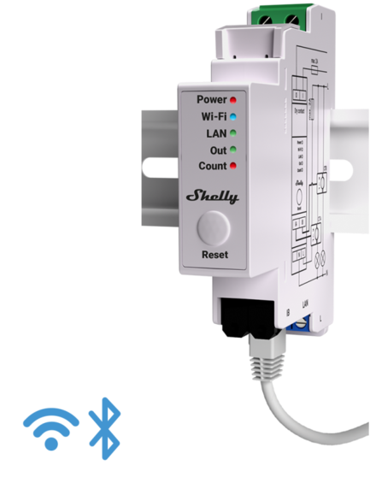
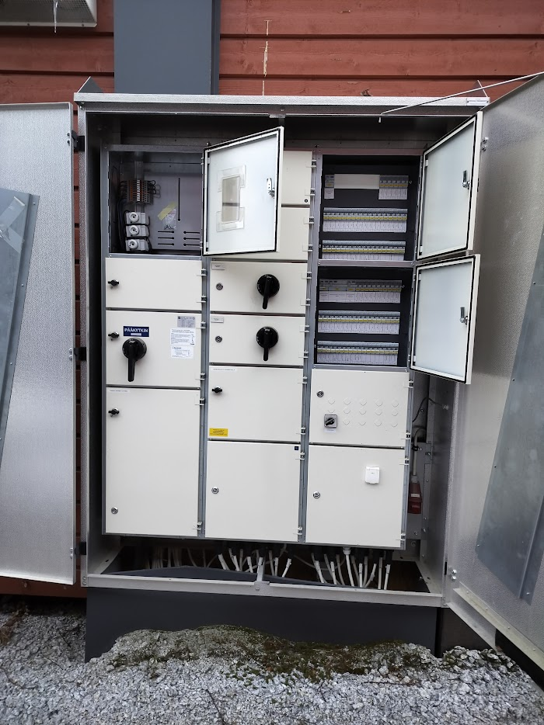
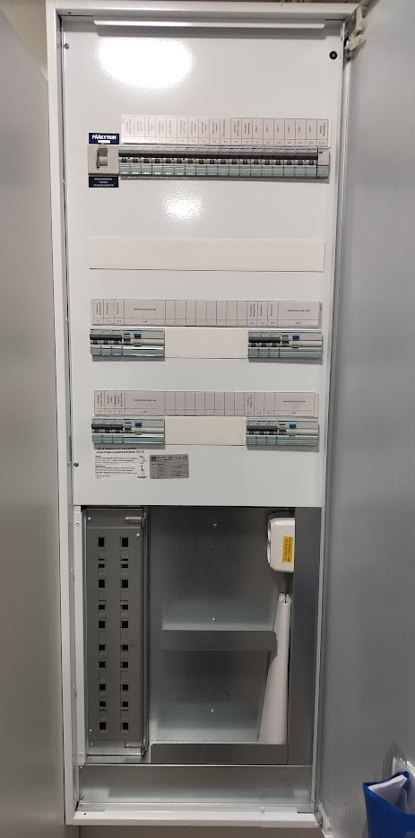
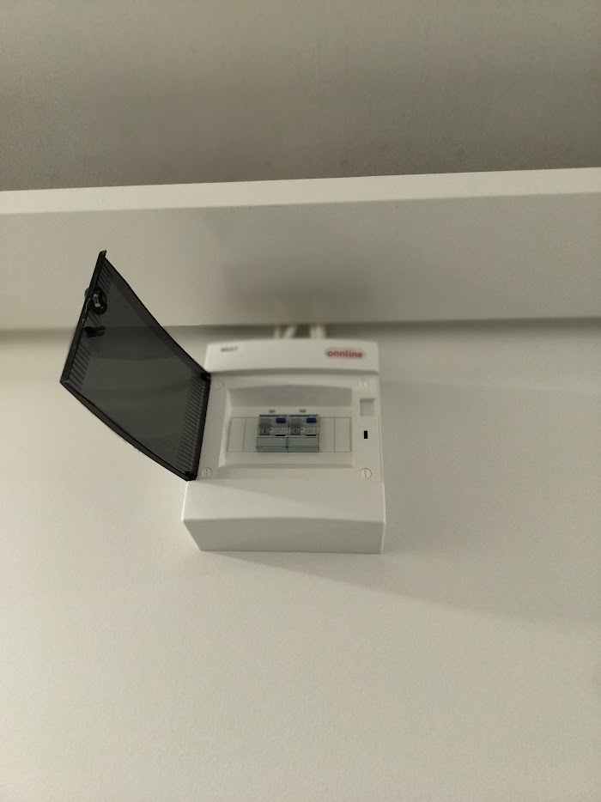
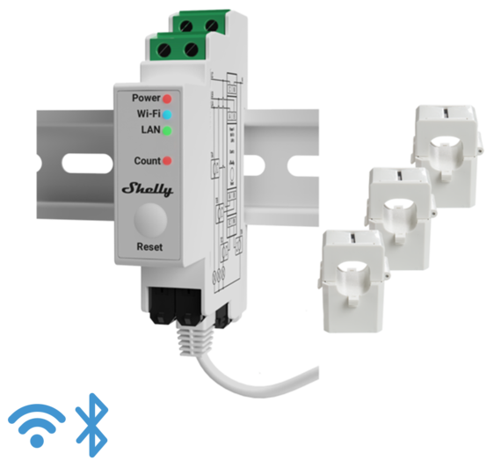
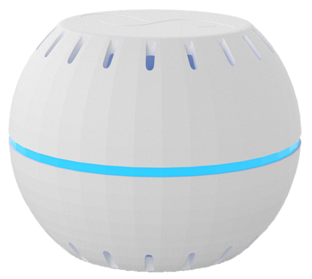
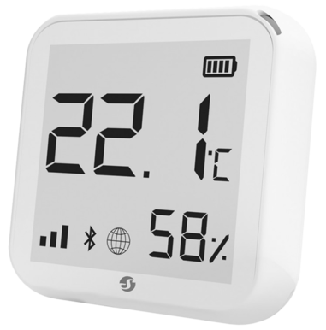
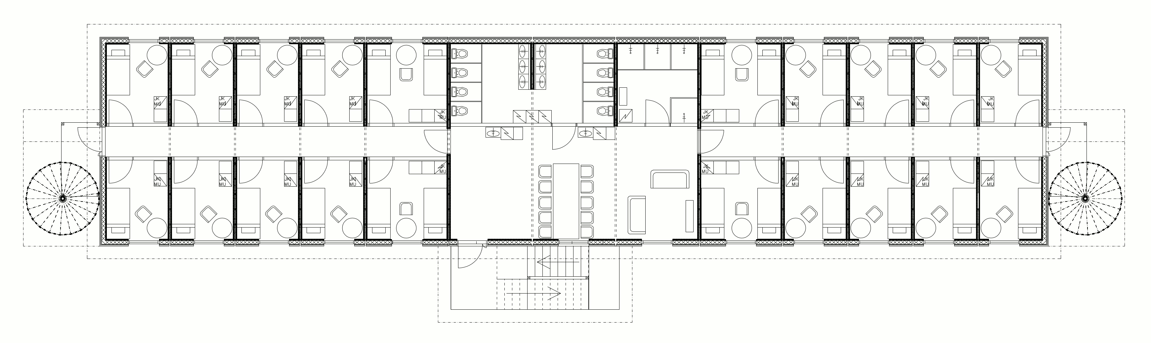
Apartments A+B
1-phase sensor, 2x linesensors PRO#002
Apartment related indoor environment
H&T#001 A H&T#002 B
Floor related indoor environment H&T3#001
Rakennus A
3-vaihemittari, 3x mittapäät PRO3#001
A
B
ILP
ILP (Heating device)
1-phase sensor, 2x linesensors
PRO#001
1x PRO 3EM (Building A)
2x PRO EM (ILP and Apartments A+B)
1x H&T Gen3 (with screen, Kitchen)
2x H&T (Small sensor, Apartment A and Apartment B)

