Slide 1
Introduction to Sequence Diagrams
Yoobee Colleges

Slide 2
What is a Sequence Diagram?
• A type of UML diagram that shows object interactions over time
• Visualizes the sequence of messages exchanged
• Helps model the logic of complex operations, functions, or procedures
• Useful in both analysis and design phases

Slide 3

Key Elements in a Sequence Diagram
Actors – external entities (e.g., users, systems)
Objects/Classes – components that interact
Lifelines – timeline for each object
Messages – arrows showing communication
Activation Bars – show when objects are active

Slide 4

Example Scenario: User Login
• Scenario: A user logs into a system
• Participants:
- User
- Login Page
- AuthService
- Database

Slide 5
Sequence Diagram: Login Process
1. User -> Login Page: enter credentials
2. Login Page -> AuthService: validate credentials
3. AuthService -> Database: query user record
4. Database -> AuthService: return result
5. AuthService -> Login Page: success/failure
6. Login Page -> User: show result

Slide 6
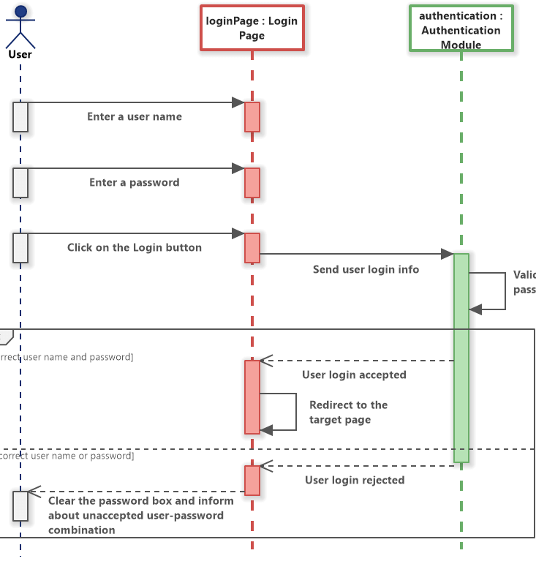

Slide 7
Best Practices
• Keep diagrams clear and simple
• Focus on key interactions only
• Use consistent and meaningful names
• Align lifelines and messages neatly
• Review and update diagrams regularly

Slide 8
Tools to Create Sequence Diagrams
• Lucidchart
• Draw.io
• PlantUML
• StarUML
• Visual Paradigm

Slide 9
Summary and Learning Tips
• Sequence diagrams visualize how objects interact
• Help understand system behavior over time
• Practice by drawing diagrams for everyday systems
• Use diagram tools to speed up your workflow

Slide 10

Q&A?

