Slide 1
自我介紹
(nizima Live)

Slide 2
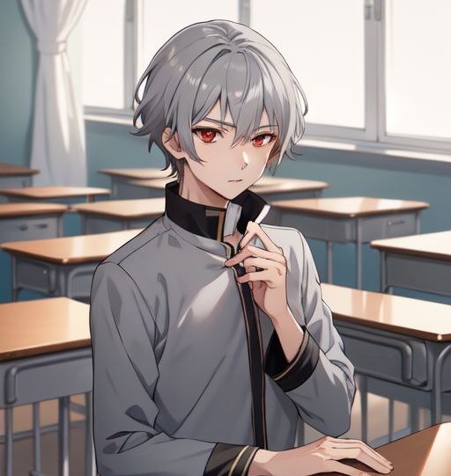
1.目標
Notes:
Description: Anti-Description:: boy, gray hair, red eyes, gray men‘s student uniform, high collar，classroom
Anti-Description: tie, bow tie, red clothing

Slide 3
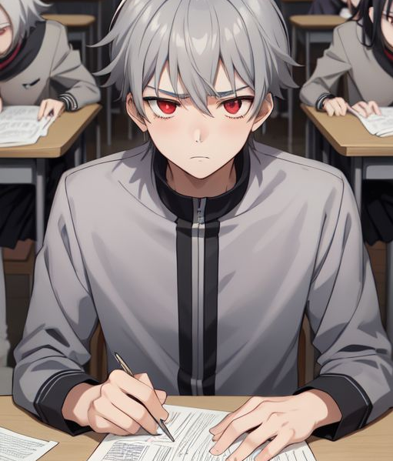
2.阻礙
Notes:
Description: boy, gray hair, red eyes, gray men's student uniform, high collar, exam, sad
Anti-Description: tie, bow tie, red clothing

Slide 4
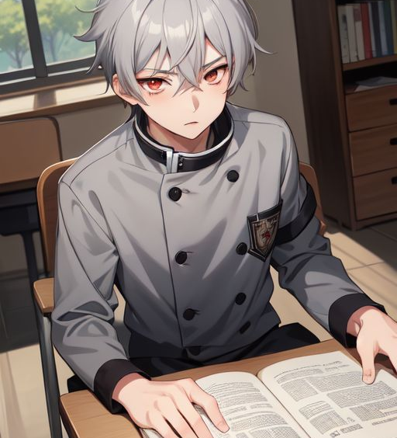
3.努力
Notes:
Description: boy, gray hair, red eyes, gray men's student uniform, high collar, read book
Anti-Description: tie, bow tie, red clothing

Slide 5
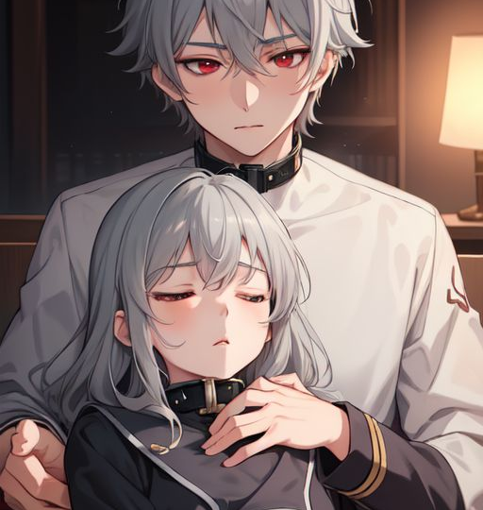
4.結果
Notes:
Description: boy, gray hair, red eyes, gray men's student uniform, high collar, hold a sleeping girl
Anti-Description: tie, bow tie, red clothing

Slide 6
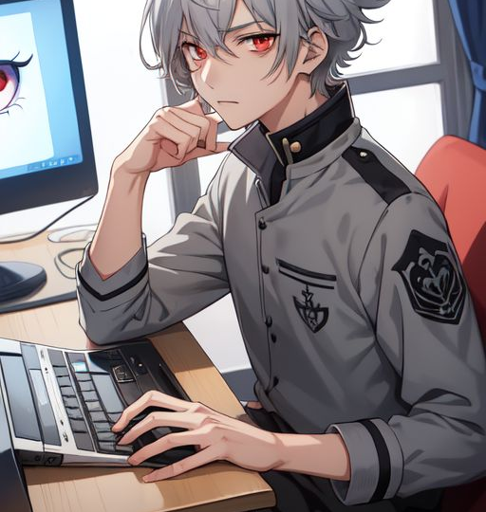
5.意外
Notes:
Description: boy, gray hair, red eyes, gray men's student uniform, high collar, play computer, dark circle, haggard
Anti-Description: tie, bow tie, red clothing

Slide 7
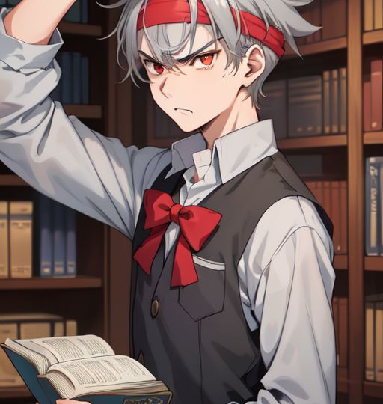
6.轉折
Notes:
Description: boy, gray hair, red eyes, gray men's student uniform, high collar, a lot of book, angry, headband, learning
Anti-Description: tie, bow tie, red clothing

Slide 8
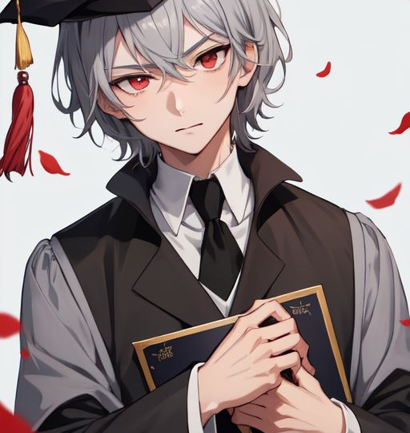
7.結局
Notes:
Description: boy, gray hair, red eyes, bachelor's uniform, high collar, bachelor's cap, graduate
Anti-Description: tie, bow tie, red clothing

